Slide 1
PHYS 1443 – Section 003 Lecture #3
Wednesday, Jan. 27, 2021
Dr. Jaehoon Yu
Estimates
Dimensional Analysis
Fundamentals of kinematics
Concepts of kinematic quantities
Displacement
Average Velocity and Speed

Slide 2
Reminder: Special Project #1 for Extra Credit
Find the solutions for yx²-zx+v=0 ➔ 5 points
x is the unknown variable, and y, z and v are constant coefficients!
You cannot just plug into the quadratic equations!
You must show a complete algebraic process of obtaining the solutions!
Derive the kinematic equation from first principles and the known kinematic equations ➔ 10 points
You must show your OWN work in detail to obtain the full credit
Must be handwritten and in much more detail than in this lecture note!!!
Please do not copy from the lecture note or from your friends. You will all get 0!!
BE SURE to show all the details of your own work, including all formulae, proper references to them and explanations
Due at the beginning of the class 1:00pm Monday, Feb. 1 on Canvas
File name must be: SP1-LastName-FirstName-SP21.pdf

Slide 3
Estimates & Order-of-Magnitude Calculations
Estimate = Approximation
Useful for rough calculations to determine the necessity of higher precision
Usually done under certain assumptions
Might require modification of assumptions, if higher precision is necessary
Order of magnitude estimate: Estimates done to the precision of 10s or exponents of 10s;
Three orders of magnitude: 10³=1,000
Round up for Order of magnitude estimate; 8x10⁷ ~ 10⁸
Similar terms: “Ball-park-figures”, “guesstimates”, etc
3

Slide 4
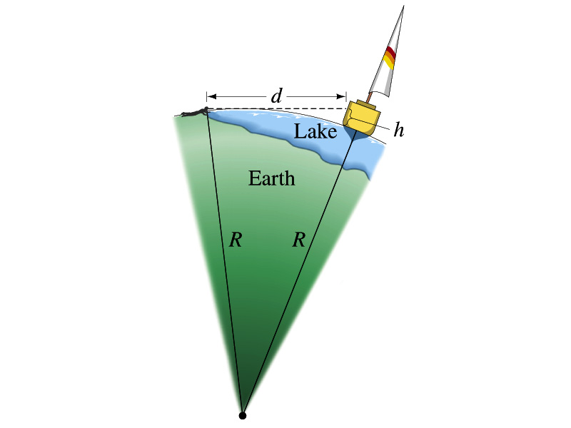
Example for Estimates
Estimate the radius of the Earth using triangulation as shown in the picture when d=4.4km and h=1.5m.
Pythagorian theorem
D=4.4km
Solving for R
R
R+h
4
Real R=6380km

Slide 5
Dimensions of Units and Dimensional Analysis
An extremely useful concept in solving physical problems
Good to write physical laws in mathematical expressions
No matter what units are used the base quantities are the same
Length (distance) is the length whether meter or inch is used to express the size: Usually denoted as [L]
Length of a car is in the dimension of length
What about the height of a person?
The same is true for Mass ([M]) and Time ([T])
One can say “Dimension of Length, Mass or Time”
Dimensions are treated as algebraic quantities: Can perform two algebraic operations; multiplication or division (poll 5)
5

Slide 6
Dimensions of units and Dimensional Analysis cnt’d
One can use dimensions only to check the validity of one’s expression: Dimensional analysis
Eg: Speed [v] = [L]/[T]=[L][T⁻¹]
Distance (L) traveled by a car running at the speed V in time T
L = V*T = [L/T]*[T]=[L]
More general expression of dimensional analysis is using exponents: eg. [v]=[L^{n}T^{m}] =[L][T⁻¹] where n = 1 and m = -1
6

Slide 7
Examples
Show that the expression [v] = [at] is dimensionally correct
Speed: [v] =[L]/[T]
Acceleration: [a] =[L]/[T]²
Thus, [at] = (L/T²)xT=LT⁽⁻²⁺¹⁾ =LT⁻¹ =[L]/[T]= [v]
Suppose the acceleration a of a circularly moving particle with speed v and radius r is proportional to r^{n} and v^{m}. What are n andm?
a
r
v
Dimensionless
constant
Length
Speed
7

Slide 8
Some Fundamentals
Kinematics: Description of Motion without understanding the cause of the motion
Dynamics: Description of motion accompanied with an understanding the cause of the motion
Vector and Scalar quantities: (poll 6)
Scalar: Physical quantities that require magnitude but no direction
Speed, length, mass, height, volume, area, magnitude of a vector quantity, etc
Vector: Physical quantities that require both magnitude and direction
Velocity, Acceleration, Force, Momentum
It does not make sense to say “I ran with velocity of 10miles/hour.”
Objects can be treated as point-like if their sizes are smaller than the scale in the problem
Earth can be treated as a point like object (or a particle)in celestial problems
Simplification of the problem (The first step in setting up to solve a problem…)
Any other examples?
8

Slide 9
Some More Fundamentals
Motions: Can be described as long as the position is known at any given time (or position is expressed as a function of time)
Translation: Linear motion along a line
Rotation: Circular or elliptical motion
Vibration: Oscillation
Dimensions of geometry
0 dimension: A point
1 dimension: Linear drag of a point, resulting in a straightline ➔ Motion in one-dimension is a motion on a straightline
2 dimension: Linear drag of a line resulting in a surface
3 dimension: Perpendicular Linear drag of a surface, resulting in a stereo object
9

Slide 10
Displacement, Velocity and Speed
One dimensional displacement is defined as (poll6):
A vector quantity
Displacement is the difference between initial and final poisitions of the motion and is a vector quantity. How is this different than distance?
Unit (poll3)?
m
The average velocity is defined as:
Unit (poll3, 6)??
m/s
A vector quantity
Displacement per unit time in the interval throughout the motion
The average speed is defined as:
Unit (poll3, 6)?
m/s
A scalar quantity
Can someone tell me what the difference between speed and velocity is?

