Slide 1
PHYS 1443 – Section 003 Lecture #4
Monday, Feb. 1, 2021
Dr. Jaehoon Yu
Concepts of kinematic quantities
Average Velocity and Speed
Instantaneous velocity and speed
Acceleration
Today’s homework is homework #3, due 11pm, Tuesday, Feb. 9!!

Slide 2
Announcements
First term exam in class Wednesday, Feb. 10
BYOF: You may bring a one 8.5x11.5 sheet (front and back) of handwritten formulae and values of constants for the exam
No derivations, word definitions, setups or solutions of any problems, figures, pictures, diagrams or arrows, etc!
No additional formulae or values of constants will be provided!
Must email me the photos of front and back of the formula sheet, including the blank at jaehoonyu@uta.edu no later than 12:00pm the day of the test
The subject of the email should be the same as your file name
File name must be FS-E1-LastName-FirstName-SP21.pdf
Once submitted, you cannot change, unless I ask you to delete part of the sheet!
Quiz 1 Results
Class average: 45.1/70
Equivalent to 64/100
Top score: 70/70

Slide 3
Special Project #2 for Extra Credit
Show that the trajectory of a projectile motion is a parabola!! (20 points)
You MUST show full details of your OWN computations, including every step of the derivation, to obtain any credit
Beyond what was covered in this lecture note and in the book!
You must show your OWN work in detail to obtain the full credit
Must be handwritten and in much more detail than in this lecture note or the book!
Please do not copy from the lecture note or from your friends. You will all get 0!!
BE SURE to show all the details of your own work, including all formulae, proper references to them and explanations
Due at the beginning of the class 1:00pm Monday, Feb. 15 on Canvas
File name must be: SP2-LastName-FirstName-SP21.pdf

Slide 4
Recap: Displacement, Velocity and Speed
One dimensional displacement is defined as (poll6):
A vector quantity
Displacement is the difference between initial and final poisitions of the motion and is a vector quantity. How is this different than distance?
Unit (poll3)?
m
The average velocity is defined as:
Unit (poll3, 6)??
m/s
A vector quantity
Displacement per unit time in the interval throughout the motion
The average speed is defined as:
Unit (poll3, 6)?
m/s
A scalar quantity
Can someone tell me what the difference between speed and velocity is?

Slide 5
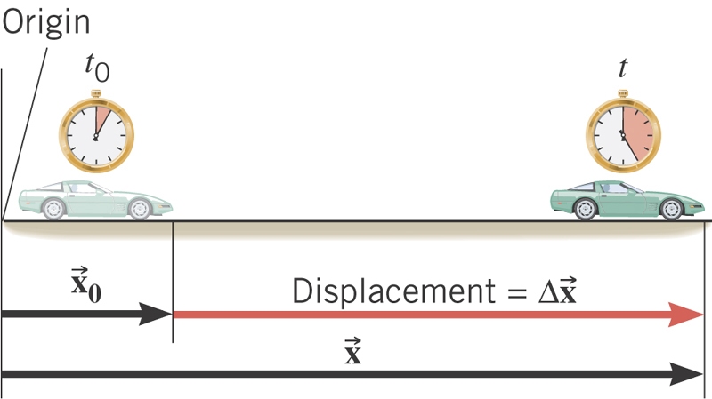
What is the displacement?
How much is the elapsed time?
What is the average velocity?
What is the average speed ?

Slide 6
Difference between Speed and Velocity
Let’s take a simple one dimensional translational motion that has many segments:
Let’s call this line as X-axis
Let’s have 6 segments of motions in a total time interval of 20 s.
+10m
+15m
+5m
-5m
-10m
-15m
Total Displacement:
Average Velocity:
Total Distance Traveled:
Average Speed:
6

Slide 7
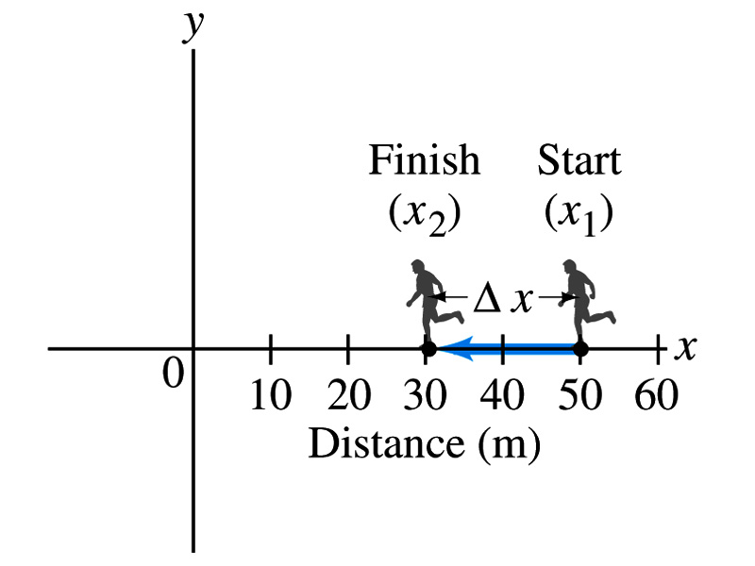
Example
The position of a runner as a function of time is plotted as moving along the x axis of a coordinate system. During a 3.00-s time interval, the runner’s position changes from x₁=50.0m to x₂=30.5 m, as shown in the figure. What was the runner’s average velocity? What was the average speed?
Displacement:
Average Velocity:
Average Speed:
7

Slide 8
Example of a segmented motion
You drove a beat-up pickup truck along a straight road for 8.4km at 70km/h, at which point the truck ran out of gas and stopped. Over the next 30min, you walked another 2.0km farther along the road in the same direction to a gas station.
(a) what is your overall displacement from the beginning of your drive to your arrival at the station?
You can split this motion in two segments
Segment 1: from the start to the point where the truck ran out of gas, Δx₁
Segment 2: from the point where you started walking to the gas station, Δx₂
Overall displacement Δx is
8

Slide 9
Example, cnt’d
You drove a beat-up pickup truck along a straight road for 8.4km at 70km/h, at which point the truck ran out of gas and stopped. Over the next 30min, you walked another 2.0km farther along the road in the same direction to a gas station.
(b) What is the time interval Δt from the beginning of your drive to your arrival at the station?
Figure out the time interval in each segments of the motion and add them together.
We know what the interval for the second segment is: Δt₂=30min
What is the interval for the first segment, Δt₁?
Use the definition of average velocity and solve it for Δt₁
Add the two time intervals for total time interval Δt
9

Slide 10
Example, cnt’d
You drove a beat-up pickup truck along a straight road for 8.4km at 70km/h, at which point the truck ran out of gas and stopped. Over the next 30min, you walked another 2.0km farther along the road in the same direction to a gas station.
(c) What is your average velocity v_{avg} from the beginning of your drive to your arrival at the station?
Using the definition of the average velocity, just simply divide the overall displacement by the overall time interval:
What is the average speed?
What is the average velocity and average speed in km/h?
10

Slide 11
Instantaneous Velocity and Speed
Can average quantities tell you the detailed story of the whole motion?
NO!!
Instantaneous velocity is defined as (poll 6,3):
What does this mean?
Displacement in an infinitesimal time interval
Average velocity over a very, very short amount of time
Instantaneous speed is the size (magnitude) of the velocity vector (poll 6,3): :
*Magnitude of Vectors are Expressed in absolute values

Slide 12
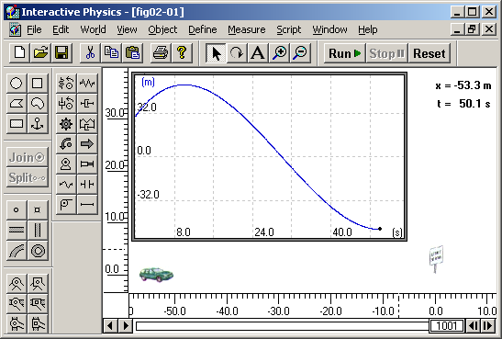
Instantaneous Velocity
Instantaneous Velocity
Average Velocity
Time
12
12

Slide 13
Position vs Time Plot
Position
It is helpful to understand motions to draw them on a position vs time plot.
x₁
1
2
3
x=0
time
t=0
t₁
t₂
t₃
Running at a constant velocity (go from x=0 to x=x₁ in t₁, Displacement is + x₁ in t₁ time interval, velocity is)
Velocity is 0 (go from x₁ to x₁ no matter how much time changes)
Running at a constant velocity but in the reverse direction as 1. (go from x₁ to x=0 in t₃-t₂ time interval, Displacement is - x₁ in t₃-t₂ time interval)
v₁=(x₁-0)/(t₁-0)=x₁/t₁
Does this motion physically make sense?
13
13

Slide 14
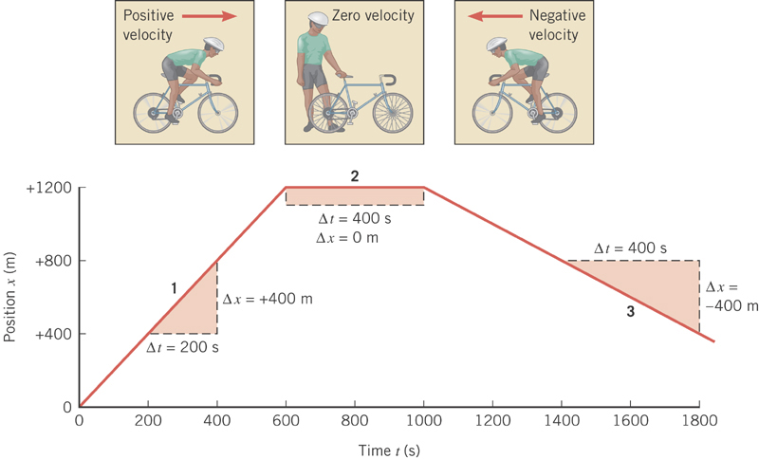

Slide 15
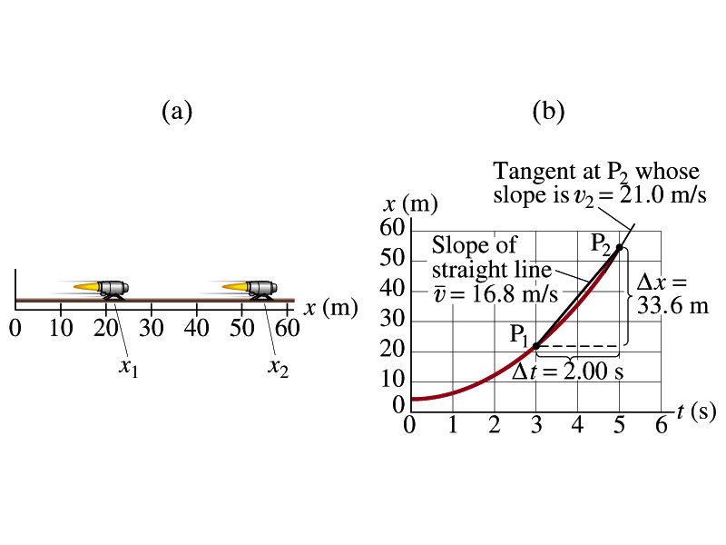
Example
A jet engine moves along a track. Its position as a function of time is given by the equation x=At²+B where A=2.10m/s² and B=2.80m.
(a) Determine the displacement of the engine during the interval from t₁=3.00s to t₂=5.00s.
Displacement is, therefore:
(b) Determine the average velocity during this time interval.
15
15

Slide 16
Example cont’d
(c) Determine the instantaneous velocity at t=t₂=5.00s.
Calculus formula for derivative
and
The derivative of the engine’s equation of motion is
The instantaneous velocity at t=5.00s is
16
16

Slide 17
Definitions of Displacement, Velocity and Speed
Displacement (poll 6,5):
Average velocity (poll 6,5):
Average speed (poll 6,5):
Instantaneous velocity (poll 6,5):
Instantaneous speed (poll 6,5):
17
17

Slide 18
Acceleration
Change of velocity in time (what kind of quantity is this? Polls 6,5 )
Vector
Definition of the average acceleration:
analogous to
Definition of the instantaneous acceleration:
analogous to
In calculus terms: The slope (derivative) of the velocity vector with respect to time or the change of slopes of position as a function of time

Slide 19
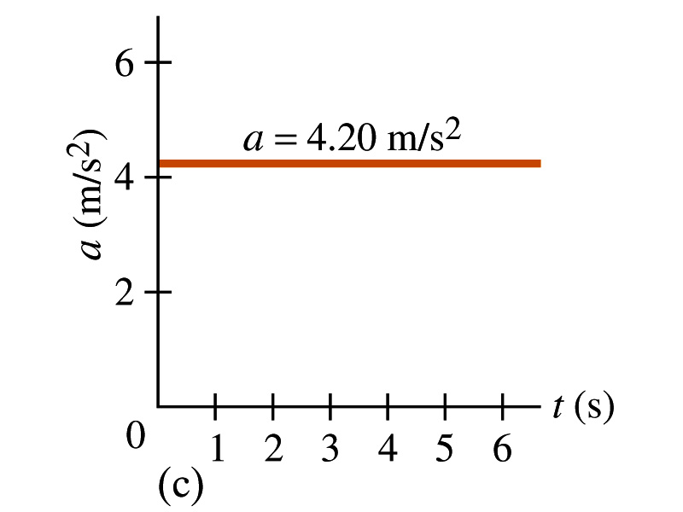
Acceleration vs Time Plot
What does this plot tell you?
Yes, you are right!!
The acceleration of this motion is a constant!!
The speed increases at a constant rate!

Slide 20
Example
A car accelerates along a straight road from rest to 75km/h in 5.0s.
What is the magnitude of its average acceleration?

Slide 21
A few Important Things on Acceleration
When an object is moving in a constant velocity (v=v₀), there is no acceleration (a=0)
Is there any acceleration when an object is not moving?
When an object is moving faster as time goes on, (v=v(t) ), acceleration is positive (a>0).
Incorrect, since the object might be moving in negative direction initially
When an object is moving slower as time goes on, (v=v(t) ), acceleration is negative (a<0)
Incorrect, since the object might be moving in negative direction initially
In all cases, velocity is positive, unless the direction of the movement changes.
Incorrect, since the object might be moving in negative direction initially
Is there acceleration if an object moves in a constant speed but changes direction?
The answer is YES!!

Slide 22
Displacement, Velocity, Speed & Acceleration
Displacement
Average velocity
Average speed
Instantaneous velocity
Instantaneous speed
Average acceleration
Instantaneous acceleration
22
22

Slide 23
Example for Acceleration
Velocity, v_{x}, is express in:
Find the average acceleration in time interval, t=0 to t=2.0s
Find instantaneous acceleration at any time t and t=2.0s
Instantaneous Acceleration at any time
Instantaneous Acceleration at any time t=2.0s

Slide 24
Example for Acceleration
Position is express in:
Find the particle’s velocity function v(t) and the acceleration function a(t).
Find the average acceleration between t=2.0s and t=4.0s
Find the average velocity between t=2.0s and t=4.0s

