Slide 1
PHYS 1443 – Section 003 Lecture #6
Monday, Feb. 8, 2021
Dr. Jaehoon Yu
CH3: Motion in two dimensions
Vector and scalars, their operations
Motion under constant acceleration
Projectile Motion
Maximum range and height
Today’s homework is homework #4, due 11pm, Tuesday, Feb. 23!!

Slide 2
Announcements
First term exam in class this Wednesday, Feb. 10
Covers CH1.1 to what we finish today (CH3.5 or 3.6) + math refresher
BYOF: You may bring a one 8.5x11.5 sheet (front and back) of handwritten formulae and values of constants for the exam
No derivations, word definitions, setups or solutions of any problems, figures, pictures, diagrams or arrows, etc!
No additional formulae or values of constants will be provided!
Must email me the photos of front and back of the formula sheet, including the blank at jaehoonyu@uta.edu no later than 12:00pm the day of the test
The subject of the email should be the same as your file name
File name must be FS-E1-LastName-FirstName-SP21.pdf
Once submitted, you cannot change, unless I ask you to delete part of the sheet!
Reminder: Extra credit special COVID seminar at 4pm Saturday, March 20
Extra credit for participation and for asking the relevant questions
Dr. Linda Lee, a practicing physician from Wisconsin
Mark your calendars!!

Slide 3
Reminder: Special Project #2 for Extra Credit
Show that the trajectory of a projectile motion is a parabola!! (20 points)
You MUST show full details of your OWN computations, including every step of the derivation, to obtain any credit
Beyond what was covered in this lecture note and in the book!
You must show your OWN work in detail to obtain the full credit
Must be handwritten and in much more detail than in this lecture note or the book!
Please do not copy from the lecture note or from your friends. You will all get 0!!
BE SURE to show all the details of your own work, including all formulae, proper references to them and explanations
Due at the beginning of the class 1:00pm Monday, Feb. 15 on Canvas
File name must be: SP2-LastName-FirstName-SP21.pdf

Slide 4
Properties of Vectors
sizes
directions
Two vectors are the same if their and the are the same, no matter where they are on a coordinate system!!
y
Which ones are the same vectors?
D
F
A=B=E=D
A
Why aren’t the others?
B
x
C: The same magnitude but opposite direction: C=-A:A negative vector
E
C
F: The same direction but different magnitude

Slide 5
Vector Operations
Addition:
Triangular Method: One can add vectors by connecting the head of one vector to the tail of the other (head-to-tail)
Parallelogram method: Connect the tails of the two vectors and extend
Addition is commutative: Changing order of operation does not affect the results A+B=B+A, A+B+C+D+E=E+C+A+B+D
A+B
A
A+B
B
=
OR
B
B
A
A+B
A
Subtraction:
The same as adding a negative vector:A - B = A + (-B)
A
-B
Since subtraction is the equivalent to adding a negative vector, subtraction is also commutative!!!
A-B
Multiplication by a scalar is increasing the magnitude A, B=2A
A
B=2A

Slide 6
Example for Vector Addition
A car travels 20.0km due north followed by 35.0km in a direction 60.0º west of north. Find the magnitude and direction of resultant displacement.
Bsin60º
N
B
60^{ο}
Bcos60^{ο}
20
r
θ
A
E
Do this using components!!

Slide 7
Components and Unit Vectors
Coordinate systems are useful in expressing vectors in their components
y
(+,+)
A_{y}
(A_{x},A_{y})
}Components
A
(-,+)
θ
x
} Magnitude
(-,-)
(+,-)
A_{x}

Slide 8
Unit Vectors
Unit vectors are the ones that tells us the directions of the components
Dimensionless
Magnitudes these vectors are exactly 1
Unit vectors are usually expressed in i, j, k or
So a vector A can be expressed as

Slide 9
Examples of Vector Operations
Find the resultant vector which is the sum of A=(2.0i+2.0j) and B =(2.0i-4.0j)
Find the resultant displacement of three consecutive displacements: d₁=(15i+30j +12k)cm, d₂=(23i+14j -5.0k)cm, and d₃=(-13i+15j)cm
Magnitude

Slide 10
Displacement, Velocity, and Acceleration in 2-dim
Displacement:
Average Velocity:
How is each of these quantities defined in 1-D?
Instantaneous Velocity:
Average Acceleration
Instantaneous Acceleration:

Slide 11
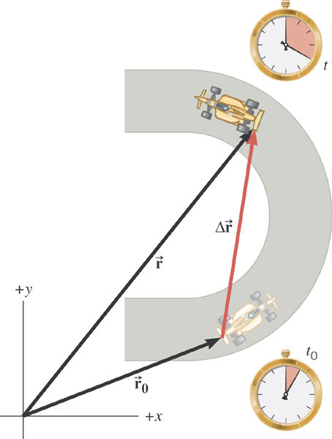
2D Displacement

Slide 12
2D Average Velocity
Average velocity is the
displacement divided by
the elapsed time.

Slide 13
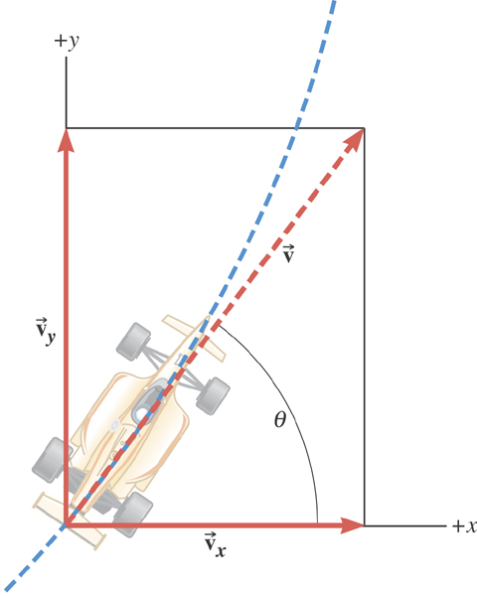
The instantaneous velocity indicates how fast the car moves and the direction of motion at each time instance.

Slide 14
2D Average Acceleration

Slide 15
Kinematic Quantities in 1D and 2D
Quantities | 1 Dimension | 2 Dimension
Displacement
Average Velocity
Inst. Velocity
Average Acc.
Inst. Acc.
What is the difference between 1D and 2D quantities?

Slide 16
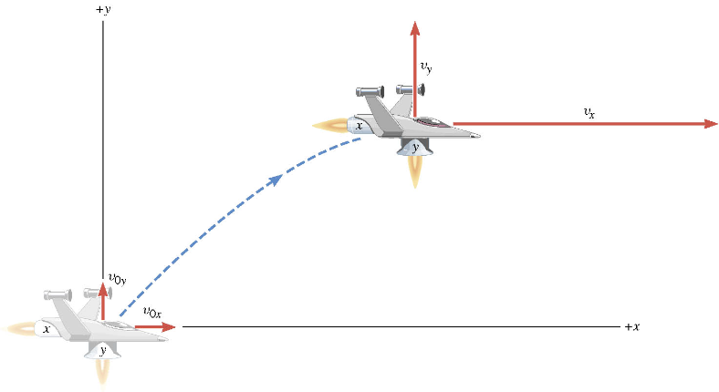
A Motion in 2 Dimension
This is a motion that could be viewed as two motions combined into one. (superposition…)

Slide 17
Motion in horizontal direction (x)

Slide 18
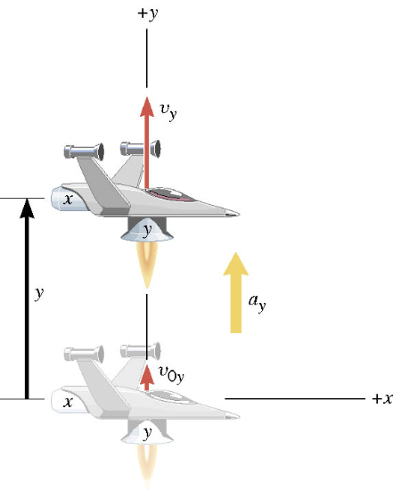
Motion in vertical direction (y)

Slide 19
A Motion in 2 Dimension
Imagine you adding the two 1 dimensional motions on the left. It would make up a one 2 dimensional motion on the right.

Slide 20
Kinematic Equations in 2-Dim
x-component
y-component

Slide 21
Ex. A Moving Spacecraft
In the x direction, the spacecraft in zero-gravity zone has an initial velocity component of +22 m/s and an acceleration of +24 m/s². In the y direction, the analogous quantities are +14 m/s and an acceleration of +12 m/s². Find (a) x and v_{x}, (b) y and v_{y}, and (c) the final velocity of the spacecraft at time 7.0 s.

Slide 22
How do we solve this problem?
Visualize the problem ➔ Draw a picture!
Decide which directions are to be called positive (+) and negative (-).
Write down the values that are given for any of the five kinematic variables associated with each direction.
Verify that the information contains values for at least three of the kinematic variables. Do this for x and y separately. Select the appropriate equation.
When the motion is divided into segments in time, remember that the final velocity of one time segment is the initial velocity for the next.
Keep in mind that there may be two possible answers to a kinematics problem.

Slide 23
Ex. continued
In the x direction, the spacecraft in a zero gravity zone has an initial velocity component of +22 m/s and an acceleration of +24 m/s². In the y direction, the analogous quantities are +14 m/s and an acceleration of +12 m/s². Find (a) x and v_{x}, (b) y and v_{y}, and (c) the final velocity of the spacecraft at time 7.0 s.
x | a_{x} | v_{x} | v_{ox} | t
? |  | ?
+24.0 m/s²
+22.0 m/s
7.0 s
y | a_{y} | v_{y} | v_{oy} | t
? |  | ?
+12.0 m/s²
+14.0 m/s
7.0 s

Slide 24
First, the motion in x-direciton…
x | a_{x} | v_{x} | v_{ox} | t
? | +24.0 m/s² | ? | +22 m/s | 7.0 s

Slide 25
Now, the motion in y-direction…
y | a_{y} | v_{y} | v_{oy} | t
? | +12.0 m/s² | ? | +14 m/s | 7.0 s

Slide 26
The final velocity…
A vector can be fully described when the magnitude and the direction are given. Any other way to describe it?
Yes, you are right! Using components and unit vectors!!

Slide 27
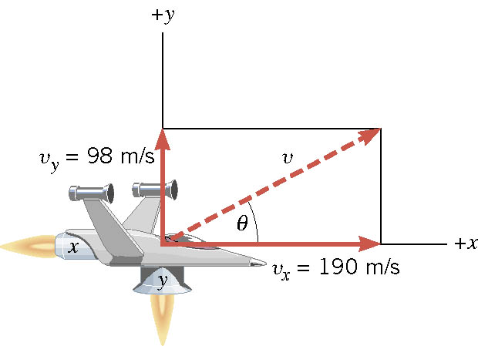
If we visualize the motion…

Slide 28
2-dim Motion Under Constant Acceleration
Position vectors in x-y plane:
Velocity vectors in x-y plane:
Velocity vectors in terms of the acceleration vector
X-comp
Y-comp

Slide 29
2-dim Motion Under Constant Acceleration
How are the 2D position vectors written in acceleration vectors?
Position vector components
Putting them together in a vector form
Regrouping the above
2D problems can be interpreted as two 1D problems in x and y

Slide 30
Example for 2-D Kinematic Equations
A particle starts at origin when t=0 with an initial velocity v=(20i-15j)m/s. The particle moves in the xy plane with a_{x}=4.0m/s². Determine the components of the velocity vector at any time t.
Velocity vector
Compute the velocity and the speed of the particle at t=5.0 s.

Slide 31
Example for 2-D Kinematic Eq. Cnt’d
Angle of the Velocity vector
Determine the x and y components of the particle at t=5.0 s.
Can you write down the position vector at t=5.0s?

