Slide 1
PHYS 1443 – Section 003
Lecture #7
Monday, Feb. 22, 2021
Dr. Jaehoon Yu
CH3: Motion in two dimensions
  Projectile Motion
  Maximum range and height
CH4: Newton’s Laws of Motion
  Force & Newton’s 1st Law of Motion
Today’s homework is homework #5, due 11pm, Tuesday, March 9!!

Slide 2
Announcements
Quiz #2 beginning of the class next Wednesday, March 3
  Covers CH3.4 to what we finish next Monday, March 1
  BYOF: You may bring a one 8.5x11.5 sheet (front and back) of handwritten formulae and values of constants for the test
  No derivations, word definitions, setups or solutions of any problems, figures, pictures, diagrams or arrows, etc!
  Must email me the photos of front and back of the formula sheet, including the blank at jaehoonyu@uta.edu no later than 12:00pm the day of the test
    The subject of the email should be the same as your file name
    File name must be FS-Q2-LastName-FirstName-SP21.pdf
    Once submitted, you cannot change, unless I ask you to delete part of the sheet!
Reminder: Extra credit special COVID seminar at 4pm Saturday, March 20
  Extra credit for participation and for asking the relevant questions
  Dr. Linda Lee, a practicing physician from Wisconsin
Term 1 results
  Class average: 79/102
    Equivalent to 77.4/100
  Top score: 102/102

Slide 3
Evaluation Policy
Homework: 25%!!! (clinic: https://www.uta.edu/physics/current/clinics.php)
Exams
  Final Comprehensive Exam (2pm, Mon., 5/10/21): 23%
  Mid-term Comprehensive Exam (2:30pm, Wed., 3/10/21): 20%
  One better of the two term Exams (2/10/21 and 4/12/21): 12%
  Missing an exam is not permissible unless pre-approved
    No makeup test
    You will get an F if you miss any of the exams without a prior approval no matter how well you’ve been doing in class!
Lab score: 10%
  If passed the lab before, can request a lab exemption (form available on web)
Pop-quizzes: 10%
Extra credits: 10% of the total
  Random attendances
  Strong participation in the class discussions
  Special projects (BIGGGGG!!!)
  Special seminars
Grading will be done on a sliding scale (poll 9)
100%

Slide 4
SP #3 – Statistical Analysis : COVID19
Make comparisons of COVID-19 statistics between the U.S., South Korea, Italy and Texas from https://coronaboard.com on spreadsheet
  Total 60 points: 1 point for each of the top 20 cells and 2 points for each of the 12 cells for testing and the 8 cells for vaccination
Fill the US Historic event analysis table at the bottom, 1 point each (16 points total) and make a >3 sentence statement on COVID19 with respect to other events (6 points) ➔ 22 points total
What are the 3 fundamental quantitative requirements for opening up (2 points each, 6 points total)?
  Must be quantitative! (e.g. number of tests per capita per day, positivity rate, etc)
Assess the readiness of the three fundamental requirements U.S. (Do NOT just take politician’s words!). Must provide the independent scientific entity’s reference you took the information from. (2 point each, total 6 points)
Evaluate quantitatively the success/failure of the US responses to COVID-19 in 2020 in 5 sentences and that in 2021 in 5 sentences. Must provide quantitative reasons behind your conclusion! (2 points each sentence, 20 points total)
Assess quantitatively the effectiveness of wearing masks (4 points) and at least 4 reasons for it being effective (1 point each, 0.5 point extra after the first 4).
Possible maximum: 122 points total
Due: 11pm, Friday, March 19
  Submit one pdf file SP3-YourLastName-YourFirstName.pdf, including the spreadsheet
  Spreadsheet will be posted on canvas. Download ASAP.

Slide 6
Recap: Kinematic Equations in 2-Dim
x-component
y-component

Slide 7
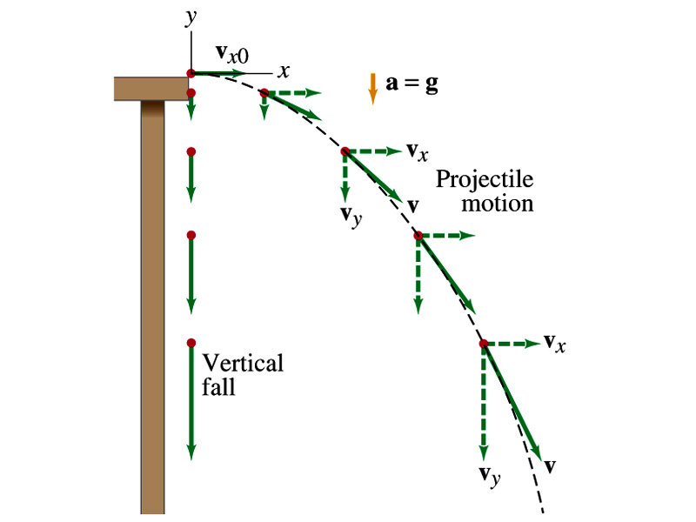
Projectile Motion
A 2-dim motion of an object under only the gravitational acceleration with the following assumptions
  Free fall acceleration, g, is constant over the range of the motion (poll 12)
  Air resistance and other effects are negligible
A motion under constant acceleration!!!! ➔ Superposition of two motions
  Horizontal motion with constant velocity ( no acceleration )
  Vertical motion under constant acceleration ( g )

Slide 8
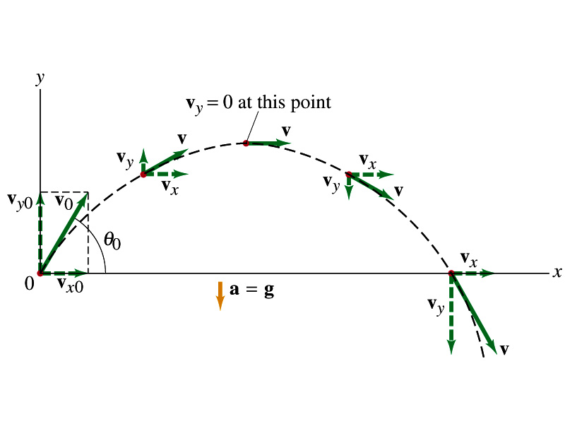
Projectile Motion
The only acceleration in this motion. It is a constant!! (poll 12, 13)

Slide 9
Show that a projectile motion is a parabola!!!
x-component
y-component
In a projectile motion, the only acceleration is gravitational one whose direction is always toward the center of the earth (downward). (poll 6)
a_{x}=0
Plug t into
the above
What kind of parabola is this? (poll 13)

Slide 10
Example for Projectile Motion
A ball is thrown with an initial velocity v=(20i+40j)m/s. Determine the time of flight and the distance the ball is from the original position when landed.
Which component determines the flight time and the distance?
Flight time is determined by the y component, because the ball stops moving when it is on the ground after the flight.
So the possible solutions are…
Distance is determined by the x component in 2-dim, because the ball is at y=0 position when it completed it’s flight.
Why isn’t 0 the answer?

Slide 11
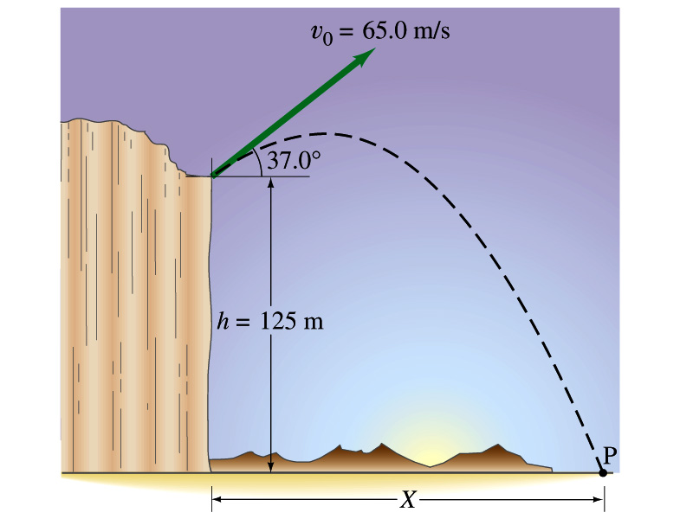
Example for a Projectile Motion
A stone was thrown upward from the top of a cliff at an angle of 37º to horizontal with an initial speed of 65.0m/s. If the height of the cliff is 125.0m, how long is it before the stone hits the ground?
Becomes
The stone lands after the initial time.
11

Slide 12
Example cont’d
What is the speed of the stone just before it hits the ground?
What are the maximum height and the maximum range of the stone?
Do these yourselves at home for fun!!!
12

Slide 13
Example for a Projectile Motion
A rescue plane flies at 198km/h (=55.0m/s) and constant height h=500m toward a point directly over a victim, where a rescue capsule is to land. What should be the angle Φ of the pilot’s line of sight to the victim when the capsule release is made?
Once the rescue capsule is release, it will undergo a projectile motion, and this becomes a simple trigonometry problem. What is the initial angle of capsule release?
What is the velocity of the capsule as it reaches the water? If it stops after pushing the victim 50cm into the water, what would be the acceleration of the capsule?
13

Slide 14
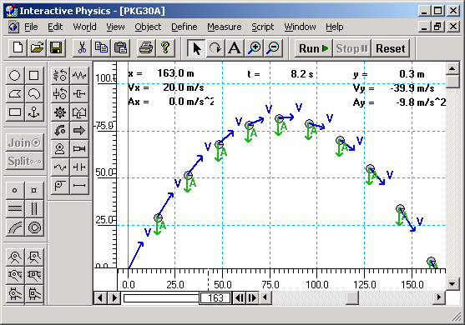
Horizontal Range and Max Height
Based on what we have learned, one can analyze a projectile motion in more detail
  Maximum height an object can reach
  Maximum range
What happens at the maximum height?
At the maximum height the object’s vertical motion stops to turn around!!
v_{i}
h
θ
Solve for t_{A}
This is the time to reach the peak!
14

Slide 15
Horizontal Range and Max Height
Since no acceleration is in the x direction, it still flies even if v_{y}=0.
Range
Height
15

Slide 16
Maximum Range and Height
What are the conditions that give the maximum height and range to a projectile motion?
This formula tells us that the maximum height can be achieved when θ_{i}=90º!!!
This formula tells us that the maximum range can be achieved when 2θ_{i}=90º, i.e., θ_{i}=45º!!!
16

Slide 17
Force
We’ve been learning kinematics; describing motion without understanding what the cause of the motion is. Now we are going to learn dynamics!!
FORCE is what causes an object to move.
Can someone tell me what FORCE is?
The above statement is not entirely correct. Why?
Because when an object is moving with a constant velocity no force is exerted on the object!!!
FORCE is what causes changes to the velocity of an object!! (poll 6)
What does this statement mean?
When there is force, there is change of velocity!!
What does force cause? (poll 10)
an acceleration
What happens if there are several forces being exerted on an object?
Force is a vector quantity, so vector sum of all forces, the NET FORCE, determines the direction of the resulting acceleration of the object.
F₁
F₂
NET FORCE, F= F₁+F₂
When the net force on an object is 0, it has constant velocity and is at its equilibrium!!

