Slide 1
PHYS 1443 – Section 003
Lecture #8
Wednesday, Feb. 24, 2021
Dr. Jaehoon Yu
CH4: Newton’s Laws of Motion
  Force & Newton’s 1st Law of Motion
  Mass
  Newton’s second law of motion

Slide 2
Announcements
Quiz #2 beginning of the class next Wednesday, March 3
  Covers CH3.4 to what we finish next Monday, March 1
  BYOF: You may bring a one 8.5x11.5 sheet (front and back) of handwritten formulae and values of constants for the test
  No derivations, word definitions, setups or solutions of any problems, figures, pictures, diagrams or arrows, etc!
  Must email me the photos of front and back of the formula sheet, including the blank at jaehoonyu@uta.edu no later than 12:00pm the day of the test
    The subject of the email should be the same as your file name
    File name must be FS-Q2-LastName-FirstName-SP21.pdf
    Once submitted, you cannot change, unless I ask you to delete part of the sheet!
Mid-term comprehensive online exam in class on Wed. March 10
  Covers CH1.1 through what we learn on Monday, March 8 + Math refresher
Reminder: Extra credit special COVID seminar at 4pm Saturday, March 20
  Extra credit for participation and for asking the relevant questions
  Dr. Linda Lee, a practicing physician from Wisconsin

Slide 3
Reminder: SP #3 – Statistical Analysis : COVID19
Make comparisons of COVID-19 statistics between the U.S., South Korea, Italy and Texas from https://coronaboard.com on spreadsheet
  Total 44 points: 1 point for each of the top 20 cells and 2 points for each of the 8 cells for vaccination
Fill the US Historic event analysis table at the bottom 12 cells of the sheet (2 points per cell, 24 points total) and make a >3 sentence statement on COVID19 with respect to other events (6 points)
What are the 3 fundamental quantitative requirements for opening up (2 points each, 6 points total)?
  Must be quantitative! (e.g. number of tests per capita per day, positivity rate, etc)
Assess the readiness of the three fundamental requirements U.S. (Do NOT just take politician’s words!). Must provide the independent scientific entity’s reference you took the information from. (2 point each, total 6 points)
Evaluate quantitatively the success/failure of the US responses to COVID-19 in 2020 in 5 sentences and that in 2021 in 5 sentences. Must provide quantitative reasons behind your conclusion! (2 points each sentence, 20 points total)
Assess quantitatively the effectiveness of wearing masks (4 points) and at least 4 reasons for it being effective (1 point each, 0.5 point extra after the first 4).
Possible maximum: 122 points total
Due: 11pm, Friday, March 19
  Submit one pdf file SP3-YourLastName-YourFirstName.pdf, including the spreadsheet
  Spreadsheet will be posted on canvas. Download ASAP.

Slide 5
More on Force
There are various classes of forces
Contact Forces: Force exerted by physical contact of objects
Examples of Contact Forces: Baseball hit by a bat, Car collisions
Field Forces: Forces exerted without physical contact of objects
Examples of Field Forces: Gravitational Force, Electro-magnetic force
What are possible ways to measure the strength of force?
A calibrated spring whose length changes linearly with the force exerted .
Force is a vector quantity, so the addition of multiple forces must be done following the rules of vector additions. (poll 6)

Slide 6
Newton’s First Law and Inertial Frames
Aristotle (384-322BC): The natural state of a body is rest. Thus, a force is required to move an object. To move faster, ones needs a larger force.
Galileo’s statement on natural states of matter: Any velocity once imparted to a moving body will be rigidly maintained, as long as the external causes of retardation are removed!!
Galileo’s statement is formulated by Newton into the 1st law of motion (Law of Inertia): In the absence of external forces, an object at rest remains at rest and an object in motion continues in motion with a constant velocity.
What does this statement tell us?
When no net force is exerted on an object, the velocity of the object cannot change
  This means that the object cannot accelerate.
Objects would like to keep its current state of motion, as long as there is no net force that interferes with the motion. This tendency is called the Inertia.
A frame of reference that is moving at a constant velocity is called the Inertial Frame.
The Newtonian mechanics holds in an Inertial reference Frame.
Is a frame of reference with an acceleration an Inertial Frame?
NO!

Slide 7
Mass
Mass: A measure of the inertia of an object or the quantity of matter
A fundamental property of matter
Independent of the object’s surroundings: The same no matter where you go.
Independent of the method of measurement: The same no matter how you measure it.
The heavier the object, the bigger the inertia !!
It is harder to make changes to the motion of a heavier object than a lighter one.
For the same forces applied to two different masses result in different accelerations depending on the mass.
Note that the mass and the weight of an object are two different quantities!!
Weight of an object is the magnitude of the gravitational force exerted on the object.
Not an inherent property of an object!!!
Weight will change if you measure on the Earth or on the Moon but the mass won’t!!
Unit of mass? (poll 3)

Slide 8
Newton’s Second Law of Motion
The acceleration of an object is directly proportional to the net force exerted on it and is inversely proportional to the object’s mass. (poll 6)
How do we write the above statement in a mathematical expression?
From this we obtain
Newton’s 2nd Law of Motion
Since force is a vector quantity, each component must also satisfy:
When working with forces, one must identify an object and only the forces which act on that object, no other forces!

Slide 9
Unit of Force
From the vector expression in the previous page, what do you conclude the dimension and the unit of the force are? (poll 3, 5)
The dimension of force is
The unit of force in SI is
For ease of use, we define a new derived unit called, Newton (N)

Slide 10
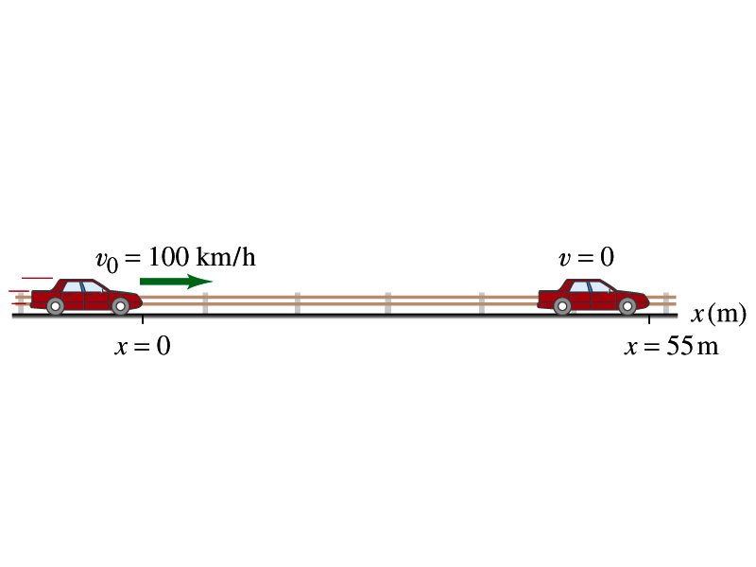
Example for Force
What constant net force is required to bring a 1500kg car to rest from a speed of 100km/h within a distance of 55m?
What do we need to know to figure out the force?
Acceleration!!
What are given?
Initial speed:
Final speed:
Displacement:
This is a one dimensional motion. Which kinetic formula do we use to find acceleration?
Acceleration
Thus, the force needed to stop the car is
Linearly proportional to the mass of the car
Squarely proportional to the speed of the car
Inversely proportional to the force by the brake
Given the force how far does the car move till it stops?

Slide 11
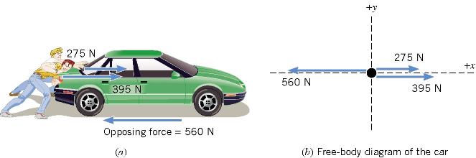
Free Body Diagram
A free-body-diagram is a diagram that represents the object and the forces that act on it.

Slide 12
Ex. Pushing a stalled car
What is the net force in this example?
F=
275 N
+ 395 N
– 560 N =
+110 N
Which direction?
The + x axis of the coordinate system.

Slide 13
What is the acceleration the car receives?
If the mass of the car is 1850 kg, then by Newton’s second law, the acceleration is
Since the motion is
in 1 dimension
Now we solve this
equation for a

Slide 14
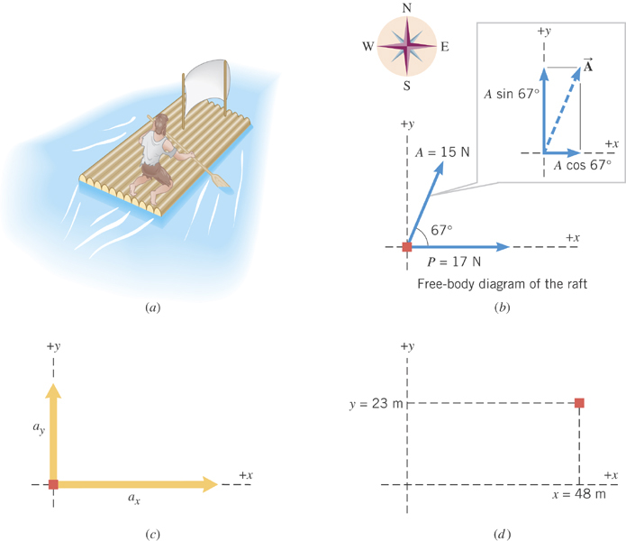
Ex. Stranded man on a raft
A man is stranded on a raft (mass of man and raft = 1300kg)m as shown in the figure. By paddling, he causes an average force P of 17N to be applied to the raft in a direction due east (the +x direction). The wind also exerts a force A on the raft. This force has a magnitude of 15N and points 67º North of East. Ignoring any resistance from the water, find the x and y components of the raft’s acceleration.

Slide 15
First, let’s compute the net force on the raft as follows:
Force | x component | y component
+17 N
0 N
+(15N)cos67º
+(15N)sin67º
+17+15cos67º=
+15sin67º=
+23(N)
+14(N)

Slide 16
Now compute the acceleration components in x and y directions!!
And put them all together for the overall acceleration:

Slide 17
Example for Newton’s 2nd Law of Motion
Determine the magnitude and direction of the acceleration of the puck whose mass is 0.30kg and is being pulled by two forces, F1 and F2, as shown in the picture, whose magnitudes of the forces are 8.0 N and 5.0 N, respectively.
Components of F₁
F₁
θ₁=60^{ο}
Components of F₂
θ₂=−20^{ο}
F₂
Components of total force F
Magnitude and direction of acceleration a
Acceleration
Vector a
17

