Slide 1
PHYS 1443 – Section 003
Lecture #9
Monday, March 1, 2021
Dr. Jaehoon Yu
CH4: Newton’s Laws of Motion
  Newton’s third law of motion
  Categories of Forces
  Gravitational Force and Weight
  Application of Newton’s Laws
  Force of Friction
Today’s homework is homework #5, due 11pm, Tuesday, March 23!!

Slide 2
Announcements
Quiz #2 beginning of the class this Wednesday, March 3
  Covers CH3.4 to what we finish today, Monday, March 1
  BYOF: You may bring a one 8.5x11.5 sheet (front and back) of handwritten formulae and values of constants for the test
  No derivations, word definitions, setups or solutions of any problems, figures, pictures, diagrams or arrows, etc!
  Must email me the photos of front and back of the formula sheet, including the blank at jaehoonyu@uta.edu no later than 12:00pm the day of the test
    The subject of the email should be the same as your file name
    File name must be FS-Q2-LastName-FirstName-SP21.pdf
    Once submitted, you cannot change, unless I ask you to delete part of the sheet!
Mid-term comprehensive online exam in class on Wed. March 10
  Covers CH1.1 through what we learn on Monday, March 8 + Math refresher
Reminder: Extra credit special COVID seminar at 4pm Saturday, March 20
  Extra credit for participation and for asking the relevant questions
  Dr. Linda Lee, a practicing physician from Wisconsin

Slide 3
Reminder: SP #3 – Statistical Analysis : COVID19
Make comparisons of COVID-19 statistics between the U.S., South Korea, Italy and Texas from https://coronaboard.com on spreadsheet
  Total 44 points: 1 point for each of the top 20 cells and 2 points for each of the 8 cells for vaccination
Fill the US Historic event analysis table at the bottom 12 cells of the sheet (2 points per cell, 24 points total) and make a >3 sentence statement on COVID19 with respect to other events (6 points)
What are the 3 fundamental quantitative requirements for opening up (2 points each, 6 points total)?
  Must be quantitative! (e.g. number of tests per capita per day, positivity rate, etc)
Assess the readiness of the three fundamental requirements U.S. (Do NOT just take politician’s words!). Must provide the independent scientific entity’s reference you took the information from. (2 point each, total 6 points)
Evaluate quantitatively the success/failure of the US responses to COVID-19 in 2020 in 5 sentences and that in 2021 in 5 sentences. Must provide quantitative reasons behind your conclusion! (2 points each sentence, 20 points total)
Assess quantitatively the effectiveness of wearing masks (4 points) and at least 4 reasons for it being effective (1 point each, 0.5 point extra after the first 4).
Possible maximum: 122 points total
Due: 11pm, Friday, March 19
  Submit one pdf file SP3-YourLastName-YourFirstName.pdf, including the spreadsheet
  Spreadsheet will be posted on canvas. Download ASAP.

Slide 5
SP#4: Newton’s 3rd Law
The mass of the spacecraft is 11,000 kg and the mass of the astronaut is 92 kg. What is the velocity of the space craft and the astronaut 10 sec into the motion if they were in contact for 50cm during with the astronaut is applying the force of 36N?
Maximum score: 20 points
Please be sure to show details of your OWN work!
Must be handwritten!
Due 2:30pm, Monday, March 8
Submit one pdf file SP4-YourLastName-YourFirstName.pdf on canvas assignment #4

Slide 6
Newton’s Third Law (Law of Action and Reaction)
When two objects interact, the force F₁₂ that object 1 exerts on object 2 is equal in magnitude and opposite in direction to the force F₂₁ object 2 exerts on object 1.
F₁₂
F₂₁
2
1
The reaction force is equal in magnitude to the action force but in opposite direction. These two forces always act on different objects.
What is the reaction force to the force of a free falling object?
The gravitational force exerted by the object to the Earth!
Stationary objects on top of a table has a reaction force (called the normal force) from the table to balance the action force, the gravitational force.
6

Slide 7
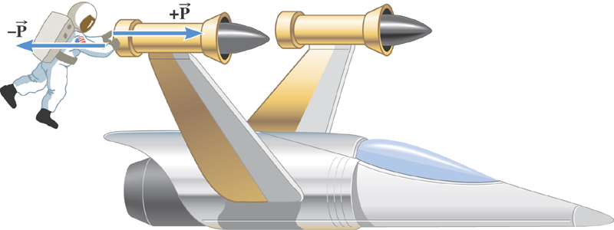
Ex. The Accelerations Produced by Action and Reaction Forces
Which one do you think will get larger acceleration?
Suppose that the magnitude of the force P is 36 N. If the mass of the spacecraft is 11,000 kg and the mass of the astronaut is 92 kg, what are the accelerations?

Slide 8
Ex. continued
Force exerted on the space craft by the astronaut
Force exerted on the astronaut by the space craft
space craft’s acceleration
astronaut’s acceleration

Slide 9
Example of Newton’s 3rd Law
A large man and a small boy stand facing each other on frictionless ice. They put their hands together and push against each other so that they move apart. a) Who moves away with the higher speed and by how much?
F₁₂
F₂₁= - F₁₂
m
M
Since
and
Establish the
equation
Divide by m
9

Slide 10
Example of Newton’s 3rd Law, cnt’d
Man’s speed
Boy’s speed
So boy’s speed is higher than man’s, if M>m, by the ratio of the masses.
b) Who moves farther while their hands are in contact?
Boy’s displacement
Man’s displacement
Given in the same time interval, since the boy has higher acceleration and thereby higher speed, he moves farther than the man.
10

Slide 11
Categories of Forces
Fundamental Forces: Truly unique forces that cannot be derived from any other forces (poll 2)
  Total of three fundamental forces
    Gravitational Force
    Electro-Weak Force (the unified force of EM and Weak)
    Strong Nuclear Force
Non-fundamental forces: Forces that can be derived from fundamental forces
  Friction
  Tension in a rope
  Normal or support forces

Slide 12
Gravitational Force and Weight
The attractive force exerted on an object by the Earth (Polls 3, 6, 12)
Gravitational Force, F_{g}
Weight of an object with mass M is
Since weight depends on the magnitude of gravitational acceleration, g, it varies depending on geographical location. (poll 7)
By measuring the forces one can determine masses. This is why you can measure mass using the spring scale.

Slide 13
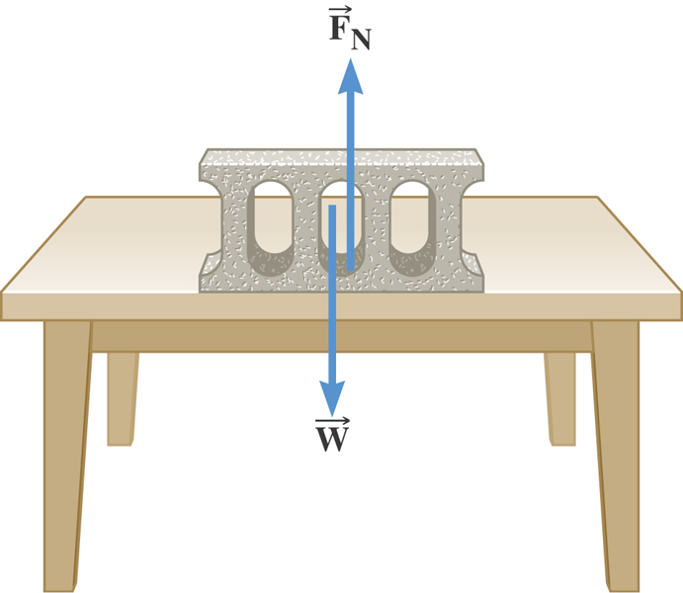
The Normal Force
The normal force is one component of the reactionary force that a surface exerts on an object with which it is in contact – namely, the component that is perpendicular to the surface. (polls 6, 3)

Slide 14
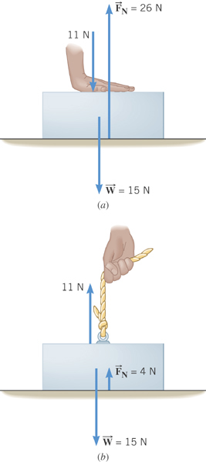
Some normal force exercises
Case 1: Hand pushing down the book
Case 2: Hand pulling up the book

Slide 15
Some Basic Information
When Newton’s laws are applied, external forces are only of interest!!
Because, as described in Newton’s first law, an object will keep its current motion unless non-zero net external force is applied.
Why?
Reaction force that reacts to the action force due to the surface structure of an object. Its direction is perpendicular to the surface.
Normal Force, n:
Tension, T:
The reactionary force by a stringy object against an external force exerted on it.
A graphical tool which is a diagram of external forces on an object and is extremely useful analyzing forces and motion!! Drawn only on an object.
Free-body diagram

Slide 16
Free Body Diagrams and Solving Problems
Free-body diagram: A diagram of vector forces acting on an object
A great tool to solve a problem using forces or using dynamics
Select a point on an object in the problem
Identify all the forces acting only on the selected object
Define a reference frame with positive and negative axes specified (easier if one of the axes is aligned with the anticipated direction of motion!)
Draw arrows to represent the force vectors on the selected point
Write down the net force vector equation
Write down the force components to solve the problem for the motion of an object
Draw the FBD on the box of mass M.
What do you think are the forces acting on this object?
M
Gravitational force
the force supporting the object exerted by the floor
Draw FBD on the elevator!
What do you think are the forces acting on this elevator?
M_{e}
Gravitational forces
The force pulling the elevator (Tension)
What about the box in the elevator?
Gravitational force on the box
Normal force
m

Slide 17
Applications of Newton's Laws
Suppose you are pulling a box on frictionless ice, using a rope.
What are the forces being exerted on the box?
M
T
Gravitational force: F_{g}
n= -F_{g}
Normal force: n
Free-body diagram
T
Tension force: T
n= -F_{g}
Total force: F=F_{g}+n+T=T
F_{g}=-Mg
T
If T is a constant force, a_{x}, is constant
F_{g}=-Mg
What happened to the motion in y-direction?

Slide 18
Example for Using Newton’s Laws
A traffic light weighing 125 N hangs from a cable tied to two other cables fastened to a support. The upper cables make angles of 37.0º and 53.0º with the horizontal. Find the tension in the three cables.
y
37º
53º
Free-body
Diagram
T₁
T₂
37º
53º
x
T₃
Newton’s 2nd law
x-comp. of net force
y-comp. of net force

