Slide 1
PHYS 1443 – Section 003
Lecture #10
Wednesday, March 3, 2021
Dr. Jaehoon Yu
CH4: Newton’s Laws of Motion
  Application of Newton’s Laws
  Force of Friction
  Motion with friction
CH5: Circular Motion and Gravitation
  Kinematics of Uniform Circular Motion
  Dynamics of Uniform Circular Motion

Slide 2
Announcements
Mid-term comprehensive in class next Wednesday, March 10
  Covers CH1.1 through what we learn on Monday, March 8 + Math refresher
  BYOF: You may bring a one 8.5x11.5 sheet (front and back) of handwritten formulae and values of constants for the test
  No derivations, word definitions, setups or solutions of any problems, figures, pictures, diagrams or arrows, etc!
  Must email me the photos of front and back of the formula sheet, including the blank at jaehoonyu@uta.edu no later than 12:00pm the day of the test
    The subject of the email should be the same as your file name
    File name must be FS-E2-LastName-FirstName-SP21.pdf
    Once submitted, you cannot change, unless I ask you to delete part of the sheet!
Reminder: Extra credit special COVID seminar at 4pm Saturday, March 20
  Extra credit for participation and for asking the relevant questions
  Dr. Linda Lee, a practicing physician from Wisconsin

Slide 3
Reminder: SP #3 – Statistical Analysis : COVID19
Make comparisons of COVID-19 statistics between the U.S., South Korea, Italy and Texas from https://coronaboard.com on spreadsheet
  Total 44 points: 1 point for each of the top 20 cells and 2 points for each of the 8 cells for vaccination
Fill the US Historic event analysis table at the bottom 12 cells of the sheet (2 points per cell, 24 points total) and make a >3 sentence statement on COVID19 with respect to other events (6 points)
What are the 3 fundamental quantitative requirements for opening up (2 points each, 6 points total)?
  Must be quantitative! (e.g. number of tests per capita per day, positivity rate, etc)
Assess the readiness of the three fundamental requirements U.S. (Do NOT just take politician’s words!). Must provide the independent scientific entity’s reference you took the information from. (2 point each, total 6 points)
Evaluate quantitatively the success/failure of the US responses to COVID-19 in 2020 in 5 sentences and that in 2021 in 5 sentences. Must provide quantitative reasons behind your conclusion! (2 points each sentence, 20 points total)
Assess quantitatively the effectiveness of wearing masks (4 points) and at least 4 reasons for it being effective (1 point each, 0.5 point extra after the first 4).
Possible maximum: 122 points total
Due: 11pm, Friday, March 19
  Submit one pdf file SP3-YourLastName-YourFirstName.pdf, including the spreadsheet
  Spreadsheet will be posted on canvas. Download ASAP.

Slide 5
Reminder: SP#4 – Newton’s 3rd Law
The mass of the spacecraft is 11,000 kg and the mass of the astronaut is 92 kg. What is the velocity of the space craft and the astronaut 10 sec into the motion if they were in contact for 50cm during with the astronaut is applying the force of 36N?
Maximum score: 20 points
Please be sure to show details of your OWN work!
Must be handwritten!
Due 2:30pm, Monday, March 8
Submit one pdf file SP4-YourLastName-YourFirstName.pdf on canvas assignment #4

Slide 6
Steps for solving mechanics problems using Newton’s Laws
Identify all the forces acting on the object of interest in the problem.
Establish a vector sum equation using all identified forces.
  Note that the vector sum of all forces are the net force that provides the acceleration to the object’s motion
Identify all components of the forces in each direction.
Establish the force equation for each component, whose right hand-side will be the mass of the object times the acceleration in the particular direction.
Solve each equation of component for the the quantities of interests.
If any further equation of motion is of interest, use combinations of kinematic equations to obtain the answers.

Slide 7
Example w/o Friction
A crate of mass M is placed on a frictionless inclined plane of angle θ.
a) Determine the acceleration of the crate after it is released.
y
y
n
y
M
a
n
x
x
d
Free-body
Diagram
x
F_{g}
θ
θ
F_{g}= -Mg
(b) Supposed the crate was released at the top of the incline, and the length of the incline is d. How long does it take for the crate to reach the bottom and what is its speed at the bottom?

Slide 8
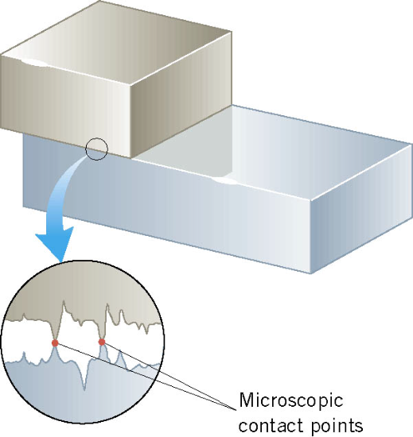
Friction Force
When an object is in contact with a surface, there is a force acting on that object. The component of this force, parallel to the surface is called the friction force.
This resistive force is exerted on a moving object due to
The viscosity or other types of frictional property of the medium in or surface on which the object moves.
Always opposite to the movement!!

Slide 9
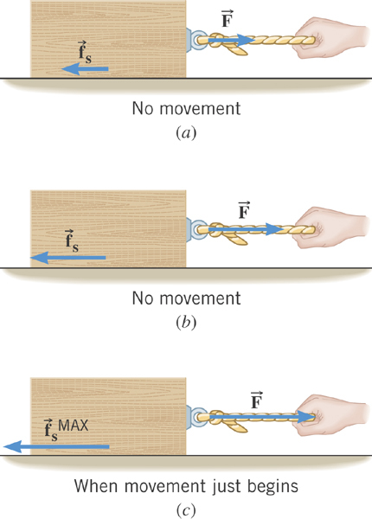
Static Friction
When the two surfaces are not sliding against one another,
the friction is called static friction.
This resistive force acts
on the object up to the time just before the object starts moving.

Slide 10
Magnitude of the Static Friction
The magnitude of the static friction force can have any value from zero up to the maximum value.
is called the coefficient of static friction.
What is the unit?
None
Once the object starts moving, there is NO MORE static friction!!
Kinetic friction applies during the move!!

Slide 11
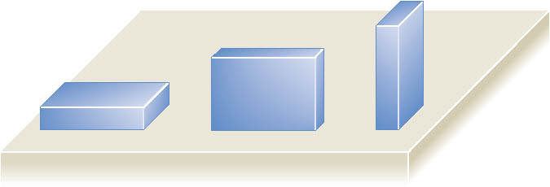
Note that the magnitude of the static friction force does not depend on the contact area of the surfaces.

Slide 12
Kinetic Friction
Static friction opposes the impending relative motion between
two objects.
Kinetic friction opposes the relative sliding motions that is happening. This resistive force acts on the objects only during its movement.
Normally much smaller than the static friction!!
is called the coefficient of kinetic friction.
What is the direction of friction forces?
opposite to the movement

Slide 13
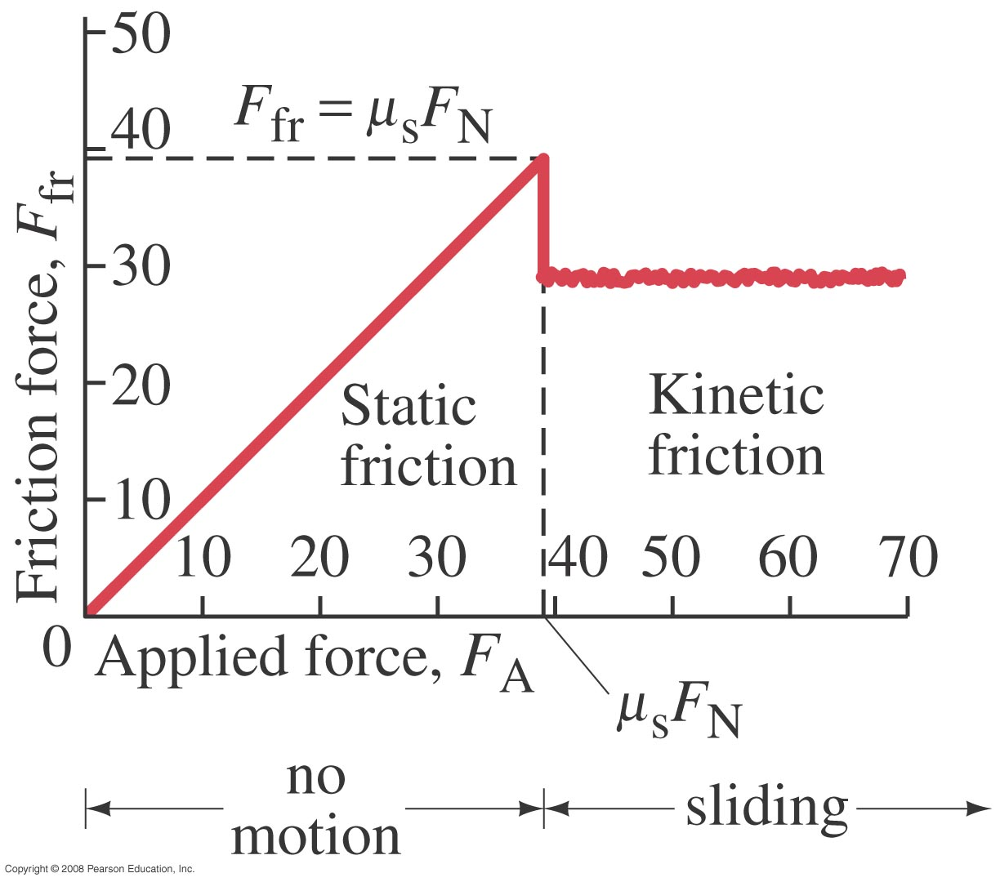
Friction Force vs Applied Force

Slide 14
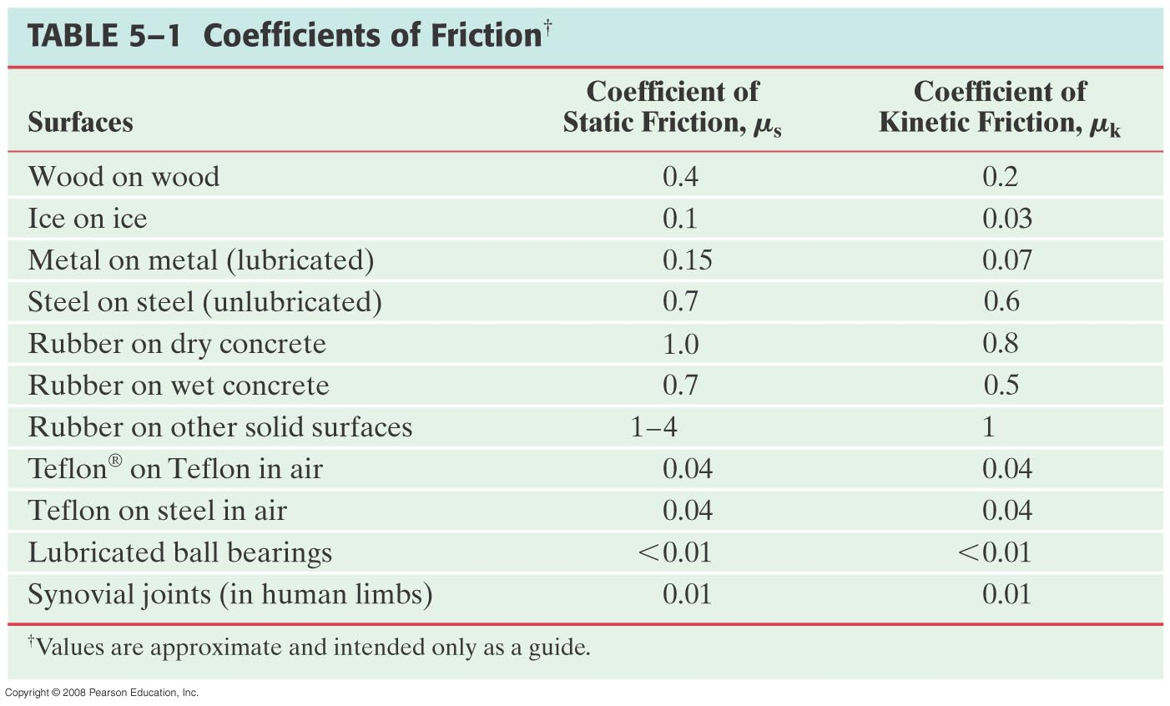
Coefficients of Friction
What are these?

Slide 15
Forces of Friction Summary
Resistive force exerted on a moving object due to viscosity or other types frictional property of the medium in or surface on which the object moves.
These forces are either proportional to the speed or the normal force.
Force of static friction, f_{s}:
The resistive force exerted on the object until just before the beginning of its movement
Empirical Formula
What does this formula tell you?
Static friction force increases till it reaches the limit!!
Beyond the limit, the object moves, and there is NO MORE static friction but the kinetic friction takes it over.
Force of kinetic friction, f_{k}
The resistive force exerted on the object during its movement
Which direction does kinetic friction apply?
Opposite to the motion!

Slide 16
Look at this problem again…
Suppose you are pulling a box on a rough surfice, using a rope.
What are the forces being exerted on the box?
M
T
Gravitational force: F_{g}
Normal force: n
n= -F_{g}
Tension force: T
Free-body diagram
F_{f}
T
Friction force: F_{f}
n= -F_{g}
Total force:
F=F_{g}+n+T+F_{f}
F_{g}=Mg
F_{f}
T
If T is a constant force, a_{x}, is constant
F_{g}=Mg

Slide 17
Example w/ Friction
Suppose a block is placed on a rough surface inclined relative to the horizontal. The inclination angle is increased till the block starts to move. Show that by measuring this critical angle, θ_{c}, one can determine coefficient of static friction, μ_{s}.
y
f_{s}=μ_{s}n
n
y
M
Free-body
Diagram
a
n
x
f_{s}=μ_{s}n
x
F_{g}
θ
θ
F= -Mg
Net force
x comp.
y comp.

Slide 18
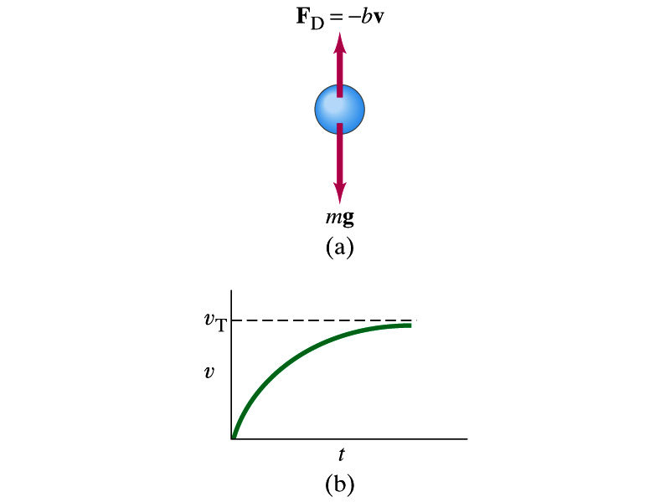
Motion in Resistive Force
A medium can exert resistive forces on an object moving through it due to viscosity or other types frictional properties of the medium.
Some examples?
Air resistance, viscous force of liquid, etc
These forces are exerted on moving objects in the opposite direction to the movement.
These forces are proportional to such factors as speed. They almost always increase with increasing speed.
Two different cases of proportionality:
  Forces linearly proportional to speed: Slowly moving or very small objects
  Forces proportional to square of speed: Large objects w/ reasonable speed

