Slide 1
PHYS 1443 – Section 003 Lecture #13
Monday, March 29, 2021
Dr. Jaehoon Yu
CH6: Work and Energy
Work-Kinetic Energy Theorem
Work under friction
Potential Energy and the Conservative Force
Gravitational Potential Energy
Elastic Potential Energy
Conservation of Energy
Today’s homework is homework #8, due 11pm, Tuesday, April 13!!

Slide 2
Announcements
Reading Assignments: CH7.9 and CH7.10

Slide 3
Reminder - SP #5: Comparing Fundamental Forces
Two protons are separated by 1m.
Compute the gravitational force (F_{G}) between the two protons (10 points)
Compute the electric force (F_{E}) between the two protons (10 points)
Compute the ratio of FG/FE (5 points) and explain what this tells you (5 point)
You must specify the formulae for each of the forces and the values of the necessary quantities, such as mass, charge, constants, etc, in your report!
Maximum score: 30 points
Please be sure to show details of your OWN, handwritten work!
Due 2:30pm, this Wednesday, March 31
Submit one pdf file SP5-YourLastName-YourFirstName.pdf on canvas assignment #5

Slide 4
Kinetic Energy and Work-Kinetic Energy Theorem
Some problems are hard to solve using Newton’s second law
If forces exerting on an object during the motion are complicated
Relate the work done on the object by the net force to the change of the speed of the object
ΣF
Suppose net force ΣF was exerted on an object for displacement d to increase its speed from v_{i} to v_{f}.
M
M
v_{i}
v_{f}
The work on the object by the net force ΣF is
s
Using the kinematic equation of motion
Kinetic Energy
Work
Work
Work done by the net force causes the change in the object’s kinetic energy.
Work-Kinetic Energy Theorem

Slide 5
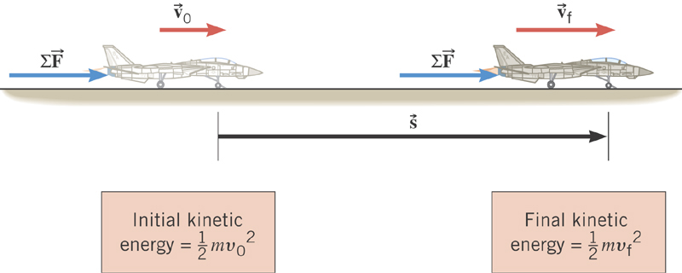
Work-Kinetic Energy Theorem
When a net external force by the jet engine does work on an object, the kinetic energy of the object changes according to

Slide 6
Work and Kinetic Energy
A meaningful work in physics is done only when the sum of the forces exerted on an object made a change in the object’s motion.
What does this mean?
However much tired your arms feel, if you were just holding an object without moving it you have not done any meaningful work on the object.
Mathematically, the work is written as the product of magnitudes of the net force vector, the magnitude of the displacement vector and the angle between them.
Kinetic Energy is the energy associated with the motion and capacity to perform work. Work causes change of energy after the completion⬅ Work-Kinetic energy theorem
Unit (Poll 6, 3, 1)?
Nm=Joule

Slide 7
Example for Work-KE Theorem
A 6.0kg block initially at rest is pulled to East along a horizontal, frictionless surface by a constant horizontal force of 12N. Find the speed of the block after it has moved 3.0m.
M
F
M
Work done by the force F is
v_{i}=0
v_{f}
d
From the work-kinetic energy theorem, we know
Since initial speed is 0, the above equation becomes
Solving the equation for v_{f}, we obtain

Slide 8
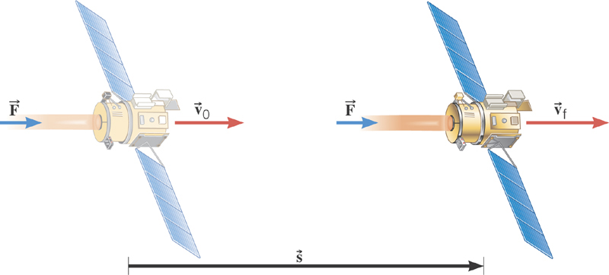
Ex. Deep Space 1
The mass of the space probe is 474-kg, and its initial speed is 275 m/s. If the 56.0-mN force acts on the probe parallel through a displacement of 2.42×10⁹m, what is its final speed?
Solve for v_{f}

Slide 9
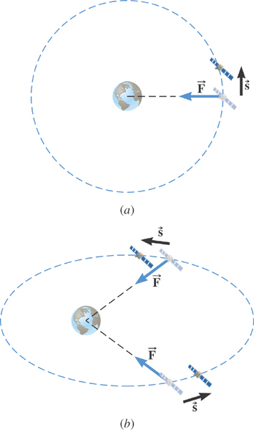
Ex. Satellite Motion and Work By the Gravity
A satellite is moving about the earth in a circular orbit and an elliptical orbit. For these two orbits, determine whether the kinetic energy of the satellite changes during the motion.
For a circular orbit
No change!
Why not?
Gravitational force is the only external force but it is perpendicular to the displacement. So no work.
For an elliptical orbit
Changes!
Why?
Gravitational force is the only external force but its angle with respect to the displacement varies. So it performs work.

Slide 10
Work and Energy Involving Kinetic Friction
What do you think the work looks like if there is friction?
Static friction does not matter! Why?
Then which friction matters?
It isn’t there when the object is moving.
Kinetic Friction
Friction force F_{fr} works on the object to slow down
F_{fr}
M
M
The work on the object by the friction F_{fr} is
v_{i}
v_{f}
d
The negative sign means that the work is done on the friction!
The final kinetic energy of an object, taking into account its initial kinetic energy, friction force and all other sources of work, is
t=0, KE_{i}
Friction,
Engine work
t=T, KE_{f}

Slide 11
Example of Work Under Friction
A 6.0kg block initially at rest is pulled to East along a horizontal surface with coefficient of kinetic friction μ_{k}=0.15 by a constant horizontal force of 12N. Find the speed of the block after it has moved 3.0m.
M
F
M
Work done by the force F is
F_{k}
v_{i}=0
v_{f}
d=3.0m
Work done by friction F_{k} is
Thus the total work is
Do this problem by first computing the net force. Is the answer the same?
Using work-kinetic energy theorem and the fact that the initial speed is 0, we obtain
Solving the equation
for v_{f}, we obtain

Slide 12
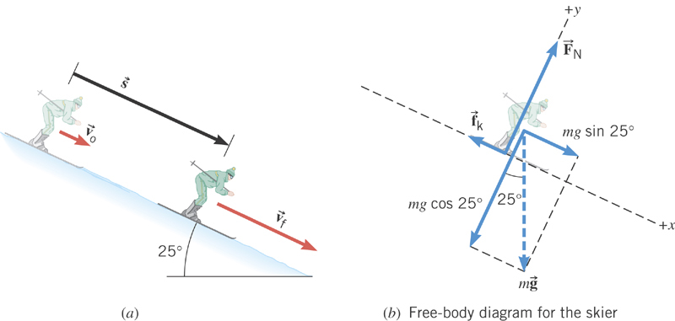
Ex. Downhill Skiing
A 58kg skier is coasting down a 25º slope. A kinetic frictional force of magnitude f_{k}=70N opposes her motion. At the top of the slope, the skier’s speed is v₀=3.6m/s. Ignoring air resistance, determine the speed v_{f} at the point that is displaced 57m downhill.
y
x
What are the forces in this motion?
Gravitational force: F_{g}
Normal force: F_{N}
Kinetic frictional force: f_{k}
What are the X and Y component of the net force in this motion?
Y component
From this we obtain
What is the coefficient of kinetic friction?

Slide 13
Ex. Now with the X component
X component
Total work by this force
From work-kinetic energy theorem
Solving for v_{f}
What is her acceleration?

Slide 14
Potential Energy & Conservation of Mechanical Energy
Energy associated with a system of objects ➔ Stored energy which has the potential or the possibility to work or to convert to kinetic energy
In order to describe potential energy, U, a system must be defined.
What does this mean?
The concept of potential energy can only be used under the special class of forces called the conservative force which results in the principle of conservation of mechanical energy.
What are other forms of energies in the universe?
Mechanical Energy
Chemical Energy
Biological Energy
Electromagnetic Energy
Nuclear Energy
These different types of energies are stored in the universe in many different forms!!!
If ALL forms of energy are accounted for, the total energy in the entire universe is conserved. It just transforms from one form to another.

Slide 15
Gravitational Potential Energy
This potential energy is given to an object by the gravitational field in the system of Earth by virtue of the object’s height from an arbitrary zero level
When an object is falling, the gravitational force, mg, performs the work on the object, increasing the object’s kinetic energy. So the potential energy of an object at height h, the potential to do work, is expressed as
m
h_{i}
mg
m
The work done on the object by the gravitational force as the brick drops from h_{i} to h_{f} is:
h_{f}
(since )
What does this mean?
Work by the gravitational force as the brick drops from h_{i} to h_{f} is the negative change of the system’s potential energy
➔ Potential energy was spent in order for the gravitational force to increase the brick’s kinetic energy.

Slide 16
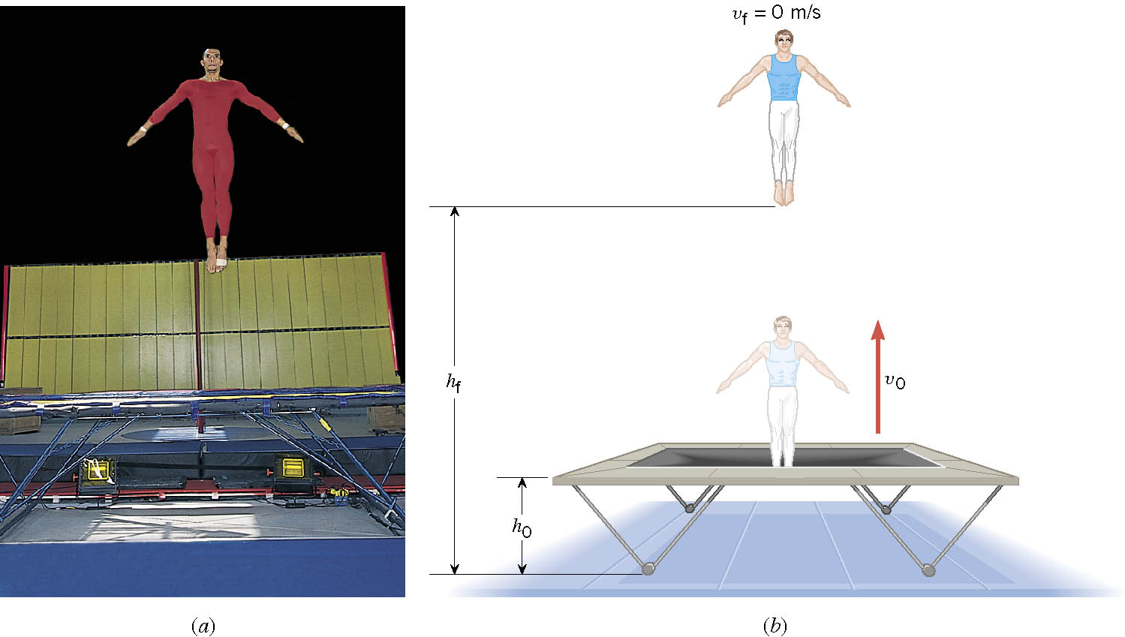
Ex. A Gymnast on a Trampoline
The gymnast leaves the trampoline at an initial height of 1.20 m and reaches a maximum height of 4.80 m before falling back down. What was the initial speed of the gymnast?

Slide 17
Ex. Continued
From the work-kinetic energy theorem
Work done by the gravitational force
Since at the maximum height, the final speed is 0. Using work-KE theorem, we obtain

Slide 18
Conservative Forces and Potential Energy
The work done on an object by a conservative force is equal to the decrease in the potential energy of the system
What does this statement tell you?
The work done by a conservative force is equal to the negative change of the potential energy associated with that force.
Only the changes in potential energy of a system is physically meaningful!!
We can rewrite the above equation in terms of the potential energy U
So the potential energy associated with a conservative force at any given position becomes
Potential energy function
What can you tell from the potential energy function above?
Since U_{i} is a constant, it only shifts the resulting U_{f}(x) by a constant amount. One can always change the initial potential so that U_{i} can be 0.

