Slide 1
PHYS 1443 – Section 003
Lecture #14
Wednesday, March 31, 2021
Dr. Jaehoon Yu
CH6: Work and Energy
  Potential Energy and the Conservative Force
  Conservation of Energy
  Work Done By a Non-conservative Force
  Energy Diagram
  Universal Gravitational Field
  General Gravitational Potential Energy
  Power

Slide 2
More Conservative and Non-conservative Forces
The work done on an object by the gravitational force does not depend on the object’s path in the absence of a retardation force.
N
When directly falls, the work done on the object by the gravitation force is
m
h
l
When sliding down the hill of length l, the work is
mg
θ
How about if we lengthen the incline by a factor of 2, keeping the height the same??
Still the same amount of work☺
So, the work done by the gravitational force on an object is independent of the path of the object’s movement. It only depends on the difference of the object’s initial and final position in the direction of the force.
Forces like gravitational and elastic forces are called the conservative force
If the work performed by the force does not depend on the path.
If the net work performed on a closed path is 0.
Total mechanical energy is conserved!!

Slide 3
Example for Potential Energy
A 1.8m tall bowler drops bowling ball of mass 7kg on his toe. Choosing the floor level as y=0, estimate the total work done on the ball by the gravitational force as the ball falls on the toe.
Let’s assume the top of the toe is 0.03m from the floor and the hand was 0.5m above the floor.
M
b) Perform the same calculation using the top of the bowler’s head as the origin.
What has to change?
First, we must re-compute the positions of the ball in his hand and on his toe.
Since the bowler’s height is 1.8m, the ball’s original position is –1.3m, and the toe is at –1.77m.

Slide 4
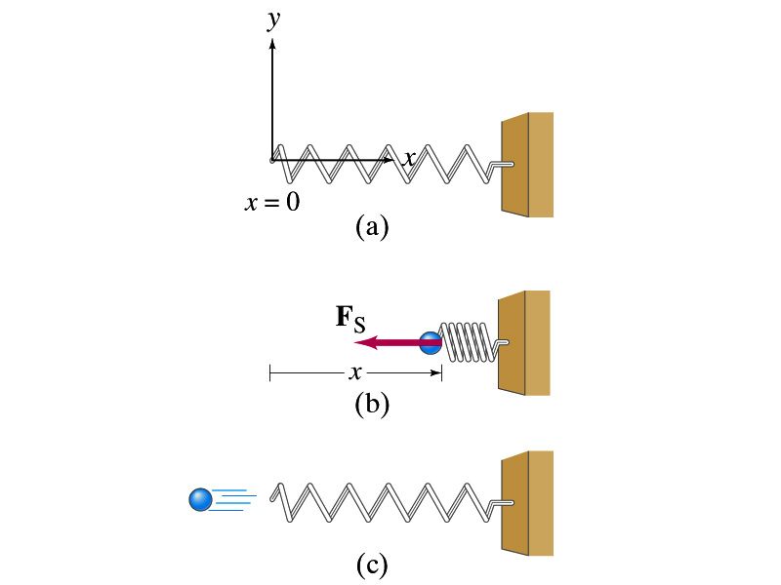
Elastic Potential Energy
Potential energy given to an object by a spring or an object with elasticity in the system that consists of an object and the spring.
The force spring exerts on an object when it is distorted from its equilibrium by a distance x is
Hooke’s Law
The work performed on the object by the spring is
The potential energy of this system is
What do you see from the above equations?
The work done on the object by the spring depends only on the initial and final position of the distorted spring.
Where else did you see this trend?
The gravitational potential energy, U_{g}
So what does this tell you about the elastic force?
A conservative force!!!

Slide 5
Conservation of Mechanical Energy
Total mechanical energy is the sum of kinetic and potential energies
Let’s consider a brick of mass m at the height h from the ground
What is the brick’s potential energy?
m
h
mg
What happens to the energy as the brick falls to the ground?
m
The brick gains speed
By how much?
h₁
So what?
The brick’s kinetic energy increases to
And?
The lost potential energy is converted to the kinetic energy!!
The total mechanical energy of a system remains constant in any isolated system of objects that interacts only through conservative forces: Principle of mechanical energy conservation
What does this mean?

Slide 6
Example
A ball of mass m at rest is dropped from the height h above the ground. a) Neglecting the air resistance determine the speed of the ball when it is at any given height y above the ground.
PE
KE
Using the principle of mechanical energy conservation
m
mgh
0
mv_{i}²/2
h
mg
m
mgy
mv²/2
mv_{f}²/2
b) Determine the speed of the ball at y if it had non-zero initial speed v_{i} at the time of the release at the original height h.
y
Again, using the principle of mechanical energy conservation but with non-zero initial kinetic energy!!!
0
This result look very similar to a kinematic expression, doesn’t it? Which one is it?

Slide 7
Example
A ball of mass m is attached to a light cord of length L, making up a pendulum. The ball is released from rest when the cord makes an initial angle θ_{A} with the vertical, and the pivoting point P is frictionless. Find the speed of the ball when it is at the lowest point, B.
P
Compute the potential energy at the maximum height, h. Remember where the 0 is.
PE
L
KE
_{θA}
T
mgh
h{
m
0
Using the principle of mechanical energy conservation
0
m
mg
B
mv²/2
b) Determine tension T at the point B.
Using Newton’s 2nd law of motion and recalling the centripetal acceleration of a circular motion
Cross check the result in a simple situation. What happens when the initial angle θ_{A} is 0?
How many forces do you see at point B?
2:
F_{g}, T

Slide 8
Work Done by Non-conservative Force
Mechanical energy of a system is not conserved when any one of the forces in the system is a non-conservative (dissipative) force.
Two kinds of non-conservative forces:
Applied forces: Forces that are external to the system. These forces can take away or add energy to the system. So, the mechanical energy of the system is no longer conserved.
If you were to hit a freefalling ball, the force you apply to the ball is external to the system of the ball and the Earth. Therefore, you add kinetic energy to the ball-Earth system.
Kinetic Friction: An internal non-conservative force that causes an irreversible transformation of energy. The friction force causes the kinetic and potential energy to transfer to an internal energy.

Slide 9
Example of Non-Conservative Force
A skier starts from rest at the top of frictionless hill whose vertical height is 20.0m and the inclination angle is 20º. Determine how far the skier can get on the snow at the bottom of the hill when the coefficient of kinetic friction between the ski and the snow is 0.210.
Compute the speed at the bottom of the hill, using the mechanical energy conservation on the hill before friction starts working at the bottom
Don’t we need to know the mass?
h=20.0m
θ=20º
The change of kinetic energy is the same as the work done by the kinetic friction.
What does this mean in this problem?
Since we are interested in the distance the skier can get to before stopping, the friction must do as much work as the available kinetic energy to take it all away.
Since
We don’t know the mass!
Well, it turns out we don’t need to know the mass.
What does this mean?
No matter how heavy the skier is he will get as far as anyone else has gotten starting from the same height.

