Slide 1
PHYS 1443 – Section 003
Lecture #16
Wednesday, April 7, 2021
Dr. Jaehoon Yu
CH7: Linear Momentum
  Linear Momentum and Force
  Conservative of Linear Momentum
  Impulse
  Collisions – Elastic and Inelastic

Slide 2
Announcements
2nd non-comprehensive exam in class next Wednesday, Apr. 14
  Covers CH5.5 to what we finish coming Monday, Apr. 12
  Do NOT miss the exam. You will get an F!
  BYOF: You may bring one 8.5x11.5 sheet (front and back) of handwritten formulae and values of constants for the test
  No derivations, word definitions, setups or solutions of any problems, figures, pictures, diagrams or arrows, etc!
  Must email me the photos of front and back of the formula sheet, including the blank at jaehoonyu@uta.edu no later than 12:00pm the day of the test
    The subject of the email should be the same as your file name
    File name must be FS-E3-LastName-FirstName-SP21.pdf
    Once submitted, you cannot change, unless I ask you to delete part of the sheet!

Slide 3
Special Project #6: Electric Power Usage
Make a list of the power consumption of all electric and electronic devices at your home and compile them in a table. (10 points total for the first 10 items and 0.5 points each additional item.)
  Similar electric/electronic devices count as one item.
    All light bulbs make up one item, computers another, refrigerators, TVs, dryers (hair and clothes), electric cooktops, heaters, microwave ovens, electric ovens, dishwashers, etc.
    All you have to do is to count add all wattages of the light bulbs together as the power of the item
Estimate the cost of electricity for each of the items on the table using your own electric cost per kWh (if you don’t find your own, use $0.12/kWh) and put them in the relevant column. (5 points total for the first 10 items and 0.2 points each additional items)
Estimate the the total amount of energy in Joules and the total electricity cost per day, per month and per year for your home. (8 points)
Due: Beginning of the class, 2:30pm, Monday, Apr. 19
  Scan all pages of your special project into the pdf format
  Save all pages into one file with the filename SP6-YourLastName-YourFirstName.pdf
  Submit on CANVAS

Slide 5
More on Conservation of Linear Momentum in a Two Body System
In the previous class, we’ve learned that the total momentum of the system is conserved if no external forces are exerted on the system.
Kind/unit? (poll 6, 3)
What does this mean?
As in the case of energy conservation, this means that the total vector sum of all momenta in the system is the same before and after any interactions
Mathematically this statement can be written as
This can be generalized into conservation of linear momentum in many particle systems.
Whenever two or more particles in an isolated system interact, the total momentum of the system remains constant.

Slide 6
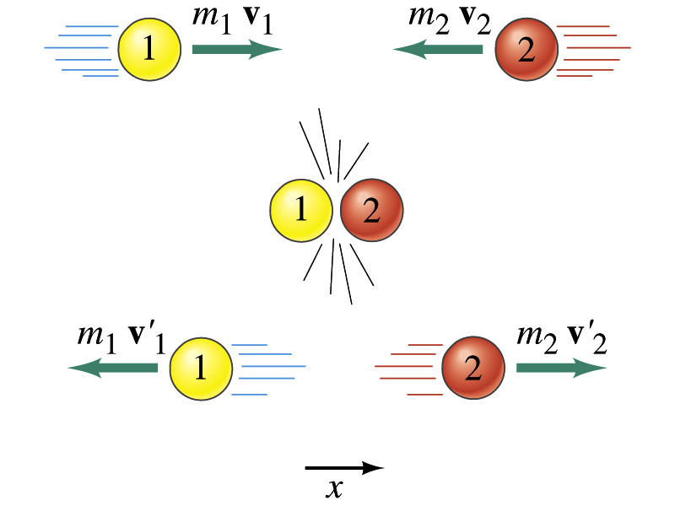
Linear Momentum Conservation
Initial
Final

Slide 7
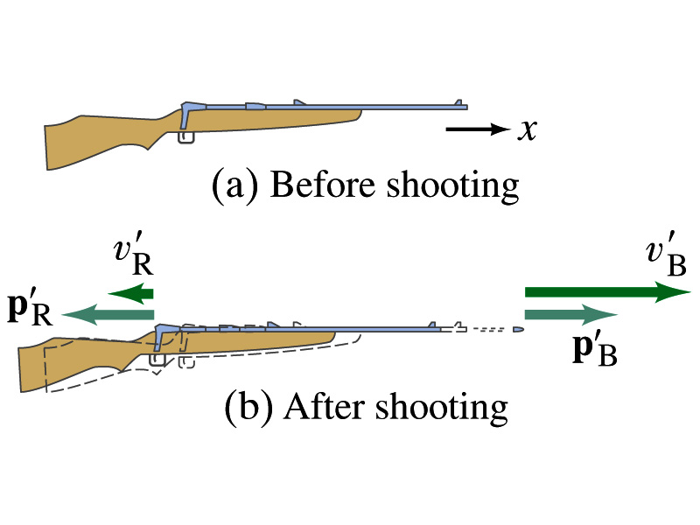
Example: Rifle Recoil
Calculate the recoil velocity of a 5.0kg rifle that shoots a 0.020kg bullet at a speed of 620m/s.
From momentum conservation, we can write
The x-comp
Solving the above for v_{R} and using the rifle’s mass and the bullet’s mass, we obtain
Which law does this remind you of? (poll 14)

Slide 8
Example for Linear Momentum Conservation
Estimate an astronaut’s (M=70kg) resulting velocity after he throws his book (m=1kg) to a direction in the space to move to another direction.
v_{A}
v_{B}
From momentum conservation, we can write
Assuming the astronaut’s mass is 70kg, and the book’s mass is 1kg and using linear momentum conservation
Now if the book gained a velocity of 20 m/s in +x-direction, the Astronaut’s velocity is

Slide 9
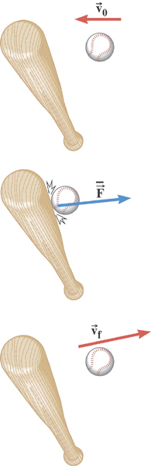
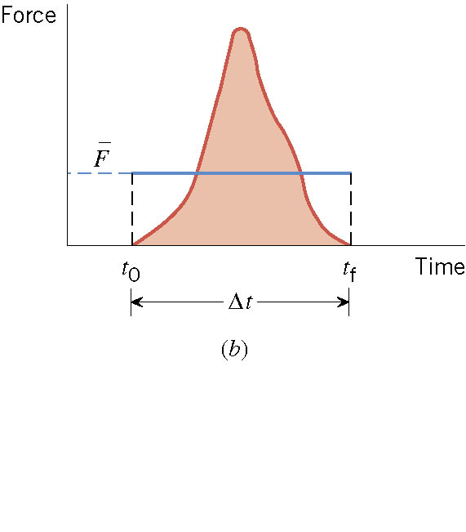
Impulse
There are many situations when the force on an object is not constant and in fact quite complicated!!

Slide 10
Ball Hit by a Bat
Multiply either side by Δt

Slide 11
Impulse and Linear Momentum
Net force causes change of momentum ➔ Newton’s second law
By integrating the above equation in a time interval t_{i} to t_{f}, one can obtain impulse J.
Effect of the force F acting on an object over the time interval Δt=t_{f}-t_{i} is equal to the change of the momentum of the object caused by that force. Impulse is the degree of which an external force changes an object’s momentum.
So what do you think an impulse is?
The above statement is called the impulse-momentum theorem and is equivalent to Newton’s second law.
What are the dimension and unit of Impulse? (poll 6,3) What is the direction of an impulse vector?
Defining a time-averaged force
Impulse can be rewritten
If force is constant
It is generally assumed that the impulse force acts on a short time but much greater than any other forces present.

Slide 12
Example for Impulse
In a crash test, an automobile of mass 1500kg collides with a wall. The initial and final velocities of the automobile are v_{i}= -15.0i m/s and v_{f}=2.60i m/s. If the collision lasts for 0.150 seconds, what would be the impulse caused by the collision and the average force exerted on the automobile?
Let’s assume that the force involved in the collision is a lot larger than any other forces in the system during the collision. From the problem, the initial and final momentum of the automobile before and after the collision is
Therefore the impulse on the automobile due to the collision is
The average force exerted on the automobile during the collision is

Slide 13
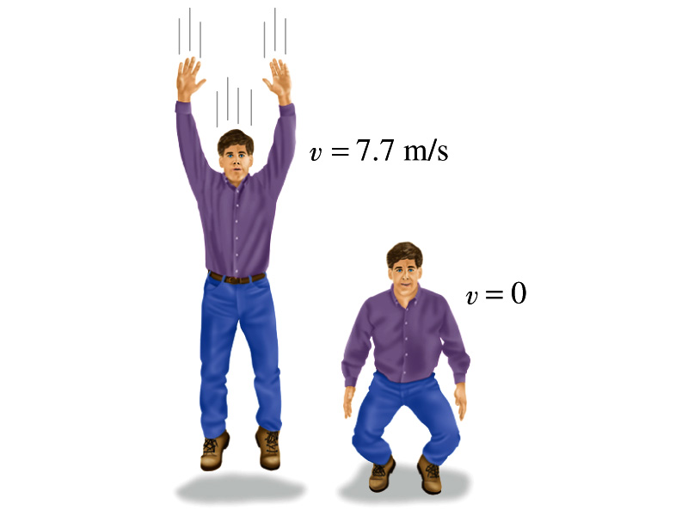
Another Example for Impulse
(a) Calculate the impulse experienced when a 70 kg person lands on firm ground after jumping from a height of 3.0 m. Then estimate the average force exerted on the person’s feet by the ground, if the landing is (b) stiff-legged and (c) with bent legs. In the former case, assume the body moves 1.0cm during the impact, and in the second case, when the legs are bent, about 50 cm.
We don’t know the force. How do we do this?
Obtain velocity of the person before striking the ground.
Solving the above for velocity v, we obtain
Then as the person strikes the ground, the momentum becomes 0 quickly giving the impulse

Slide 14
Example cont’d
In coming to rest, the body decelerates from 7.7m/s to 0m/s in a distance d=1.0cm=0.01m.
The average speed during this period is
The time period the collision lasts is
Since the magnitude of the impulse is
The average force on the feet during this landing is
How large is this average force?
If landed in stiff legged, the feet must sustain 300 times the body weight. The person will likely break his leg.
For bent legged landing:

