Slide 1
PHYS 1443 – Section 003
Lecture #17
Monday, April 12, 2021
Dr. Jaehoon Yu
CH7: Linear Momentum
  Collisions – Elastic and Inelastic
  Collisions in Two Dimensions
  Center of Mass
  Center of Mass of a Rigid Body
  Motion of a Group of Objects
CH8: Rotational Motion

Slide 2
Announcements
2nd non-comprehensive exam in class this Wednesday, Apr. 14
  Roll call starts at 2:20pm!
  Covers CH5.5 to CH7.10
  Do NOT miss the exam. You will get an F!
  BYOF: You may bring one 8.5x11.5 sheet (front and back) of handwritten formulae and values of constants for the test
  No derivations, word definitions, setups or solutions of any problems, figures, pictures, diagrams or arrows, etc!
  Must email me the photos of front and back of the formula sheet, including the blank at jaehoonyu@uta.edu no later than 12:00pm the day of the test
    The subject of the email should be the same as your file name
    File name must be FS-E3-LastName-FirstName-SP21.pdf
    Once submitted, you cannot change, unless I ask you to delete part of the sheet!

Slide 3
Reminder SP#6: Electric Power Usage
Make a list of the power consumption of all electric and electronic devices at your home and compile them in a table. (10 points total for the first 10 items and 0.5 points each additional item.)
  Similar electric/electronic devices count as one item.
    All light bulbs make up one item, computers another, refrigerators, TVs, dryers (hair and clothes), electric cooktops, heaters, microwave ovens, electric ovens, dishwashers, etc.
    All you have to do is to count add all wattages of the light bulbs together as the power of the item
Estimate the cost of electricity for each of the items on the table using your own electric cost per kWh (if you don’t find your own, use $0.12/kWh) and put them in the relevant column. (5 points total for the first 10 items and 0.2 points each additional items)
Estimate the the total amount of energy in Joules and the total electricity cost per day, per month and per year for your home. (8 points)
Due: Beginning of the class, 2:30pm, Monday, Apr. 19
  Scan all pages of your special project into the pdf format
  Save all pages into one file with the filename SP6-YourLastName-YourFirstName.pdf
  Submit on CANVAS

Slide 5
Collisions
Generalized collisions must cover not only the physical contact but also the collisions without a physical contact such as that of electromagnetic ones on a microscopic scale.
The collisions of these ions never involve physical contact because the electromagnetic repulsive force between these two become great as they get closer causing a collision.
Consider a case of a collision between a proton on a helium ion.
F
F₁₂
Assuming no external forces, the force exerted on particle 1 by particle 2, F₂₁, changes the momentum of particle 1 by
t
F₂₁
Likewise for particle 2 by particle 1
Using Newton’s 3rd law we obtain
So the momentum change of the system in a collision is 0, and the momentum is conserved

Slide 6
Elastic and Inelastic Collisions
Momentum is conserved in any collisions as long as external forces are negligible.
Collisions are classified as elastic or inelastic based on whether the kinetic energy is conserved, meaning whether KE is the same before and after the collision.
Elastic Collision
A collision in which the total kinetic energy and momentum are the same before and after the collision.
Inelastic Collision
A collision in which the momentum is the same before and after the collision but not the total kinetic energy .
Two types of inelastic collisions:Perfectly inelastic and inelastic
Perfectly Inelastic: Two objects stick together after the collision, moving together with the same velocity.
Inelastic: Colliding objects do not stick together after the collision but some kinetic energy is lost.
Note: Momentum is conserved in all collisions but kinetic energy is only in elastic collisions.

Slide 7
Elastic and Perfectly Inelastic Collisions
In a perfectly inelastic collision, the objects stick together after the collision, moving together. Momentum is conserved in this collision, so the final velocity of the stuck system is
How about an elastic collision?
In an elastic collision, both the momentum and the kinetic energy are conserved. Therefore, the final speeds in an elastic collision can be obtained in terms of initial speeds as
From momentum
conservation above
What happens when the two masses are the same? – See the video

Slide 8
Example for a Collision in 1D
A car of mass 1800kg stopped at a traffic light is rear-ended by a 900kg car, and the two become entangled. If the lighter car was moving at 20.0m/s before the collision what is the velocity of the entangled cars after the collision?
Before collision
The momenta before and after the collision are
m₂
20.0m/s
m₁
After collision
Since momentum of the system must be conserved
m₂
m₁
v_{f}
What can we learn from these equations on the direction and magnitude of the velocity before and after the collision?
The cars are moving in the same direction as the lighter car’s original direction to conserve momentum.
The magnitude is inversely proportional to its own mass.

Slide 9
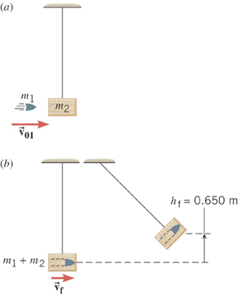
Example: A Ballistic Pendulum
The mass of a block of wood is 2.50-kg and the mass of the bullet is 0.0100-kg. The block swings to a maximum height of 0.650 m above the initial position. Find the initial speed of the bullet. Ignore the resistance from the air and the pivot point.
What kind of collision?
Perfectly inelastic collision
No net external force
➔ momentum conserved
Solve for V₀₁
What do we not know?
Final speed after collision!!
How can we get it?
Using the mechanical energy conservation!

Slide 10
Ex. A Ballistic Pendulum, cnt’d
Now using the mechanical energy conservation
Solve for V_{f}
Using the solution obtained previously, we obtain

Slide 11
Two dimensional Collisions
In two dimension, one needs to use the components of the momenta and apply the momentum conservation to solve physical problems.
v_{1i}
m₁
x-comp.
m₂
y-comp.
v_{1f}
m₁
θ
Consider a system of two particle collisions and scatters in two dimension as shown in the picture. (This is the case at a fixed target accelerator experiment.) The momentum conservation tells us:
Φ
m₂
v_{2f}
And for the elastic collisions, the kinetic energy is conserved:
What do you think we can learn from these relationships?

Slide 12
Example for Two Dimensional Collisions
Proton #1 with a speed 3.50x10⁵ m/s collides elastically with proton #2 initially at rest. After the collision, proton #1 moves at an angle of 37º to the horizontal axis and proton #2 deflects at an angle ϕ to the same axis. Find the final speeds of the two protons and the scattering angle of proton #2, Φ.
v_{1i}
Since both the particles are protons m₁=m₂=m_{p}.
m₁
m₂
Using momentum conservation, one obtains
v_{1f}
x-comp.
m₁
θ
y-comp.
Φ
Canceling m_{p} and putting in all known quantities, one obtains
m₂
v_{2f}
From kinetic energy conservation:
Solving Eqs. 1-3, one gets
Do this at home☺

Slide 13
Center of Mass
We’ve been solving physical problems treating objects as sizeless points with masses but in reality, objects have shapes with masses distributed throughout the body.
The center of mass of a system is the average position of the system’s mass and represents the motion of the system as if all the mass is on this point.
What does above statement tell you concerning the forces being exerted on the system?
The total external force exerted on the system of total mass M causes the center of mass to move at an acceleration given by as if all the mass of the system is concentrated on the center of mass.
Consider a massless rod with two balls attached at either end.
m₁
m₂
x₁
x₂
The position of the center of mass of this system is the mass averaged position of the system
x_{CM}
CM is closer to the heavier object

Slide 14
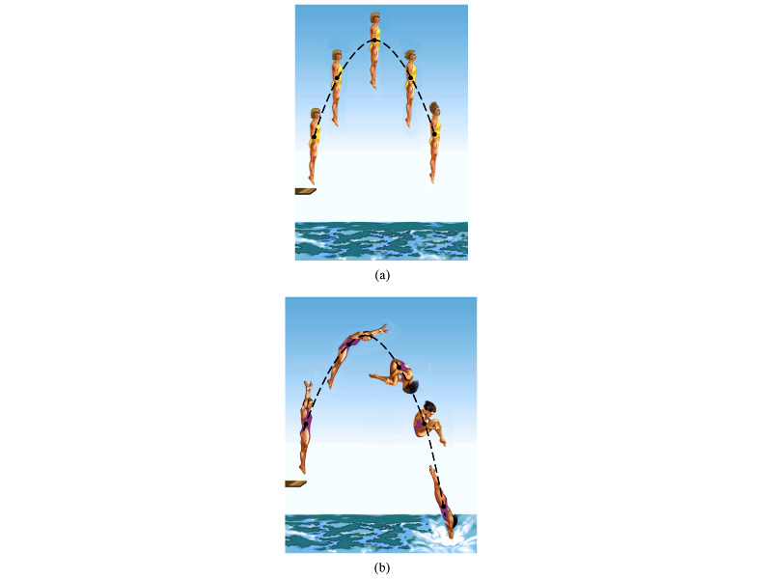
Motion of a Diver and the Center of Mass
A diver performs a simple dive.
The motion of the center of mass follows a parabola since it is a projectile motion.
A diver performs a complicated dive.
The motion of the center of mass still follows the same parabola since it still is a projectile motion.
The motion of the center of mass of the diver is always the same.

Slide 15
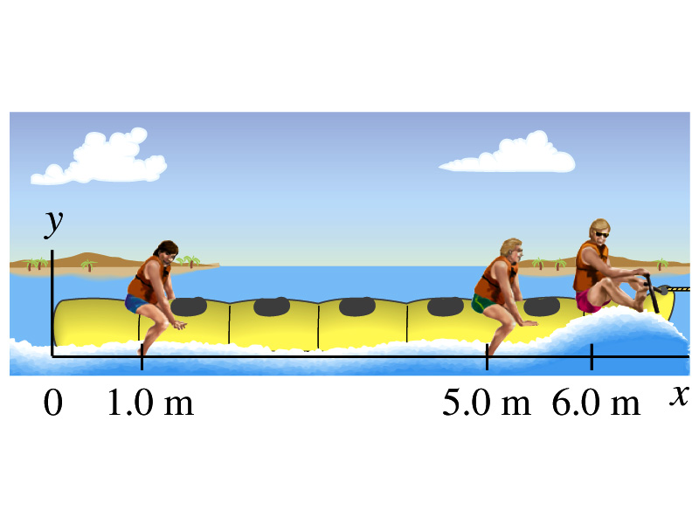
Example for CM
Thee people of roughly equivalent mass M on a lightweight (air-filled) banana boat sit along the x axis at positions x₁=1.0m, x₂=5.0m, and x₃=6.0m. Find the position of CM.
Using the formula for CM

Slide 16
Example for Center of Mass in 2-D
A system consists of three particles as shown in the figure. Find the position of the center of mass of this system.
Using the formula for CM for each position vector component
y=2
m₁
(0,2)
(0.75,1)
r_{CM}
(1,0)
(2,0)
m₂
m₃
x=1
x=2
One obtains
If

Slide 17
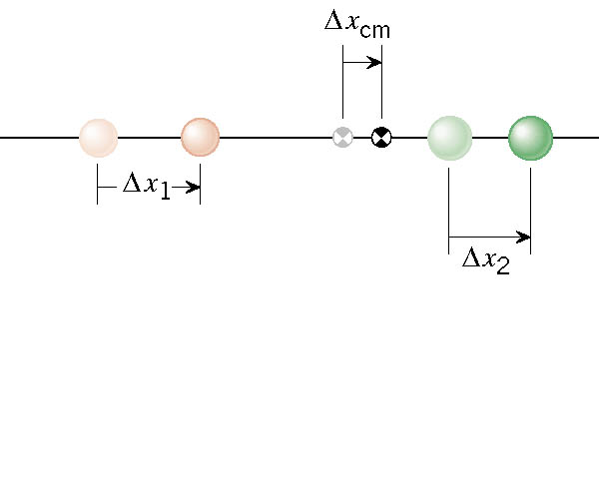
Velocity of the Center of Mass
In an isolated system, the total linear momentum does not change, therefore the velocity of the center of mass does not change.

Slide 18
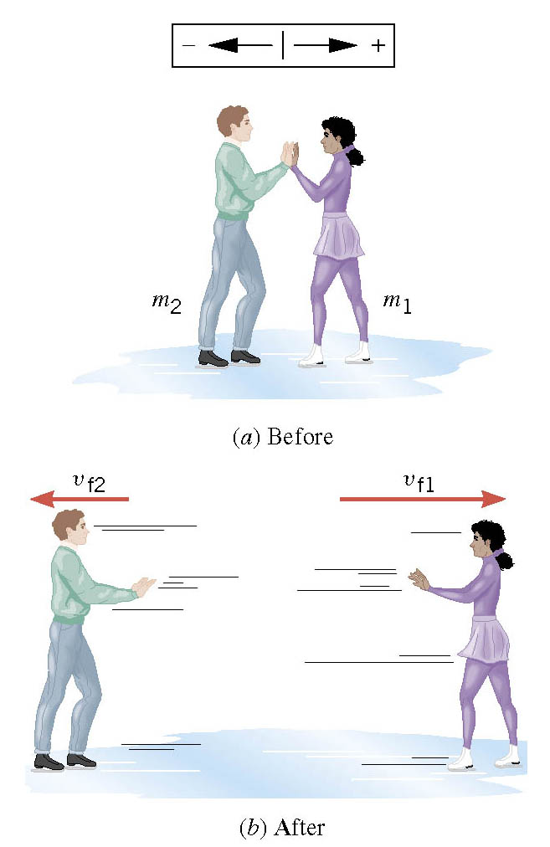
The Ice Skater Problem
Starting from rest, two skaters push off against each other on ice where friction is negligible. One is a 54-kg woman and one is a 88-kg man. The woman moves away with a velocity of +2.5 m/s. Man’s velocity?

Slide 19
Center of Mass of a Rigid Object
The formula for CM can be extended to a system of many particles or a Rigid Object
The position vector of the center of mass of a many particle system is
A rigid body – an object with shape and size with mass spread throughout the body, ordinary objects – can be considered as a group of particles with mass m_{i} densely spread throughout the given shape of the object
Δm_{i}
r_{i}
r_{CM}

Slide 20
Example: CM of a thin rod
Show that the center of mass of a rod of mass M and length L lies in midway between its ends, assuming the rod has a uniform mass per unit length.
L
The formula for CM of a continuous object is
x
Since the density of the rod (λ) is constant;
dx
Δm=λdx
The mass of a small segment
Therefore
Find the CM when the density of the rod non-uniform but varies linearly as a function of x, λ=αx

Slide 21
Center of Mass and Center of Gravity
CM
The center of mass of any symmetric object lies on the axis of symmetry and on any plane of symmetry, if the object’s mass is evenly distributed throughout the body.
Axis of symmetry
One can use gravity to locate CM.
Hang the object by one point and draw a vertical line following a plum-bob.
Hang the object by another point and do the same.
The point where the two lines meet is the CM.
How do you think you can determine the CM of the objects that are not symmetric?
Center of Gravity
Since a rigid object can be considered as a collection of small masses, one can see the total gravitational force exerted on the object as
Δm_{i}
What does this equation tell you?
The net effect of these small gravitational forces is equivalent to a single force acting on a point (Center of Gravity) with mass M.
Δm_{i}g
The CoG is the point in an object as if all the gravitational force is acting on!

Slide 22
Motion of a Group of Particles
We’ve learned that the CM of a system can represent the motion of a system. Therefore, for an isolated system of many particles in which the total mass M is preserved, the velocity, total momentum, acceleration of the system are
Velocity of the system
Total Momentum of the system
Acceleration of the system
The external force acting on the system
What about the internal forces?
System’s momentum is conserved.
If net external force is 0

