Slide 1
PHYS 1443 – Section 003
Lecture #18
Monday, April 19, 2021
Dr. Jaehoon Yu
CH7: Linear Momentum
  Motion of a Group of Objects
CH8: Rotational Motion
  Fundamentals of Rotational Motion
  Rotational Kinematics
  Torque & Vector Product
  Moment of Inertia
Today’s homework is homework #10, due 11pm, Tuesday, May 4!!

Slide 2
Announcements
The skipped homework #9 is due 11pm, Tuesday, April 27!!
Special project #6 deadline extended to next Monday, Apr. 26
2nd non-comprehensive exam results
  Class average: 63.3/102
    Equivalent to 62/100
    Previous results: 77.3/100 and 50.2/100
  Top score: 96/102
Evaluation Policy
  Homework: 25%
  Final exam: 23%
  Mid-term exam: 20%
  One better of the two term exams: 12%
  Lab: 10%
  Quizzes: 10%
  Extra credit: 10%

Slide 3
Center of Mass and Center of Gravity
CM
The center of mass of any symmetric object lies on the axis of symmetry and on any plane of symmetry, if the object’s mass is evenly distributed throughout the body.
Axis of symmetry
One can use gravity to locate CM.
Hang the object by one point and draw a vertical line following a plum-bob.
Hang the object by another point and do the same.
The point where the two lines meet is the CM.
How do you think you can determine the CM of the objects that are not symmetric?
Center of Gravity
Since a rigid object can be considered as a collection of small masses, one can see the total gravitational force exerted on the object as
Δm_{i}
What does this equation tell you?
The net effect of these small gravitational forces is equivalent to a single force acting on a point (Center of Gravity) with mass M.
Δm_{i}g
The CoG is the point in an object as if all the gravitational force is acting on!

Slide 4
Motion of a Group of Particles
We’ve learned that the CM of a system can represent the motion of a system. Therefore, for an isolated system of many particles in which the total mass M is preserved, the velocity, total momentum, acceleration of the system are
Velocity of the system
Total Momentum of the system
Acceleration of the system
The external force acting on the system
What about the internal forces?
System’s momentum is conserved.
If net external force is 0

Slide 5
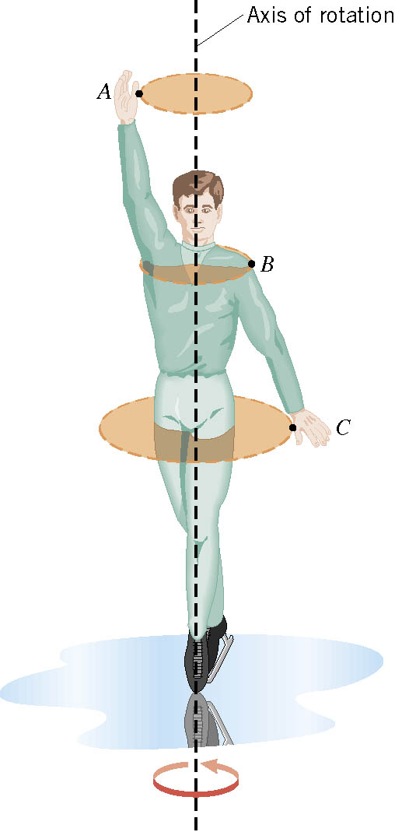
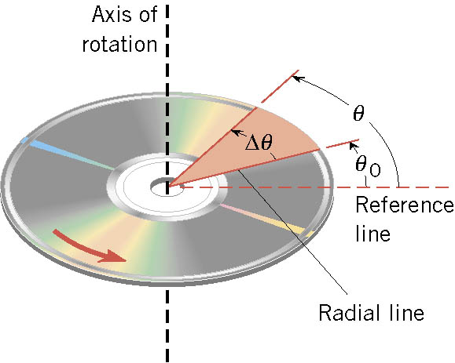
Rotational Motion and Angular Displacement
In the simplest kind of rotation, all points on a rigid object move on circular paths around an axis of rotation.
The angle swept out by the line passing through any point on the body and intersecting the axis of rotation perpendicularly is called the angular displacement.
It’s a vector!! So, there must be a direction… (poll 6)
How do we define directions?
+:if counter-clockwise
-:if clockwise
The direction vector points gets determined based on the right-hand rule.
These are just conventions!!

Slide 6
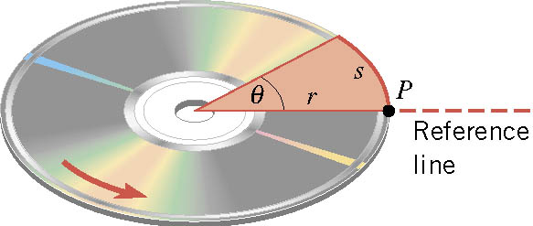

SI Unit of the Angular Displacement
Dimension?
None
For one full revolution:
Since the circumference of a circle is
2πr
One radian is an angle subtended by an arc of the same length as the radius!

Slide 7
Unit of the Angular Displacement
How many degrees are in one radian?
1 radian is
How radians is one degree?
And one degrees is
How many radians are in 10.5 revolutions?
Very important: In solving angular problems, all units, degrees or revolutions, must be converted to radians!

Slide 8
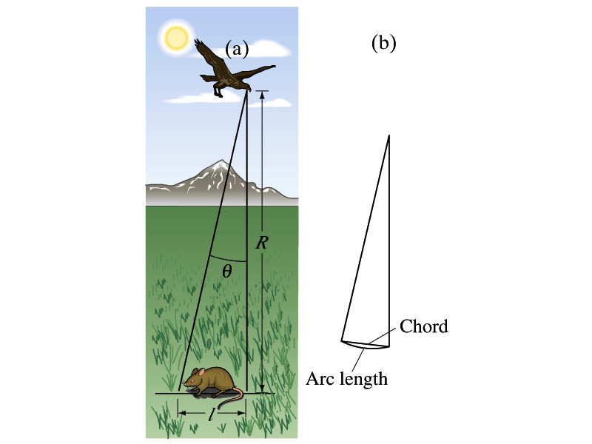
Example
A particular bird’s eyes can distinguish objects that subtend an angle no smaller than about 3x10⁻⁴ rad. (a) How many degrees is this? (b) How small an object can the bird just distinguish when flying at a height of 100m?
(a) One radian is 360º/2π. Thus
(b) Since l=rθ and for small angle arc length is approximately the same as the chord length.

Slide 9
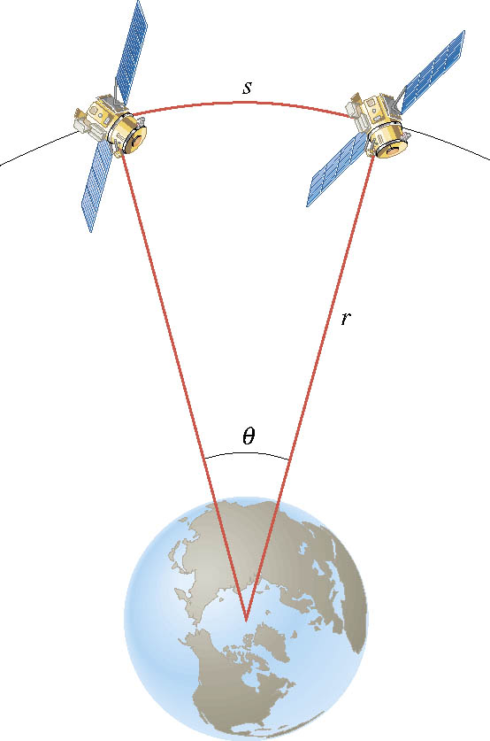
Ex. Adjacent Synchronous Satellites
Synchronous satellites are put into an orbit whose radius is 4.23×10⁷m. If the angular separation of the two satellites is 2.00 degrees, find the arc length that separates them.
What do we need to find out?
The Arc length!!!
Convert degrees to radians

Slide 10
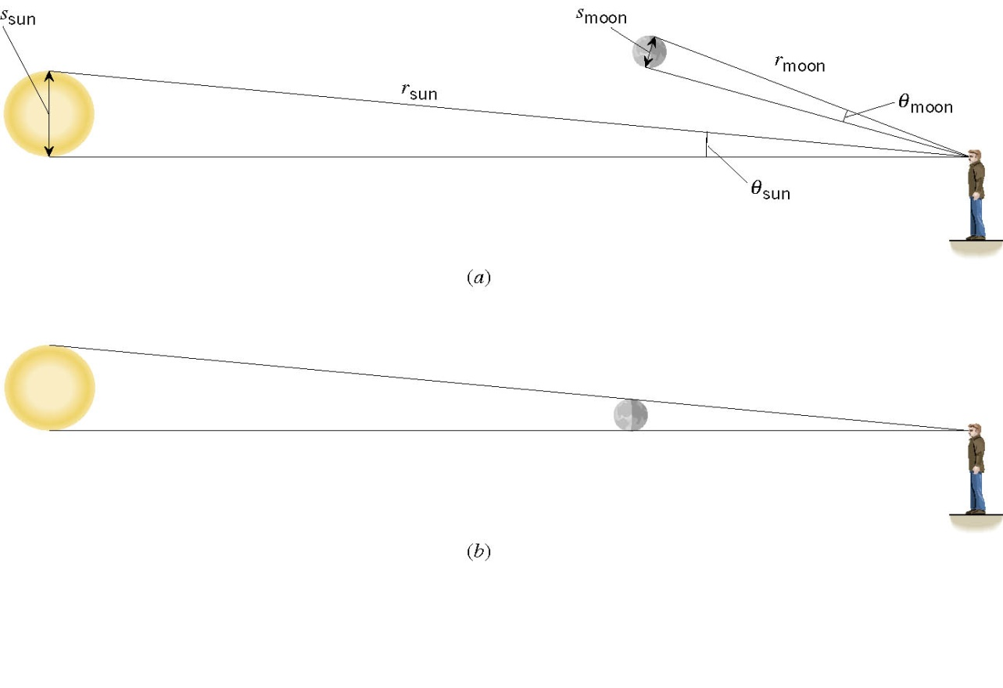
Ex. A Total Eclipse of the Sun
The diameter of the Sun is about 400 times greater than that of the moon. By coincidence, the sun is also about 400 times farther from the earth than is the moon. For an observer on the earth, compare the angle subtended by the moon to the angle subtended by the sun and explain why this result leads to a total solar eclipse.
I can even cover the entire sun with my thumb!! Why?
Because the distance (r) from my eyes to my thumb is far shorter than that to the sun.

Slide 11
Angular Displacement, Velocity, and Acceleration
Using what we have learned earlier, how would you define the angular displacement?
How about the average angular speed?
_{θf}
Unit?
rad/s
Dimension (poll 5)?
[T⁻¹]
_{θi}
And the instantaneous angular speed?
Unit?
rad/s
Dimension (poll 5)?
[T⁻¹]
By the same token, the average angular acceleration is defined as…
Unit?
rad/s²
Dimension (poll 5)?
[T⁻²]
And the instantaneous angular acceleration?
Unit?
rad/s²
When rotating about a fixed axis, every particle on a rigid object rotates through the same angle and has the same angular speed and angular acceleration.

Slide 12
Rotational Kinematics
The first type of motion we have learned in linear kinematics was under the constant acceleration. We will learn about the rotational motion under constant angular acceleration, because these are the simplest motions in both cases.
Just like the case in linear motion, one can obtain
Angular velocity under constant angular acceleration:
Linear kinematics
Angular displacement under constant angular acceleration:
Linear kinematics
One can also obtain
Linear kinematics

Slide 13
Problem Solving Strategy
Visualize the problem by drawing a picture.
Write down the values that are given for any of the five kinematic variables and convert them to SI units.
  Remember that the unit of the angle must be radians!!
Verify that the information contains values for at least three of the five kinematic variables. Select the appropriate equation.
When the motion is divided into segments, remember that the final angular velocity of one segment is the initial velocity for the next.
Keep in mind that there may be two possible answers to a kinematics problem.

Slide 14
Ex. Rotational Kinematics
A wheel rotates with a constant angular acceleration of 3.50 rad/s². If the angular speed of the wheel is 2.00 rad/s at t_{i}=0, a) through what angle does the wheel rotate in 2.00s?
Using the angular displacement formula in the previous slide, one gets

Slide 15
Example for Rotational Kinematics cnt’d
What is the angular speed at t=2.00s?
Using the angular speed and acceleration relationship
Find the angle through which the wheel rotates between t=2.00s and t=3.00s. How many revolution is it?
Using the angular kinematic formula
At t=2.00s
At t=3.00s
Angular displacement

Slide 16
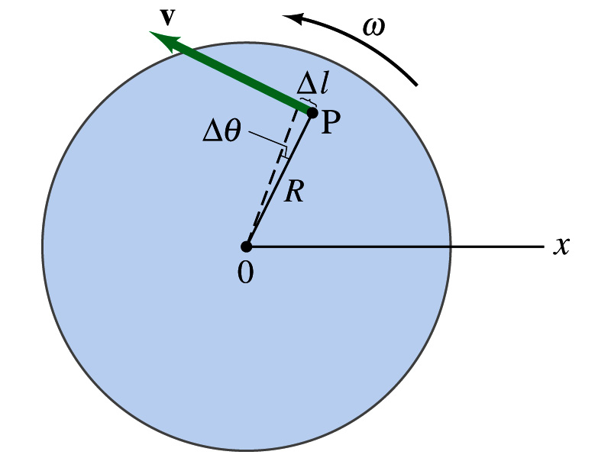
Relationship Between Angular and Linear Quantities
What do we know about a rigid object that rotates about a fixed axis of rotation?
Every particle (or masslet) in the object moves in a circle centered at the same axis of rotation.
When a point rotates, it has both the linear and angular components in its motion.
What is the linear component of the motion you see?
The direction of ω follows the righthand rule.
Linear velocity along the tangential direction.
How do we relate this linear component of the motion with angular component?
The arc-length is
So, the tangential speed v is
What does this relationship tell you about the tangential speed of the points in the object and their angular speed?:
Although every particle in the object has the same angular speed, its tangential speed differs and is proportional to its distance from the axis of rotation.
The farther away the particle is from the center of rotation, the higher the tangential speed.

Slide 17
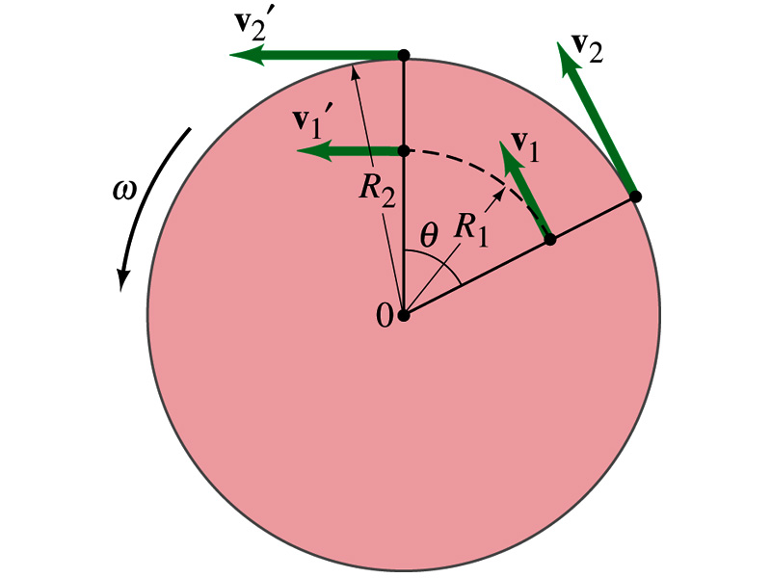
Is the lion faster than the horse?
A rotating carousel has one child sitting on a horse near the outer edge and another on a lion halfway out from the center. (a) Which child has the greater linear speed? (b) Which child has the greater angular speed?
Linear speed is the distance traveled divided by the time interval. So, the child sitting at the outer edge travels more distance within the given time than the child sitting closer to the center. Thus, the horse is faster than the lion.
(b) Angular speed is the angle traveled divided by the time interval. The angle both the children travel in the given time interval is the same. Thus, both the horse and the lion have the same angular speed.

Slide 18
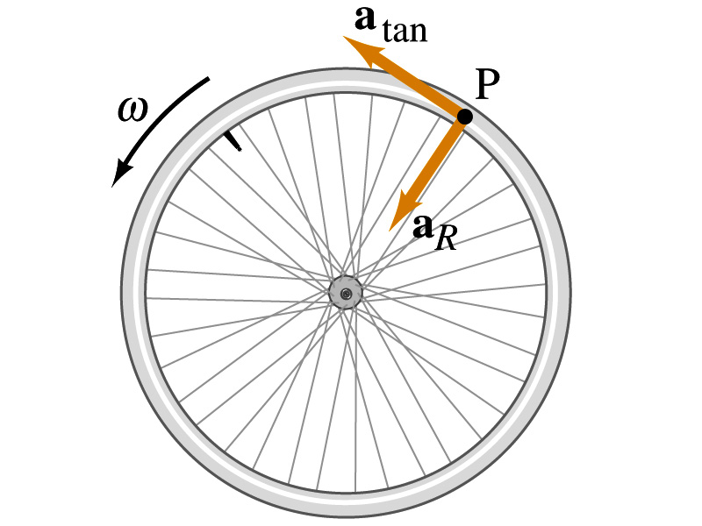
How about the acceleration?
How many different linear acceleration components do you see in a circular motion and what are they?
Two
Tangential, a_{t}, and the radial acceleration, a_{r}.
Since the tangential speed v is
The magnitude of tangential acceleration a_{t} is
What does this relationship tell you?
Although every particle in the object has the same angular acceleration, its tangential acceleration differs proportional to its distance from the axis of rotation.
The radial or centripetal acceleration a_{r} is
What does this tell you?
The father away the particle is from the rotation axis, the more radial acceleration it receives. In other words, it receives more centripetal force.
Total linear acceleration is

