Slide 1
PHYS 1443 – Section 003 Lecture #18
Wednesday, April 21, 2021
Dr. Jaehoon Yu
CH8: Rotational Motion
Relationship Between Rotational and Translational Quantities
Torque & Vector Product
Moment of Inertia
Rotational Kinetic Energy

Slide 2
Announcements
The skipped homework #9 is due 11pm, Tuesday, April 27!!
Quiz #4: next Wednesday, April 28, beginning of the class
Roll call begins at 2:20pm
Covers: CH8.1 to what we finish Monday, Apr. 26
BYOF: You may bring one 8.5x11.5 sheet (front and back) of handwritten formulae and values of constants for the test
No derivations, word definitions, setups or solutions of any problems, figures, pictures, diagrams or arrows, etc!
Must email me the photos of front and back of the formula sheet, including the blank at jaehoonyu@uta.edu no later than 12:00pm the day of the test
The subject of the email should be the same as your file name
File name must be FS-Q4-LastName-FirstName-SP21.pdf
Once submitted, you cannot change, unless I ask you to delete part of the sheet!

Slide 3
Rotational Kinematics and the Relationships between Rotational and Translational Quantities
Angular velocity under constant angular acceleration:
Translational kinematics
Angular displacement under constant angular acceleration:
Translational kinematics
One can also obtain
Translational kinematics
The arc-length is
So, the tangential speed v is
The magnitude of tangential acceleration a_{t} is
The radial or centripetal acceleration a_{r} is
Total linear acceleration is

Slide 4
Example
(a) What is the linear speed of a child seated 1.2m from the center of a steadily rotating merry-go-around that makes one complete revolution in 4.0s? (b) What is her total linear acceleration?
First, figure out what the angular speed of the merry-go-around is.
Using the formula for linear speed
Since the angular speed is constant, there is no angular acceleration.
Tangential acceleration is
Radial acceleration is
Thus the total acceleration is

Slide 5
Example for a Rotational Motion
Audio information on compact discs are transmitted digitally through the readout system consisting of laser and lenses. The digital information on the disc are stored by the pits and flat areas on the track. Since the speed of readout system is constant, it reads out the same number of pits and flats in the same time interval. In other words, the linear speed is the same no matter which track is played. a) Assuming the linear speed is 1.3 m/s, find the angular speed of the disc in revolutions per minute when the inner most (r=23mm) and outer most tracks (r=58mm) are read.
Using the relationship between angular and tangential speed

Slide 6
b) The maximum playing time of a standard music CD is 74 minutes and 33 seconds. How many revolutions does the disk make during that time?
c) What is the total length of the track past through the readout mechanism?
d) What is the angular acceleration of the CD over the 4473s time interval, assuming constant α?

Slide 7
Torque
Torque is the tendency of a force to rotate an object about an axis. Torque, τ, is a vector quantity.
F
Consider an object pivoting about the point P by the force F being exerted at a distance r from P.
φ
r
The line of Action
The line that extends out of the tail of the force vector is called the line of action.
P
l₂
l₁
The perpendicular distance from the pivoting point P to the line of action is called the moment arm.
F₂
Moment arm
Magnitude of the torque is defined as the product of the force exerted on the object to rotate it and the moment arm.
When there are more than one force exerting on certain points of an object, one can sum up the torque generated by each force vectorially. The convention for the sign of the torque is positive if rotation is in counter-clockwise and negative if clockwise.
Unit?

Slide 8
Ex. Torque
A one-piece cylinder is shaped as in the figure with core section protruding from the larger drum. The cylinder is free to rotate around the central axis shown in the picture. A rope wrapped around the drum whose radius is R₁ exerts force F₁ to the right on the cylinder, and another force exerts F₂ on the core whose radius is R₂ downward on the cylinder. A) What is the net torque acting on the cylinder about the rotation axis?
R₁
F₁
The torque due to F₁
and due to F₂
R₂
So the total torque acting on the system by the forces is
F₂
Suppose F₁=5.0 N, R₁=1.0 m, F₂= 15.0 N, and R₂=0.50 m. What is the net torque about the rotation axis and which way does the cylinder rotate from the rest?
Using the above result
The cylinder rotates in counter-clockwise.

Slide 9
Torque and Vector Product
z
Let’s consider a disk fixed onto the origin O and the force F exerts on the point p. What happens?
τ=rxF
The disk will start rotating counterclockwise about the Z axis
O
y
r
p
The magnitude of the torque given to the disk by the force F is
θ
F
x
But torque is a vector quantity, what is the direction? How is torque expressed mathematically?
What is the direction?
The direction of the torque follows the right-hand rule!!
The above operation is called the Vector product or Cross product
What is the result of a vector product?
What is another vector operation we’ve learned?
Another vector
Scalar product
Result? A scalar

Slide 10
Properties of the Vector Product
Vector Product is Non-commutative
What does this mean?
If the order of operation changes the result changes
Following the right-hand rule, the direction changes
Vector Product of two parallel vectors is 0.
Thus,
If two vectors are perpendicular to each other
Vector product follows distribution law
The derivative of a Vector product with respect to a scalar variable is

Slide 11
More Properties of Vector Product
The relationship between unit vectors,
Vector product of two vectors can be expressed in the following determinant form

Slide 12
Moment of Inertia
Rotational Inertia:
The measure of resistance of an object against changes in its rotational motion. Equivalent to mass in translational motion.
For a group of particles
For a rigid body
What are the dimension and unit of Moment of Inertia?
Determining Moment of Inertia is extremely important for computing equilibrium of a rigid body, such as a building.
Dependent on the axis of rotation!!!

Slide 13
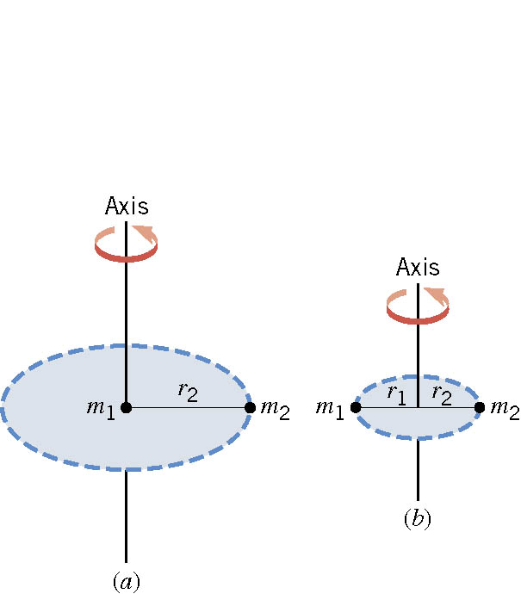
Ex. The Moment of Inertia Depends on Where the Axis Is.
Two particles each have mass m₁ and m₂ and are fixed at the ends of a thin rigid rod. The length of the rod is L. Find the moment of inertia when this object rotates relative to an axis that is perpendicular to the rod at (a) one end and (b) the center.
(a)
Which case is easier to spin?
(b)
Case (b)
Why?
Because the moment of inertia is smaller

