Slide 1
PHYS 1443 – Section 003 Lecture #19
Monday, April 26, 2021
Dr. Jaehoon Yu
CH8: Rotational Motion
Rotational Kinetic Energy
Calculation of Moment of Inertia
Parallel Axis Theorem.
Torque and the Angular Acceleration
Rolling Motion of a Rigid Body
Rolling Kinetic Energy
Work, Power and Energy in Rotation
Today’s homework is homework #11, due 11pm, Saturday, Mar. 8!!

Slide 2
Announcements
Final comprehensive exam: 2 – 4:30pm, Monday, May 10 on Quest
Covers CH1.1 through what we finish next Wednesday, May 5 + math refresher
Quiz #4 on Quest: this Wednesday, April 28, beginning of the class
Roll call begins at 2:20pm
Covers: CH8.1 to what we finish today, Monday, Apr. 26 (CH8.7)
BYOF: You may bring one 8.5x11.5 sheet (front and back) of handwritten formulae and values of constants for the test
No derivations, word definitions, setups or solutions of any problems, figures, pictures, diagrams or arrows, etc!
Must email me the photos of front and back of the formula sheet, including the blank at jaehoonyu@uta.edu no later than 12:00pm the day of the test
The subject of the email should be the same as your file name
File name must be FS-Q4-LastName-FirstName-SP21.pdf
Once submitted, you cannot change, unless I ask you to delete part of the sheet!
Please fill and submit the feedback survey ASAP

Slide 3
Relationships between Rotational and Translational Quantities & Some Rotational Quantities
The arc-length is
So, the tangential speed v at the position r from the rotational axis is
The magnitude of tangential acceleration a_{t} at the position r from the rotational axis is
The radial or centripetal acceleration a_{r} at the position r from the rotational axis is
Total linear acceleration at the position r from the rotational axis is
Torque
Moment of Inertia

Slide 4
Rotational Kinetic Energy
y
v_{i}
What do you think the kinetic energy of a rigid object undergoing a rotational motion is?
m_{i}
r_{i}
θ
Kinetic energy of a masslet, m_{i}, moving at a tangential speed, v_{i}, is
O
x
Since a rigid body is a continuous collection of masses, the total kinetic energy of a rigid object is
Since moment of Inertia, I, is defined as
The above expression is simplified as

Slide 5
Example for Moment of Inertia
In a system of four small spheres as shown in the figure, assuming the radii are negligible and the rods connecting the particles are massless, compute the moment of inertia and the rotational kinetic energy when the system rotates about the y-axis at angular speed ω.
y
m
Since the rotation is about y axis, the moment of inertia about y axis, I_{y}, is
b
l
l
M
O
M
x
b
This is because the rotation is done about y axis, and the radii of the spheres are negligible.
Why are some 0s?
m
Thus, the rotational kinetic energy is
Find the moment of inertia and rotational kinetic energy when the system rotates on the x-y plane about the z-axis that goes through the origin O.

Slide 6
Calculation of Moments of Inertia
The moment of inertia for a large rigid object can be computed, if we assume the object consists of small volume elements with mass, Δm_{i}.
The moment of inertia for the large rigid object is
It is sometimes easier to compute moments of inertia in terms of the volume of the elements rather than their mass
How can we do this?
Using the volume density, ρ, replace dm in the above equation with dV.
The moments of inertia becomes
Example: Find the moment of inertia of a uniform hoop of mass M and radius R about an axis perpendicular to the plane of the hoop and passing through its center.
y
The moment of inertia is
dm
O
R
The moment of inertia for this object is the same as that of a point of mass M at the distance R.
x
What do you notice from this result?

Slide 7
Ex. Rigid Body Moment of Inertia
Calculate the moment of inertia of a uniform rigid rod of length L and mass M about an axis perpendicular to the rod and passing through its center of mass.
y
The line density of the rod is
so the mass of a masslet is
dx
x
The moment of inertia is
x
L
What is the moment of inertia when the rotational axis is at one end of the rod?
Will this be the same as the above? Why or why not?
Since the moment of inertia is resistance to motion, it makes perfect sense for it to be harder to move when it is rotating about the axis at one end.

Slide 8
Parallel Axis Theorem
Moments of inertia for a highly symmetric object is easy to compute if the rotational axis is the same as the axis of symmetry. However, even if the axis of rotation does not coincide with axis of symmetry, the calculation can still be done in a simple manner using the parallel-axis theorem.
y
Moment of inertia is defined as
(x,y)
Since x and y are
One can substitute x and y in Eq. 1 to obtain
y’
r
y
CM
(x_{CM,}y_{CM})
y_{CM}
D
Since x’ and y’ are the distance from CM, by definition
x_{CM}
x’
x
Therefore, the parallel-axis theorem
x
What does this theorem tell you?
The moment of inertia of any object about any arbitrary axis is the same as the sum of moment of inertia for a rotation about the CM and that of the CM about the rotation axis.

Slide 9
Example for Parallel Axis Theorem
Calculate the moment of inertia of a uniform rigid rod of length L and mass M about an axis that goes through one end of the rod, using parallel-axis theorem.
y
The line density of the rod is
so the mass of a masslet is
CM
dx
x
The moment of inertia about the CM
x
L
Using the parallel axis theorem
The result is the same as using the definition of moment of inertia.
Parallel-axis theorem is useful to compute the moment of inertia for a rotation of a rigid object with complicated shape about any arbitrary axis

Slide 10
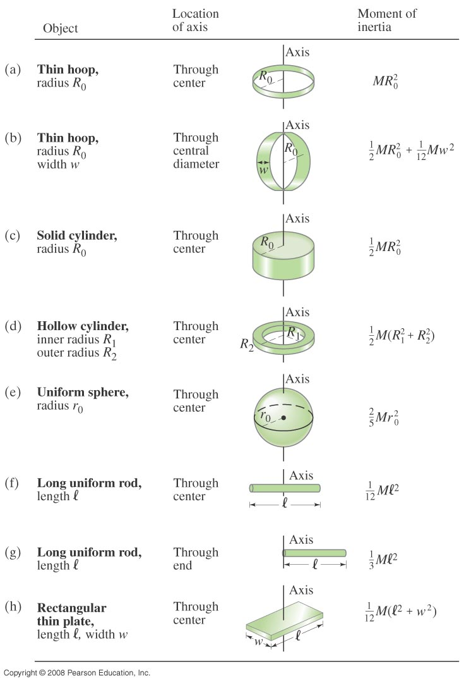
Check out Table 10 – 2 for moment of inertia for various shaped objects

Slide 11
Torque & Angular Acceleration
Let’s consider a point object with mass m rotating on a horizontal circle.
F_{t}
m
What are the forces you see in this motion?
r
F_{r}
The tangential force F_{t} and the radial force F_{r}
The tangential force F_{t} is
The torque due to tangential force F_{t} is
What do you see from the above relationship?
What does this mean?
The torque acting on a particle is proportional to the angular acceleration.
What law do you see from this relationship?
Analogs to Newton’s 2nd law of motion in rotation.
How about a rigid object?
The external tangential force δF_{t} is
δF_{t}
δm
The torque due to tangential force F_{t} is
The total torque is
r
What is the contribution due to radial force and why?
Contribution from radial force is 0, because its line of action passes through the pivoting point, making the moment arm 0.
O

Slide 12
Rolling Motion of a Rigid Body
What is a rolling motion?
A more generalized case of a motion where the rotational axis moves together with an object
A rotational motion about a moving axis
To simplify the discussion
Limit our discussion on very symmetric objects, such as cylinders, spheres, etc
Assume that the object rolls on a flat surface
Let’s consider a cylinder rolling on a flat surface, without slipping.
Under what condition does this “Pure Rolling” happen?
The total linear distance the CM of the cylinder moved is
Thus, the linear speed of the CM is
R
θ
s
s=Rθ
The condition for a “Pure Rolling motion”

Slide 13
More Rolling Motion of a Rigid Body
The magnitude of the linear acceleration of the CM is
As we learned in rotational motion, all points in a rigid body moves at the same angular speed but at different linear speeds.
P’
2v_{CM}
CM
v_{CM}
CM is moving at the same speed at all time.
P
At any given time, the point that comes to P has 0 linear speed while the point at P’ has twice the speed of CM
Why??
A rolling motion can be interpreted as the sum of Translation and Rotation
v_{CM}
v=Rω
2v_{CM}
P’
P’
P’
CM
+
CM
=
CM
v_{CM}
v=0
v_{CM}
P
v=Rω
P
P
v_{CM}

Slide 14
Kinetic Energy of a Rolling Sphere
R
Let’s consider a sphere with radius R rolling down the hill without slipping.
h
x
ω
θ
v_{CM}
Since v_{CM}=Rω
What is the speed of the CM in terms of known quantities and how do you find this out?
Since the kinetic energy at the bottom of the hill must be equal to the potential energy at the top of the hill

Slide 15
Ex: Rolling Kinetic Energy
For a solid sphere as shown in the figure, calculate the linear speed of the CM at the bottom of the hill and the magnitude of linear acceleration of the CM. Solve this problem using Newton’s second law, the dynamic method.
n
What are the forces involved in this motion?
f
y
Gravitational Force,
Frictional Force,
Normal Force
M
h
x
Newton’s second law applied to the CM gives
x
Mg
θ
Since the forces Mg and n go through the CM, their moment arm is 0 and do not contribute to torque, while the static friction f causes torque
We know that
We obtain
Substituting f in the dynamic equations

