Slide 1
PHYS 1443 – Section 003
Lecture #20
Wednesday, April 28, 2021
Dr. Jaehoon Yu
CH8: Rotational Motion
  Work, Power and Energy in Rotation
  Angular Momentum and Torque
  Angular Momentum Conservation
CH9: Equilibrium
  Conditions for Equilibrium

Slide 2
Announcements
The final comprehensive exam:
  2 – 4:30pm, Monday, May 10 on Quest
  Roll call begins at 1:45pm on Monday, May 10!
  Do not miss the exam. You will get an F!
  Covers CH1.1 through what we finish next Monday, May 3 + math refresher
    No class on May 5
  BYOF: You may bring one 8.5x11.5 sheet (front and back) of handwritten formulae and values of constants for the test
  No derivations, word definitions, setups or solutions of any problems, figures, pictures, diagrams or arrows, etc!
  Must email me the photos of front and back of the formula sheet, including the blank at jaehoonyu@uta.edu no later than 11:00am the day of the test
    The subject of the email should be the same as your file name
    File name must be FS-E4-LastName-FirstName-SP21.pdf
    Once submitted, you cannot change, unless I ask you to delete part of the sheet!
Please fill and submit the feedback survey ASAP

Slide 3
Work, Power, and Energy in Rotation
F
Let’s consider the motion of a rigid body with a single external force F exerting on the point P, moving the object by Δs.
Fsinφ
φ
Δs
The work done by the force F as the object rotates through the infinitesimal distance Δs=rΔθ is
Δθ
r
Fcosφ
O
What is Fsinϕ?
The tangential component of the force F.
What is the work done by radial component Fcosϕ?
Zero, because it is perpendicular to the displacement.
Since the magnitude of torque is rFsinϕ,
How was the power defined in linear motion?
The rate of work, or power, becomes
The rotational work done by an external force equals the change in rotational Kinetic energy.
The work put in by the external force then
Work-kinetic Energy Theorem

Slide 4
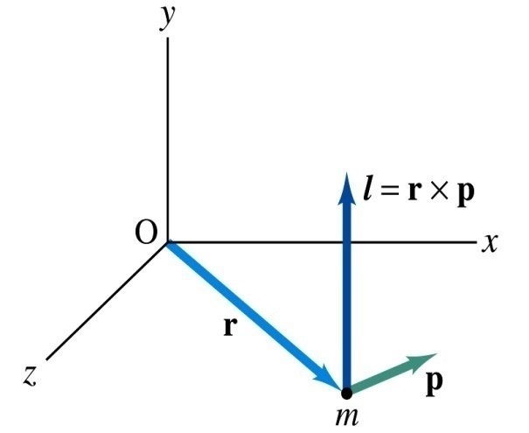
Angular Momentum of a Particle
If you grab onto a pole while running, your body will rotate about the pole, gaining angular momentum. We’ve used the linear momentum to solve physical problems with linear motions, the angular momentum will do the same for rotational motions.
z
Let’s consider a point-like object ( particle) with mass m located at the vector location r and moving with linear velocity v
The angular momentum L of this particle relative to the origin O is
y
What is the unit and dimension of angular momentum?
x
Note that L depends on origin O.
Why?
Because r changes
What else do you learn?
The direction of L is +z.
Since p is mv, the magnitude of L becomes
What do you learn from this?
If the direction of linear velocity points to the origin of rotation, the particle does not have any angular momentum.
If the linear velocity is perpendicular to position vector, the particle moves exactly the same way as a point on a rim.

Slide 5
Angular Momentum and Torque
Can you remember how net force exerting on a particle and the change of its linear momentum are related?
Total external forces exerting on a particle is the same as the change of its linear momentum.
The same analogy works in rotational motion between torque and angular momentum.
Net torque acting on the particle is
z
L=rxp
O
y
Why does this work?
Because v is parallel to the linear momentum
r
m
φ
p
x
Thus the torque-angular momentum relationship
The net torque acting on a particle is the same as the time rate change of its angular momentum

Slide 6
Angular Momentum of a System of Particles
The total angular momentum of a system of particles about some point is the vector sum of the angular momenta of the individual particles
Since the individual angular momentum can change, the total angular momentum of the system can change.
Both internal and external forces can provide torque to individual particles. However, the internal forces do not generate net torque due to Newton’s third law.
Let’s consider a two particle system where the two exert forces on each other.
Since these forces are the action and reaction forces with directions lie on the line connecting the two particles, the vector sum of the torque from these two becomes 0.
Thus, the time rate change of the angular momentum of a system of particles is equal to only the net external torque acting on the system

Slide 7
Angular Momentum Vector
A particle of mass m is moving on the xy plane in a circular path of radius r and linear velocity v about the origin O. Find the magnitude and the direction of the angular momentum with respect to O.
y
Using the definition of angular momentum
v
r
Since both the vectors, r and v, are on x-y plane and using right-hand rule, the direction of the angular momentum vector is +z (coming out of the screen)
O
x
The magnitude of the angular momentum is
So the angular momentum vector can be expressed as
Find the angular momentum in terms of angular velocity ω.
Using the relationship between linear and angular speed

Slide 8
Angular Momentum of a Rotating Rigid Body
z
Let’s consider a rigid body rotating about a fixed axis
L=rxp
Each particle of the object rotates in the xy plane about the z-axis at the same angular speed, ω
O
y
Magnitude of the angular momentum of a particle of mass m_{i} about origin O is m_{i}v_{i}r_{i}
r
m
φ
p
x
Summing over all particles’ angular momenta about z axis
What do you see?
Since I is constant for a rigid body
α is the angular acceleration
Thus, the torque-angular momentum relationship becomes
The net external torque acting on a rigid body rotating about a fixed axis is equal to the moment of inertia about that axis multiplied by the object’s angular acceleration with respect to that axis.

Slide 9
Example for Rigid Body Angular Momentum
A rigid rod of mass M and length l is pivoted without friction at its center. Two particles of mass m₁ and m₂ are attached to either end of the rod. The combination rotates on a vertical plane with an angular speed of ω. Find the expression for the magnitude of the angular momentum.
y
The moment of inertia of this system is
m₂
l
m₂ g
θ
O
x
m₁
Find the expression for the magnitude of the angular acceleration of the system when the rod makes an angle θ with the horizon.
m₁ g
If m₁ = m₂, no angular momentum because the net torque is 0.
If θ=+/−π/2, at equilibrium so no angular momentum.
First compute the net external torque
Thus, α becomes

Slide 10
Conservation of Angular Momentum
Remember under what condition the linear momentum is conserved?
Linear momentum is conserved when the net external force is 0.
By the same token, the angular momentum of a system is constant in both magnitude and direction, if the resultant external torque acting on the system is 0.
What does this mean?
Angular momentum of the system before and after a certain change is the same.
Three important conservation laws for isolated system that does not get affected by external forces
Mechanical Energy
Linear Momentum
Angular Momentum

Slide 11
Ex. Neutron Star
A star rotates with a period of 30 days about an axis through its center. After the star undergoes a supernova explosion, the stellar core which had a radius of 1.0x10⁴km collapses into a neutron star of radius 3.0km. Determine the period of rotation of the neutron star.
What is your guess about the answer?
The period will be significantly shorter, because its radius got smaller.
Let’s make some assumptions:
There is no external torque acting on it
The shape remains spherical
Its mass remains constant
Using angular momentum conservation
The angular speed of the star with the period T is
Thus

Slide 12
Kepler’s Second Law and Angular Momentum Conservation
Consider a planet of mass M_{p} moving around the Sun in an elliptical orbit.
Since the gravitational force acting on the planet is always toward radial direction, it is the central force.
D
r
A
S
dr
Therefore, the torque acting on the planet by this force is always 0.
B
C
Since torque is the time rate change of angular momentum L, the angular momentum is constant.
Because the gravitational force exerted on a planet by the Sun results in no torque, the angular momentum L of the planet is constant.
Since the area swept by the motion of the planet is
This is Keper’s second law which states that the radius vector from the Sun to a planet sweeps out equal areas in equal time intervals.

Slide 13
Similarity Between Linear and Rotational Motions
All physical quantities in linear and rotational motions show striking similarity.
Quantities | Linear | Rotational
Mass | Mass | Moment of Inertia
Length of motion | Distance | Angle (Radian)
Speed
Acceleration
Force | Force | Torque
Work | Work | Work
Power
Momentum
Kinetic Energy | Kinetic | Rotational

