Slide 1
PHYS 1443 – Section 003 Lecture #21
Monday, May 3, 2021
Dr. Jaehoon Yu
CH9: Static Equilibrium
Conditions for Equilibrium
Elastic Properties of Solids
CH10: Fluids
Density and Specific Gravity
Variation of Pressure and Depth
Pascal’s Principle

Slide 2
Announcements
Reading assignments: CH 9.5, 9.6 and 9.7
The final comprehensive exam:
2 – 4:30pm, Monday, May 10 on Quest
Roll call begins at 1:45pm on Monday, May 10!
Covers CH1.1 through CH10.5 + math refresher
No class this Wednesday, May 5
BYOF: You may bring one 8.5x11.5 sheet (front and back) of handwritten formulae and values of constants for the test
No derivations, word definitions, setups or solutions of any problems, figures, pictures, diagrams or arrows, etc!
Must email me the photos of front and back of the formula sheet, including the blank at jaehoonyu@uta.edu no later than 11:00am the day of the test
The subject of the email should be the same as your file name
File name must be FS-E4-LastName-FirstName-SP21.pdf
Once submitted, you cannot change, unless I ask you to delete part of the sheet!
Please fill out and submit the feedback survey ASAP (only 30!)

Slide 3
Conditions for Equilibrium
What do you think the term “An object is at its equilibrium” means?
Either the object is at rest (Static Equilibrium) or its center of mass is moving at a constant velocity (Dynamic Equilibrium).
When do you think an object is at its equilibrium?
Translational Equilibrium: Equilibrium in linear motion
Is this it?
The above condition is sufficient for a point-like object to be at its translational equilibrium. However, for an object with size this is not sufficient. One more condition is needed. What is it?
Let’s consider two forces equal in magnitude but in opposite direction acting on a rigid object as shown in the figure. What do you think will happen?
F
d
CM
The object will rotate about the CM. Since the net torque acting on the object about a rotational axis is not 0.
d
-F
For an object to be at its static equilibrium, the object should not have linear or angular speed.

Slide 4
More on Conditions for Equilibrium
To simplify the problem, we will only deal with forces acting on x-y plane, giving torque only along z-axis. What do you think the conditions for equilibrium be in this case?
The six possible equations from the two vector equations turns to three equations.
AND
What happens if there are many forces exerting on an object?
If an object is at its translational static equilibrium, and if the net torque acting on the object is 0 about one axis, the net torque must be 0 about any arbitrary axis.
F₁
F₂
O
r’
r₅
O’
F₃
F₅
Why is this true?
F₄
Because the object is not moving, no matter what the rotational axis is, there should not be any motion. It is simply a matter of mathematical manipulation.

Slide 5
How do we solve a static equilibrium problem?
Select the object to which the equations for equilibrium are to be applied.
Identify all the forces and draw a free-body diagram with them indicated on it & with their directions and locations properly indicated
Choose a convenient set of x and y axes and write down the force equation for each x and y component with correct signs.
Establish the equations that specify the balance of forces at equilibrium. Set the net force in the x and y directions equal to 0.
Select the most optimal rotational axis for torque calculations ➔ Selecting the axis such that the torque from one or more of the unknown forces become 0 makes the problem much easier to solve.
Establish the torque equation with proper signs.
Solve the force and torque equations for the desired unknown quantities.

Slide 6
Example for Mechanical Equilibrium
A uniform 40.0 N board supports the father and the daughter each weighing 800 N and 350 N, respectively, and is not moving. If the support (or fulcrum) is under the center of gravity of the board, and the father is 1.00 m from the center of gravity (CoG), what is the magnitude of the normal force n exerted on the board by the support?
1m
x
Since there is no linear motion, this system is in its translational equilibrium
n
F
D
M_{F}g
M_{D}g
M_{B}g
Therefore, the magnitude of the normal force
Determine where the child should sit to balance the system.
The net torque about the fulcrum by all the forces are
Therefore, to balance the system the daughter must sit at

Slide 7
Example for Mech. Equilibrium Cont’d
Determine the position of the child to balance the system for different position of axis of rotation.
Rotational axis
1m
x
n
x/2
F
D
M_{F}g
M_{F}g
The net torque about the axis of rotation by all the forces are
M_{B}g
Since the normal force is
The net torque can be rewritten
What do we learn?
Therefore
No matter where the rotation axis is, net effect of the torque is identical.

Slide 8
Ex. Human Forearm
A person holds a 50.0N sphere in his hand. The forearm is horizontal. The biceps muscle is attached 3.00 cm from the joint, and the sphere is 35.0cm from the joint. Find the upward force exerted by the biceps on the forearm and the downward force exerted by the upper arm, acting on the joint. Neglect the weight of the forearm.
Since the system is in equilibrium, from the translational equilibrium condition
F_{B}
d
O
F_{U}
l
mg
From the rotational equilibrium condition
Thus, the force exerted by the biceps muscle is
Force exerted by the upper arm is

Slide 9
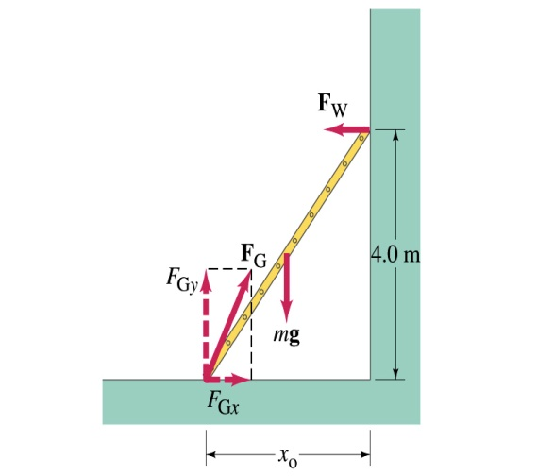
Example: Ladder Balance
A 5.0 m long ladder leans against a wall at a point 4.0m above the ground. The ladder is uniform and has mass 12.0kg. Assuming the wall is frictionless (but ground is not), determine the forces exerted on the ladder by the ground and the wall.
F_{W}
First the translational equilibrium, using components
FBD
F_{Gy}
mg
O
F_{Gx}
Thus, the y component of the force by the ground is
The length x₀ is, from Pythagorian theorem

Slide 10
Example cont’d
From the rotational equilibrium
Thus, the force exerted on the ladder by the wall is
The x component of the force by the ground is
Solve for F_{Gx}
Thus, the force exerted on the ladder by the ground is
The angle between the ground force to the floor

Slide 11
Elastic Properties of Solids
We have been assuming that the objects do not change their shapes when external forces are exerting on it. It this realistic?
No. In reality, objects get deformed as external forces act on it, though the internal forces resist the deformation as it takes place.
Deformation of solids can be understood in terms of Stress and Strain
Stress: The amount of the deformation force per unit area the object is subjected
Strain: The measure of the degree of deformation
It is empirically known that for small stresses, strain is proportional to stress
The constants of proportionality are called the Elastic Modulus
Three types of Elastic Modulus
Young’s modulus: The measure of the elasticity in length
Shear modulus: The measure of the elasticity in area
Bulk modulus: The measure of the elasticity in volume

Slide 12
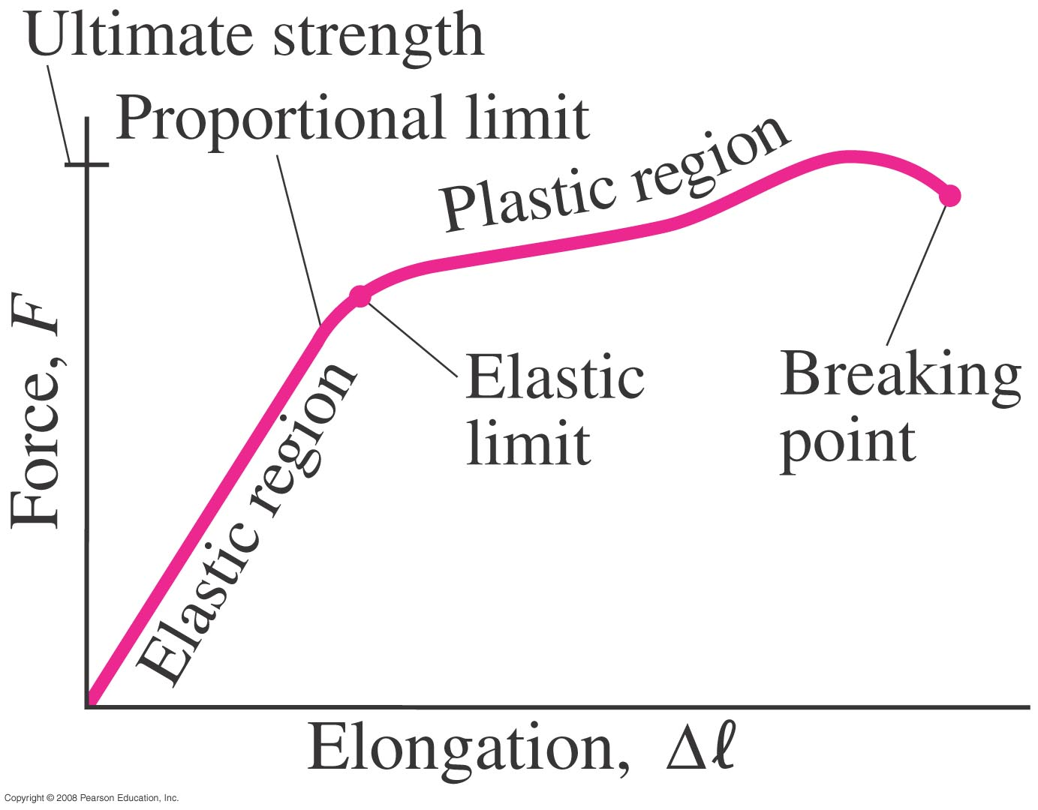
Elastic Limit and Ultimate Strength
The elastic limit: The limit of elasticity beyond which an object cannot recover its original shape or the maximum stress that can be applied to a substance before it becomes permanently deformed
The ultimate strength: The maximum force that can be applied on the object before breaking it

Slide 13
Young’s Modulus
Let’s consider a long bar with cross sectional area A and initial length L_{i}.
L_{i}
After the stretch
L_{f}=L_{i}+ΔL
F_{ex}
F_{ex}
F_{in}
A:cross sectional area
F_{ex}=F_{in}
Tensile stress
Tensile strain
Used to characterize a rod or wire stressed under tension or compression
Young’s Modulus is defined as
What is the unit of Young’s Modulus?
Force per unit area
Experimental Observations
For a fixed external force, the change in length is proportional to the original length
The necessary force to produce the given strain is proportional to the crosssectional area

Slide 14
Bulk Modulus
Bulk Modulus characterizes the response of a substance to uniform squeezing or reduction of pressure.
F
V
After the pressure change
F
V’
F
F
Volume stress =pressure
If the pressure on an object changes by ΔP=ΔF/A, the object will undergo a volume change ΔV.
Bulk Modulus is defined as
Because the change of volume is reverse to change of pressure.
Compressibility is the reciprocal of Bulk Modulus

Slide 15
Example for Solid’s Elastic Property
A solid brass sphere is initially under normal atmospheric pressure of 1.0x10⁵N/m². The sphere is lowered into the ocean to a depth at which the pressures is 2.0x10⁷N/m². The volume of the sphere in air is 0.5m³. By how much its volume change once the sphere is submerged?
Since bulk modulus is
The amount of volume change is
From table 12.1, bulk modulus of brass is 8.0x10¹⁰ N/m²
The pressure change ΔP is
Therefore the resulting volume change ΔV is
The volume has decreased.

Slide 16
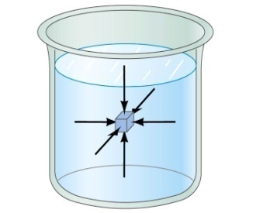
Fluid and Pressure
What are the three phases of matter?
Solid, Liquid and Gas
How do you distinguish them?
Using the time it takes for a particular substance to change its shape in reaction to external forces.
What is a fluid?
A collection of molecules that are randomly arranged and loosely bound by the force between them or by an external container.
We will first learn about mechanics of fluid at rest, fluid statics.
In what ways do you think fluid exerts stress on an object submerged in it?
Fluid cannot exert shearing or tensile stress. Thus, the only force the fluid exerts on an object immersed in it is the force perpendicular to the surface of the object.
This force by the fluid on an object usually is expressed in the form of the force per unit area at the given depth, or the pressure, defined as
Expression of pressure for an infinitesimal area dA by the force dF is
Note that pressure is a scalar quantity because it’s the magnitude of the force on surface area A.
What is the unit and the dimension of pressure?
Unit:N/m²
Dim.: [M][L⁻¹][T⁻²]
Special SI unit for pressure is Pascal

Slide 17
Density and Specific Gravity
Density, ρ(rho), of an object is defined as mass per unit volume
Unit?
Dimension?
Specific gravity of a substance is defined as the ratio of the density of the substance to that of the water at 4.0 ºC (ρ_{H2O}=1.00g/cm³).
Unit?
None
Dimension?
None
What do you think would happen of a substance in the water dependent on SG?
Sink in the water
Float on the surface

Slide 18
Example for Pressure
The mattress of a waterbed is 2.00m long by 2.00m wide and 30.0cm deep. a) Find the weight of the water in the mattress.
The volume density of water at the normal condition (4ºC and 1 atm) is 1000kg/m³. So, the total mass of the water in the mattress is
Therefore, the weight of the water in the mattress is
b) Find the pressure exerted by the water on the floor when the bed rests in its normal position, assuming the entire lower surface of the mattress makes a contact with the floor.
Since the surface area of the mattress is 4.00 m², the pressure exerted on the floor is

Slide 19
Variation of Pressure and Depth
Water pressure increases as a function of depth, and the air pressure decreases as a function of altitude. Why?
P₀A
It seems that the pressure has a lot to do with the total mass of the fluid above the object that puts the weight on the object.
Let’s imagine the liquid contained in a cylinder with height h and the cross-sectional area A immersed in a fluid of density ρ at rest, as shown in the figure, and the system is in its equilibrium.
h
Mg
If the liquid in the cylinder is the same substance as the fluid, the mass of the liquid in the cylinder is
PA
Since the system is in its equilibrium
Therefore, we obtain
The pressure at the depth h below the surface of the fluid open to the atmosphere is greater than the atmospheric pressure by ρgh.
Atmospheric pressure P₀ is

Slide 20
Pascal’s Principle and Hydraulics
A change in the pressure applied to a fluid is transmitted to every point of the fluid and to the walls of the container, undiminished.
What happens if P₀is changed?
The resultant pressure P at any given depth h increases as much as the change in P₀.
This is the principle behind hydraulic pressure. How?
A₂
Since the pressure change caused by the the force F₁ applied onto the area A₁ is transmitted to the F₂ on an area A₂.
d₁
F₁
d₂
A₁
F₂
In other words, the force gets multiplied by the ratio of the areas A₂/A₁ and is transmitted to the force F₂ on the surface.
Therefore, the resultant force F₂ is
This seems to violate some kind of conservation law, doesn’t it?
No, the actual displaced volume of the fluid is the same. And the work done by the forces are still the same.

Slide 21
Example for Pascal’s Principle
In a car lift used in a service station, compressed air exerts a force on a small piston that has a circular cross section and a radius 5.00cm. This pressure is transmitted by a liquid to a piston that has a radius of 15.0cm. What force must the compressed air exert to lift a car weighing 13,300N? What air pressure produces this force?
Using Pascal’s principle, one can deduce the relationship between the forces, the force exerted by the compressed air is
Therefore, the necessary pressure of the compressed air is

Slide 22
Example for Pascal’s Principle
Estimate the force exerted on your eardrum due to the water above when you are swimming at the bottom of the pool with a depth 5.0 m. Assume the surface area of the eardrum is 1.0cm².
We first need to find out the pressure difference that is being exerted on the eardrum. Then estimate the area of the eardrum to find out the force exerted on the eardrum.
Since the outward pressure in the middle of the eardrum is the same as the normal air pressure
Estimating the surface area of the eardrum at 1.0cm²=1.0x10⁻⁴ m², we obtain

Slide 23
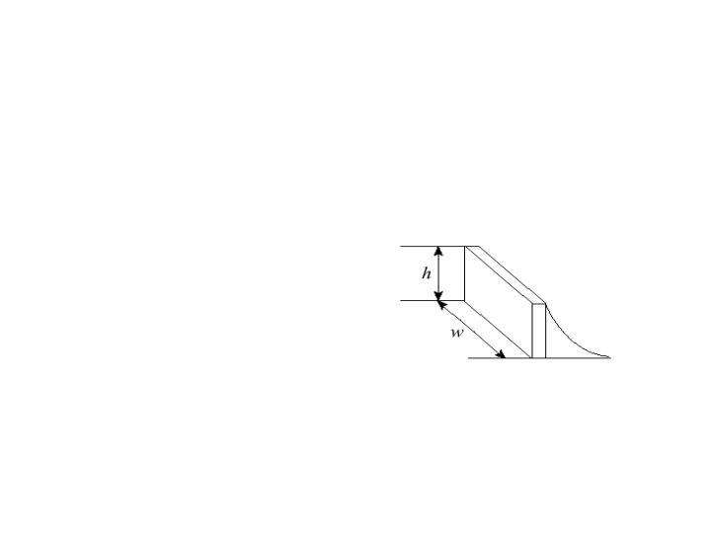
Example for Pascal’s Principle
Water is filled to a height H behind a dam of width w. Determine the resultant force exerted by the water on the dam.
Since the water pressure varies as a function of depth, we will have to do some calculus to figure out the total force.
H
h
The pressure at the depth h is
dy
y
The infinitesimal force dF exerting on a small strip of dam dy is
Therefore the total force exerted by the water on the dam is

Slide 24
Congratulations!!!!
You all are impressive and have done very well, over COVID!!!
I certainly had a lot of fun with ya’ll and am truly proud of you!
Good luck with your exam!!!
Have a safe, fruitful summer!!

