Slide 1
PHYS 1443 – Section 001
Lecture #1
Monday, June 6, 2011
Dr. Jaehoon Yu
Class Introduction
Standard and units
Dimensional Analysis
Today’s homework is homework #1, due 10pm, Wednesday, June 8!!

Slide 2
Announcements
Reading assignment #1: Read and follow through all sections in appendices A and B by Wednesday, June 8
  There will be a quiz this Wednesday, June 8, on this reading assignment

Slide 3
Special Problems for Extra Credit
Derive the quadratic equation for Bx²-Cx+A=0 ➔ 5 points
Derive the kinematic equation from first principles and the known kinematic equations ➔ 10 points
You must show your work in detail to obtain full credit
Due at the start of the class, Thursday, June 9

Slide 4
Who am I?
Name: Dr. Jaehoon Yu (You can call me Dr. Yu)
Office: Rm 342, Chemistry and Physics Building
  Office Hours: 10:00 – 11:0apm Mon. through Thur. or by appointment
Extension: x22814, E-mail: jaehoonyu@uta.edu
My profession: High Energy Particle Physics (HEP)
  Collide particles (protons on anti-protons or electrons on anti-electrons, positrons) at the energies equivalent to 10,000 Trillion degrees
  To understand
    Fundamental constituents of matter
    Interactions or forces between the constituents
    Origin of Mass
    Creation of Universe (Big Bang Theory)
  A pure scientific research activity
    Direct use of the fundamental laws we find may take longer than we want but
    Indirect product of research contribute to every day lives; eg. WWW

Slide 5
We always wonder…
What is the universe made of?
How does the universe work?
What are the things that holds the universe together?
What are the governing principles of the universe?
How can we live in the universe well?
Where do we all come from?
HEP looks into the smallest possible things to find the answers to these deep questions

Slide 6
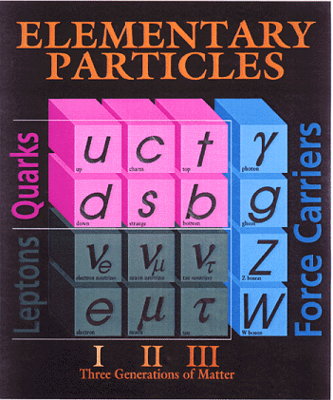
The Standard Model of Particle Physics
Prescribes the following fundamental structure:
Three families of leptons and quarks together with 12 force mediators ➔ Simple and elegant!!!
Tested to a precision of 1 part per million!
Discovered in 1995, ~170m_{p}
~0.01m_{p}
Directly observed in 2000
Family

Slide 7
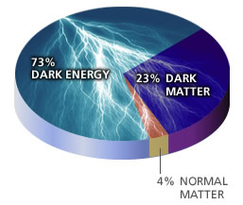
Good, but still lots we don’t know…
Why are there three families of quarks and leptons?
Why is the mass range so large (0.01m_{p} – 175 m_{p})?
How do matters acquire mass?
  Higgs mechanism but where is the Higgs, the God particle?
Why is the matter in the universe made only of particles?
  What happened to anti-particles? Or anti-matters?
Why are there only three apparent forces?
Is the picture we present the real thing?
  What makes up the 96% of the universe?
  How about extra-dimensions?
How is the universe created?
Are there any other theories that describe the universe better?
  Does the super-symmetry exist?

Slide 8
Accelerators are Powerful Microscopes.
They make high energy particle beams
that allow us to see small things.
seen by
low energy beam
(poorer resolution)
seen by
high energy beam
(better resolution)

Slide 9
Accelerators are also Time Machines.
They make particles last seen
in the earliest moments of the universe.
Energy
particle beam
energy
anti-particle beam
energy
Particle and anti-particle annihilate.
E = mc²

Slide 10
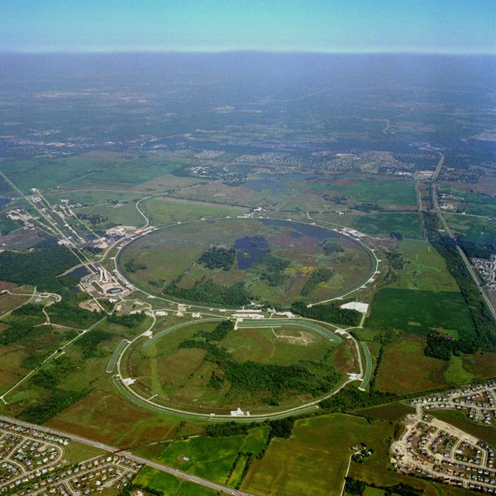
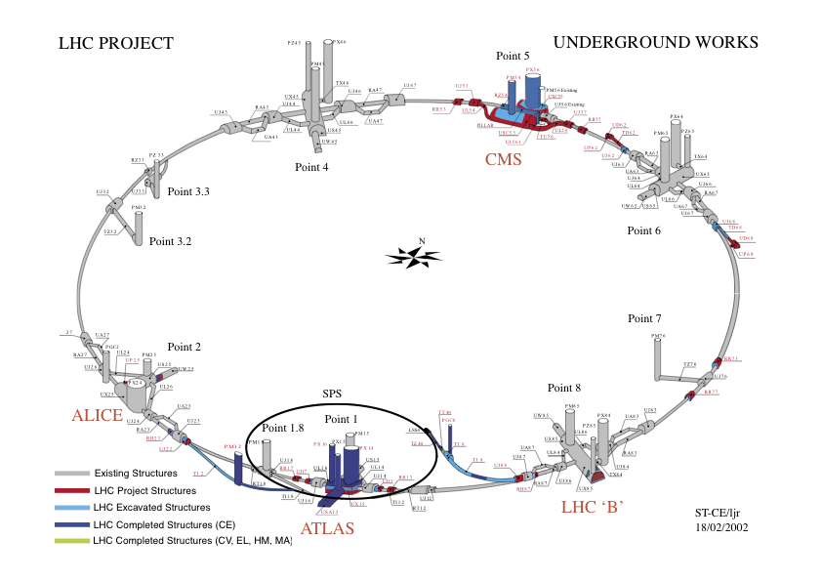
Fermilab Tevatron and LHC at CERN
World’s Highest Energy proton-anti-proton collider
  6km circumference
  E_{cm}=1.96 TeV (=6.3x10⁻⁷J/p➔ 13M Joules on 10⁻⁴m²)
  Equivalent to the kinetic energy of a 20t truck at the speed 81mi/hr➔ 130km/hr
    ~100,000 times the energy density at ground 0 of the atom bomb dropped on Hiroshima
  To be shut down Sept. 30, 2011
World’s Highest Energy p-p collider
  27km circumference, 100m underground
  Design E_{cm}=14 TeV (=44x10⁻⁷J/p➔ 362M Joules on the area less than 10⁻⁴m²)
  Equivalent to the kinetic energy of a B727 (80tons) at the speed 193mi/hr ➔ 312km/hr
    ~3M times the energy density at ground 0 of atom bomb dropped on Hiroshima
First 7TeV collisions on 3/30/10 ➔ The highest energy humans ever achieved!!
  First collisions in 2011 in mid March, 2011
Chicago
CDF
p
DØ
Tevatron
p

Slide 11
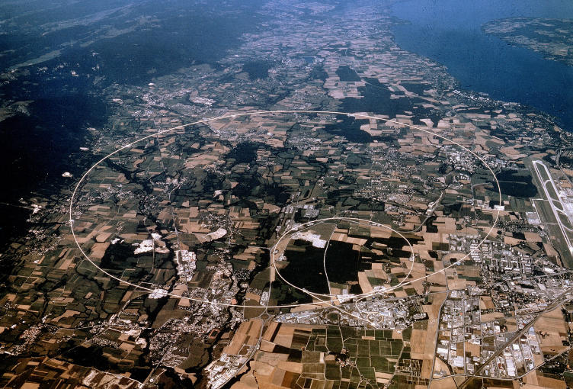


LHC @ CERN Aerial View
CMS
France
Geneva Airport
ATLAS
Swizerland

Slide 12
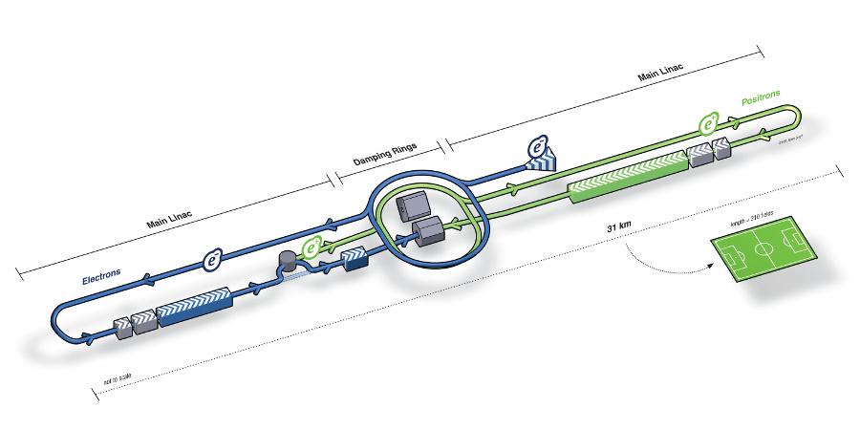
A Future Linear Collider
An electron-positron collider on a straight line for precision measurements
CMS Energy: 0.5 – 1 TeV
10~15 years from now
Takes 10 years to build the accelerator and the detector
L~31km
Circumference ~6.6km
~310 soccer fields

Slide 13
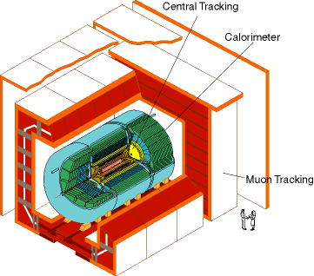
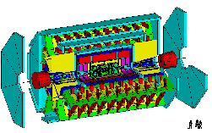
DØ Detector
ATLAS Detector
30’
30’
50’
Weighs 5000 tons and 5 story tall
Can inspect 3,000,000 collisions/second
Record 100 collisions/second
Records approximately 10,000,000 bytes/second
Records 0.5x10¹⁵ (500,000,000,000,000) bytes per year (0.5 PetaBytes).
Weighs 7000 tons and 10 story tall
Can inspect 1,000,000,000 collisions/second
Records 200 – 400 collisions/second
Records approximately 350,000,000 bytes/second
Will record 2x10¹⁵ (2,000,000,000,000,000) bytes each year (2 PetaByte).

Slide 14
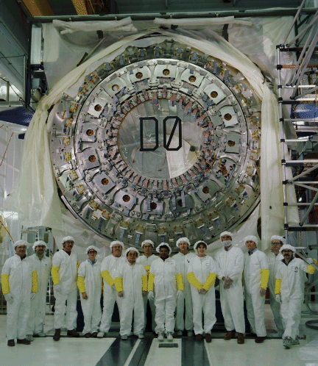
DØ Central Calorimeter 1990

Slide 15
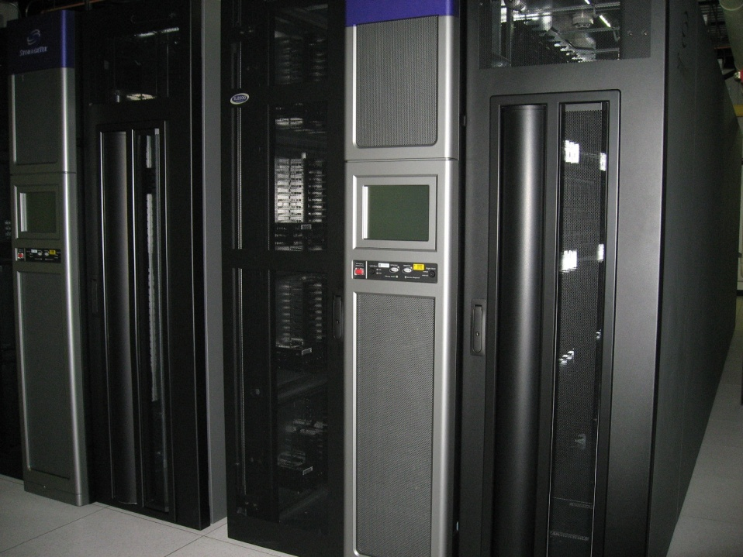
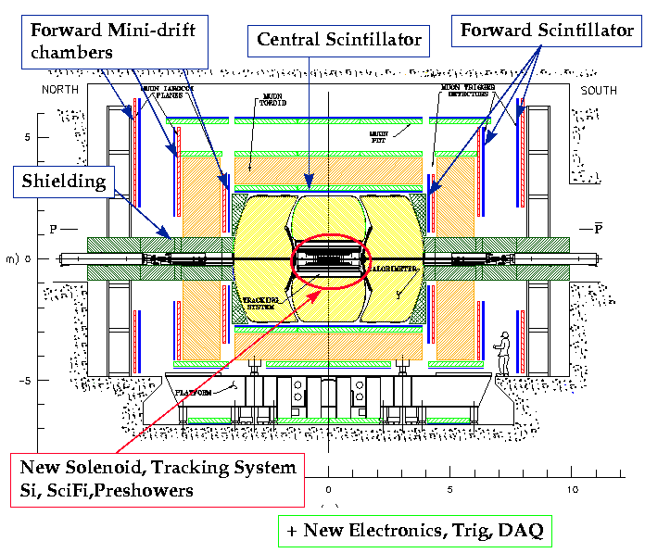
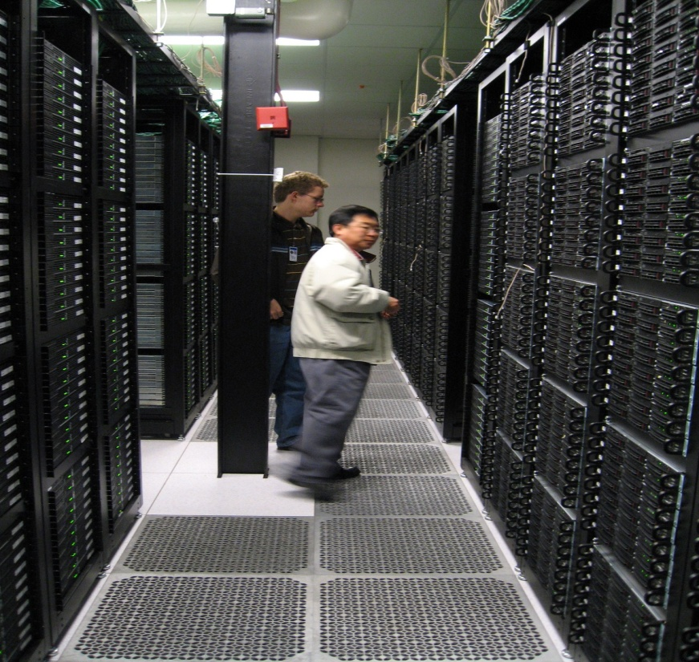
Computers put together a picture
Digital data
p
‾p
Data Reconstruction

Slide 16
How does an Event Look in a Collider Detector?
CH
Highest E_{T} dijet event at DØ
“calorimeter jet”
hadrons
FH
γ
EM
“particle jet”
Time
“parton jet”
Notes:
RECO [Slide 1]
Very briefly mention RECO version used.
Mention that these are fixed-cone jets of R=0.7 found by iterative algorithm, Et is the scalar Et sum of the towers.
List corrections we apply (basically) to RECO. No more is needed for AIDA restoration or Ht-revertexing at this point, but following three slides will be about eta bias -- so just briefly prepare listeners for this!

Slide 17
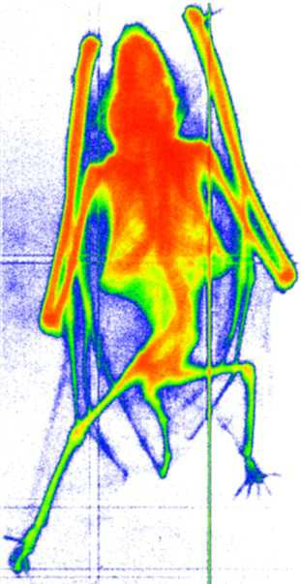
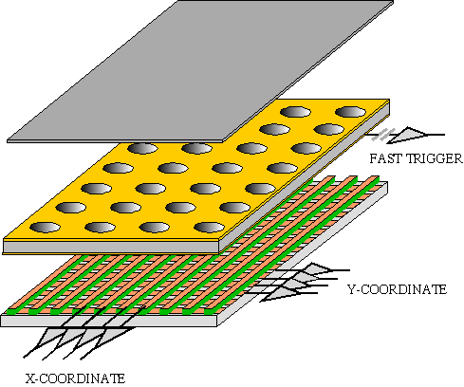
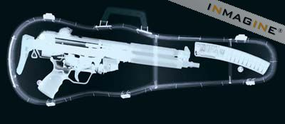
GEM Application Potential
FAST X-RAY IMAGING
Using the lower GEM signal, the readout can be self-triggered with energy discrimination:
9 keV absorption radiography of a small mammal (image size ~ 60 x 30 mm²)
A. Bressan et al,
Nucl. Instr. and Meth. A 425(1999)254
F. Sauli, Nucl. Instr. and Meth.A 461(2001)47

Slide 18
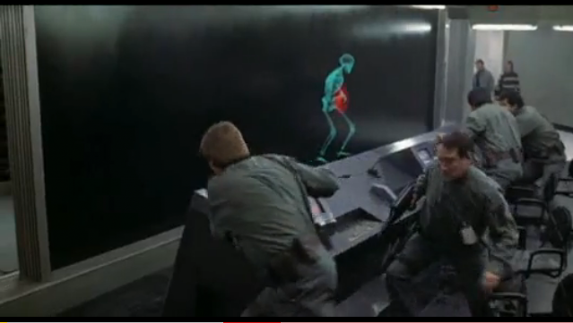
And in not too distant future, we could do …

Slide 19
Information & Communication Source
My web page: http://www-hep.uta.edu/~yu/
  Contact information & Class Schedule
  Syllabus
  Homework
  Holidays and Exam days
  Evaluation Policy
  Class Style & Communication
  Other information
Office Hours: 10:00 – 11:00am, Mondays through Thursdays or by appointments

Slide 20
Evaluation Policy
Homework: 30%
Exams
  Midterm and Final Comprehensive Exams (6/21 and 7/11): 22.5% each
  Missing an exam is not permissible unless pre-approved
    No makeup test!!
    You will get an F if you miss any of the exams without a prior approval
Lab score: 15%
Pop-quizzes: 10%
Extra credits: 10% of the total
  Random attendances
  Strong participation in the class discussions
  Special projects
  Planetarium shows and Other many opportunities
Grading will be done on a sliding scale
100%

Slide 21
Homework
Solving homework problems is the only way to comprehend class material
An electronic homework system has been setup for you
  Details are in the material distributed today and on the web
  https://quest.cns.utexas.edu/student/courses/list
  Choose the course PHYS1443-001-SUMMER2011, unique number 43111
  Download homework #1, solve the one problem and submit them online
  Multiple unsuccessful tries will deduct points
  Roster will close at midnight Wednesday, June 8
  You need a UT e-ID: Go and apply at the URL https://idmanager.its.utexas.edu/eid_self_help/?createEID&qwicap-page-id=EA027EFF7E2DA39E if you don’t have one.
Each homework carries the same weight
ALL homework grades will be used for the final grade
Home work will constitute 30% of the total ➔ A good way of keeping your grades high
Strongly encouraged to collaborate ➔ Does not mean you can copy

Slide 22
Attendances and Class Style
Attendances:
  Will be taken randomly
  Will be used for extra credits
Class style:
  Lectures will be on electronic media
    The lecture notes will be posted on the web AFTER each class
  Will be mixed with traditional methods
  Active participation through questions and discussions are STRONGLY encouraged ➔ Extra credit….
  Communication between you and me is extremely important
    If you have problems, please do not hesitate talking to me

Slide 23
Lab and Physics Clinic
Physics Labs:
  Starts, Wed. June 8, 2011
  Important to understand physical principles through experiments
  15% of the grade
  Lab syllabus is available in your assigned lab rooms.
    Go by the lab room between 8am - 6pm M – F and pick up the syllabus
Physics Clinic:
  Room SH007, 12 – 6pm Mon – Thur and 1 – 6pm Sat.
  Free of charge
  They provide general help on physics, including help solving homework problems
    Do not expect solutions of the problem from them!
    Do not expect them to tell you whether your answers are correct!
    It is your responsibility to make sure that you have done everything correctly!
  Will let you know via e-mail when the service begins

Slide 24
Extra credit
10% addition to the total
  Could boost a B to A, C to B or D to C
What constitute for extra credit?
  Random attendances
  Physics department colloquium participation
    Some will be double or triple credit (
  Strong participation in the class discussions
  Special projects
  Watch the valid planetarium shows
  Many other opportunities

Slide 25
Valid Planetarium Shows
Regular running shows
  Magnificent Sun
  Violent Universe
  Wonders of the Universe
Shows that need special arrangements
  Stars of the Pharaohs
  Black Holes
  Two small pieces of glass
  SOPHIA
How to submit for extra credit?
  Obtain the ticket stub that is signed and dated by the planetarium star lecturer of the day
  Collect the ticket stubs
  Tape all of them on a sheet of paper with your name and ID written on it
  Submit the sheet at the end of the semester when asked

Slide 26
What can you expect from this class?
All A’s?
  This would be really nice, wouldn’t it?
  But if it is too easy it is not fulfilling or meaningful….
This class is not going to be a stroll in the park!! (Very fast pace!!)
You will earn your grade in this class.
  You will need to put in sufficient time and sincere efforts
  Exams and quizzes will be tough!!
    Sometimes problems might not look exactly like what you learned in the class
    Just putting the right answer in free response problems does not work!
But you have a great control of your grade in your hands
  Homework is 30% of the total grade!!
    Means you will have many homework problems
      Sometimes much more than any other classes
      Sometimes homework problems will be something that you have yet to learn in class
  Lab 15%
  Extra credit 10%
I will work with you so that your efforts are properly awarded

Slide 27
What do we want to learn in this class?
Physics is everywhere around you.
Understand the fundamental principles that surrounds you in everyday lives…
Identify what laws of physics applies to what phenomena and use them appropriately
Understand the impact of such physical laws
Learn how to research and analyze what you observe.
Learn how to express observations and measurements in mathematical language
Learn how to express your research in systematic manner in writing
I don’t want you to be scared of PHYSICS!!!
Most importantly, let us have a lot of FUN!!

Slide 28
Why do Physics?
Exp.{
To understand nature through experimental observations and measurements (Research)
Establish limited number of fundamental laws, usually with mathematical expressions
Predict the nature’s course
Theory and Experiment work hand-in-hand
Theory works generally under restricted conditions
Discrepancies between experimental measurements and theory are good for improvements
Improves our everyday lives, even though some laws can take a while till we see them amongst us
Theory {
28

Slide 29
Brief History of Physics
AD 18th century:
  Newton’s Classical Mechanics: A theory of mechanics based on observations and measurements
AD 19th Century:
  Electricity, Magnetism, and Thermodynamics
Late AD 19th and early 20th century (Modern Physics Era)
  Einstein’s theory of relativity: Generalized theory of space, time, and energy (mechanics)
  Quantum Mechanics: Theory of atomic phenomena
Physics has come very far, very fast, and is still progressing, yet we’ve got a long way to go
  What is matter made of?
  How do matters get mass?
  How and why do matters interact with each other?
  How is universe created?
29

Slide 30
Models, Theories and Laws
Models: An analogy or a mental image of a phenomena in terms of something we are familiar with
  Thinking light as waves, behaving just like water waves
  Often provide insights for new experiments and ideas
Theories: More systematically improved version of models
  Can provide quantitative predictions that are testable and more precise
Laws: Certain concise but general statements about how nature behaves
  Energy conservation
  The statement must be found experimentally valid to become a law
Principles: Less general statements of how nature behaves
  Has some level of arbitrariness
30

Slide 31
Uncertainties
Physical measurements have limited precision, however good they are, due to:
  Number of measurements
  Quality of instruments (meter stick vs micro-meter)
  Experience of the person doing measurements
  Etc
In many cases, uncertainties are more important and difficult to estimate than the central (or mean) values
Stat.{
{
Syst.
31

Slide 32
Significant Figures
Denote the precision of the measured values
  The number 80 implies precision of +/- 1, between 79 and 81
    If you are sure to +/-0.1, the number should be written 80.0
  Significant figures: non-zero numbers or zeros that are not place-holders
    34, 34.2, 0.001, 34.100
      34 has two significant digits
      34.2 has 3
      0.001 has one because the 0’s before 1 are place holders to position “.”
      34.100 has 5, because the 0’s after 1 indicates that the numbers in these digits are indeed 0’s.
    When there are many 0’s, use scientific notation for simplicity:
      31400000=3.14x10⁷
      0.00012=1.2x10⁻⁴
32

Slide 33
Significant Figures
Operational rules:
  Addition or subtraction: Keep the smallest number of decimal place in the result, independent of the number of significant digits: 12.001+ 3.1=
  Multiplication or Division: Keep the smallest number of significant digits in the result: 12.001 x 3.1 = , because the smallest significant figures is ?.
15.1
37
What does this mean?
The worst precision determines the precision the overall operation!!
In English?
Can’t get any better than the worst measurement!
33

Slide 34
Needs for Standards and Units
Seven basic quantities for physical measurements
  Length, Mass, Time, Electric Current, Temperature, the Amount of substance and Luminous intensity
Need a language that everyone can understand each other
  Consistency is crucial for physical measurements
  The same quantity measured by one must be comprehendible and reproducible by others
  Practical matters contribute
A system of unit called SI (System Internationale) was established in 1960
  Length in meters (m)
  Mass in kilo-grams (kg)
  Time in seconds (s)
34

Slide 35
Definition of Three Relevant Base Units
SI Units
Definitions
1 m (Length) = 100 cm
One meter is the length of the path traveled by light in vacuum during the time interval of 1/299,792,458 of a second.
1 kg (Mass) =
1000 g
It is equal to the mass of the international prototype of the kilogram, made of platinum-iridium in International Bureau of Weights and Measure in France.
1 s (Time)
One second is the duration of 9,192,631,770 periods of the radiation corresponding to the transition between the two hyperfine levels of the ground state of the Cesium 133 (C¹³³) atom.
There are total of seven base quantities (see table 1-5 on page 7)
There are prefixes that scales the units larger or smaller for convenience (see pg. 7)
Units for other quantities, such as Newtons for force and Joule for energy, for ease of use
35

Slide 36
Prefixes, expressions and their meanings
Larger
Smaller
deca (da): 10¹
hecto (h): 10²
kilo (k): 10³
mega (M): 10⁶
giga (G): 10⁹
tera (T): 10¹²
peta (P): 10¹⁵
exa (E): 10¹⁸
zetta (Z): 10²¹
yotta (Y): 10²⁴
deci (d): 10⁻¹
centi (c): 10⁻²
milli (m): 10⁻³
micro (μ): 10⁻⁶
nano (n): 10⁻⁹
pico (p): 10⁻¹²
femto (f): 10⁻¹⁵
atto (a): 10⁻¹⁸
zepto (z): 10⁻²¹
yocto (y): 10⁻²⁴
36

Slide 37
International Standard Institutes
International Bureau of Weights and Measure http://www.bipm.fr/
  Base unit definitions: http://www.bipm.fr/enus/3_SI/base_units.html
  Unit Conversions: http://www.bipm.fr/enus/3_SI/
US National Institute of Standards and Technology (NIST) http://www.nist.gov/
37

Slide 38
How do we convert quantities from one unit to another?
Unit 1 =
Conversion factor X
Unit 2
1 inch | 2.54 | cm
1 inch | 0.0254 | m
1 inch | 2.54x10⁻⁵ | km
1 ft | 30.3 | cm
1 ft | 0.303 | m
1 ft | 3.03x10⁻⁴ | km
1 hr | 60 | minutes
1 hr | 3600 | seconds
And many | More | Here….
38

Slide 39
Examples 1.3 and 1.4 for Unit Conversions
Ex 1.3: An apartment has a floor area of 880 square feet (ft²). Express this in square meters (m²).
What do we need to know?
Ex 1.4: Where the posted speed limit is 55 miles per hour (mi/h or mph), what is this speed (a) in meters per second (m/s) and (b) kilometers per hour (km/h)?
(a)
(b)
39

Slide 40
Estimates & Order-of-Magnitude Calculations
Estimate = Approximation
  Useful for rough calculations to determine the necessity of higher precision
  Usually done under certain assumptions
  Might require modification of assumptions, if higher precision is necessary
Order of magnitude estimate: Estimates done to the precision of 10s or exponents of 10s;
  Three orders of magnitude: 10³=1,000
  Round up for Order of magnitude estimate; 8x10⁷ ~ 10⁸
  Similar terms: “Ball-park-figures”, “guesstimates”, etc
40

Slide 41
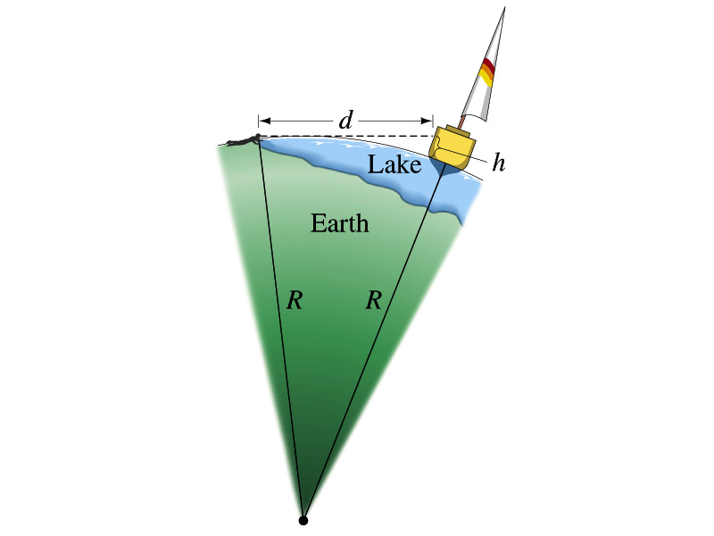
Example 1.8
Estimate the radius of the Earth using triangulation as shown in the picture when d=4.4km and h=1.5m.
Pythagorian theorem
d=4.4km
Solving for R
R
R+h
41

