Slide 1
PHYS 1443 – Section 001
Lecture #2
Tuesday, June 7, 2011
Dr. Jaehoon Yu
Dimensional Analysis
Fundamentals
One Dimensional Motion: Average Velocity; Acceleration; Motion under constant acceleration; Free Fall

Slide 2
Announcements
Homework registration and submissions
  18/27 registered but only 1 submitted the answer!
  I will then have to approve your enrollment request
    So please go ahead and take an action as soon as possible
    The roster closes tomorrow, Wednesday!
Quiz tomorrow at the beginning of the class!
  Problems will be on Appendices A and B!

Slide 3
Special Problems for Extra Credit
Derive the quadratic equation for Bx²-Cx+A=0 ➔ 5 points
Derive the kinematic equation from first principles and the known kinematic equations ➔ 10 points
You must show your work in detail to obtain full credit
Due at the start of the class, Thursday, June 9

Slide 4
Dimension and Dimensional Analysis
An extremely useful concept in solving physical problems
Good to write physical laws in mathematical expressions
No matter what units are used the base quantities are the same
  Length (distance) is length whether meter or inch is used to express the size: Usually denoted as [L]
  The same is true for Mass ([M])and Time ([T])
  One can say “Dimension of Length, Mass or Time”
  Dimensions are treated as algebraic quantities: Can perform two algebraic operations; multiplication or division
4

Slide 5
Dimension and Dimensional Analysis
One can use dimensions only to check the validity of one’s expression: Dimensional analysis
  Eg: Speed [v] = [L]/[T]=[L][T⁻¹]
    Distance (L) traveled by a car running at the speed V in time T
      L = V*T = [L/T]*[T]=[L]
More general expression of dimensional analysis is using exponents: eg. [v]=[L^{n}T^{m}] =[L][T⁻¹] where n = 1 and m = -1
5

Slide 6
Examples
Show that the expression [v] = [at] is dimensionally correct
    Speed: [v] =[L]/[T]
    Acceleration: [a] =[L]/[T]²
    Thus, [at] = (L/T²)xT=LT⁽⁻²⁺¹⁾ =LT⁻¹ =[L]/[T]= [v]
Suppose the acceleration a of a circularly moving particle with speed v and radius r is proportional to r^{n} and v^{m}. What are n andm?
a
r
v
Dimensionless
constant
Length
Speed
6

Slide 7
Some Fundamentals
Kinematics: Description of Motion without understanding the cause of the motion
Dynamics: Description of motion accompanied with understanding the cause of the motion
Vector and Scalar quantities:
  Scalar: Physical quantities that require magnitude but no direction
    Speed, length, mass, height, volume, area, energy, heat, etc
  Vector: Physical quantities that require both magnitude and direction
    Velocity, Acceleration, Force, Momentum
    It does not make sense to say “I ran with velocity of 10miles/hour.”
Objects can be treated as point-like if their sizes are smaller than the scale in the problem
  Earth can be treated as a point like object (or a particle) in celestial problems
    Simplification of the problem (The first step in setting up to solve a problem…)
  Any other examples?
7

Slide 8
Some More Fundamentals
Motions:Can be described as long as the position is known at any given time (or position is expressed as a function of time)
  Translation: Linear motion along a line
  Rotation: Circular or elliptical motion
  Vibration: Oscillation
Dimensions
  0 dimension: A point
  1 dimension: Linear drag of a point, resulting in a line ➔ Motion in one-dimension is a motion on a line
  2 dimension: Linear drag of a line resulting in a surface
  3 dimension: Perpendicular Linear drag of a surface, resulting in a stereo object
8

Slide 9
Displacement, Velocity and Speed
One dimensional displacement is defined as:
A vector quantity
Displacement is the difference between initial and final potions of the motion and is a vector quantity. How is this different than distance?
Unit?
m
The average velocity is defined as:
Unit?
m/s
A vector quantity
Displacement per unit time in the period throughout the motion
The average speed is defined as:
Unit?
m/s
A scalar quantity

Slide 10
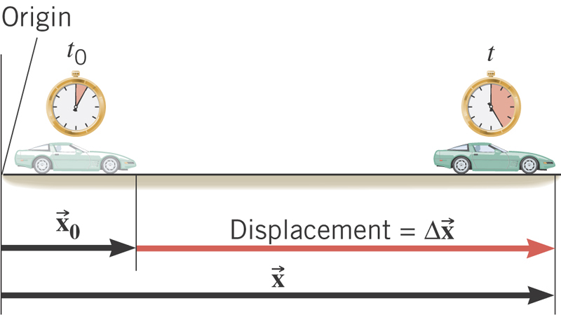
What is the displacement?
How much is the elapsed time?

Slide 11
Displacement, Velocity and Speed
One dimensional displacement is defined as:
Displacement is the difference between initial and final potions of the motion and is a vector quantity. How is this different than distance?
Unit?
m
The average velocity is defined as:
Unit?
m/s
Displacement per unit time in the period throughout the motion
The average speed is defined as:
Unit?
m/s
Can someone tell me what the difference between speed and velocity is?

Slide 12
Difference between Speed and Velocity
Let’s take a simple one dimensional translation that has many steps:
Let’s call this line as X-axis
Let’s have a couple of motions in a total time interval of 20 sec.
+10m
+15m
+5m
-5m
-10m
-15m
Total Displacement:
Average Velocity:
Total Distance Traveled:
Average Speed:
12

Slide 13
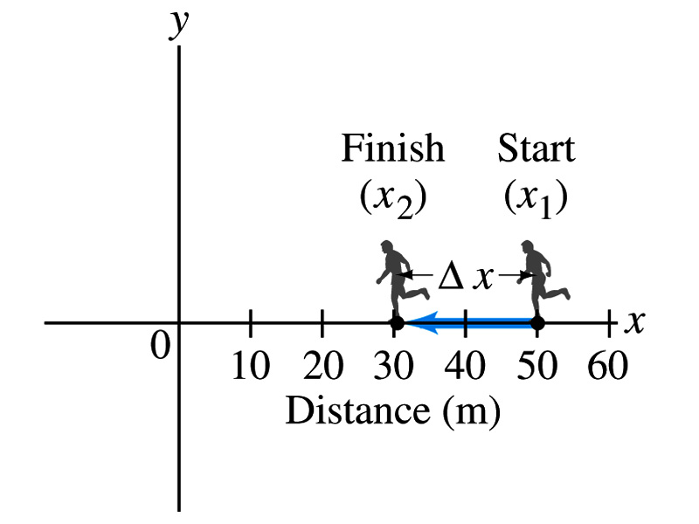
Example 2.1
The position of a runner as a function of time is plotted as moving along the x axis of a coordinate system. During a 3.00-s time interval, the runner’s position changes from x₁=50.0m to x₂=30.5 m, as shown in the figure. What was the runner’s average velocity? What was the average speed?
Displacement:
Average Velocity:
Average Speed:
13

Slide 14
Instantaneous Velocity and Speed
Can average quantities tell you the detailed story of the whole motion?
NO!!
Instantaneous velocity is defined as:
  What does this mean?
    Displacement in an infinitesimal time interval
    Average velocity over a very, very short amount of time
Instantaneous speed is the size (magnitude) of the velocity vector:
*Magnitude of Vectors are Expressed in absolute values

Slide 15
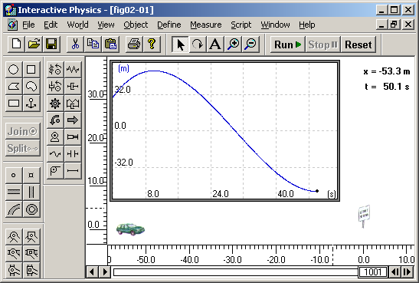
Instantaneous Velocity
Instantaneous Velocity
Average Velocity
Time
15
15

Slide 16
Position vs Time Plot
Position
It is helpful to understand motions to draw them on position vs time plots.
x₁
1
2
3
x=0
time
t=0
t₁
t₂
t₃
Running at a constant velocity (go from x=0 to x=x₁ in t₁, Displacement is + x₁ in t₁ time interval)
Velocity is 0 (go from x₁ to x₁ no matter how much time changes)
Running at a constant velocity but in the reverse direction as 1. (go from x₁ to x=0 in t₃-t₂ time interval, Displacement is - x₁ in t₃-t₂ time interval)
Does this motion physically make sense?
16
16

Slide 17
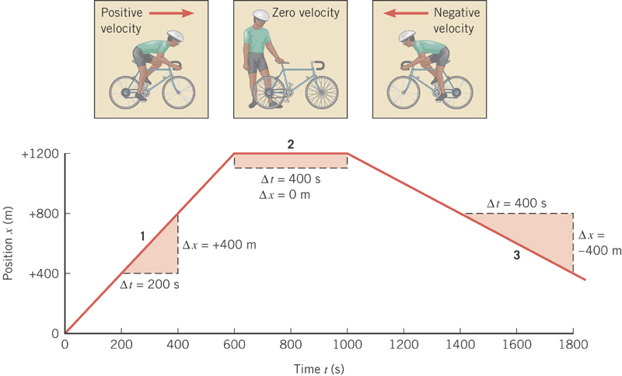

Slide 18
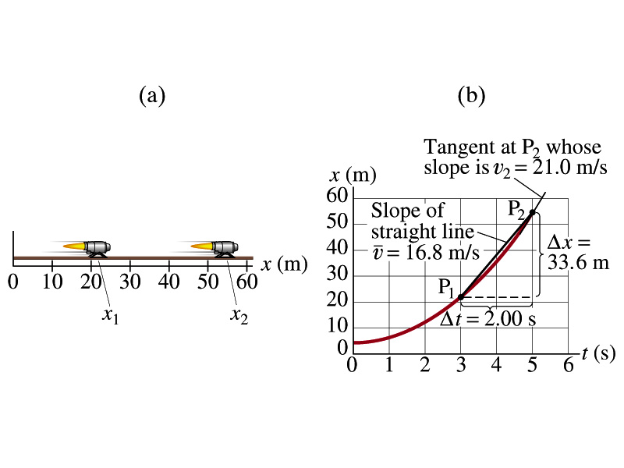
Example 2.3
A jet engine moves along a track. Its position as a function of time is given by the equation x=At²+B where A=2.10m/s² and B=2.80m.
(a) Determine the displacement of the engine during the interval from t₁=3.00s to t₂=5.00s.
Displacement is, therefore:
(b) Determine the average velocity during this time interval.
18
18

Slide 19
Example 2.3 cont’d
(c) Determine the instantaneous velocity at t=t₂=5.00s.
Calculus formula for derivative
and
The derivative of the engine’s equation of motion is
The instantaneous velocity at t=5.00s is
19
19

Slide 20
Displacement, Velocity and Speed
Displacement
Average velocity
Average speed
Instantaneous velocity
Instantaneous speed
20
20

Slide 21
Acceleration
Change of velocity in time (what kind of quantity is this?)
Vector
Definition of the average acceleration:
analogous to
Definition of the instantaneous acceleration:
analogous to
In calculus terms: The slope (derivative) of the velocity vector with respect to time or the change of slopes of position as a function of time

Slide 22
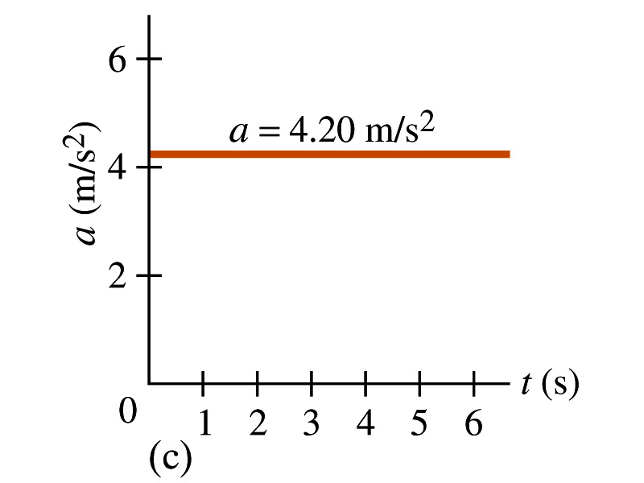
Acceleration vs Time Plot
What does this plot tell you?
Yes, you are right!!
The acceleration of this motion is a constant!!

Slide 23
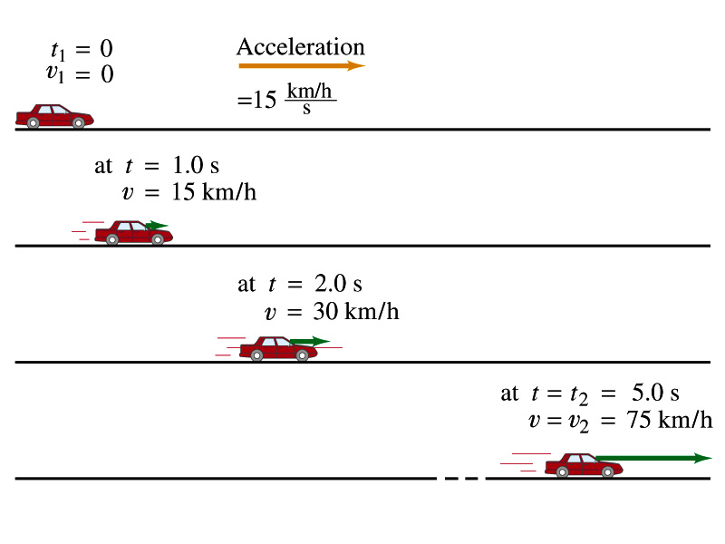
Example 2.4
A car accelerates along a straight road from rest to 75km/h in 5.0s.
What is the magnitude of its average acceleration?

Slide 24
Few Confusing Things on Acceleration
When an object is moving in a constant velocity (v=v₀), there is no acceleration (a=0)
  Is there any acceleration when an object is not moving?
When an object is moving faster as time goes on, (v=v(t) ), acceleration is positive (a>0).
  Incorrect, since the object might be moving in negative direction initially
When an object is moving slower as time goes on, (v=v(t) ), acceleration is negative (a<0)
  Incorrect, since the object might be moving in negative direction initially
In all cases, velocity is positive, unless the direction of the movement changes.
  Incorrect, since the object might be moving in negative direction initially
Is there acceleration if an object moves in a constant speed but changes direction?
The answer is YES!!

Slide 25
Displacement, Velocity, Speed & Acceleration
Displacement
Average velocity
Average speed
Instantaneous velocity
Instantaneous speed
Average acceleration
Instantaneous acceleration
25
25

Slide 26
One Dimensional Motion
Let’s focus on the simplest case: acceleration is a constant (a=a₀)
Using the definitions of average acceleration and velocity, we can derive equations of motion (description of motion, velocity and position as a function of time)
(If t_{f}=t and t_{i}=0)
For constant acceleration, average velocity is a simple numeric average
(If t_{f}=t and t_{i}=0)
Resulting Equation of Motion becomes

Slide 27
Kinematic Equations of Motion on a Straight Line Under Constant Acceleration
Velocity as a function of time
Displacement as a function of velocities and time
Displacement as a function of time, velocity, and acceleration
Velocity as a function of Displacement and acceleration
You may use different forms of Kinematic equations, depending on the information given to you in specific physical problems!!

Slide 28
How do we solve a problem using a kinematic formula under constant acceleration?
Identify what information is given in the problem.
  Initial and final velocity?
  Acceleration?
  Distance, initial position or final position?
  Time?
Convert the units of all quantities to SI units to be consistent.
Identify what the problem wants
Identify which kinematic formula is most appropriate and easiest to solve for what the problem wants.
  Frequently multiple formulae can give you the answer for the quantity you are looking for. ➔ Do not just use any formula but use the one that can be easiest to solve.
Solve the equations for the quantity or quantities wanted.

Slide 29
Example 2.11
Suppose you want to design an air-bag system that can protect the driver in a head-on collision at a speed 100km/hr (~60miles/hr). Estimate how fast the air-bag must inflate to effectively protect the driver. Assume the car crumples upon impact over a distance of about 1m. How does the use of a seat belt help the driver?
How long does it take for the car to come to a full stop?
As long as it takes for it to crumple.
The initial speed of the car is
We also know that
and
Using the kinematic formula
The acceleration is
Thus the time for air-bag to deploy is

