Slide 1
PHYS 1443 – Section 001
Lecture #3
Wednesday, June 8, 2011
Dr. Jaehoon Yu
One Dimensional Motion: Free Fall
Coordinate System
Vectors and Scalars and their operations
Motion in Two Dimensions: Motion under constant acceleration; Projectile Motion; Maximum ranges and heights
Newton’s Laws of Motion
Today’s homework is homework #2, due 10pm, Monday, June 13!!

Slide 2
Announcements
Homework registration and submissions
  27/28 registered but only 9 completed the submission
  The due for homework #1, the freebee, is 10pm tonight!
Quiz #2 coming Tuesday, June 14
  Covers: CH 1.1 – what we finish on Monday, June 13
Reading assignment
  CH3.9

Slide 3
Reminder: Special Problems for Extra Credit
Derive the quadratic equation for Bx²-Cx+A=0 ➔ 5 points
Derive the kinematic equation from first principles and the known kinematic equations ➔ 10 points
You must show your work in detail to obtain full credit
Due at the start of the class, Thursday, June 9

Slide 4
Special Project for Extra Credit
Show that the trajectory of a projectile motion is a parabola!!
  20 points
  Due: next Tuesday, June 14
  You MUST show full details of your OWN computations to obtain any credit
    Much beyond what was covered in page 40 of this lecture note!!

Slide 5
Free Fall
Free fall motion is a motion under the influence of the gravitational pull (gravity) only; Which direction is a freely falling object moving?
  A motion under constant acceleration
  All kinematic formula we learned can be used to solve for falling motions.
Gravitational acceleration is inversely proportional to the distance between the object and the center of the earth
The magnitude of the gravitational acceleration is g=9.80m/s² on the surface of the earth, most of the time.
The direction of gravitational acceleration is ALWAYS toward the center of the earth, which we normally call (-y); where up and down direction are indicated as the variable “y”
Thus the correct denotation of gravitational acceleration on the surface of the earth is g=-9.80m/s² when +y points upward
Yes, down to the center of the earth!!

Slide 6
Example for Using 1D Kinematic Equations on a Falling object (similar to Ex. 2.16)
Stone was thrown straight upward at t=0 with +20.0m/s initial velocity on the roof of a 50.0m high building,
  What is the acceleration in this motion?
g=-9.80m/s²
  (a) Find the time the stone reaches at the maximum height.
  What is so special about the maximum height?
V=0
Solve for t
  (b) Find the maximum height.

Slide 7
Example of a Falling Object cnt’d
  (c) Find the time the stone reaches back to its original height.
  (d) Find the velocity of the stone when it reaches its original height.
  (e) Find the velocity and position of the stone at t=5.00s.
Velocity
Position

Slide 8
2D Coordinate Systems
They make it easy and consistent to express locations or positions
Two commonly used systems, depending on convenience, are
  Cartesian (Rectangular) Coordinate System
    Coordinates are expressed in (x,y)
  Polar Coordinate System
    Coordinates are expressed in distance from the origin ® and the angle measured from the x-axis, θ (r,θ)
Vectors become a lot easier to express and compute
+y
How are Cartesian and Polar coordinates related?
y₁
(x₁,y₁)
(r₁,θ₁)
=
r₁
θ₁
+x
O (0,0)
x₁

Slide 9
Example
Cartesian Coordinate of a point in the xy plane are (x,y)= (-3.50,-2.50)m. Find the equivalent polar coordinates of this point.
y
θ
x
θ_{s}
r
(-3.50,-2.50)m

Slide 10
Vector and Scalar
Vector quantities have both magnitudes (sizes) and directions
Force, gravitational acceleration, momentum
Normally denoted in BOLD letters, F, or a letter with arrow on top
Their sizes or magnitudes are denoted with normal letters, F, or absolute values:
Scalar quantities have magnitudes only
Can be completely specified with a value and its unit
Energy, heat, mass, time
Normally denoted in normal letters, E
Both have units!!!

Slide 11
Properties of Vectors
sizes
directions
Two vectors are the same if their and the are the same, no matter where they are on a coordinate system!!
y
Which ones are the same vectors?
D
F
A=B=E=D
A
Why aren’t the others?
B
x
C: The same magnitude but opposite direction: C=-A:A negative vector
E
C
F: The same direction but different magnitude

Slide 12
Vector Operations
Addition:
  Triangular Method: One can add vectors by connecting the head of one vector to the tail of the other (head-to-tail)
  Parallelogram method: Connect the tails of the two vectors and extend
  Addition is commutative: Changing order of operation does not affect the results A+B=B+A, A+B+C+D+E=E+C+A+B+D
A+B
A
A+B
B
=
OR
B
A+B
B
A
A
Subtraction:
  The same as adding a negative vector:A - B = A + (-B)
A
-B
Since subtraction is the equivalent to adding a negative vector, subtraction is also commutative!!!
A-B
Multiplication by a scalar is increasing the magnitude A, B=2A
A
B=2A

Slide 13
Example for Vector Addition
A car travels 20.0km due north followed by 35.0km in a direction 60.0º west of north. Find the magnitude and direction of resultant displacement.
Bsin60º
N
B
60^{ο}
Bcos60^{ο}
20
r
θ
A
E
Do this using components!!

Slide 14
Components and Unit Vectors
Coordinate systems are useful in expressing vectors in their components
y
(+,+)
A_{y}
(A_{x},A_{y})
}Components
A
(-,+)
θ
x
} Magnitude
(-,-)
(+,-)
A_{x}

Slide 15
Unit Vectors
Unit vectors are the ones that tells us the directions of the components
Dimensionless
Magnitudes these vectors are exactly 1
Unit vectors are usually expressed in i, j, k or
So a vector A can be expressed as

Slide 16
Examples of Vector Operations
Find the resultant vector which is the sum of A=(2.0i+2.0j) and B =(2.0i-4.0j)
Find the resultant displacement of three consecutive displacements: d₁=(15i+30j +12k)cm, d₂=(23i+14j -5.0k)cm, and d₃=(-13i+15j)cm
Magnitude

Slide 17
Displacement, Velocity, and Acceleration in 2-dim
Displacement:
Average Velocity:
How is each of these quantities defined in 1-D?
Instantaneous Velocity:
Average Acceleration
Instantaneous Acceleration:

Slide 18
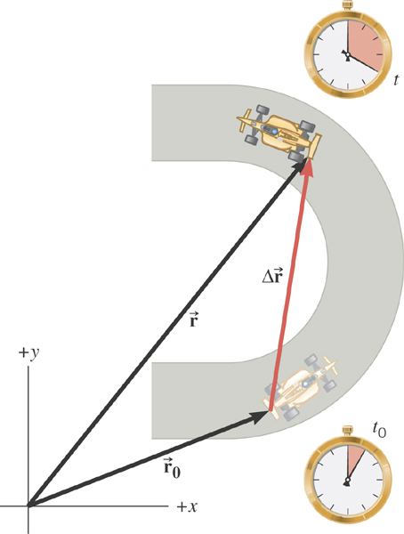
2D Displacement

Slide 19
2D Average Velocity
Average velocity is the
displacement divided by
the elapsed time.

Slide 20
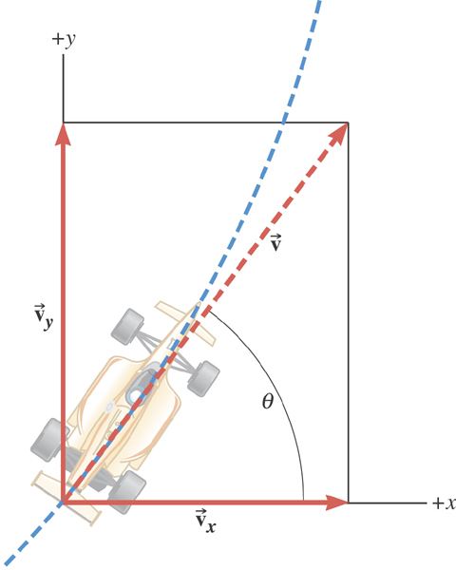
The instantaneous velocity indicates how fast the car moves and the direction of motion at each instant of time.

Slide 21
2D Average Acceleration

Slide 22
Kinematic Quantities in 1D and 2D
Quantities | 1 Dimension | 2 Dimension
Displacement
Average Velocity
Inst. Velocity
Average Acc.
Inst. Acc.
What is the difference between 1D and 2D quantities?

