Slide 1
PHYS 1443 – Section 001
Lecture #4
Thursday, June 9, 2011
Dr. Jaehoon Yu
Motion in Two Dimensions:
  Motion under a constant acceleration
  Projectile Motion
  Maximum range and Maximum height
Newton’s Laws of Motion
  Force; Mass; Newton’s 1st – 3rd Laws

Slide 2
Announcements
Homework
  100% of you have registered and submitted!!
  Excellent job!
  6/27 already started working on HW#2, Great!!
Quiz 1 results
  Class average: 7.5/12
    Equivalent to 62.5/100
  Top score: 11.2/12
Quiz #2 coming Tuesday, June 14
  Covers: CH 1.1 – what we finish on Monday, June 13

Slide 3
Reminder: Special Project for Extra Credit
Show that the trajectory of a projectile motion is a parabola!!
  20 points
  Due: next Tuesday, June 14
  You MUST show full details of your OWN computations to obtain any credit
    Much beyond what was covered in page 21 of this lecture note!!

Slide 4
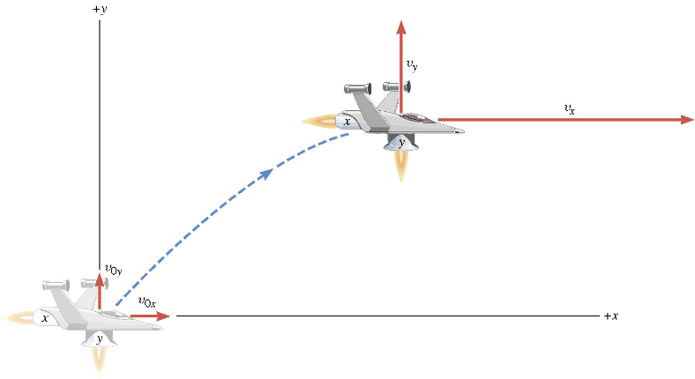
A Motion in 2 Dimension
This is a motion that could be viewed as two motions combined into one. (superposition…)

Slide 5
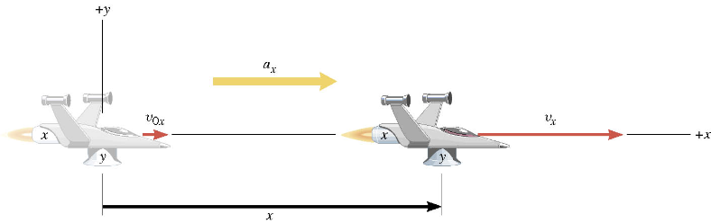
Motion in horizontal direction (x)

Slide 6
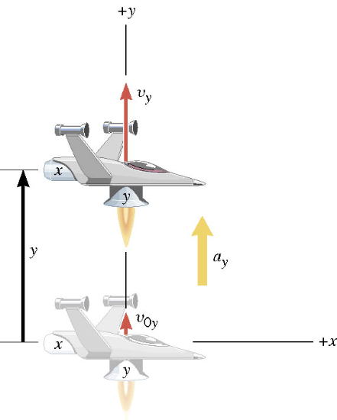
Motion in vertical direction (y)

Slide 7
A Motion in 2 Dimension
Imagine you add the two 1 dimensional motions on the left. It would make up a one 2 dimensional motion on the right.

Slide 8
Kinematic Equations in 2-Dim
x-component
y-component

Slide 9
Ex. A Moving Spacecraft
In the x direction, the spacecraft in zero-gravity zone has an initial velocity component of +22 m/s and an acceleration of +24 m/s². In the y direction, the analogous quantities are +14 m/s and an acceleration of +12 m/s². Find (a) x and v_{x}, (b) y and v_{y}, and (c) the final velocity of the spacecraft at time 7.0 s.

Slide 10
How do we solve this problem?
Visualize the problem ➔ Draw a picture!
Decide which directions are to be called positive (+) and negative (-).
Write down the values that are given for any of the five kinematic variables associated with each direction.
Verify that the information contains values for at least three of the kinematic variables. Do this for x and y separately. Select the appropriate equation.
When the motion is divided into segments in time, remember that the final velocity of one time segment is the initial velocity for the next.
Keep in mind that there may be two possible answers to a kinematics problem.

Slide 11
Ex. continued
In the x direction, the spacecraft in a zero gravity zone has an initial velocity component of +22 m/s and an acceleration of +24 m/s². In the y direction, the analogous quantities are +14 m/s and an acceleration of +12 m/s². Find (a) x and v_{x}, (b) y and v_{y}, and (c) the final velocity of the spacecraft at time 7.0 s.
x | a_{x} | v_{x} | v_{ox} | t
? |  | ?
+24.0 m/s²
+22.0 m/s
7.0 s
y | a_{y} | v_{y} | v_{oy} | t
? |  | ?
+12.0 m/s²
+14.0 m/s
7.0 s

Slide 12
First, the motion in x-direciton…
x | a_{x} | v_{x} | v_{ox} | t
? | +24.0 m/s² | ? | +22 m/s | 7.0 s

Slide 13
Now, the motion in y-direction…
y | a_{y} | v_{y} | v_{oy} | t
? | +12.0 m/s² | ? | +14 m/s | 7.0 s

Slide 14
The final velocity…
A vector can be fully described when the magnitude and the direction are given. Any other way to describe it?
Yes, you are right! Using the components and unit vectors!!

Slide 15
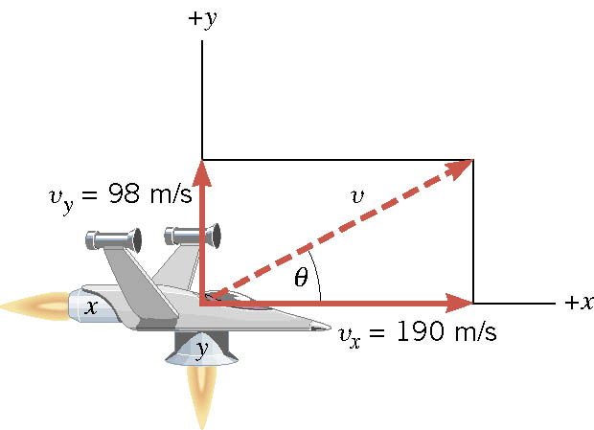
If we visualize the motion…

Slide 16
2-dim Motion Under Constant Acceleration
Position vectors in x-y plane:
Velocity vectors in x-y plane:
Velocity vectors in terms of the acceleration vector
X-comp
Y-comp

Slide 17
2-dim Motion Under Constant Acceleration
How are the 2D position vectors written in acceleration vectors?
Position vector components
Putting them together in a vector form
Regrouping the above
2D problems can be interpreted as two 1D problems in x and y

Slide 18
Example for 2-D Kinematic Equations
A particle starts at origin when t=0 with an initial velocity v=(20i-15j)m/s. The particle moves in the xy plane with a_{x}=4.0m/s². Determine the components of the velocity vector at any time t.
Velocity vector
Compute the velocity and the speed of the particle at t=5.0 s.

Slide 19
Example for 2-D Kinematic Eq. Cnt’d
Angle of the Velocity vector
Determine the x and y components of the particle at t=5.0 s.
Can you write down the position vector at t=5.0s?

Slide 20
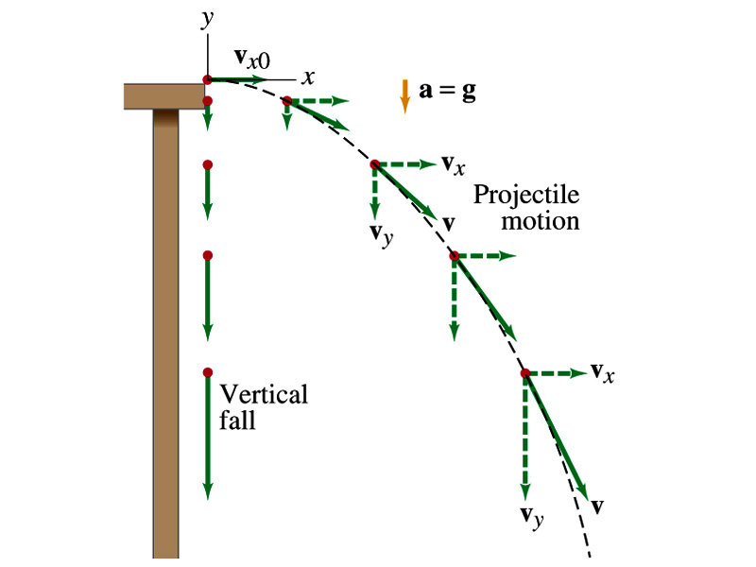
Projectile Motion
A 2-dim motion of an object under the gravitational acceleration with the following assumptions
  Free fall acceleration, g, is constant over the range of the motion
  Air resistance and other effects are negligible
A motion under constant acceleration!!!! ➔ Superposition of two motions
  Horizontal motion with constant velocity ( no acceleration )
  Vertical motion under constant acceleration ( g )

Slide 21
Show that a projectile motion is a parabola!!!
x-component
y-component
In a projectile motion, the only acceleration is gravitational one whose direction is always toward the center of the earth (downward).
a_{x}=0
Plug t into
the above
What kind of parabola is this?

Slide 22
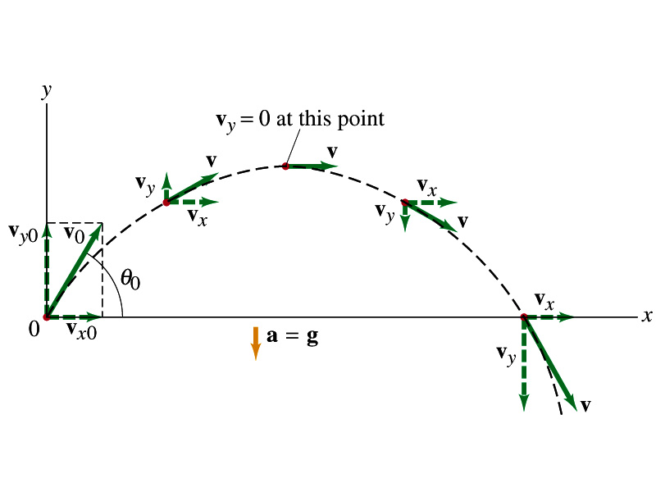
Projectile Motion
The only acceleration in this motion. It is a constant!!

Slide 23
Example for Projectile Motion
A ball is thrown with an initial velocity v=(20i+40j)m/s. Estimate the time of flight and the distance the ball is from the original position when landed.
Which component determines the flight time and the distance?
Flight time is determined by the y component, because the ball stops moving when it is on the ground after the flight.
So the possible solutions are…
Distance is determined by the x component in 2-dim, because the ball is at y=0 position when it completed it’s flight.
Why isn’t 0 the solution?

Slide 24
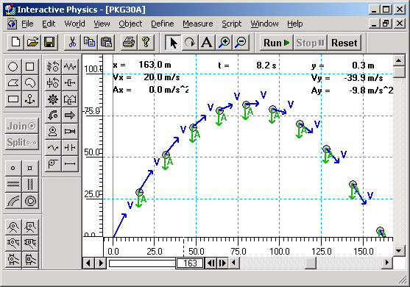
Horizontal Range and Max Height
Based on what we have learned, one can analyze a projectile motion in more detail
  Maximum height an object can reach
  Maximum range
What happens at the maximum height?
At the maximum height the object’s vertical motion stops to turn around!!
v_{i}
h
θ
Solve for t_{A}
24

Slide 25
Horizontal Range and Max Height
Since no acceleration is in x direction, it still flies even if v_{y}=0.
Range
Height
25

Slide 26
Maximum Range and Height
What are the conditions that give maximum height and range of a projectile motion?
This formula tells us that the maximum height can be achieved when θ_{i}=90º!!!
This formula tells us that the maximum range can be achieved when 2θ_{i}=90º, i.e., θ_{i}=45º!!!
26

Slide 27
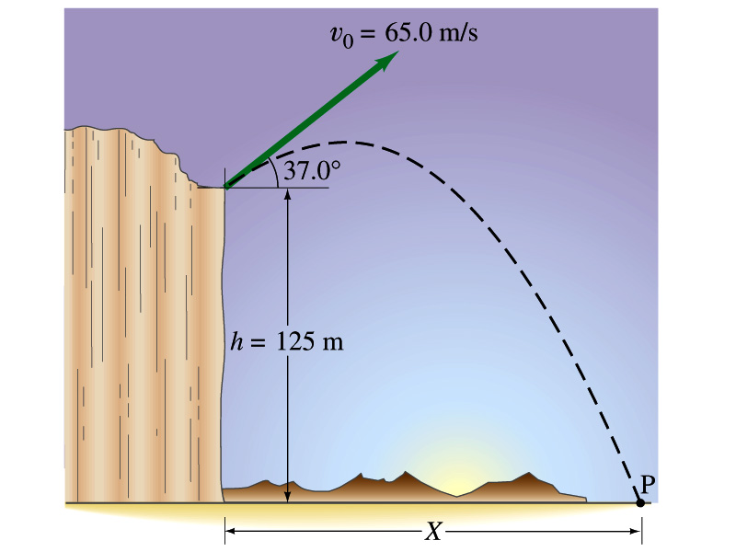
Example for a Projectile Motion
A stone was thrown upward from the top of a cliff at an angle of 37º to horizontal with initial speed of 65.0m/s. If the height of the cliff is 125.0m, how long is it before the stone hits the ground?
Becomes
Since negative time represents the time with the stone on the ground if it were thrown from the ground.
27

Slide 28
Example cont’d
What is the speed of the stone just before it hits the ground?
What are the maximum height and the maximum range of the stone?
Do these yourselves at home for fun!!!
28

