Slide 1
PHYS 1443 – Section 001
Lecture #6
Tuesday, June 14, 2011
Dr. Jaehoon Yu
Newton’s Laws of Motion
  Newton’s third law of motion
  Categories of Forces
Free Body Diagram
Application of Newton’s Laws
Force of friction

Slide 2
Announcements
Mid-term exam
  In the class on Tuesday, June 21, 2011
  Covers: CH 1.1 – what we finish Monday, June 20 plus Appendices A and B
  Mixture of free response problems and multiple choice problems
Bring your special project #2 during the intermission

Slide 3
Special Project for Extra Credit
A large man and a small boy stand facing each other on frictionless ice. They put their hands together and push against each other so that they move apart. a) Who moves away with the higher speed, by how much and why? b) Who moves farther in the same elapsed time, by how much and why?
Derive the formulae for the two problems above in much more detail and explain your logic in a greater detail than what is in this lecture note.
Be sure to clearly define each variables used in your derivation.
Each problem is 10 points.
Due is Monday, June 20.

Slide 4
Special Project for Extra Credit
A 92kg astronaut tied to an 11000kg space craft with a 100m bungee cord pushes the space craft with a force P=36N in space. Assuming there is no loss of energy at the end of the cord, and the cord does not extend beyond its original length, the astronaut and the space craft get pulled back toward each other by the cord toward a head-on collision.
What are the speeds of the astronaut and the space craft just before they collide? (10 points)
What are the magnitudes of the accelerations of the astronaut and the space craft if they come to a full stop in 0.5m from the point of initial contact? (10 points)
What are the magnitudes of the forces exerting on the astronaut and the space craft when they come to a full stop? 6 points)
Due is Wednesday, June 22.

Slide 5
Newton’s Third Law (Law of Action and Reaction)
If two objects interact, the force F₂₁ that object 2 exerts on object 1 is equal in magnitude and opposite in direction to the force F₁₂ that object 1 exerts on object 2.
F₁₂
F₂₁
2
1
The reaction force is equal in magnitude to the action force but in opposite direction. These two forces always act on different objects.
What is the reaction force to the force of a free falling object?
The gravitational force exerted by the object to the Earth!
Stationary objects on top of a table has a reaction force (called the normal force) from the table to balance the action force, the gravitational force.
5

Slide 6
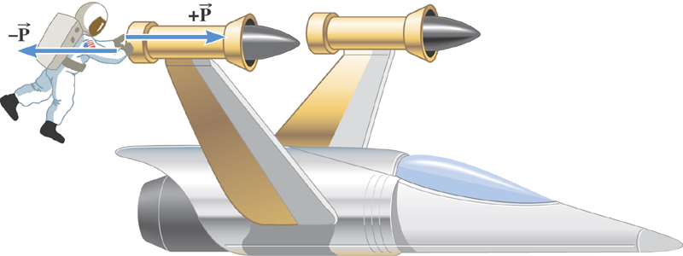
Ex. The Accelerations Produced by Action and Reaction Forces
Which one do you think will get larger acceleration?
Yes, you are right! The astronaut!
Suppose that the magnitude of the force P is 36 N. If the mass of the spacecraft is 11,000 kg and the mass of the astronaut is 92 kg, what are the accelerations?

Slide 7
Ex. continued
Force exerted on the space craft by the astronaut
Force exerted on the astronaut by the space craft
space craft’s acceleration
astronaut’s acceleration

Slide 8
Example of Newton’s 3rd Law
A large man and a small boy stand facing each other on frictionless ice. They put their hands together and push against each other so that they move apart. a) Who moves away with the higher speed and by how much?
F₁₂
F₂₁= - F₁₂
m
M
Since
and
Establish the
equation
Divide by m
8

Slide 9
Example of Newton’s 3rd Law, cnt’d
Man’s velocity
Boy’s velocity
So boy’s velocity is higher than man’s, if M>m, by the ratio of the masses.
b) Who moves farther while their hands are in contact?
Boy’s displacement
Man’s displacement
Given in the same time interval, since the boy has higher acceleration and thereby higher speed, he moves farther than the man.
9

Slide 10
Categories of Forces
Fundamental Forces: Truly unique forces that cannot be derived from any other forces
  Total of three fundamental forces
    Gravitational Force
    Electro-Weak Force
    Strong Nuclear Force
Non-fundamental forces: Forces that can be derived from fundamental forces
  Friction
  Tension in a rope
  Normal or support forces

Slide 11
Gravitational Force and Weight
The attractive force exerted on an object by the Earth
Gravitational Force, F_{g}
Weight of an object with mass M is
Since weight depends on the magnitude of gravitational acceleration, g, it varies depending on geographical location.
By measuring the forces one can determine masses. This is why you can measure mass using the spring scale.

Slide 12
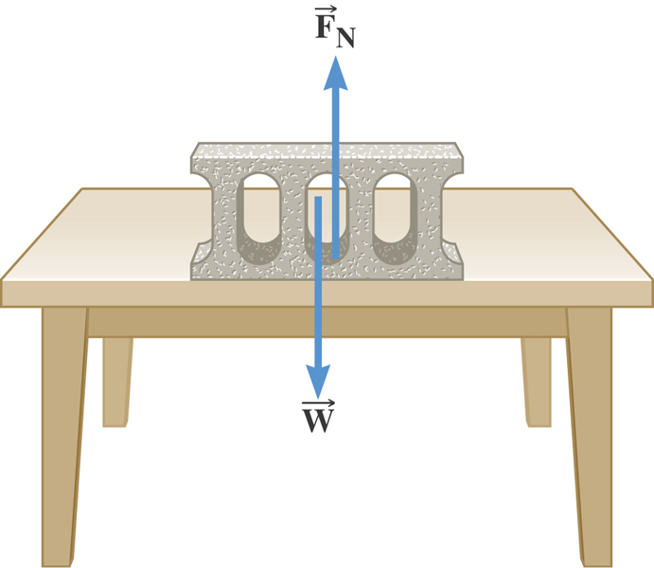
The Normal Force
The normal force is one component of the force that a surface exerts on an object with which it is in contact – namely, the component that is perpendicular to the surface.

Slide 13
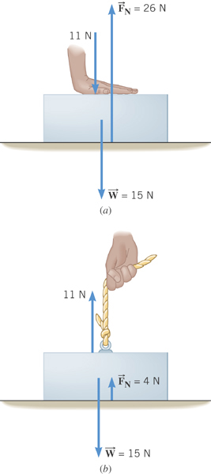
Some normal force exercises
Case 1: Hand pushing down on the book
Case 2: Hand pulling up the book

Slide 14
Some Basic Information
When Newton’s laws are applied, external forces are only of interest!!
Because, as described in Newton’s first law, an object will keep its current motion unless non-zero net external force is applied.
Why?
Reaction force that reacts to action forces due to the surface structure of an object. Its direction is perpendicular to the surface.
Normal Force, n:
Tension, T:
The reactionary force by a stringy object against an external force exerted on it.
A graphical tool which is a diagram of external forces on an object and is extremely useful analyzing forces and motion!! Drawn only on an object.
Free-body diagram

Slide 15
Free Body Diagrams and Solving Problems
Free-body diagram: A diagram of vector forces acting on an object
A great tool to solve a problem using forces or using dynamics
Select a point on an object in the problem
Identify all the forces acting only on the selected object
Define a reference frame with positive and negative axes specified
Draw arrows to represent the force vectors on the selected point
Write down net force vector equation
Write down the forces in components to solve the problems
No matter which one we choose to draw the diagram on, the results should be the same, as long as they are from the same motion
Which one would you like to select to draw FBD?
What do you think are the forces acting on this object?
M
Gravitational force
the force supporting the object exerted by the floor
Which one would you like to select to draw FBD?
What do you think are the forces acting on this elevator?
M_{e}
Gravitational force
The force pulling the elevator (Tension)
What about the box in the elevator?
Gravitational force
Normal force
m

Slide 16
Applications of Newton’s Laws
Suppose you are pulling a box on frictionless ice, using a rope.
What are the forces being exerted on the box?
M
T
Gravitational force: F_{g}
n= -F_{g}
Normal force: n
Free-body diagram
T
Tension force: T
n= -F_{g}
Total force: F=F_{g}+n+T=T
F_{g}=Mg
T
If T is a constant force, a_{x}, is constant
F_{g}=Mg
What happened to the motion in y-direction?

Slide 17
Example for Using Newton’s Laws
A traffic light weighing 125 N hangs from a cable tied to two other cables fastened to a support. The upper cables make angles of 37.0º and 53.0º with the horizontal. Find the tension in the three cables.
y
37º
53º
Free-body
Diagram
T₁
T₂
37º
53º
x
T₃
Newton’s 2nd law
x-comp. of net force
y-comp. of net force

Slide 18
Example w/o Friction
A crate of mass M is placed on a frictionless inclined plane of angle θ.
a) Determine the acceleration of the crate after it is released.
y
y
n
y
M
a
n
x
x
d
Free-body
Diagram
x
F_{g}
θ
θ
F= -Mg
Supposed the crate was released at the top of the incline, and the length of the incline is d. How long does it take for the crate to reach the bottom and what is its speed at the bottom?

Slide 19
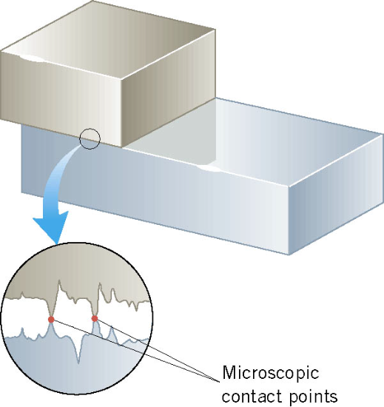
Friction Force
When an object is in contact with a surface there is a force acting on that object. The component of this force that is parallel to the surface is called the friction force.
This resistive force is exerted on a moving object due to
viscosity or other types of frictional property of the medium in or surface on which the object moves.
Always opposite to the movement!!

Slide 20
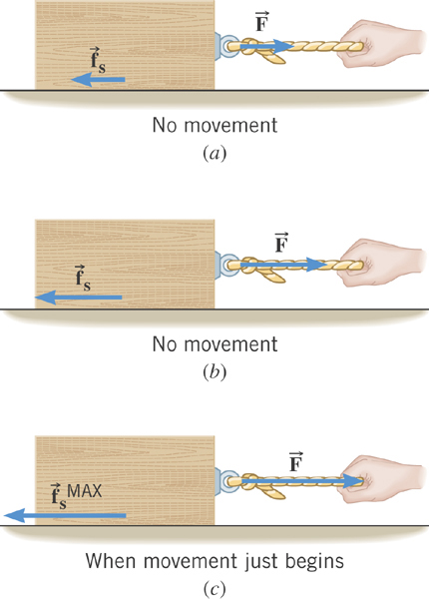
Static Friction
When the two surfaces are not sliding across one another
the friction is called static friction.
The resistive force exerted
on the object up to the time just before the object starts moving.

Slide 21
Magnitude of the Static Friction
The magnitude of the static friction force can have any value from zero up to the maximum value.
is called the coefficient of static friction.
What is the unit?
None
Once the object starts moving, there is NO MORE static friction!!
Kinetic friction applies during the move!!

Slide 22
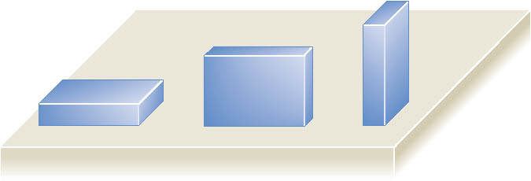
Note that the magnitude of the frictional force does not depend on the contact area of the surfaces.

Slide 23
Kinetic Friction
Static friction opposes the impending relative motion between
two objects.
Kinetic friction opposes the relative sliding motions that is happening. The resistive force exerted on the object during its movement.
Normally much smaller than static friction!!
is called the coefficient of kinetic friction.
What is the direction of friction forces?
opposite to the movement

Slide 24
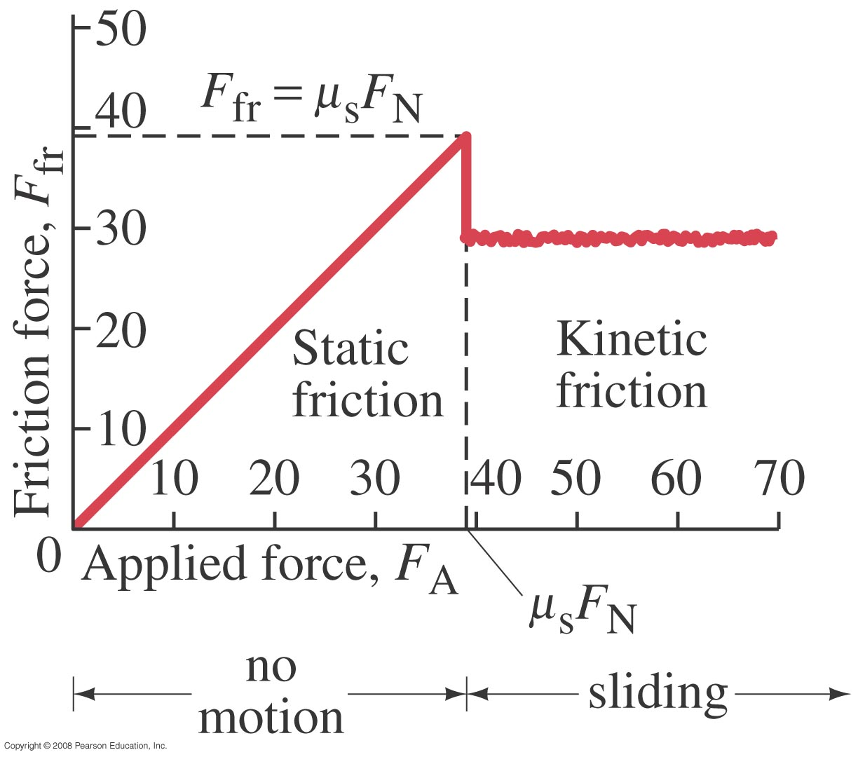
Figure 5.3
Friction Force vs Applied Force

Slide 25
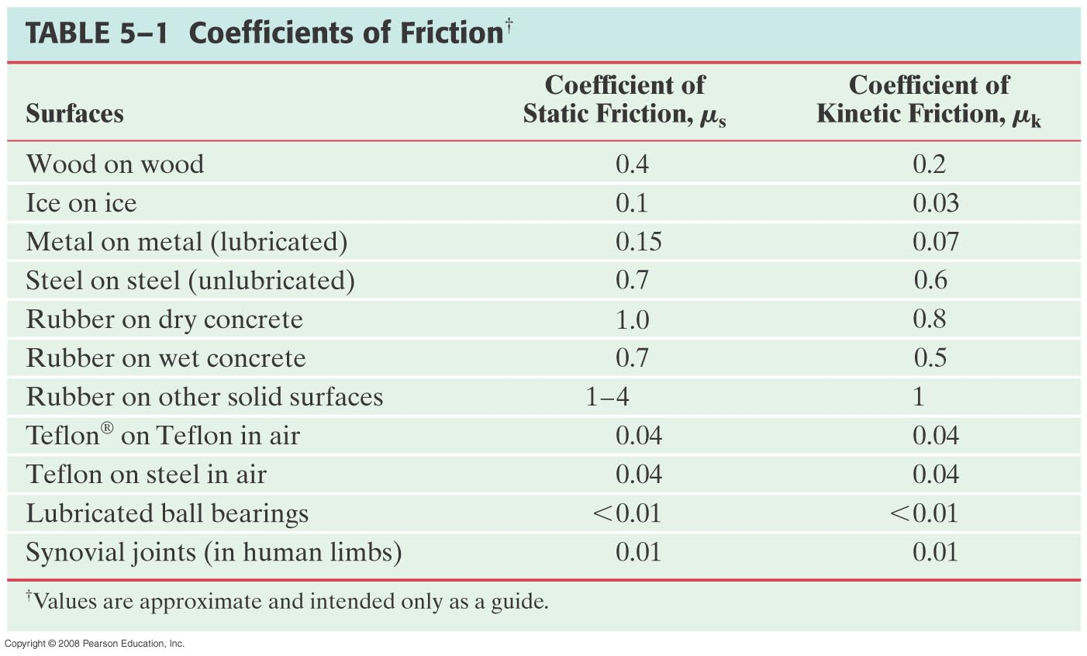
Coefficients of Friction
What are these?

