Slide 1
PHYS 1443 – Section 001
Lecture #7
Wednesday, June 15, 2011
Dr. Jaehoon Yu
Force of friction
Uniform Circular Motion
Motion Under Resistive Forces

Slide 2
Announcements
Mid-term exam
  In the class on Tuesday, June 21, 2011
  Covers: CH 1.1 – what we finish Monday, June 20 plus Appendices A and B
  Mixture of free response problems and multiple choice problems
Reading assignments
  CH5.5 and 5.6

Slide 3
Reminder: Special Project for Extra Credit
A large man and a small boy stand facing each other on frictionless ice. They put their hands together and push against each other so that they move apart. a) Who moves away with the higher speed, by how much and why? b) Who moves farther in the same elapsed time, by how much and why?
Derive the formulae for the two problems above in much more detail and explain your logic in a greater detail than what is in this lecture note.
Be sure to clearly define each variables used in your derivation.
Each problem is 10 points.
Due is Monday, June 20.

Slide 4
Special Project for Extra Credit
A 92kg astronaut tied to an 11000kg space craft with a 100m bungee cord pushes the space craft with a force P=36N in space. Assuming there is no loss of energy at the end of the cord, and the cord does not stretch beyond its original length, the astronaut and the space craft get pulled back to each other by the cord toward a head-on collision. Answer the following questions.
What are the speeds of the astronaut and the space craft just before they collide? (10 points)
What are the magnitudes of the accelerations of the astronaut and the space craft if they come to a full stop in 0.5m from the point of initial contact? (10 points)
What are the magnitudes of the forces exerting on the astronaut and the space craft when they come to a full stop? 6 points)
Due is Wednesday, June 22.

Slide 5
Components and Unit Vectors
Coordinate systems are useful in expressing vectors in their components
y
(+,+)
A_{y}
(A_{x},A_{y})
}Components
A
(-,+)
θ
x
} Magnitude
(-,-)
(+,-)
A_{x}

Slide 6
Unit Vectors
Unit vectors are the ones that tells us the directions of the components
Dimensionless
Magnitudes these vectors are exactly 1
Unit vectors are usually expressed in i, j, k or
So a vector A can be expressed as

Slide 7
Forces of Friction Summary
Resistive force exerted on a moving object due to viscosity or other types frictional property of the medium in or surface on which the object moves.
These forces are either proportional to the velocity or the normal force.
Force of static friction, f_{s}:
The resistive force exerted on the object until just before the beginning of its movement
Empirical Formula
What does this formula tell you?
Frictional force increases till it reaches the limit!!
Beyond the limit, the object moves, and there is NO MORE static friction but the kinetic friction takes it over.
Force of kinetic friction, f_{k}
The resistive force exerted on the object during its movement
Which direction does kinetic friction apply?
Opposite to the motion!

Slide 8
Look at this problem again…
Suppose you are pulling a box on a rough surfice, using a rope.
What are the forces being exerted on the box?
M
T
Gravitational force: F_{g}
Normal force: n
n= -F_{g}
Tension force: T
Free-body diagram
F_{f}
T
Friction force: F_{f}
n= -F_{g}
Net force:
F=F_{g}+n+T+F_{f}
F_{g}=Mg
F_{f}
T
If T is a constant force, a_{x}, is constant
F_{g}=Mg

Slide 9
Example 4.16 w/ Friction
Suppose a block is placed on a rough surface inclined relative to the horizontal. The inclination angle is increased till the block starts to move. Show that by measuring this critical angle, θ_{c}, one can determine coefficient of static friction, μ_{s}.
y
f_{s}=μ_{s}n
n
y
M
Free-body
Diagram
a
n
x
f_{s}=μ_{s}n
x
F_{g}
θ
θ
F= -Mg
Net force
x comp.
y comp.

Slide 10
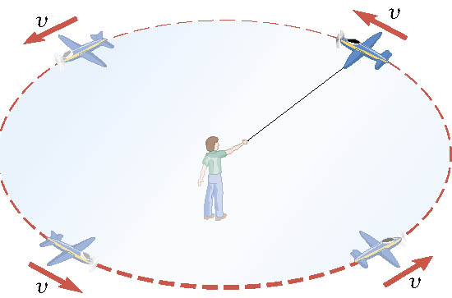
Definition of the Uniform Circular Motion
Uniform circular motion is the motion of an object traveling at a constant speed on a circular path.
Is there an acceleration in this motion?
Yes, you are absolutely right!
There is an acceleration!!

Slide 11
Speed of a uniform circular motion?
Let T be the period of this motion, the time it takes for the object to travel once around the complete circle whose radius is r is

Slide 12
Ex. : A Tire-Balancing Machine
The wheel of a car has a radius of 0.29m and is being rotated at 830 revolutions per minute on a tire-balancing machine. Determine the speed at which the outer edge of the wheel is moving.

Slide 13
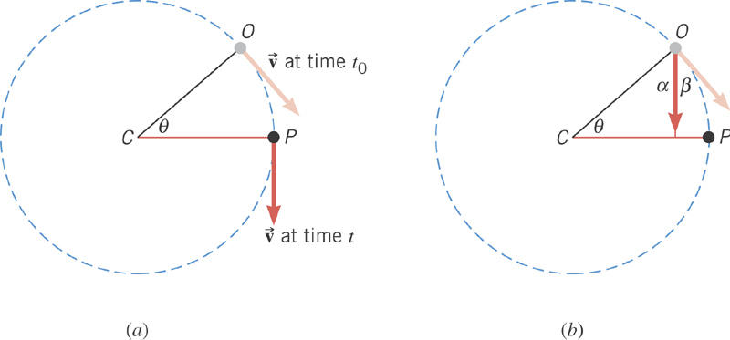
Centripetal Acceleration
In uniform circular motion, the speed is constant, but the direction of the velocity vector is not constant.
The change of direction of the velocity is the same as the change of the angle in the circular motion!

Slide 14
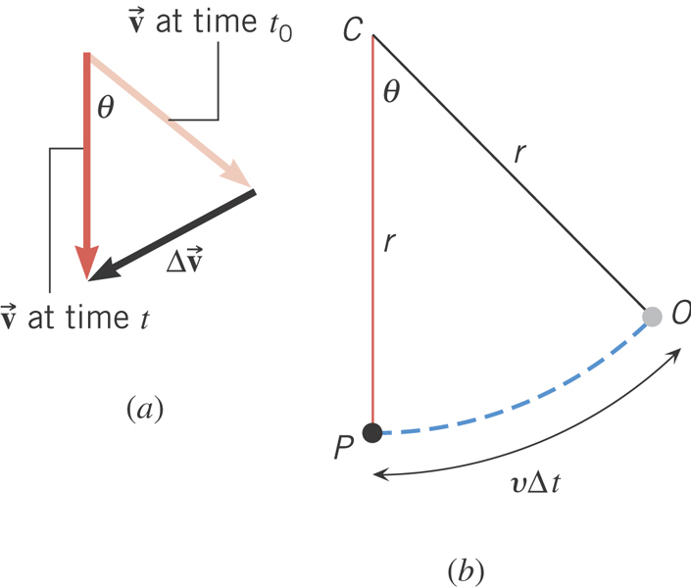
Centripetal Acceleration
From the geometry
What is the direction of a_{c}?
Always toward the center of circle!
Centripetal Acceleration

Slide 15
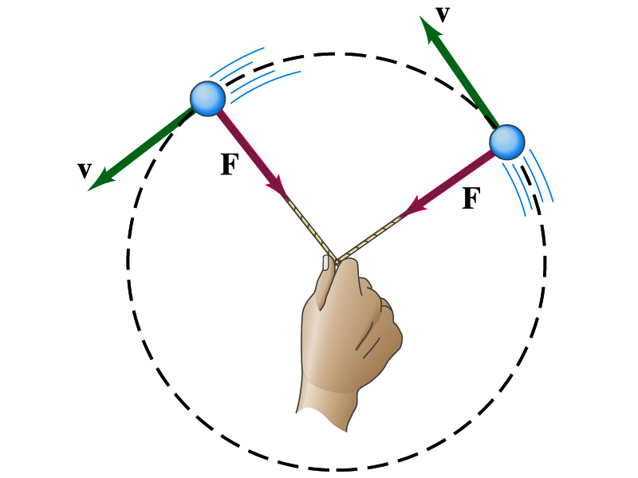
Newton’s Second Law & Uniform Circular Motion
The centripetal * acceleration is always perpendicular to the velocity vector, v, and points to the center of the axis (radial direction) in a uniform circular motion.
Are there forces in this motion? If so, what do they do?
The force that causes the centripetal acceleration acts toward the center of the circular path and causes the change in the direction of the velocity vector. This force is called the centripetal force.
What do you think will happen to the ball if the string that holds the ball breaks?
The external force no longer exist. Therefore, based on Newton’s 1st law, the ball will continue its motion without changing its velocity and will fly away along the tangential direction to the circle.
*Mirriam Webster: Proceeding or acting in the direction toward the center or axis

Slide 16
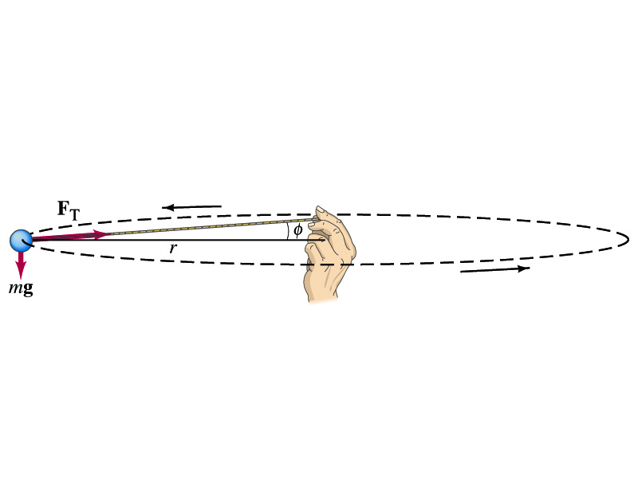
Ex. 5.11 of Uniform Circular Motion
A ball of mass 0.500kg is attached to the end of a 1.50m long cord. The ball is moving in a horizontal circle. If the string can withstand the maximum tension of 50.0 N, what is the maximum speed the ball can attain before the cord breaks?
Centripetal acceleration:
When does the string break?
when the required centripetal force is greater than the sustainable tension.
Calculate the tension of the cord when speed of the ball is 5.00m/s.

Slide 17
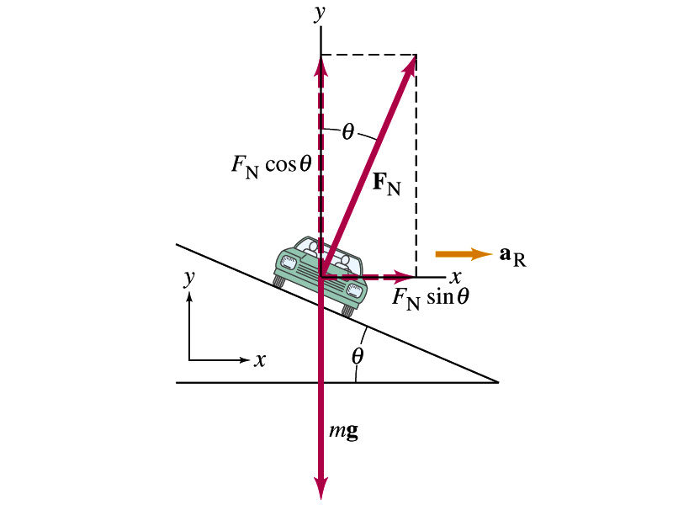
Example 5.15: Banked Highway
(a) For a car traveling with speed v around a curve of radius r, determine the formula for the angle at which the road should be banked so that no friction is required to keep the car from skidding.
y
x comp.
x
y comp.
(b) What is this angle for an expressway off-ramp curve of radius 50m at a design speed of 50km/h?

Slide 18
Forces in Non-uniform Circular Motion
An object has both tangential and radial accelerations.
What does this statement mean?
The object is moving under both tangential and radial forces.
F_{r}
F
F_{t}
These forces cause not only the velocity but also the speed of the ball to change. The object undergoes a curved motion in the absence of constraints, such as a string.
What is the magnitude of the net acceleration?

Slide 19
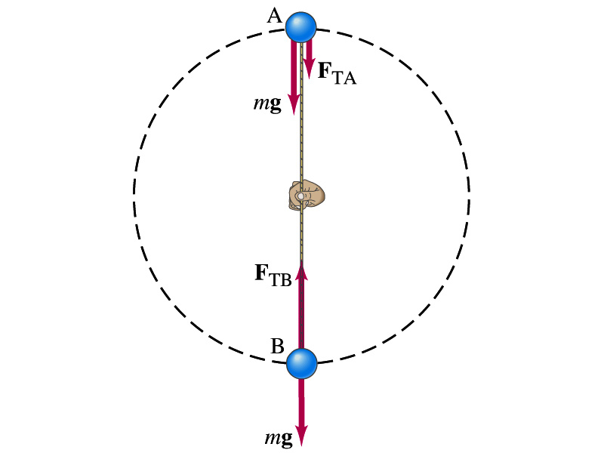
Ex. 5.12 for Non-Uniform Circular Motion
A ball of mass m is attached to the end of a cord of length R. The ball is moving in a vertical circle. Determine the tension of the cord at any instance in which the speed of the ball is v and the cord makes an angle θ with vertical.
V
What are the forces involved in this motion?
m
T
The gravitational force F_{g}
The radial force, T, providing the tension.
θ
R
F_{g}=mg
tangential comp.
Radial comp.
At what angles the tension becomes the maximum and the minimum. What are the tensions?

