Slide 1
PHYS 1443 – Section 001
Lecture #8
Thursday, June 16, 2011
Dr. Jaehoon Yu
Motion Under Resistive Forces
Newton’s Law of Universal Gravitation
Kepler’s Third Law
Satellite Motion
Motion in Accelerated Frames
Today’s homework is homework #4, due 10pm, Monday, June 20!!

Slide 2
Announcements
Mid-term exam
  In the class on Tuesday, June 21, 2011
  Covers: CH 1.1 – what we finish Monday, June 20 plus Appendices A and B
  Mixture of free response problems and multiple choice problems
Quiz 2 results
  Class average: 21.5/35
    Equivalent to 61.4/100
    Previous result: 62.5/100
  Top score: 35/35

Slide 3
Reminder: Special Project for Extra Credit
A large man and a small boy stand facing each other on frictionless ice. They put their hands together and push against each other so that they move apart. a) Who moves away with the higher speed, by how much and why? b) Who moves farther in the same elapsed time, by how much and why?
Derive the formulae for the two problems above in much more detail and explain your logic in a greater detail than what is in this lecture note.
Be sure to clearly define each variables used in your derivation.
Each problem is 10 points.
Due is Monday, June 20.

Slide 4
Reminder: Special Project for Extra Credit
A 92kg astronaut tied to an 11000kg space craft with a 100m bungee cord pushes the space craft with a force P=36N in space. Assuming there is no loss of energy at the end of the cord, and the cord does not stretch beyond its original length, the astronaut and the space craft get pulled back to each other by the cord toward a head-on collision. Answer the following questions.
What are the speeds of the astronaut and the space craft just before they collide? (10 points)
What are the magnitudes of the accelerations of the astronaut and the space craft if they come to a full stop in 0.5m from the point of initial contact? (10 points)
What are the magnitudes of the forces exerting on the astronaut and the space craft when they come to a full stop? 6 points)
Due is Wednesday, June 22.

Slide 5
Special Project
Derive the formula for the gravitational acceleration ( ) at the radius from the center, inside of the Earth. (10 points)
Compute the fractional magnitude of the gravitational acceleration 1km and 500km inside the surface of the Earth with respect to that on the surface. (6 points, 3 points each)
Due at the beginning of the class Monday, June 27

Slide 6
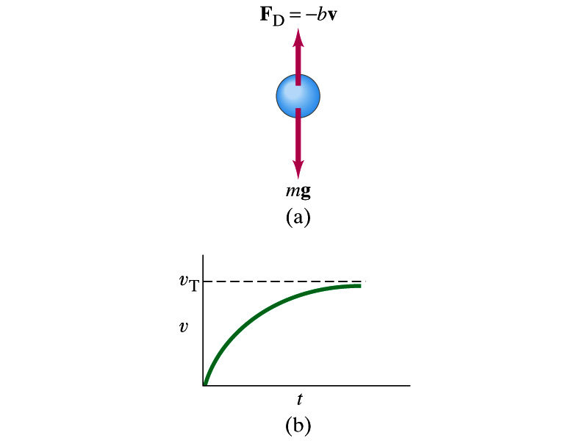
Motion in Resistive Forces
Medium can exert resistive forces on an object moving through it due to viscosity or other types frictional properties of the medium.
Some examples?
Air resistance, viscous force of liquid, etc
These forces are exerted on moving objects in the opposite direction of the movement.
These forces are proportional to such factors as speed. They almost always increase with increasing speed.
Two different cases of proportionality:
  Forces linearly proportional to speed: Slowly moving or very small objects
  Forces proportional to square of speed: Large objects w/ reasonable speed

Slide 7
Newton’s Law of Universal Gravitation
People have been very curious about the stars in the sky, making observations for a long time. The data people collected, however, have not been explained until Newton has discovered the law of gravitation.
Every object in the universe attracts every other object with a force that is directly proportional to the product of their masses and inversely proportional to the square of the distance between them.
How would you write this law mathematically?
With G
G is the universal gravitational constant, and its value is
Unit?
This constant is not given by the theory but must be measured by experiments.
This form of forces is known as the inverse-square law, because the magnitude of the force is inversely proportional to the square of the distances between the objects.

Slide 8
Free Fall Acceleration & Gravitational Force
The weight of an object with mass m is mg. Using the force exerting on an object of mass m on the surface of the Earth, one can obtain
What would the gravitational acceleration be if the object is at an altitude h above the surface of the Earth?
Distance from the center of the Earth to the object at the altitude h.
What do these tell us about the gravitational acceleration?
The gravitational acceleration is independent of the mass of the object
The gravitational acceleration decreases as the altitude increases
If the distance from the surface of the Earth gets infinitely large, the weight of the object approaches 0.

Slide 9
Ex. 6.2 for Gravitational Force
The international space station is designed to operate at an altitude of 350km. Its designed weight (measured on the surface of the Earth) is 4.22x10⁶N. What is its weight in its orbit?
The total weight of the station on the surface of the Earth is
M_{E}
Since the orbit is at 350km above the surface of the Earth, the gravitational force at that altitude is
Therefore the weight in the orbit is

Slide 10
Example for Universal Gravitation
Using the fact that g=9.80m/s² on the Earth’s surface, find the average density of the Earth.
Since the gravitational acceleration is
Solving for g
Solving for M_{E}
Therefore the density of the Earth is

Slide 11
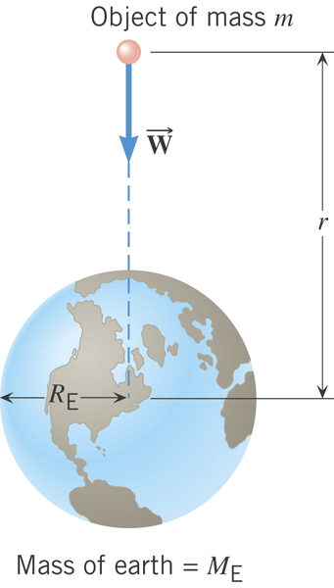
Gravitational Acceleration
On the surface of the Earth
Gravitational acceleration at distance r from the center of the earth!
What is the SI unit of g?
m/s²

Slide 12
Period of a Satellite in an Orbit
Speed of a satellite
Square either side and solve for T2
Period of a satellite
Kepler’s 3rd Law
This is applicable to any satellite or even for planets and moons.

Slide 13
Example of Kepler’s Third Law
Calculate the mass of the Sun using the fact that the period of the Earth’s orbit around the Sun is 3.16x10⁷s, and its distance from the Sun is 1.496x10¹¹m.
Using Kepler’s third law.
The mass of the Sun, M_{s}, is

Slide 14
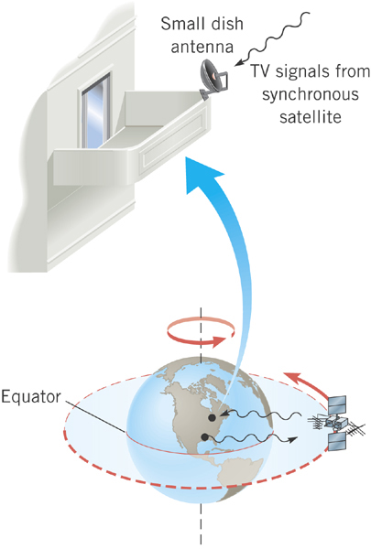
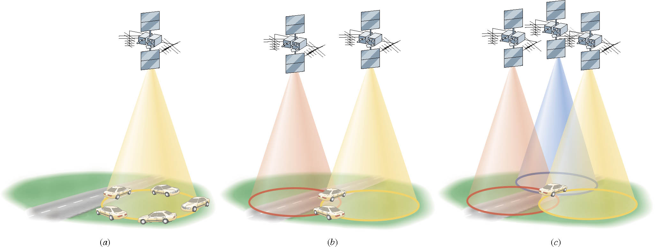
Geo-synchronous Satellites
Global Positioning System (GPS)
Satellite TV
What period should these satellites have?
The same as the earth!!
24 hours

Slide 15
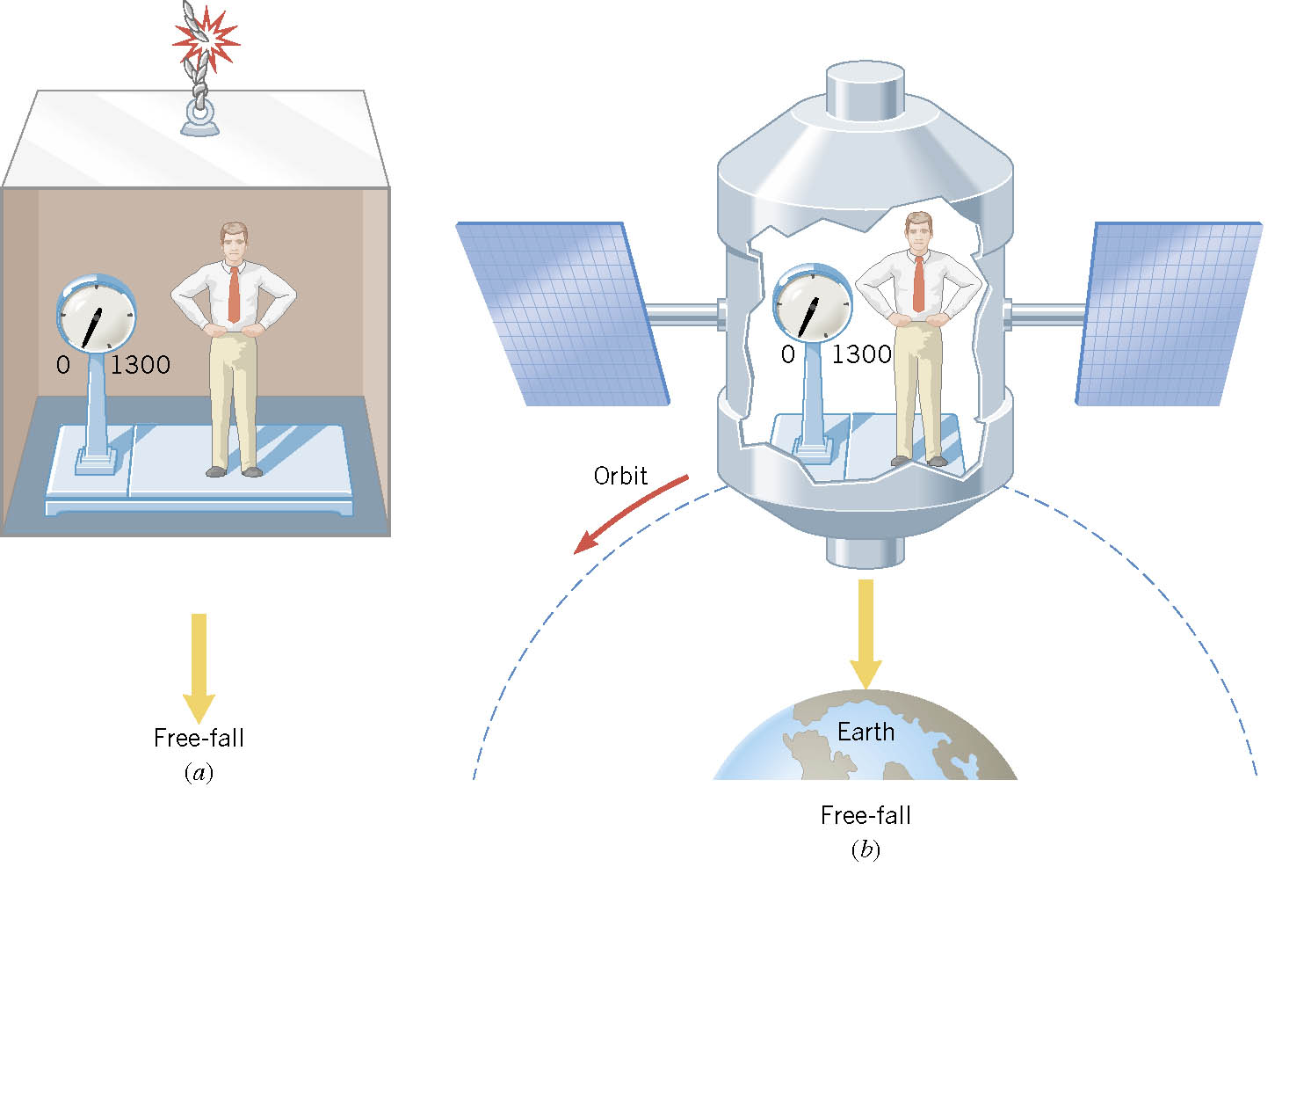
Ex. Apparent Weightlessness and Free Fall
0
0
In each case, what is the weight recorded by the scale?

Slide 16
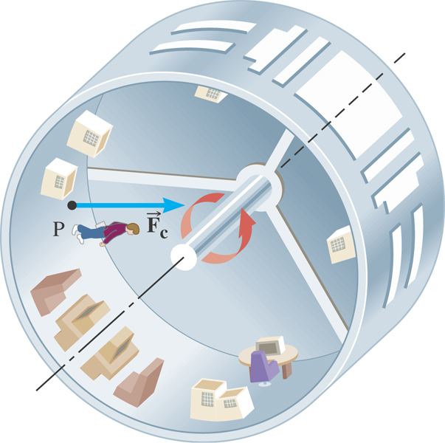
Ex. Artificial Gravity
At what speed must the surface of the space station move so that the astronaut experiences a push on his feet equal to his weight on earth? The radius is 1700 m.

Slide 17
The Law of Gravity and Motions of Planets
Newton assumed that the law of gravitation applies the same whether it is to the apple or to the Moon.
The interacting bodies are assumed to be point like objects.
Newton predicted that the ratio of the Moon’s acceleration a_{M} to the apple’s acceleration g would be
Moon
Apple
g
a_{M}
v
R_{E}
Therefore the centripetal acceleration of the Moon, a_{M,} is
Newton also calculated the Moon’s orbital acceleration a_{M} from the knowledge of its distance from the Earth and its orbital period, T=27.32 days=2.36x10⁶s
This means that the distance to the Moon is about 60 times that of the Earth’s radius, and its acceleration is reduced by the square of the ratio. This proves that the inverse square law is valid.

Slide 18
Motion in Accelerated Frames
Newton’s laws are valid only when observations are made in an inertial frame of reference. What happens in a non-inertial frame?
Fictitious forces are needed to apply Newton’s second law in an accelerated frame.
This force does not exist when the observations are made in an inertial reference frame.
What does this mean and why is this true?
Let’s consider a free ball inside a box under uniform circular motion.
How does this motion look like in an inertial frame (or frame outside a box)?
v
We see that the box has a radial force exerted on it but none on the ball directly
F_{r}
r
How does this motion look like in the box?
The ball is tumbled over to the wall of the box and feels that it is getting force that pushes it toward the wall.
Why?
According to Newton’s first law, the ball wants to continue on its original movement but since the box is turning, the ball feels like it is being pushed toward the wall relative to everything else in the box.

Slide 19
Example of Motion in Accelerated Frames
A ball of mass m is hung by a cord to the ceiling of a boxcar that is moving with an acceleration a. What do the inertial observer at rest and the non-inertial observer traveling inside the car conclude? How do they differ?
This is how the ball looks like no matter which frame you are in.
θ
a_{c}
How do the free-body diagrams look for two frames?
m
How do the motions interpreted in these two frames? Any differences?
For an inertial frame observer, the forces being exerted on the ball are only T and F_{g}. The acceleration of the ball is the same as that of the box car and is provided by the x component of the tension force.
Inertial Frame
T
θ
m
F_{g}=mg
In the non-inertial frame observer, the forces being exerted on the ball are T, F_{g}, and F_{fic}.
For some reason the ball is under a force, F_{fic}, that provides acceleration to the ball.
Non-Inertial Frame
T
θ
F_{fic}
m
F_{g}=mg
While the mathematical expression of the acceleration of the ball is identical to that of inertial frame observer’s, the cause of the force is dramatically different.

