Slide 1
PHYS 1443 – Section 001
Lecture #9
Monday, June 20, 2011
Dr. Jaehoon Yu
Work Done By A Constant Force
Scalar Product of Vectors
Work Done By A Varying Force
Kinetic Energy, Work-Kinetic Energy Theorem
Work and Energy Involving Kinetic Friction
Potential Energy and the Conservative Force
Today’s homework is homework #5, due 10pm, Thursday, June 23!!

Slide 2
Announcements
Mid-term exam
  8 – 10am, in the class tomorrow, Tuesday, June 21, 2011
  Covers: CH 1.1 – what we finish today (CH7.4) plus Appendices A and B
  Mixture of free response problems and multiple choice problems
Bring the special project #3 during the intermission

Slide 3
Reminder: Special Project for Extra Credit
A 92kg astronaut tied to an 11000kg space craft with a 100m bungee cord pushes the space craft with a force P=36N in space. Assuming there is no loss of energy at the end of the cord, and the cord does not stretch beyond its original length, the astronaut and the space craft get pulled back to each other by the cord toward a head-on collision. Answer the following questions.
What are the speeds of the astronaut and the space craft just before they collide? (10 points)
What are the magnitudes of the accelerations of the astronaut and the space craft if they come to a full stop in 0.5m from the point of initial contact? (10 points)
What are the magnitudes of the forces exerting on the astronaut and the space craft when they come to a full stop? 6 points)
Due is Wednesday, June 22.

Slide 4
Special Project
Derive the formula for the gravitational acceleration ( ) at the radius from the center, inside of the Earth. (10 points)
Compute the fractional magnitude of the gravitational acceleration 1km and 500km inside the surface of the Earth with respect to that on the surface. (6 points, 3 points each)
Due at the beginning of the class Monday, June 27

Slide 5
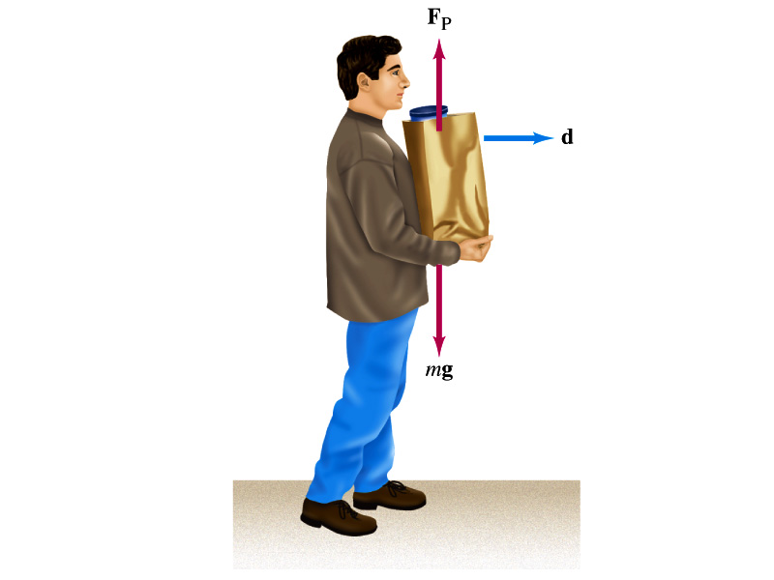
Let’s think about the meaning of work!
A person is holding a grocery bag and walking at a constant velocity.
Is he doing any work ON the bag?
  No
  Why not?
  Because the force he exerts on the bag, F_{p}, is perpendicular to the displacement!!
  This means that he is not adding any energy to the bag.
So what does this mean?
  In order for a force to perform any meaningful work, the energy of the object the force exerts on must change!!
What happened to the person?
  He spends his energy just to keep the bag up but did not perform any work on the bag.

Slide 6
Work Done by the Constant Force
A meaningful work in physics is done only when the net forces exerted on an object changes the energy of the object.
y
F
Free Body
Diagram
θ
M
M
θ
x
d
Which force did the work?
Force
Why?
What kind?
Scalar
Unit?
How much work did it do?
What does this mean?
Physically meaningful work is done only by the component of the force along the direction of the motion of the object.
Work is an energy transfer!!

Slide 7
Scalar Product of Two Vectors
Product of magnitude of the two vectors and the cosine of the angle between them
Operation is commutative
Operation follows the distribution law of multiplication
Scalar products of Unit Vectors
How does scalar product look in terms of components?
=0

Slide 8
Example of Work by Scalar Product
A particle moving on the xy plane undergoes a displacement d=(2.0i+3.0j)m as a constant force F=(5.0i+2.0j) N acts on the particle.
Y
a) Calculate the magnitude of the displacement and that of the force.
F
d
X
b) Calculate the work done by the force F.
Can you do this using the magnitudes and the angle between d and F?

Slide 9
Example of Work w/ Constant Force
A man cleaning a floor pulls a vacuum cleaner with a force of magnitude F=50.0N at an angle of 30.0º with East. Calculate the work done by the force on the vacuum cleaner as the vacuum cleaner is displaced by 3.00m to East.
F
M
30^{ο}
M
d
Does work depend on mass of the object being worked on?
No
Why ?
This is because the work done by the force bringing the object to a displacement d is constant independent of the mass of the object being worked on. The only difference would be the acceleration and the final speed of each of the objects after the completion of the work!!

Slide 10
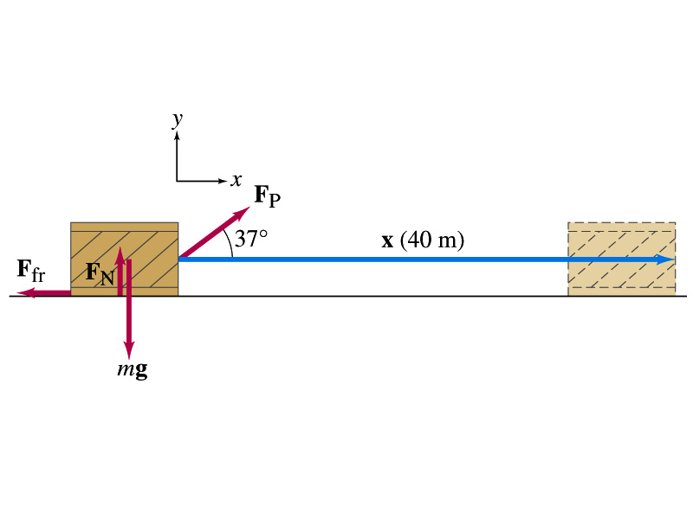
Ex. 7.1 Work done on a crate
A person pulls a 50kg crate 40m along a horizontal floor by a constant force F_{p}=100N, which acts at a 37º angle as shown in the figure. The floor is rough and exerts a friction force F_{fr}=50N. Determine (a) the work done by each force and (b) the net work done on the crate.
What are the forces exerting on the crate?
F_{p}
F_{fr}
F_{G}=-mg
F_{N}=+mg
Which forces perform the work on the crate?
F_{p}
F_{fr}
Work done on the crate by F_{G}
Work done on the crate byF_{N}
Work done on the crate by F_{p}:
Work done on the crate by F_{fr}:
So the net work on the crate
This is the same as

Slide 11
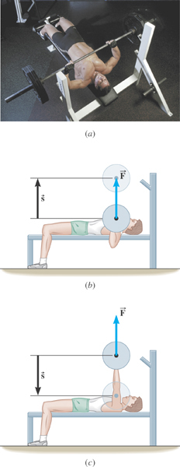
Ex. Bench Pressing and The Concept of Negative Work
A weight lifter is bench-pressing a barbell whose weight is 710N a distance of 0.65m above his chest. Then he lowers it the same distance. The weight is raised and lowered at a constant velocity. Determine the work in the two cases.
What is the angle between the force and the displacement?
What does the negative work mean?
The gravitational force does the work on the weight lifter!

Slide 12
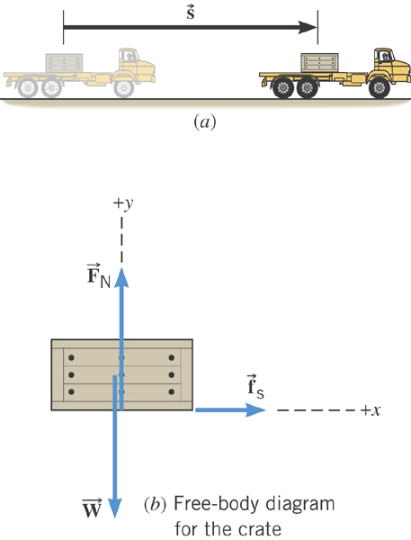
Ex. Accelerating a Crate
The truck is accelerating at a rate of +1.50 m/s². The mass of the crate is 120-kg and it does not slip. The magnitude of the displacement is 65 m. What is the total work done on the crate by all of the forces acting on it?
What are the forces acting in this motion?
Gravitational force on the crate, weight, W or F_{g}
Normal force force on the crate, F_{N}
Static frictional force on the crate, f_{s}

Slide 13
Ex. Continued…
Let’s figure out what the work done by each force in this motion is.
Work done by the gravitational force on the crate, W or F_{g}
Work done by Normal force force on the crate, F_{N}
Work done by the static frictional force on the crate, f_{s}
Which force did the work?
Static frictional force on the crate, f_{s}
How?
By holding on to the crate so that it moves with the truck!

Slide 14
Work Done by the Varying Force
If the force depends on the position of the object in motion,
one must consider the work in small segments of the displacement where the force can be considered constant
  Then add all the work-segments throughout the entire motion (x_{i}→ x_{f})
In the limit where Δx→0
  If more than one force is acting, the net work done by the net force is
One of the position dependent forces is the force by the spring
The work done by the spring force is
Hooke’s Law

Slide 15
Kinetic Energy and Work-Kinetic Energy Theorem
Some problems are hard to solve using Newton’s second law
  If forces exerting on an object during the motion are complicated
  Relate the work done on the object by the net force to the change of the speed of the object
ΣF
Suppose net force ΣF was exerted on an object for displacement d to increase its speed from v_{i} to v_{f}.
M
M
v_{i}
v_{f}
The work on the object by the net force ΣF is
s
Using the kinematic equation of motion
Kinetic Energy
Work
Work
Work done by the net force causes change in the object’s kinetic energy.
Work-Kinetic Energy Theorem

Slide 16
Work and Kinetic Energy
A meaningful work in physics is done only when the sum of the forces exerted on an object made a motion to the object.
What does this mean?
However much tired your arms feel, if you were just holding an object without moving it you have not done any physical work to the object.
Mathematically, the work is written as the product of magnitudes of the net force vector, the magnitude of the displacement vector and the angle between them.
Kinetic Energy is the energy associated with the motion and capacity to perform work. Work causes change of energy after the completion⬅ Work-Kinetic energy theorem
Nm=Joule

Slide 17
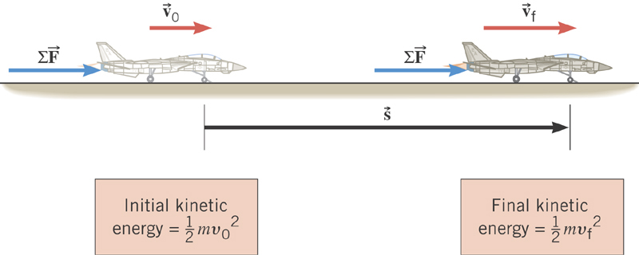
Work-Kinetic Energy Theorem
When a net external force by the jet engine does work on and object, the kinetic energy of the object changes according to

Slide 18
Example for Work-KE Theorem
A 6.0kg block initially at rest is pulled to East along a horizontal, frictionless surface by a constant horizontal force of 12N. Find the speed of the block after it has moved 3.0m.
M
F
M
Work done by the force F is
v_{i}=0
v_{f}
d
From the work-kinetic energy theorem, we know
Since initial speed is 0, the above equation becomes
Solving the equation for v_{f}, we obtain

Slide 19
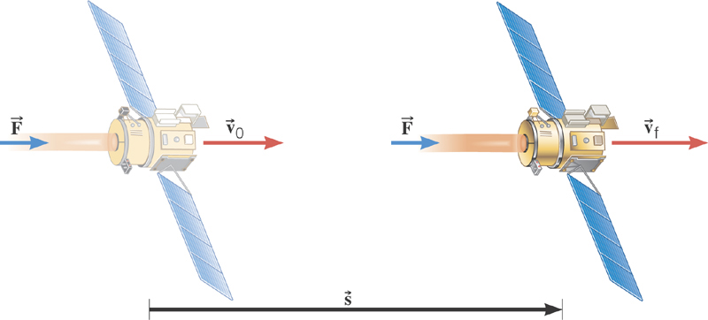
Ex. Deep Space 1
The mass of the space probe is 474-kg and its initial speed is 275 m/s. If the 56.0-mN force acts on the probe parallel through a displacement of 2.42×10⁹m, what is its final speed?
Solve for v_{f}

Slide 20
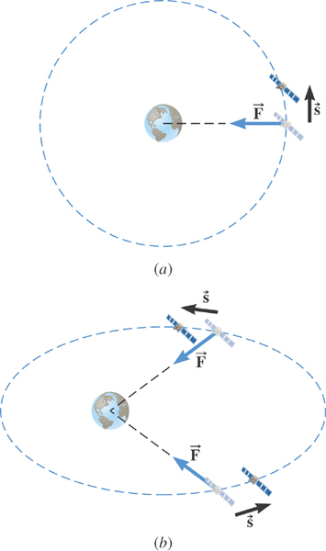
Ex. Satellite Motion and Work By the Gravity
A satellite is moving about the earth in a circular orbit and an elliptical orbit. For these two orbits, determine whether the kinetic energy of the satellite changes during the motion.
For a circular orbit
No change!
Why not?
Gravitational force is the only external force but it is perpendicular to the displacement. So no work.
For an elliptical orbit
Changes!
Why?
Gravitational force is the only external force but its angle with respect to the displacement varies. So it performs work.

Slide 21
Work and Energy Involving Kinetic Friction
What do you think the work looks like if there is friction?
  Static friction does not matter! Why?
  Then which friction matters?
It isn’t there when the object is moving.
Kinetic Friction
Friction force F_{fr} works on the object to slow down
F_{fr}
M
M
The work on the object by the friction F_{fr} is
v_{i}
v_{f}
d
The negative sign means that the work is done on the friction!
The final kinetic energy of an object, taking into account its initial kinetic energy, friction force and all other sources of work, is
t=0, KE_{i}
Friction,
Engine work
t=T, KE_{f}

Slide 22
Example of Work Under Friction
A 6.0kg block initially at rest is pulled to East along a horizontal surface with coefficient of kinetic friction μ_{k}=0.15 by a constant horizontal force of 12N. Find the speed of the block after it has moved 3.0m.
M
F
M
Work done by the force F is
F_{k}
v_{i}=0
v_{f}
d=3.0m
Work done by friction F_{k} is
Thus the total work is
Using work-kinetic energy theorem and the fact that initial speed is 0, we obtain
Solving the equation
for v_{f}, we obtain

Slide 23
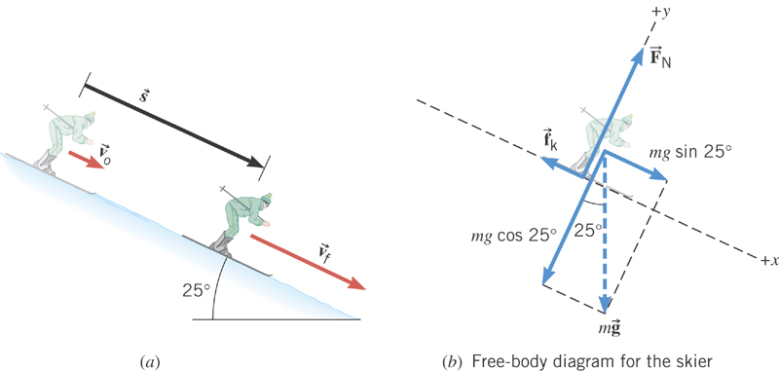
Ex. Downhill Skiing
A 58kg skier is coasting down a 25º slope. A kinetic frictional force of magnitude f_{k}=70N opposes her motion. At the top of the slope, the skier’s speed is v₀=3.6m/s. Ignoring air resistance, determine the speed v_{f} at the point that is displaced 57m downhill.
y
x
What are the forces in this motion?
Gravitational force: F_{g}
Normal force: F_{N}
Kinetic frictional force: f_{k}
What are the X and Y component of the net force in this motion?
Y component
From this we obtain
What is the coefficient of kinetic friction?

Slide 24
Ex. Now with the X component
X component
Total work by this force
From work-kinetic energy theorem
Solving for v_{f}
What is her acceleration?

