Slide 1
PHYS 1443 – Section 001
Lecture #10
Wednesday, June 22, 2011
Dr. Jaehoon Yu
Potential Energy and the Conservative Force
  Gravitational Potential Energy
  Elastic Potential Energy
Conservation of Energy
Energy Diagram
General Energy Conservation & Mass Equivalence
More on gravitational potential energy
  Escape speed
Power

Slide 2
Special Project
Derive the formula for the gravitational acceleration ( ) at the radius from the center, inside of the Earth. (10 points)
Compute the fractional magnitude of the gravitational acceleration 1km and 500km inside the surface of the Earth with respect to that on the surface. (6 points, 3 points each)
Due at the beginning of the class Monday, June 27

Slide 3
Valid Planetarium Shows
Regular shows
  TX star gazing; Nanocam; Ice Worlds
Private shows for a group of 15 or more
  Bad Astronomy; Black Holes; IBEX; Magnificent Sun
  Microcosm; Stars of the Pharaohs; Time Space
  Two Small Pieces of Glass; SOFIA
  Violent Universe; Wonders of the Universe
Please watch the show and obtain the signature on the back of the ticket stub

Slide 4
Potential Energy & Conservation of Mechanical Energy
Energy associated with a system of objects ➔ Stored energy which has the potential or the possibility to work or to convert to kinetic energy
In order to describe potential energy, U, a system must be defined.
What does this mean?
The concept of potential energy can only be used under the special class of forces called the conservative force which results in the principle of conservation of mechanical energy.
What are other forms of energies in the universe?
Mechanical Energy
Chemical Energy
Biological Energy
Electromagnetic Energy
Nuclear Energy
These different types of energies are stored in the universe in many different forms!!!
If one takes into account ALL forms of energy, the total energy in the entire universe is conserved. It just transforms from one form to another.

Slide 5
Gravitational Potential Energy
This potential energy is given to an object by the gravitational field in the system of Earth by virtue of the object’s height from an arbitrary zero level
When an object is falling, the gravitational force, Mg, performs the work on the object, increasing the object’s kinetic energy. So the potential energy of an object at height h, the potential to do work, is expressed as
m
h_{i}
mg
m
The work done on the object by the gravitational force as the brick drops from h_{i} to h_{f} is:
h_{f}
(since )
What does this mean?
Work by the gravitational force as the brick drops from y_{i} to y_{f} is the negative change of the system’s potential energy
➔ Potential energy was spent in order for the gravitational force to increase the brick’s kinetic energy.

Slide 6
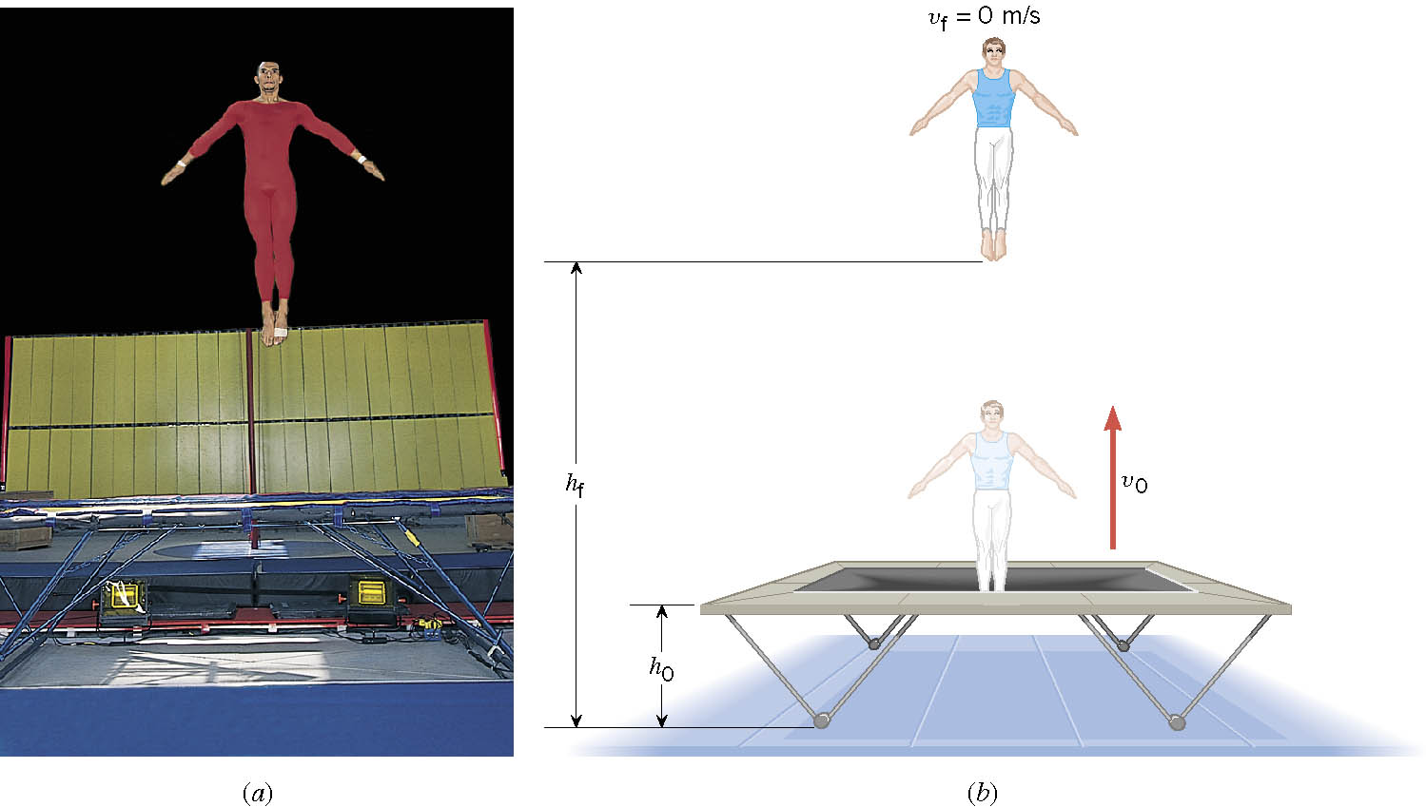
Ex. A Gymnast on a Trampoline
The gymnast leaves the trampoline at an initial height of 1.20 m and reaches a maximum height of 4.80 m before falling back down. What was the initial speed of the gymnast?

Slide 7
Ex. Continued
From the work-kinetic energy theorem
Work done by the gravitational force
Since at the maximum height, the final speed is 0. Using work-KE theorem, we obtain

Slide 8
Conservative Forces and Potential Energy
The work done on an object by a conservative force is equal to the decrease in the potential energy of the system
What does this statement tell you?
The work done by a conservative force is equal to the negative change of the potential energy associated with that force.
Only the changes in potential energy of a system is physically meaningful!!
We can rewrite the above equation in terms of the potential energy U
So the potential energy associated with a conservative force at any given position becomes
Potential energy function
What can you tell from the potential energy function above?
Since U_{i} is a constant, it only shifts the resulting U_{f}(x) by a constant amount. One can always change the initial potential so that U_{i} can be 0.

Slide 9
More Conservative and Non-conservative Forces
The work done on an object by the gravitational force does not depend on the object’s path in the absence of a retardation force.
N
When directly falls, the work done on the object by the gravitation force is
m
h
l
When sliding down the hill of length l, the work is
mg
θ
How about if we lengthen the incline by a factor of 2, keeping the height the same??
Still the same amount of work☺
So the work done by the gravitational force on an object is independent of the path of the object’s movements. It only depends on the difference of the object’s initial and final position in the direction of the force.
Forces like gravitational and elastic forces are called the conservative force
If the work performed by the force does not depend on the path.
If the work performed on a closed path is 0.
Total mechanical energy is conserved!!

Slide 10
Example for Potential Energy
A bowler drops bowling ball of mass 7kg on his toe. Choosing the floor level as y=0, estimate the total work done on the ball by the gravitational force as the ball falls on the toe.
Let’s assume the top of the toe is 0.03m from the floor and the hand was 0.5m above the floor.
M
b) Perform the same calculation using the top of the bowler’s head as the origin.
What has to change?
First we must re-compute the positions of the ball in his hand and on his toe.
Assuming the bowler’s height is 1.8m, the ball’s original position is –1.3m, and the toe is at –1.77m.

Slide 11
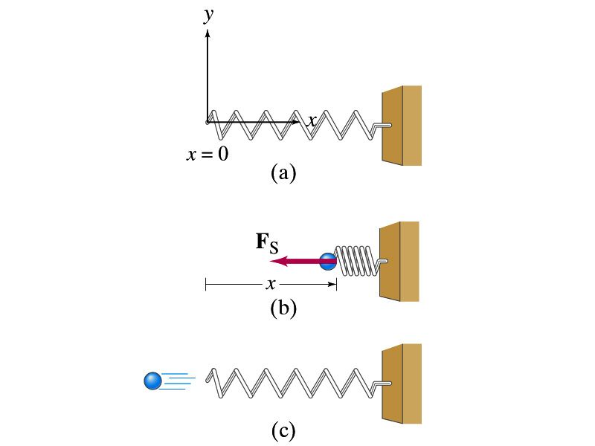
Elastic Potential Energy
Potential energy given to an object by a spring or an object with elasticity in the system that consists of an object and the spring.
The force spring exerts on an object when it is distorted from its equilibrium by a distance x is
Hooke’s Law
The work performed on the object by the spring is
The potential energy of this system is
What do you see from the above equations?
The work done on the object by the spring depends only on the initial and final position of the distorted spring.
Where else did you see this trend?
The gravitational potential energy, U_{g}
So what does this tell you about the elastic force?
A conservative force!!!

Slide 12
Conservation of Mechanical Energy
Total mechanical energy is the sum of kinetic and potential energies
Let’s consider a brick of mass m at the height h from the ground
What is the brick’s potential energy?
m
h
mg
What happens to the energy as the brick falls to the ground?
m
The brick gains speed
By how much?
h₁
So what?
The brick’s kinetic energy increases
And?
The lost potential energy is converted to kinetic energy!!
The total mechanical energy of a system remains constant in any isolated system of objects that interacts only through conservative forces: Principle of mechanical energy conservation
What does this mean?

Slide 13
Example
A ball of mass m at rest is dropped from the height h above the ground. a) Neglecting air resistance determine the speed of the ball when it is at the height y above the ground.
PE
KE
Using the principle of mechanical energy conservation
m
mgh
0
mv_{i}²/2
h
mg
m
mgy
mv²/2
mv_{f}²/2
b) Determine the speed of the ball at y if it had initial speed v_{i} at the time of the release at the original height h.
y
Again using the principle of mechanical energy conservation but with non-zero initial kinetic energy!!!
0
This result look very similar to a kinematic expression, doesn’t it? Which one is it?

Slide 14
Example
A ball of mass m is attached to a light cord of length L, making up a pendulum. The ball is released from rest when the cord makes an angle θ_{A} with the vertical, and the pivoting point P is frictionless. Find the speed of the ball when it is at the lowest point, B.
Compute the potential energy at the maximum height, h. Remember where the 0 is.
PE
L
KE
_{θA}
T
mgh
h{
m
0
Using the principle of mechanical energy conservation
0
m
mg
B
mv²/2
b) Determine tension T at the point B.
Using Newton’s 2nd law of motion and recalling the centripetal acceleration of a circular motion
Cross check the result in a simple situation. What happens when the initial angle θ_{A} is 0?

Slide 15
Work Done by Non-conservative Forces
Mechanical energy of a system is not conserved when any one of the forces in the system is a non-conservative (dissipative) force.
Two kinds of non-conservative forces:
Applied forces: Forces that are external to the system. These forces can take away or add energy to the system. So the mechanical energy of the system is no longer conserved.
If you were to hit a free falling ball , the force you apply to the ball is external to the system of the ball and the Earth. Therefore, you add kinetic energy to the ball-Earth system.
Kinetic Friction: Internal non-conservative force that causes irreversible transformation of energy. The friction force causes the kinetic and potential energy to transfer to internal energy

Slide 16
Example of Non-Conservative Force
A skier starts from rest at the top of frictionless hill whose vertical height is 20.0m and the inclination angle is 20º. Determine how far the skier can get on the snow at the bottom of the hill when the coefficient of kinetic friction between the ski and the snow is 0.210.
Compute the speed at the bottom of the hill, using the mechanical energy conservation on the hill before friction starts working at the bottom
Don’t we need to know the mass?
h=20.0m
θ=20º
The change of kinetic energy is the same as the work done by the kinetic friction.
What does this mean in this problem?
Since we are interested in the distance the skier can get to before stopping, the friction must do as much work as the available kinetic energy to take it all away.
Since
Well, it turns out we don’t need to know the mass.
What does this mean?
No matter how heavy the skier is he will get as far as anyone else has gotten starting from the same height.

Slide 17
How is the conservative force related to the potential energy?
Work done by a force component on an object through the displacement Δx is
For an infinitesimal displacement Δx
Results in the conservative force-potential relationship
This relationship says that any conservative force acting on an object within a given system is the same as the negative derivative of the potential energy of the system with respect to the position.
Does this statement make sense?
1. spring-ball system:
2. Earth-ball system:
The relationship works in both the conservative force cases we have learned!!!

