Slide 1
PHYS 1443 – Section 001
Lecture #12
Monday, June 27, 2011
Dr. Jaehoon Yu
Linear Momentum and Forces
Linear Momentum Conservation
Impulse and Linear Momentum
Collisions
Today’s homework is homework #7, due 10pm, Thursday, June 30!!

Slide 2
Announcements
Quiz #3 tomorrow, Wednesday, June 29
  Beginning of the class
  Covers CH8.1 through what we learn tomorrow, Tuesday, June 28
Mid-term grade discussions
  Second half of the class
  I strongly urge you all to come and discuss your grades
Bring your special projects to the grade discussion if you haven’t already submitted

Slide 3
Linear Momentum
The principle of energy conservation can be used to solve problems that are harder to solve just using Newton’s laws. It is used to describe motion of an object or a system of objects.
A new concept of linear momentum can also be used to solve physical problems, especially the problems involving collisions of objects.
Linear momentum of an object of mass m moving at the velocity v is defined as
What can you tell from this definition about momentum?
Momentum is a vector quantity.
The heavier the object the higher the momentum
The higher the velocity the higher the momentum
Its unit is kg.m/s
What else can use see from the definition? Do you see force?
The change of momentum in a given time interval

Slide 4
Linear Momentum and Forces
What can we learn from this force-momentum relationship?
The rate of the change of particle’s momentum is the same as the net force exerted on it.
When the net force is 0, the particle’s linear momentum is a constant as a function of time.
If a particle is isolated, the particle experiences no net force. Therefore its momentum does not change and is conserved.
Something else we can do with this relationship. What do you think it is?
The relationship can be used to study the case where the mass changes as a function of time.
Can you think of a few cases like this?
Motion of a meteorite
Motion of a rocket

Slide 5
Conservation of Linear Momentum in a Two Particle System
Consider an isolated system with two particles that do not have any external forces exerting on it. What is the impact of Newton’s 3rd Law?
If particle#1 exerts force on particle #2, there must be a reaction force that the particle #2 exerts on #1. Both the forces are internal forces, and thus the net force in the entire SYSTEM is still 0.
Now how would the momenta of these particles look like?
Let say that the particle #1 has momentum p₁ and #2 has p₂ at some point of time.
Using momentum-force relationship
and
And since net force of this system is 0
Therefore
The total linear momentum of the system is conserved!!!

Slide 6
More on Conservation of Linear Momentum in a Two Body System
From the previous slide we’ve learned that the total momentum of the system is conserved if no external forces are exerted on the system.
What does this mean?
As in the case of energy conservation, this means that the total vector sum of all momenta in the system is the same before and after any interactions
Mathematically this statement can be written as
This can be generalized into conservation of linear momentum in many particle systems.
Whenever two or more particles in an isolated system interact, the total momentum of the system remains constant.

Slide 7
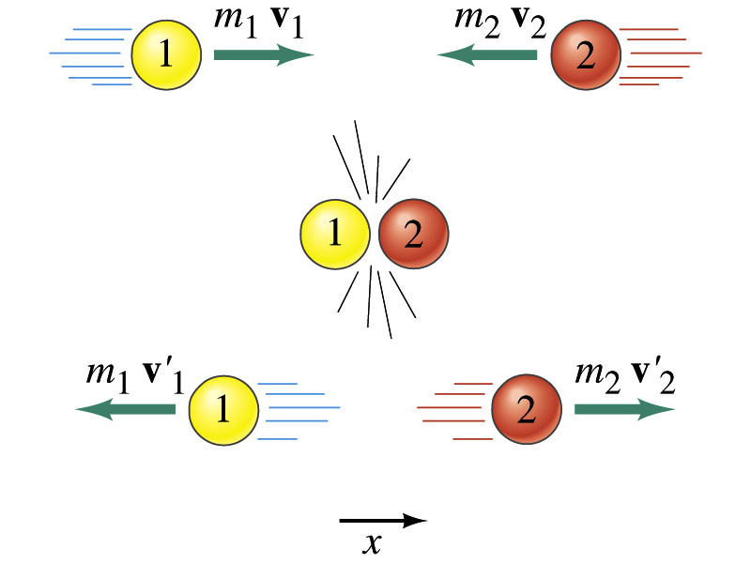
Linear Momentum Conservation
Initial
Final

Slide 8
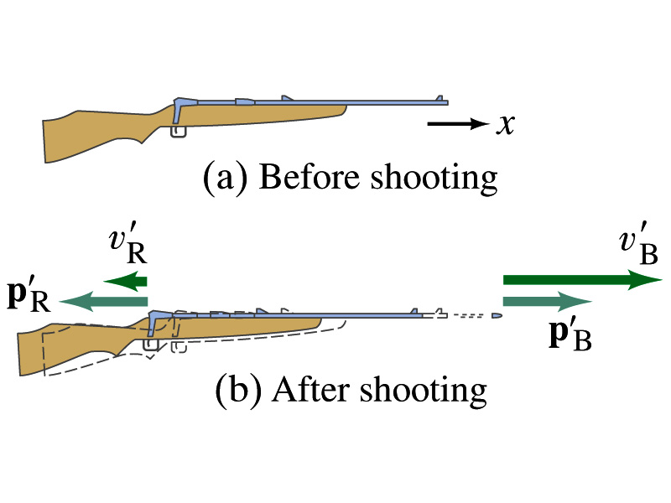
Example 9.4: Rifle Recoil
Calculate the recoil velocity of a 5.0kg rifle that shoots a 0.020kg bullet at a speed of 620m/s.
From momentum conservation, we can write
The x-comp
Solving the above for v_{R} and using the rifle’s mass and the bullet’s mass, we obtain

Slide 9
Example for Linear Momentum Conservation
Estimate an astronaut’s (M=70kg) resulting velocity after he throws his book (m=1kg) to a direction in the space to move to another direction.
v_{A}
v_{B}
From momentum conservation, we can write
Assuming the astronaut’s mass is 70kg, and the book’s mass is 1kg and using linear momentum conservation
Now if the book gained a velocity of 20 m/s in +x-direction, the Astronaut’s velocity is

Slide 10
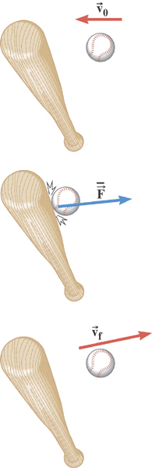
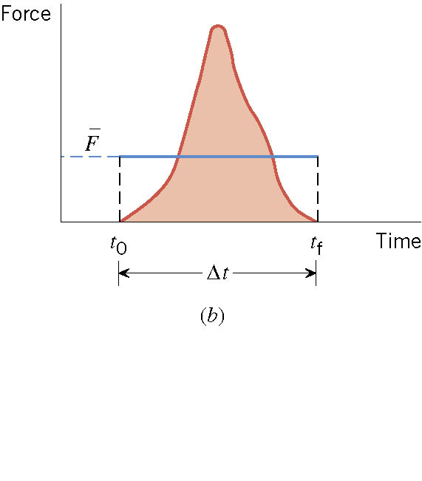
Impulse
There are many situations where the force on an object is not constant and in fact quite complicated during the motion!!

Slide 11
Ball Hit by a Bat
Multiply either side by Δt

Slide 12
Impulse and Linear Momentum
Net force causes change of momentum ➔ Newton’s second law
By integrating the above equation in a time interval t_{i} to t_{f}, one can obtain impulse I.
Effect of the force F acting on an object over the time interval Δt=t_{f}-t_{i} is equal to the change of the momentum of the object caused by that force. Impulse is the degree of which an external force changes an object’s momentum.
So what do you think an impulse is?
The above statement is called the impulse-momentum theorem and is equivalent to Newton’s second law.
What are the dimension and unit of Impulse? What is the direction of an impulse vector?
Defining a time-averaged force
Impulse can be rewritten
If force is constant
It is generally assumed that the impulse force acts on a short time but much greater than any other forces present.

Slide 13
An Example for Impulse
In a crash test, an automobile of mass 1500kg collides with a wall. The initial and final velocities of the automobile are v_{i}= -15.0i m/s and v_{f}=2.60i m/s. If the collision lasts for 0.150 seconds, what would be the impulse caused by the collision and the average force exerted on the automobile?
Let’s assume that the force involved in the collision is a lot larger than any other forces in the system during the collision. From the problem, the initial and final momentum of the automobile before and after the collision is
Therefore the impulse on the automobile due to the collision is
The average force exerted on the automobile during the collision is

Slide 14
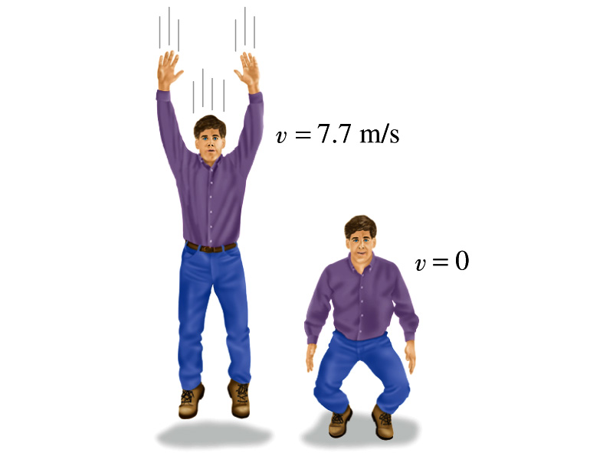
Another Example for Impulse
(a) Calculate the impulse experienced when a 70 kg person lands on firm ground after jumping from a height of 3.0 m. Then estimate the average force exerted on the person’s feet by the ground, if the landing is (b) stiff-legged and (c) with bent legs. In the former case, assume the body moves 1.0cm during the impact, and in the second case, when the legs are bent, about 50 cm.
We don’t know the force. How do we do this?
Obtain velocity of the person before striking the ground.
Solving the above for velocity v, we obtain
Then as the person strikes the ground, the momentum becomes 0 quickly giving the impulse

Slide 15
Example cont’d
In coming to rest, the body decelerates from 7.7m/s to 0m/s in a distance d=1.0cm=0.01m.
The average speed during this period is
The time period the collision lasts is
Since the magnitude of impulse is
The average force on the feet during this landing is
How large is this average force?
If landed in stiff legged, the feet must sustain 300 times the body weight. The person will likely break his leg.
For bent legged landing:

