Slide 1
PHYS 1443 – Section 001
Lecture #13
Tuesday, June 28, 2011
Dr. Jaehoon Yu
Collisions
Center of Mass
Rotational Motion
Rotational Kinematics
Relationship Between Angular and Linear quantities

Slide 2
Announcements
Reading Assignment
  CH9.10
Quiz #3 tomorrow, Wednesday, June 29
  Beginning of the class
  Covers CH8.1 through CH9.9
Planetarium Show extra credit
  Must obtain the signature of the “Star Instructor” AFTER watching the show on the ticket stub
  Tape one side of the ticket stubs on a sheet of paper with your name on it
  Submit it on the last class Thursday, July 7
    Late submissions will not be accepted!!!

Slide 3
Valid Planetarium Shows
Regular shows
  TX star gazing; Nanocam; Ice Worlds
Private shows for a group of 15 or more
  Bad Astronomy; Black Holes; IBEX; Magnificent Sun
  Microcosm; Stars of the Pharaohs; Time Space
  Two Small Pieces of Glass; SOFIA
  Violent Universe; Wonders of the Universe
Please watch the show and obtain the signature on the back of the ticket stub

Slide 4
Extra-Credit Special Project
Derive the formula for the final velocity of two objects which underwent an elastic collision as a function of known quantities m₁, m₂, v₀₁ and v₀₂ in page 8 of this lecture note in a far greater detail than in the note.
  20 points extra credit
Show mathematically what happens to the final velocities if m₁=m₂ and explain in detail in words the resulting motion.
  5 point extra credit
NO Credit will be given if the process is too close to the note!
Due: Start of the class Tuesday, July 5

Slide 5
Extra Credit: Two Dimensional Collisions
Proton #1 with a speed 5.0x10⁶ m/s collides elastically with proton #2 initially at rest. After the collision, proton #1 moves at an angle of 37º to the horizontal axis and proton #2 deflects at an angle φ to the same axis. Find the final speeds of the two protons and the scattering angle of proton #2, φ. This must be done in much more detail than the book or on page 13 of this lecture note.
10 points
Due beginning of the class Wednesday, July 6

Slide 6
Collisions
Generalized collisions must cover not only the physical contact but also the collisions without physical contact such as that of electromagnetic ones on a microscopic scale.
The collisions of these ions never involve physical contact because the electromagnetic repulsive force between these two become great as they get closer causing a collision.
Consider a case of a collision between a proton on a helium ion.
F
F₁₂
Assuming no external forces, the force exerted on particle 1 by particle 2, F₂₁, changes the momentum of particle 1 by
t
F₂₁
Likewise for particle 2 by particle 1
Using Newton’s 3rd law we obtain
So the momentum change of the system in a collision is 0, and the momentum is conserved

Slide 7
Elastic and Inelastic Collisions
Momentum is conserved in any collisions as long as external forces are negligible.
Collisions are classified as elastic or inelastic based on whether the total kinetic energy is conserved, meaning whether it is the same before and after the collision.
Elastic Collision
A collision in which the total kinetic energy and momentum are the same before and after the collision.
Inelastic Collision
A collision in which the momentum is the same before and after the collision but not the total kinetic energy .
Two types of inelastic collisions:Perfectly inelastic and inelastic
Perfectly Inelastic: Two objects stick together after the collision, moving together with the same velocity.
Inelastic: Colliding objects do not stick together after the collision but some kinetic energy is lost.
Note: Momentum is constant in all collisions but kinetic energy is only in elastic collisions.

Slide 8
Elastic and Perfectly Inelastic Collisions
In perfectly inelastic collisions, the objects stick together after the collision, moving together. Momentum is conserved in this collision, so the final velocity of the stuck system is
How about elastic collisions?
In elastic collisions, both the momentum and the kinetic energy are conserved. Therefore, the final speeds in an elastic collision can be obtained in terms of initial speeds as
From momentum
conservation above
What happens when the two masses are the same?

Slide 9
Example for Collisions
A car of mass 1800kg stopped at a traffic light is rear-ended by a 900kg car, and the two become entangled. If the lighter car was moving at 20.0m/s before the collision what is the velocity of the entangled cars after the collision?
Before collision
The momenta before and after the collision are
m₂
20.0m/s
m₁
After collision
Since momentum of the system must be conserved
m₂
m₁
v_{f}
What can we learn from these equations on the direction and magnitude of the velocity before and after the collision?
The cars are moving in the same direction as the lighter car’s original direction to conserve momentum.
The magnitude is inversely proportional to its own mass.

Slide 10
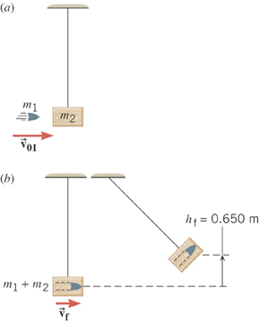
Ex.9 – 11: A Ballistic Pendulum
The mass of a block of wood is 2.50-kg and the mass of the bullet is 0.0100-kg. The block swings to a maximum height of 0.650 m above the initial position. Find the initial speed of the bullet.
What kind of collision?
Perfectly inelastic collision
No net external force ➔ momentum conserved
Solve for V₀₁
What do we not know?
The final speed!!
How can we get it?
Using the mechanical energy conservation!

Slide 11
Ex. A Ballistic Pendulum, cnt’d
Now using the mechanical energy conservation
Solve for V_{f}
Using the solution obtained previously, we obtain

Slide 12
Two dimensional Collisions
In two dimension, one needs to use components of momentum and apply momentum conservation to solve physical problems.
v_{1i}
m₁
x-comp.
m₂
y-comp.
v_{1f}
m₁
θ
Consider a system of two particle collisions and scatters in two dimension as shown in the picture. (This is the case at fixed target accelerator experiments.) The momentum conservation tells us:
φ
m₂
v_{2f}
And for the elastic collisions, the kinetic energy is conserved:
What do you think we can learn from these relationships?

Slide 13
Ex. 9 – 13: Two Dimensional Collisions
Proton #1 with a speed 3.50x10⁵ m/s collides elastically with proton #2 initially at rest. After the collision, proton #1 moves at an angle of 37º to the horizontal axis and proton #2 deflects at an angle φ to the same axis. Find the final speeds of the two protons and the scattering angle of proton #2, φ.
v_{1i}
Since both the particles are protons m₁=m₂=m_{p}.
m₁
m₂
Using momentum conservation, one obtains
v_{1f}
x-comp.
m₁
θ
y-comp.
φ
Canceling m_{p} and putting in all known quantities, one obtains
m₂
v_{2f}
From kinetic energy conservation:
Solving Eqs. 1-3 equations, one gets
Do this at home☺

Slide 14
Center of Mass
We’ve been solving physical problems treating objects as sizeless points with masses, but in realistic situations objects have shapes with masses distributed throughout the body.
Center of mass of a system is the average position of the system’s mass and represents the motion of the system as if all the mass is on the point.
What does above statement tell you concerning the forces being exerted on the system?
The total external force exerted on the system of total mass M causes the center of mass to move at an acceleration given by as if all the mass of the system is concentrated on the center of mass.
Consider a massless rod with two balls attached at either end.
m₂
The position of the center of mass of this system is the mass averaged position of the system
m₁
x₁
x₂
x_{CM}
CM is closer to the heavier object

Slide 15
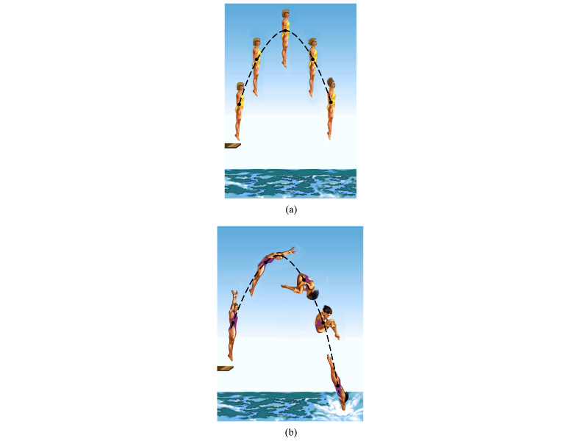
Motion of a Diver and the Center of Mass
Diver performs a simple dive.
The motion of the center of mass follows a parabola since it is a projectile motion.
Diver performs a complicated dive.
The motion of the center of mass still follows the same parabola since it still is a projectile motion.
The motion of the center of mass of the diver is always the same.

Slide 16
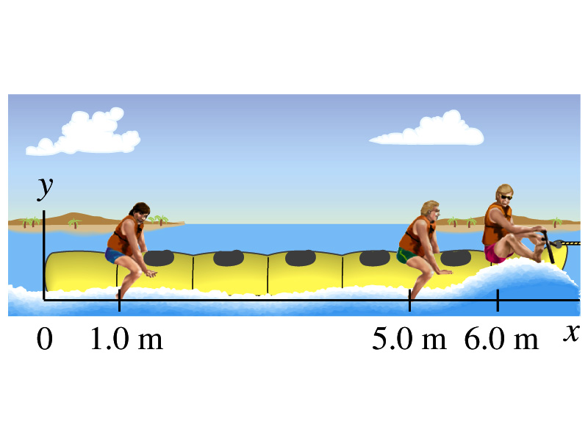
Example 9 – 14
Thee people of roughly equivalent mass M on a lightweight (air-filled) banana boat sit along the x axis at positions x₁=1.0m, x₂=5.0m, and x₃=6.0m. Find the position of CM.
Using the formula for CM

Slide 17
Ex9 – 15: Center of Mass in 2-D
A system consists of three particles as shown in the figure. Find the position of the center of mass of this system.
Using the formula for CM for each position vector component
y=2
m₁
(0,2)
(0.75,1)
r_{CM}
(1,0)
(2,0)
m₂
m₃
x=1
x=2
One obtains
If

Slide 18
Center of Mass of a Rigid Object
The formula for CM can be extended to a system of many particles or a Rigid Object
The position vector of the center of mass of a many particle system is
A rigid body – an object with shape and size with mass spread throughout the body, ordinary objects – can be considered as a group of particles with mass m_{i} densely spread throughout the given shape of the object
Δm_{i}
r_{i}
r_{CM}

Slide 19
Ex 9 – 16: CM of a thin rod
Show that the center of mass of a rod of mass M and length L lies in midway between its ends, assuming the rod has a uniform mass per unit length.
L
The formula for CM of a continuous object is
x
Since the density of the rod (λ) is constant;
dx
dm=λdx
The mass of a small segment
Therefore
Find the CM when the density of the rod non-uniform but varies linearly as a function of x, λ=αx

