Slide 1
PHYS 1443 – Section 001
Lecture #14
Wednesday, June 29, 2011
Dr. Jaehoon Yu
Motion of a Group of Particles
Rotational Motion
Rotational Kinematics
Relationship Between Angular and Linear quantities
Torque

Slide 2
Announcements
Planetarium Show extra credit
  Must obtain the signature of the “Star Instructor” AFTER watching the show on the ticket stub
  Tape one side of the ticket stubs on a sheet of paper with your name on it
  Submit it on the last class Thursday, July 7
    Late submissions will not be accepted!!!

Slide 3
Extra-Credit Special Project
Derive the formula for the final velocity of two objects which underwent an elastic collision as a function of known quantities m₁, m₂, v₀₁ and v₀₂ in page 8 of lecture note on Tuesday, June 28, in a far greater detail than in the note.
  20 points extra credit
Show mathematically what happens to the final velocities if m₁=m₂ and explain in detail in words the resulting motion.
  5 point extra credit
NO Credit will be given if the process is too close to the note!
Due: Start of the class Tuesday, July 5

Slide 4
Extra Credit: Two Dimensional Collisions
Proton #1 with a speed 5.0x10⁶ m/s collides elastically with proton #2 initially at rest. After the collision, proton #1 moves at an angle of 37º to the horizontal axis and proton #2 deflects at an angle φ to the same axis. Find the final speeds of the two protons and the scattering angle of proton #2, φ. This must be done in much more detail than the book or on page 13 of lecture note on Tuesday, June 28.
10 points
Due beginning of the class Wednesday, July 6

Slide 5
Center of Mass and Center of Gravity
CM
The center of mass of any symmetric object lies on the axis of symmetry and on any plane of symmetry, if the object’s mass is evenly distributed throughout the body.
Axis of symmetry
One can use gravity to locate CM.
Hang the object by one point and draw a vertical line following a plum-bob.
Hang the object by another point and do the same.
The point where the two lines meet is the CM.
How do you think you can determine the CM of an object that is not symmetric?
Center of Gravity
Since a rigid object can be considered as a collection of small masses, one can see the total gravitational force exerted on the object as
Δm_{i}
What does this equation tell you?
The net effect of these small gravitational forces is equivalent to a single force acting on a point (Center of Gravity) with mass M.
Δm_{i}g
The CoG is the point in an object as if all the gravitational force is acting on!

Slide 6

Motion of a Group of Particles
We’ve learned that the CM of a system can represent the motion of a system. Therefore, for an isolated system of many particles in which the total mass M is preserved, the velocity, total momentum, acceleration of the system are
Velocity of the system
Total Momentum of the system
Acceleration of the system
The external force exerting on the system
What about the internal forces?
System’s momentum is conserved.
If net external force is 0

Slide 7
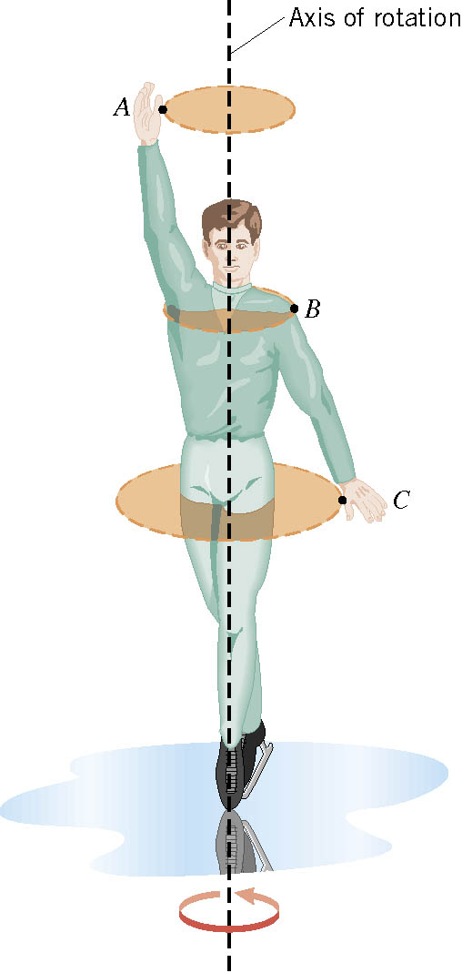
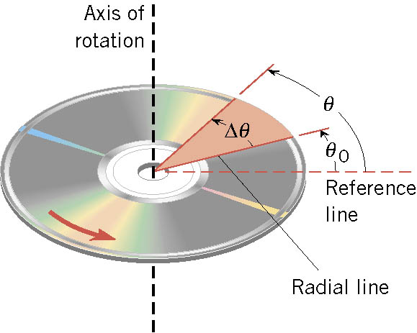
Rotational Motion and Angular Displacement
In a simplest kind of rotation, points on a rigid object moves on circular paths about the axis of rotation.
The angle swept out by a line passing through any point on the body and intersecting the axis of rotation perpendicular is called the angular displacement.
It’s a vector!! So there must be directions…
How do we define directions?
+:if counter-clockwise
-:if clockwise
The direction vector points gets determined based on the right-hand rule.
These are just conventions!!

Slide 8
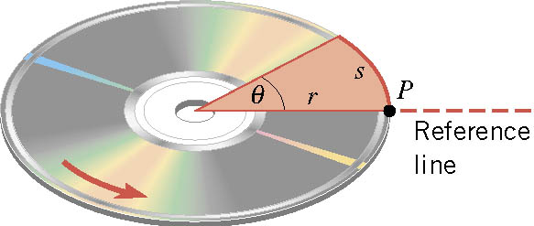



SI Unit of the Angular Displacement
Dimension?
None
For one full revolution:
Since the circumference of a circle is
2πr
How many degrees are in one radian?
1 radian is
How radians is one degree?
And one degrees is
How many radians are in 10.5 revolutions?
Very important: In solving angular problems, all units, degrees or revolutions, must be converted to radians.

Slide 9
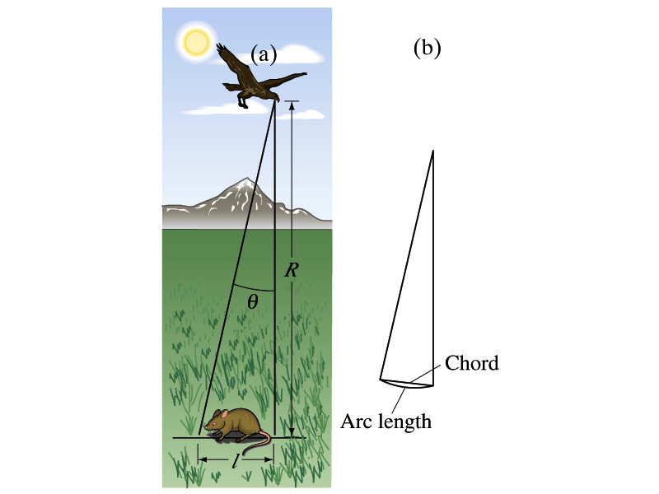
Example 10 – 1
A particular bird’s eyes can barely distinguish objects that subtend an angle no smaller than about 3x10⁻⁴ rad. (a) How many degrees is this? (b) How small an object can the bird just distinguish when flying at a height of 100m?
(a) One radian is 360º/2π. Thus
(b) Since l=rΘ and for small angle arc length is approximately the same as the chord length.

Slide 10
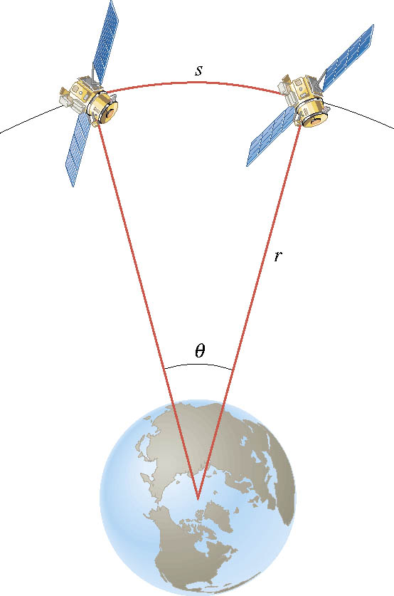
Ex. Adjacent Synchronous Satellites
Synchronous satellites are put into an orbit of radius 4.23×10⁷m. If the angular separation of the two satellites is 2.00 degrees, find the arc length that separates them.
What do we need to find out?
The Arc length!!!
Convert degrees to radians

Slide 11
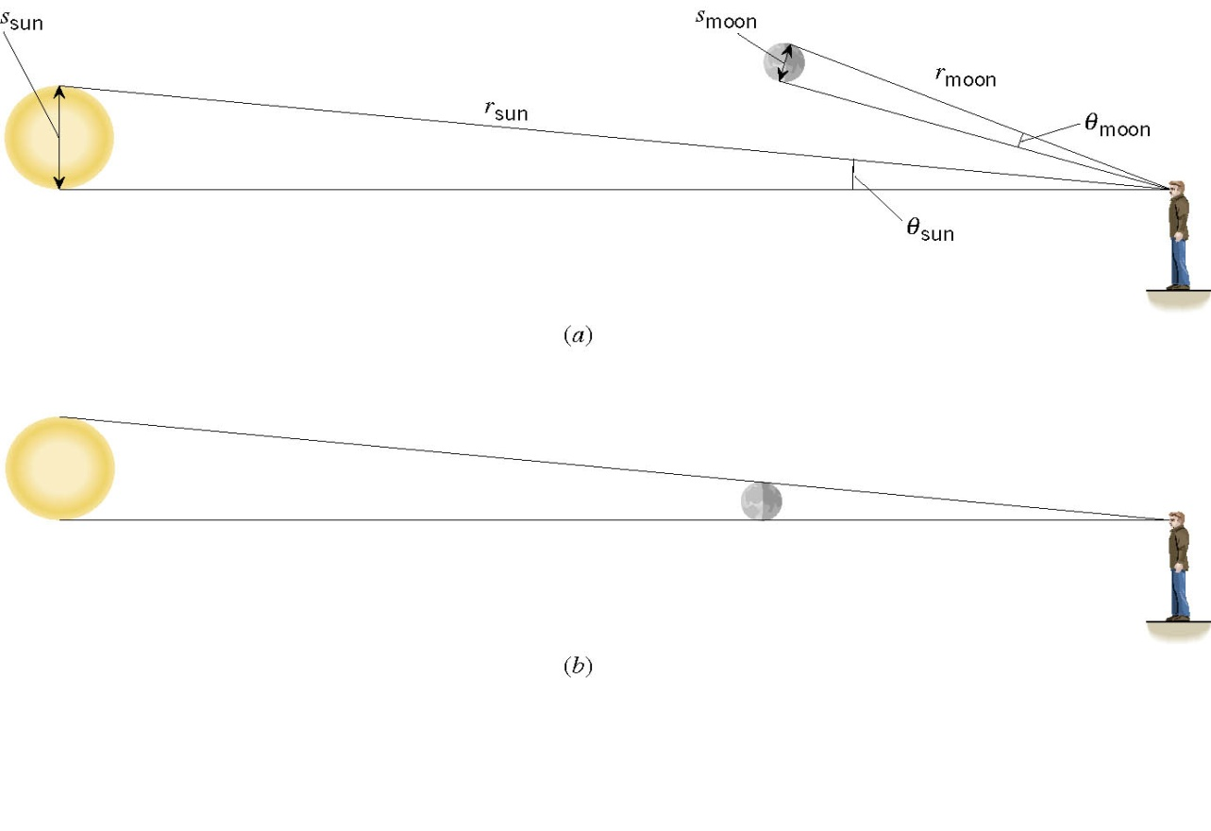
Ex. A Total Eclipse of the Sun
The diameter of the sun is about 400 times greater than that of the moon. By coincidence, the sun is also about 400 times farther from the earth than is the moon. For an observer on the earth, compare the angle subtended by the moon to the angle subtended by the sun and explain why this result leads to a total solar eclipse.
I can even cover the entire sun with my thumb!! Why?
Because the distance (r) from my eyes to my thumb is far shorter than that to the sun.

Slide 12
Angular Displacement, Velocity, and Acceleration
Using what we have learned earlier, how would you define the angular displacement?
How about the average angular speed?
_{θf}
Unit?
rad/s
_{θi}
And the instantaneous angular speed?
Unit?
rad/s
By the same token, the average angular acceleration is defined as…
Unit?
rad/s²
And the instantaneous angular acceleration?
Unit?
rad/s²
When rotating about a fixed axis, every particle on a rigid object rotates through the same angle and has the same angular speed and angular acceleration.

Slide 13
Rotational Kinematics
The first type of motion we have learned in linear kinematics was under the constant acceleration. We will learn about the rotational motion under constant angular acceleration, because these are the simplest motions in both cases.
Just like the case in linear motion, one can obtain
Angular velocity under constant angular acceleration:
Linear kinematics
Angular displacement under constant angular acceleration:
Linear kinematics
One can also obtain
Linear kinematics

Slide 14
Problem Solving Strategy
Visualize the problem by drawing a picture.
Write down the values that are given for any of the five kinematic variables and convert them to SI units.
  Remember that the unit of the angle must be radians!!
Verify that the information contains values for at least three of the five kinematic variables. Select the appropriate equation.
When the motion is divided into segments, remember that the final angular velocity of one segment is the initial velocity for the next.
Keep in mind that there may be two possible answers to a kinematics problem.

Slide 15
Ex. 10 – 4: Rotational Kinematics
A wheel rotates with a constant angular acceleration of 3.50 rad/s². If the angular speed of the wheel is 2.00 rad/s at t_{i}=0, a) through what angle does the wheel rotate in 2.00s?
Using the angular displacement formula in the previous slide, one gets

Slide 16
Example for Rotational Kinematics cnt’d
What is the angular speed at t=2.00s?
Using the angular speed and acceleration relationship
Find the angle through which the wheel rotates between t=2.00s and t=3.00s.
Using the angular kinematic formula
At t=2.00s
At t=3.00s
Angular displacement

