Slide 1
PHYS 1443 – Section 001
Lecture #15
Thursday, June 30, 2011
Dr. Jaehoon Yu
Relationship Between Angular and Linear quantities
Torque and Vector Product
Moment of Inertia
Calculation of Moment of Inertia
Torque and Angular Acceleration
Today’s homework is homework #8, due 10pm, Monday, July4!!

Slide 2
Reminder: Extra-Credit Special Project
Derive the formula for the final velocity of two objects which underwent an elastic collision as a function of known quantities m₁, m₂, v₀₁ and v₀₂ in page 8 of lecture note on Tuesday, June 28, in a far greater detail than in the note.
  20 points extra credit
Show mathematically what happens to the final velocities if m₁=m₂ and explain in detail in words the resulting motion.
  5 point extra credit
NO Credit will be given if the process is too close to the note!
Due: Start of the class Tuesday, July 5

Slide 3
Extra Credit: 2-D Collisions
Proton #1 with a speed 5.0x10⁶ m/s collides elastically with proton #2 initially at rest. After the collision, proton #1 moves at an angle of 37º to the horizontal axis and proton #2 deflects at an angle φ to the same axis. Find the final speeds of the two protons and the scattering angle of proton #2, φ. This must be done in much more detail than the book or on page 13 of lecture note on Tuesday, June 28.
10 points
Due beginning of the class Wednesday, July 6

Slide 4
Rotational Kinematics
The first type of motion we have learned in linear kinematics was under the constant acceleration. We will learn about the rotational motion under constant angular acceleration, because these are the simplest motions in both cases.
Just like the case in linear motion, one can obtain
Angular velocity under constant angular acceleration:
Linear kinematics
Angular displacement under constant angular acceleration:
Linear kinematics
One can also obtain
Linear kinematics

Slide 5
Ex. 10 – 4: Rotational Kinematics
A wheel rotates with a constant angular acceleration of 3.50 rad/s². If the angular speed of the wheel is 2.00 rad/s at t_{i}=0, a) through what angle does the wheel rotate in 2.00s?
Using the angular displacement formula in the previous slide, one gets

Slide 6
Example for Rotational Kinematics cnt’d
What is the angular speed at t=2.00s?
Using the angular speed and acceleration relationship
Find the angle through which the wheel rotates between t=2.00s and t=3.00s.
Using the angular kinematic formula
At t=2.00s
At t=3.00s
Angular displacement

Slide 7
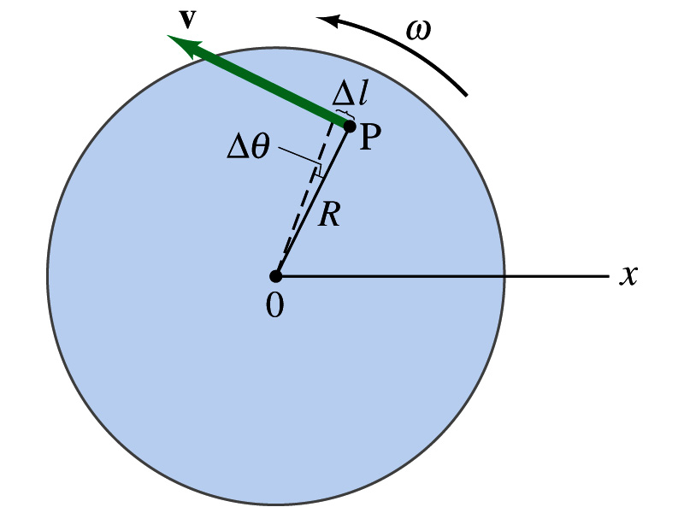
Relationship Between Angular and Linear Quantities
What do we know about a rigid object that rotates about a fixed axis of rotation?
Every particle (or masslet) in the object moves on a circle centered at the same axis of rotation.
When a point rotates, it has both the linear and angular components in its motion.
What is the linear component of the motion in the figure?
The direction of ω follows the right-hand rule.
Linear velocity along the tangential direction.
How do we related this linear component of the motion with angular component?
The arc-length is
So the tangential speed v is
What does this relationship tell you about the tangential speed of the points in the object and their angular speed?:
Although every particle in the object has the same angular speed, its tangential speed differs and is proportional to its distance from the axis of rotation.
The farther away the particle is from the center of rotation, the higher the tangential speed.

Slide 8
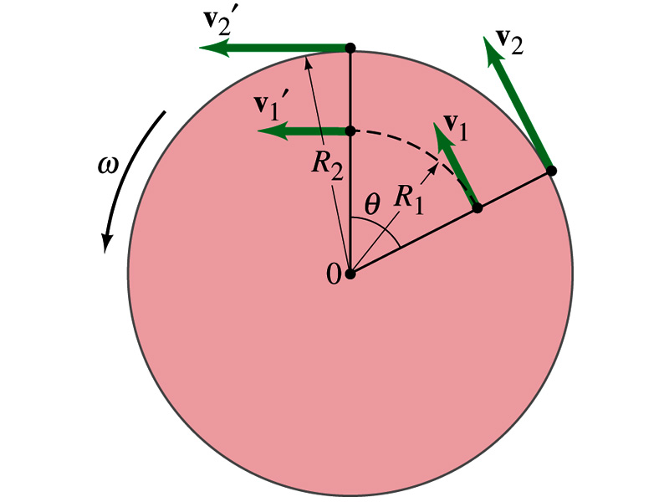
Is the lion faster than the horse?
A rotating carousel has one child sitting on a horse near the outer edge and another child on a lion halfway out from the center. (a) Which child has the greater linear speed? (b) Which child has the greater angular speed?
Linear speed is the distance traveled divided by the time interval. So the child sitting at the outer edge travels more distance within the given time than the child sitting closer to the center. Thus, the horse is faster than the lion.
(b) Angular speed is the angle traveled divided by the time interval. The angle both the children travel in the given time interval is the same. Thus, both the horse and the lion have the same angular speed.

Slide 9
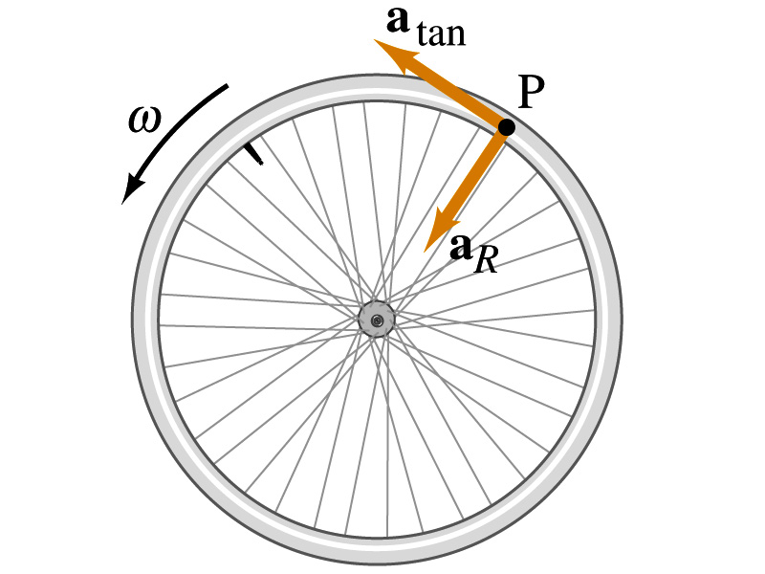
How about the acceleration?
How many different linear acceleration components do you see in a circular motion and what are they?
Two
Tangential, a_{t}, and the radial acceleration, a_{r}.
Since the tangential speed v is
The magnitude of tangential acceleration a_{t} is
What does this relationship tell you?
Although every particle in the object has the same angular acceleration, its tangential acceleration differs proportional to its distance from the axis of rotation.
The radial or centripetal acceleration a_{r} is
What does this tell you?
The father away the particle is from the rotation axis, the more radial acceleration it receives. In other words, it receives more centripetal force.
Total linear acceleration is

Slide 10
Example
(a) What is the linear speed of a child seated 1.2m from the center of a steadily rotating merry-go-around that makes one complete revolution in 4.0s? (b) What is her total linear acceleration?
First, figure out what the angular speed of the merry-go-around is.
Using the formula for linear speed
Since the angular speed is constant, there is no angular acceleration.
Tangential acceleration is
Radial acceleration is
Thus the total acceleration is

Slide 11
Example for Rotational Motion
Audio information on compact discs are transmitted digitally through the readout system consisting of laser and lenses. The digital information on the disc are stored by the pits and flat areas on the track. Since the speed of readout system is constant, it reads out the same number of pits and flats in the same time interval. In other words, the linear speed is the same no matter which track is played. a) Assuming the linear speed is 1.3 m/s, find the angular speed of the disc in revolutions per minute when the inner most (r=23mm) and outer most tracks (r=58mm) are read.
Using the relationship between angular and tangential speed

Slide 12
b) The maximum playing time of a standard music CD is 74 minutes and 33 seconds. How many revolutions does the disk make during that time?
c) What is the total length of the track past through the readout mechanism?
d) What is the angular acceleration of the CD over the 4473s time interval, assuming constant α?

Slide 13
Torque
Torque is the tendency of a force to rotate an object about an axis. Torque, τ, is a vector quantity.
F
Consider an object pivoting about the point P by the force F being exerted at a distance r from P.
φ
r
The line of Action
The line that extends out of the tail of the force vector is called the line of action.
P
d₂
d
The perpendicular distance from the pivoting point P to the line of action is called the moment arm.
F₂
Moment arm
Magnitude of torque is defined as the product of the force exerted on the object to rotate it and the moment arm.
When there are more than one force being exerted on certain points of the object, one can sum up the torque generated by each force vectorially. The convention for sign of the torque is positive if rotation is in counter-clockwise and negative if clockwise.

Slide 14
Ex. 10 – 7: Torque
A one piece cylinder is shaped as in the figure with core section protruding from the larger drum. The cylinder is free to rotate around the central axis shown in the picture. A rope wrapped around the drum whose radius is R₁ exerts force F₁ to the right on the cylinder, and another force exerts F₂ on the core whose radius is R₂ downward on the cylinder. A) What is the net torque acting on the cylinder about the rotation axis?
R₁
F₁
The torque due to F₁
and due to F₂
R₂
So the total torque acting on the system by the forces is
F₂
Suppose F₁=5.0 N, R₁=1.0 m, F₂= 15.0 N, and R₂=0.50 m. What is the net torque about the rotation axis and which way does the cylinder rotate from the rest?
Using the above result
The cylinder rotates in counter-clockwise.

Slide 15
Torque and Vector Product
z
Let’s consider a disk fixed onto the origin O and the force F exerts on the point p. What happens?
τ=rxF
The disk will start rotating counter clockwise about the Z axis
O
y
r
p
The magnitude of torque given to the disk by the force F is
θ
F
x
But torque is a vector quantity, what is the direction? How is torque expressed mathematically?
What is the direction?
The direction of the torque follows the right-hand rule!!
The above operation is called the Vector product or Cross product
What is the result of a vector product?
What is another vector operation we’ve learned?
Another vector
Scalar product
Result? A scalar

Slide 16
Properties of Vector Product
Vector Product is Non-commutative
What does this mean?
If the order of operation changes the result changes
Following the right-hand rule, the direction changes
Vector Product of two parallel vectors is 0.
Thus,
If two vectors are perpendicular to each other
Vector product follows distribution law
The derivative of a Vector product with respect to a scalar variable is

Slide 17
More Properties of Vector Product
The relationship between unit vectors,
Vector product of two vectors can be expressed in the following determinant form

Slide 18
Moment of Inertia
Rotational Inertia:
Measure of resistance of an object to changes in its rotational motion. Equivalent to mass in linear motion.
For a group of particles
For a rigid body
What are the dimension and unit of Moment of Inertia?
Determining Moment of Inertia is extremely important for computing equilibrium of a rigid body, such as a building.
Dependent on the axis of rotation!!!

Slide 19
Example for Moment of Inertia
In a system of four small spheres as shown in the figure, assuming the radii are negligible and the rods connecting the particles are massless, compute the moment of inertia and the rotational kinetic energy when the system rotates about the y-axis at angular speed ω.
y
m
Since the rotation is about y axis, the moment of inertia about y axis, I_{y}, is
b
l
l
M
O
M
x
b
This is because the rotation is done about y axis, and the radii of the spheres are negligible.
Why are some 0s?
m
Thus, the rotational kinetic energy is
Find the moment of inertia and rotational kinetic energy when the system rotates on the x-y plane about the z-axis that goes through the origin O.

Slide 20
Calculation of Moments of Inertia
Moments of inertia for large objects can be computed, if we assume the object consists of small volume elements with mass, Δm_{i}.
The moment of inertia for the large rigid object is
It is sometimes easier to compute moments of inertia in terms of volume of the elements rather than their mass
How can we do this?
Using the volume density, ρ, replace dm in the above equation with dV.
The moments of inertia becomes
Example: Find the moment of inertia of a uniform hoop of mass M and radius R about an axis perpendicular to the plane of the hoop and passing through its center.
y
The moment of inertia is
dm
O
R
The moment of inertia for this object is the same as that of a point of mass M at the distance R.
x
What do you notice from this result?

Slide 21
Ex.10 – 11 Rigid Body Moment of Inertia
Calculate the moment of inertia of a uniform rigid rod of length L and mass M about an axis perpendicular to the rod and passing through its center of mass.
y
The line density of the rod is
so the masslet is
dx
x
The moment of inertia is
x
L
What is the moment of inertia when the rotational axis is at one end of the rod.
Will this be the same as the above. Why or why not?
Since the moment of inertia is resistance to motion, it makes perfect sense for it to be harder to move when it is rotating about the axis at one end.

Slide 22
Parallel Axis Theorem
Moments of inertia for highly symmetric object is easy to compute if the rotational axis is the same as the axis of symmetry. However if the axis of rotation does not coincide with axis of symmetry, the calculation can still be done in a simple manner using parallel-axis theorem.
y
Moment of inertia is defined as
(x,y)
Since x and y are
One can substitute x and y in Eq. 1 to obtain
y’
r
y
CM
(x_{CM,}y_{CM})
y_{CM}
D
Since the x’ and y’ are the distance from CM, by definition
x_{CM}
x’
x
Therefore, the parallel-axis theorem
x
What does this theorem tell you?
Moment of inertia of any object about any arbitrary axis are the same as the sum of moment of inertia for a rotation about the CM and that of the CM about the rotation axis.

Slide 23
Example for Parallel Axis Theorem
Calculate the moment of inertia of a uniform rigid rod of length L and mass M about an axis that goes through one end of the rod, using parallel-axis theorem.
y
The line density of the rod is
so the masslet is
CM
dx
x
The moment of inertia about the CM
x
L
Using the parallel axis theorem
The result is the same as using the definition of moment of inertia.
Parallel-axis theorem is useful to compute moment of inertia of a rotation of a rigid object with complicated shape about an arbitrary axis

Slide 24
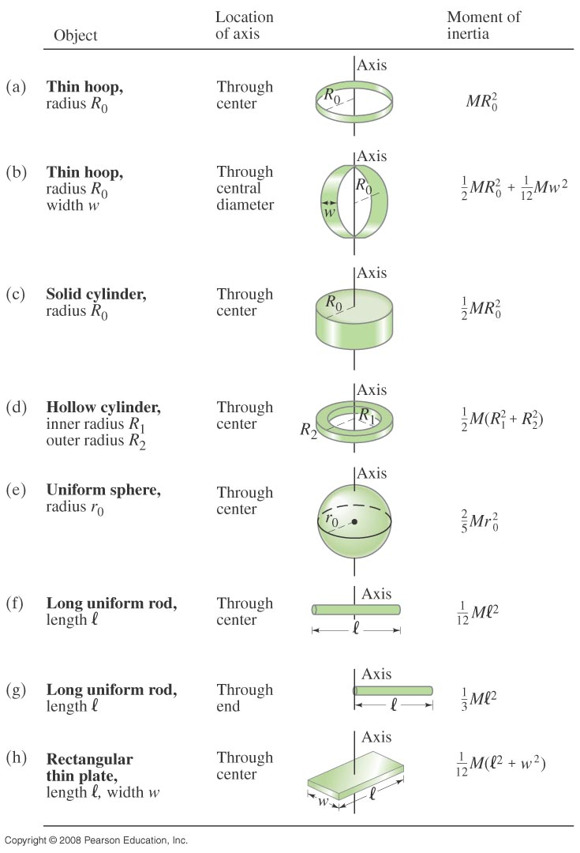
Check out Figure 10 – 20 for moment of inertia for various shaped objects

