Slide 1
PHYS 1443 – Section 001
Lecture #16
Wednesday, July 6, 2011
Dr. Jaehoon Yu
Calculation of Moment of Inertia
Torque and Angular Acceleration
Rolling Motion & Rotational Kinetic Energy
Work, Power and Energy in Rotation
Angular Momentum & Its Conservation
Equilibrium
The final homework is homework #9, due 10pm, Saturday, July 9!!

Slide 2
Announcements
Quiz #3 results
  Class average: 20.1/35
    Equivalent to 59.7/100
    Extremely consistent: 62.5 and 61.4
  Top score: 33/35
Quiz #4 tomorrow, Thursday, July 7
  Beginning of the class
  Covers CH10.1 through what we learn today (CH12.2?)
Please to not forget the planetarium special credit sheet submission tomorrow
Final Comprehensive Exam
  8 – 10am, Monday, July 11 in SH103
  Covers CH1.1 through what we learn Thursday, July 7
  Mixture of multiple choice and free response problems
Bring your two special projects during the intermission

Slide 3
Moment of Inertia
Rotational Inertia:
Measure of resistance of an object to changes in its rotational motion. Equivalent to mass in linear motion.
For a group of particles
For a rigid body
What are the dimension and unit of Moment of Inertia?
Determining Moment of Inertia is extremely important for computing equilibrium of a rigid body, such as a building.
Dependent on the axis of rotation!!!

Slide 4
Calculation of Moments of Inertia
Moments of inertia for large objects can be computed, if we assume the object consists of small volume elements with mass, Δm_{i}.
The moment of inertia for the large rigid object is
It is sometimes easier to compute moments of inertia in terms of volume of the objects rather than their mass
How can we do this?
Using the volume density, ρ, replace dm in the above equation with dV.
The moments of inertia becomes
Example: Find the moment of inertia of a uniform hoop of mass M and radius R about an axis perpendicular to the plane of the hoop and passing through its center.
y
The moment of inertia is
dm
O
R
The moment of inertia for this object is the same as that of a point of mass M at the distance R.
x
What do you notice from this result?

Slide 5
Ex.10 – 11 Rigid Body Moment of Inertia
Calculate the moment of inertia of a uniform rigid rod of length L and mass M about an axis perpendicular to the rod and passing through its center of mass.
y
The line density of the rod is
so the masslet is
dx
x
The moment of inertia is
x
L
What is the moment of inertia when the rotational axis is at one end of the rod.
Will this be the same as the above. Why or why not?
Since the moment of inertia is resistance to motion, it makes perfect sense for it to be harder to move when it is rotating about the axis at one end.

Slide 6
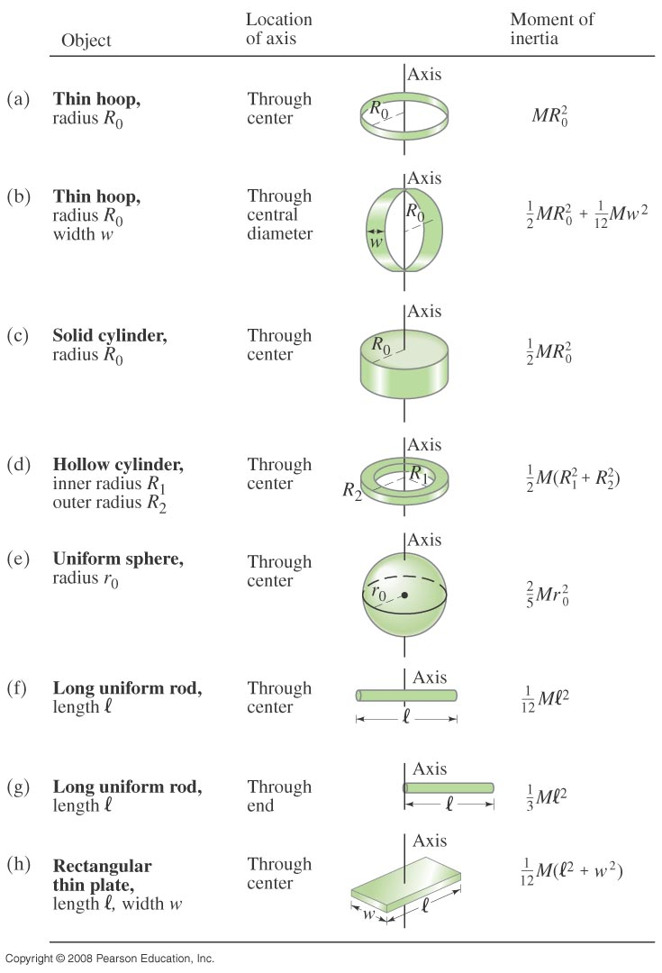
Check out Figure 10 – 20 for moment of inertia for various shaped objects

Slide 7
Torque & Angular Acceleration
F_{t}
Let’s consider a point object with mass m rotating on a circle.
m
What forces do you see in this motion?
r
F_{r}
The tangential force F_{t} and the radial force F_{r}
The tangential force F_{t} is
The torque due to tangential force F_{t} is
What do you see from the above relationship?
What does this mean?
Torque acting on a particle is proportional to the angular acceleration.
What law do you see from this relationship?
Analogs to Newton’s 2nd law of motion in rotation.
How about a rigid object?
The external tangential force δF_{t} is
δF_{t}
δm
The torque due to tangential force F_{t} is
The total torque is
r
What is the contribution due to radial force and why?
Contribution from radial force is 0, because its line of action passes through the pivoting point, making the moment arm 0.
O

Slide 8
Rolling Motion of a Rigid Body
What is a rolling motion?
A more generalized case of a motion where the rotational axis moves together with an object
A rotational motion about a moving axis
To simplify the discussion, let’s make a few assumptions
Limit our discussion on very symmetric objects, such as cylinders, spheres, etc
The object rolls on a flat surface
Let’s consider a cylinder rolling on a flat surface, without slipping.
Under what condition does this “Pure Rolling” happen?
The total linear distance the CM of the cylinder moved is
Thus the linear speed of the CM is
R
θ
s
s=Rθ
The condition for a “Pure Rolling motion”

Slide 9
More Rolling Motion of a Rigid Body
The magnitude of the linear acceleration of the CM is
As we learned in rotational motion, all points in a rigid body moves at the same angular speed but at different linear speeds.
P’
2v_{CM}
CM
v_{CM}
CM is moving at the same speed at all times.
P
At any given time, the point that comes to P has 0 linear speed while the point at P’ has twice the speed of CM
Why??
A rolling motion can be interpreted as the sum of Translation and Rotation
v_{CM}
v=Rω
2v_{CM}
P’
P’
P’
CM
+
CM
=
CM
v_{CM}
v=0
v_{CM}
P
v=Rω
P
P
v_{CM}

Slide 10
Rotational Kinetic Energy
y
v_{i}
What do you think the kinetic energy of a rigid object that is undergoing a circular motion is?
m_{i}
r_{i}
θ
Kinetic energy of a masslet, m_{i}, moving at a tangential speed, v_{i}, is
O
x
Since a rigid body is a collection of masslets, the total kinetic energy of the rigid object is
Since moment of Inertia, I, is defined as
The above expression is simplified as

Slide 11
Kinetic Energy of a Rolling Sphere
R
Let’s consider a sphere with radius R rolling down the hill without slipping.
h
x
ω
θ
v_{CM}
Since v_{CM}=Rω
What is the speed of the CM in terms of known quantities and how do you find this out?
Since the kinetic energy at the bottom of the hill must be equal to the potential energy at the top of the hill

Slide 12
Ex. 10 – 16: Rolling Kinetic Energy
For solid sphere as shown in the figure, calculate the linear speed of the CM at the bottom of the hill and the magnitude of linear acceleration of the CM. Solve this problem using Newton’s second law, the dynamic method.
n
What are the forces involved in this motion?
f
y
Gravitational Force,
Frictional Force,
Normal Force
M
h
x
Newton’s second law applied to the CM gives
x
Mg
θ
Since the forces Mg and n go through the CM, their moment arm is 0 and do not contribute to torque, while the static friction f causes torque
We know that
We obtain
Substituting f in dynamic equations

Slide 13
Work, Power, and Energy in Rotation
F
Let’s consider the motion of a rigid body with a single external force F exerting on the point P, moving the object by Δs.
Fsinφ
φ
Δs
The work done by the force F as the object rotates through the infinitesimal distance Δs=rΔθ is
Δθ
r
Fcosφ
O
What is Fsinϕ?
The tangential component of the force F.
What is the work done by radial component Fcosϕ?
Zero, because it is perpendicular to the displacement.
Since the magnitude of torque is rFsinϕ,
How was the power defined in linear motion?
The rate of work, or power, becomes
The rotational work done by an external force equals the change in rotational Kinetic energy.
The work put in by the external force then
Work-kinetic Energy Theorem

Slide 14
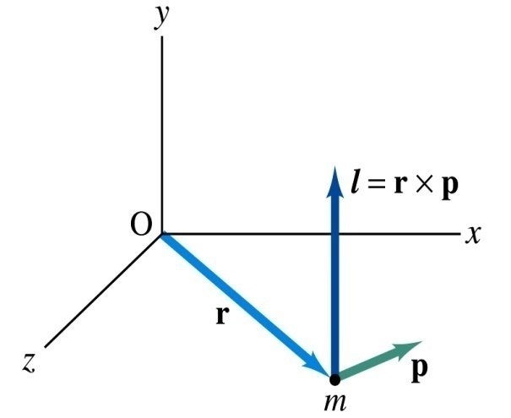
Angular Momentum of a Particle
If you grab onto a pole while running, your body will rotate about the pole, gaining angular momentum. We’ve used the linear momentum to solve physical problems with linear motions, the angular momentum will do the same for rotational motions.
z
Let’s consider a point-like object ( particle) with mass m located at the vector location r and moving with linear velocity v
The angular momentum L of this particle relative to the origin O is
y
What is the unit and dimension of angular momentum?
x
Note that L depends on origin O.
Why?
Because r changes
What else do you learn?
The direction of L is +z.
Since p is mv, the magnitude of L becomes
What do you learn from this?
If the direction of linear velocity points to the origin of rotation, the particle does not have any angular momentum.
If the linear velocity is perpendicular to position vector, the particle moves exactly the same way as a point on a rim.

Slide 15
Example for Rigid Body Angular Momentum
A rigid rod of mass M and length l is pivoted without friction at its center. Two particles of mass m₁ and m₂ are attached to either end of the rod. The combination rotates on a vertical plane with an angular speed of ω. Find an expression for the magnitude of the angular momentum.
y
The moment of inertia of this system is
m₂
l
m₂ g
θ
O
x
m₁
Find an expression for the magnitude of the angular acceleration of the system when the rod makes an angle θ with the horizon.
m₁ g
If m₁ = m₂, no angular momentum because the net torque is 0.
If θ=+/−π/2, at equilibrium so no angular momentum.
First compute the net external torque
Thus α becomes

Slide 16
Conservation of Angular Momentum
Remember under what condition the linear momentum is conserved?
Linear momentum is conserved when the net external force is 0.
By the same token, the angular momentum of a system is constant in both magnitude and direction, if the resultant external torque acting on the system is 0.
What does this mean?
Angular momentum of the system before and after a certain change is the same.
Three important conservation laws for isolated system that does not get affected by external forces
Mechanical Energy
Linear Momentum
Angular Momentum

Slide 17
Ex. 11 – 3 Neutron Star
A star rotates with a period of 30 days about an axis through its center. After the star undergoes a supernova explosion, the stellar core, which had a radius of 1.0x10⁴km, collapses into a neutron star of radius 3.0km. Determine the period of rotation of the neutron star.
What is your guess about the answer?
The period will be significantly shorter, because its radius got smaller.
Let’s make some assumptions:
There is no external torque acting on it
The shape remains spherical
Its mass remains constant
Using angular momentum conservation
The angular speed of the star with the period T is
Thus

Slide 18
Similarity Between Linear and Rotational Motions
All physical quantities in linear and rotational motions show striking similarity.
Quantities | Linear | Rotational
Mass | Mass | Moment of Inertia
Length of motion | Distance | Angle (Radian)
Speed
Acceleration
Force | Force | Torque
Work | Work | Work
Power
Momentum
Kinetic Energy | Kinetic | Rotational

Slide 19
Conditions for Equilibrium
What do you think the term “An object is at its equilibrium” means?
The object is either at rest (Static Equilibrium) or its center of mass is moving at a constant velocity (Dynamic Equilibrium).
When do you think an object is at its equilibrium?
Translational Equilibrium: Equilibrium in linear motion
Is this it?
The above condition is sufficient for a point-like object to be at its translational equilibrium. For an object with size, however, this is not sufficient. One more condition is needed. What is it?
Let’s consider two forces equal in magnitude but in opposite direction acting on a rigid object as shown in the figure. What do you think will happen?
F
d
CM
The object will rotate about the CM. The net torque acting on the object about any axis must be 0.
d
-F
For an object to be at its static equilibrium, the object should not have linear or angular speed.

Slide 20
More on Conditions for Equilibrium
To simplify the problem, we will only deal with forces acting on x-y plane, giving torque only along z-axis. What do you think the conditions for equilibrium be in this case?
The six possible equations from the two vector equations turns to three equations.
AND
What happens if there are many forces exerting on an object?
If an object is at its translational static equilibrium, and if the net torque acting on the object is 0 about one axis, the net torque must be 0 about any arbitrary axis.
F₁
F₂
O
r’
r₅
O’
F₃
F₅
Why is this true?
F₄
Because the object is not moving, no matter what the rotational axis is, there should not be any motion. It is simply a matter of mathematical manipulation.

Slide 21
How do we solve equilibrium problems?
Identify all the forces and their directions and locations
Draw a free-body diagram with forces indicated on it with their directions and locations properly noted
Write down force equation for each x and y component with proper signs
Select a rotational axis for torque calculations ➔ Selecting the axis such that the torque of one of the unknown forces become 0 makes the problem easier to solve
Write down the torque equation with proper signs
Solve the equations for unknown quantities

Slide 22
Ex. 12 – 3: Seesaw Balancing
A uniform 40.0 N board supports the father and the daughter each weighing 800 N and 350 N, respectively, and is not moving. If the support (or fulcrum) is under the center of gravity of the board, and the father is 1.00 m from CoG, what is the magnitude of the normal force n exerted on the board by the support?
1m
x
Since there is no linear motion, this system is in its translational equilibrium
n
F
D
M_{F}g
M_{D}g
M_{B}g
Therefore the magnitude of the normal force
Determine where the child should sit to balance the system.
The net torque about the fulcrum by the three forces are
Therefore to balance the system the daughter must sit

Slide 23
Seesaw Example Cont’d
Determine the position of the child to balance the system for different position of axis of rotation.
Rotational axis
1m
x
n
x/2
F
D
M_{F}g
M_{F}g
The net torque about the axis of rotation by all the forces are
M_{B}g
Since the normal force is
The net torque can be rewritten
What do we learn?
Therefore
No matter where the rotation axis is, net effect of the torque is identical.

Slide 24
Ex. 12.4 for Mechanical Equilibrium
A person holds a 50.0N sphere in his hand. The forearm is horizontal. The biceps muscle is attached 3.00 cm from the joint, and the sphere is 35.0cm from the joint. Find the upward force exerted by the biceps on the forearm and the downward force exerted by the upper arm on the forearm and acting at the joint. Neglect the weight of forearm.
Since the system is in equilibrium, from the translational equilibrium condition
F_{B}
d
O
F_{U}
l
mg
From the rotational equilibrium condition
Thus, the force exerted by the biceps muscle is
Force exerted by the upper arm is

Slide 25
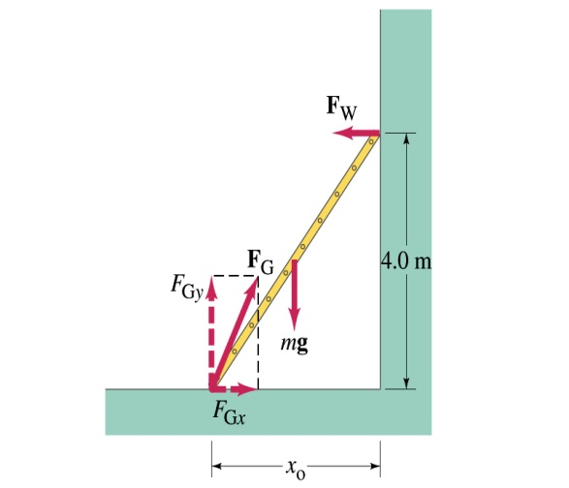
Example 12 – 6
A 5.0 m long ladder leans against a wall at a point 4.0m above the ground. The ladder is uniform and has mass 12.0kg. Assuming the wall is frictionless (but ground is not), determine the forces exerted on the ladder by the ground and the wall.
F_{W}
First the translational equilibrium, using components
FBD
F_{Gy}
mg
O
F_{Gx}
Thus, the y component of the force by the ground is
The length x₀ is, from Pythagorian theorem

Slide 26
Example 12 – 6 cont’d
From the rotational equilibrium
Thus the force exerted on the ladder by the wall is
The x component of the force by the ground is
Solve for F_{Gx}
Thus the force exerted on the ladder by the ground is
The angle between the ground force to the floor

