Slide 1
PHYS 1443 – Section 001
Lecture #17
Thursday, July 7, 2011
Dr. Jaehoon Yu
Equilibrium Problems
Elastic Property of Solids
Fluid and Pressure
Pascal’s Principle
Absolute and Relative Pressure
Flow Rate and Equation of Continuity

Slide 2
Announcements
Final Comprehensive Exam
  8 – 10am, Monday, July 11 in SH103
  Covers CH1.1 through what we finish today (CH13.6) plus Appendices A and B
  Mixture of multiple choice and free response problems
  Please do not miss the exam!!
Please bring your planetarium special credit sheet during the intermission

Slide 3
More on Conditions for Equilibrium
To simplify the problem, we will only deal with forces acting on x-y plane, giving torque only along z-axis. What do you think the conditions for equilibrium are in this case?
The six possible equations from the two vector equations turns to three equations.
AND
What happens if there are many forces exerting on an object?
If an object is at its translational static equilibrium, and if the net torque acting on the object is 0 about one axis, the net torque must be 0 about any arbitrary axis.
F₁
F₂
O
r’
r₅
O’
F₃
F₅
Why is this true?
F₄
Because the object is not moving in the first place, no matter where the rotational axis is, there should not be any motion. This simply is a matter of mathematical manipulation.

Slide 4
How do we solve equilibrium problems?
Identify all the forces and their directions and locations
Draw a free-body diagram with forces indicated on it with their directions and locations properly noted
Write down the force equation for each x and y component with proper signs
Select a rotational axis for torque calculations ➔ Selecting the axis such that the torque of one of the unknown forces become 0 makes the problem easier to solve
Write down the torque equation with proper signs
Solve the equations for unknown quantities

Slide 5
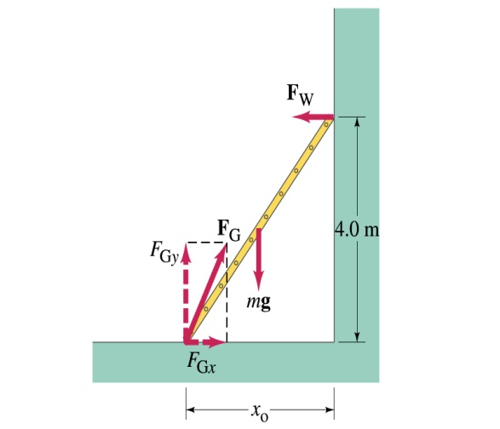
Example 12 – 6
A 5.0 m long ladder leans against a wall at a point 4.0m above the ground. The ladder is uniform and has mass 12.0kg. Assuming the wall is frictionless (but ground is not), determine the forces exerted on the ladder by the ground and the wall.
F_{W}
First the translational equilibrium, using components
FBD
F_{Gy}
mg
O
F_{Gx}
Thus, the y component of the force by the ground is
The length x₀ is, from Pythagorian theorem

Slide 6
Example 12 – 6 cont’d
From the rotational equilibrium
Thus the force exerted on the ladder by the wall is
The x component of the force by the ground is
Solve for F_{Gx}
Thus the force exerted on the ladder by the ground is
The angle between the ground force to the floor

Slide 7
Elastic Properties of Solids
We have been assuming that the objects do not change their shapes when external forces are exerting on it. It this realistic?
No. In reality, objects get deformed as external forces act on it, though the internal forces resist the deformation as it takes place.
Deformation of solids can be understood in terms of Stress and Strain
Stress: The amount of the deformation force per unit area the object is under
Strain: The measure of the degree of deformation
It is empirically known that for small stresses, strain is proportional to stress
The constants of proportionality are called Elastic Modulus
Three types of Elastic Modulus
Young’s modulus: Measure of the elasticity in a length
Shear modulus: Measure of the elasticity in an area
Bulk modulus: Measure of the elasticity in a volume

Slide 8
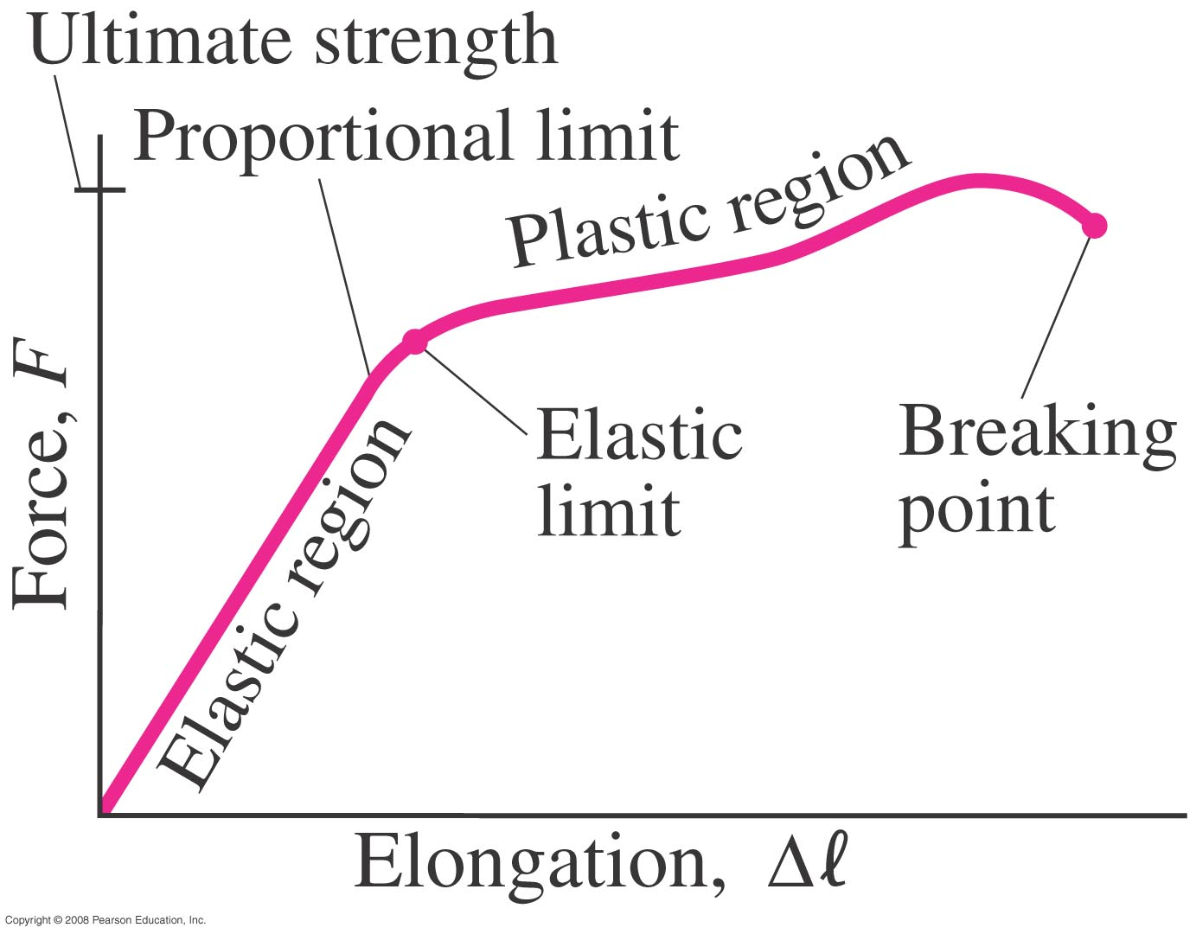
Elastic Limit and Ultimate Strength
Elastic limit: The limit of elasticity beyond which an object cannot recover its original shape or the maximum stress that can be applied to the substance before it becomes permanently deformed
Ultimate strength: The maximum force that can be applied on the object before breaking it

Slide 9
Young’s Modulus
Let’s consider a long bar with cross sectional area A and initial length L_{i}.
L_{i}
After the stretch
L_{f}=L_{i}+ΔL
F_{ex}
F_{ex}
F_{in}
A:cross sectional area
F_{ex}=F_{in}
Tensile stress
Tensile strain
Used to characterize a rod or wire stressed under tension or compression
Young’s Modulus is defined as
What is the unit of Young’s Modulus?
Force per unit area
Experimental Observations
For a fixed external force, the change in length is proportional to the original length
The necessary force to produce the given strain is proportional to the cross sectional area

Slide 10
Bulk Modulus
Bulk Modulus characterizes the response of a substance to uniform squeezing or reduction of pressure.
F
V
After the pressure change
F
V’
F
F
Volume stress =pressure
If the pressure on an object changes by ΔP=ΔF/A, the object will undergo a volume change ΔV.
Bulk Modulus is defined as
Because the change of volume is reverse to change of pressure.
Compressibility is the reciprocal of Bulk Modulus

Slide 11
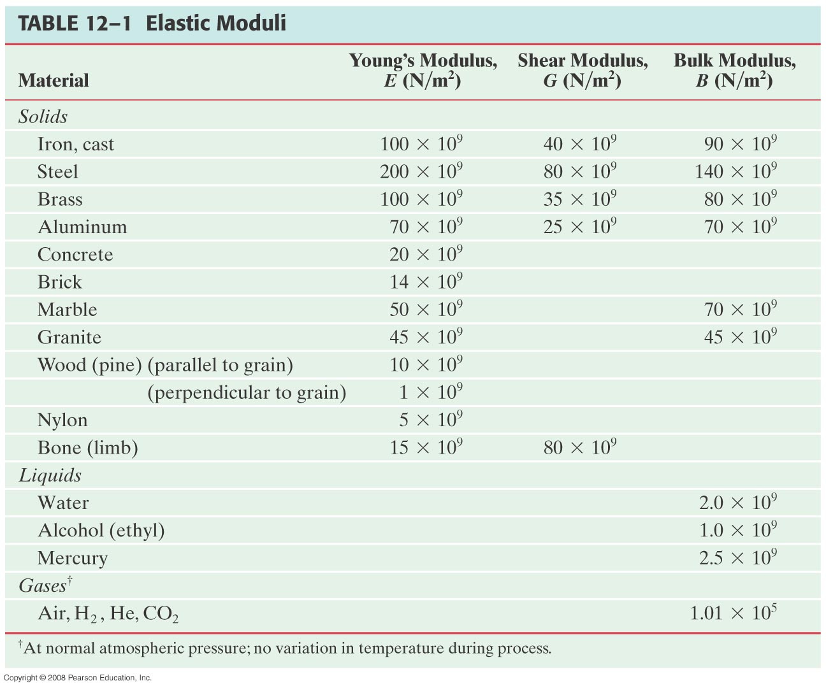
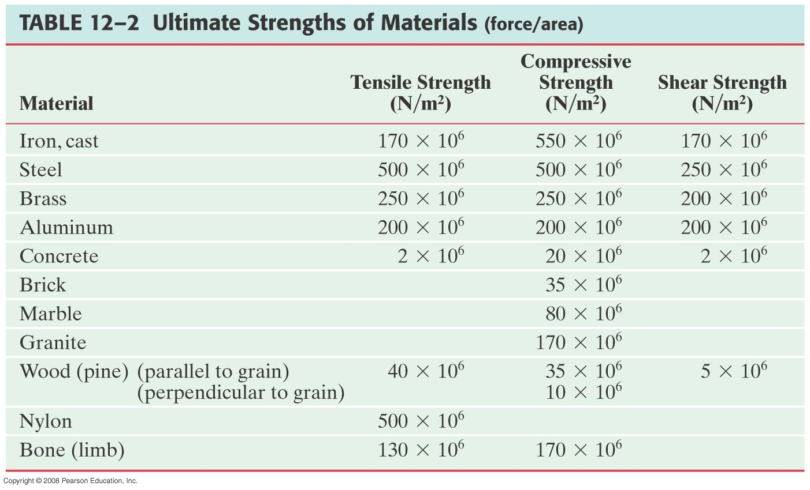
Elastic Moduli and Ultimate Strengths of Materials

Slide 12
Example for Solid’s Elastic Property
A solid brass sphere is initially under normal atmospheric pressure of 1.0x10⁵N/m². The sphere is lowered into the ocean to a depth at which the pressures is 2.0x10⁷N/m². The volume of the sphere in air is 0.5m³. By how much its volume change once the sphere is submerged?
Since bulk modulus is
The amount of volume change is
From table 12.1, bulk modulus of brass is 8.0x10¹⁰ N/m²
The pressure change ΔP is
Therefore the resulting volume change ΔV is
The volume has decreased.

Slide 13
Density and Specific Gravity
Density, ρ (rho), of an object is defined as mass per unit volume
Unit?
Dimension?
Specific Gravity of a substance is defined as the ratio of the density of the substance to that of water at 4.0 ºC (ρ_{H2O}=1.00g/cm³).
Unit?
None
Dimension?
None
What do you think would happen to the substance in the water dependent on SG?
Sink in the water
Float on the surface

Slide 14
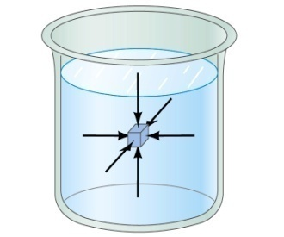
Fluid and Pressure
What are the three states of matter?
Solid, Liquid and Gas
How do you distinguish them?
Using the time it takes for a particular substance to change its shape in reaction to external forces.
What is a fluid?
A collection of molecules that are randomly arranged and loosely bound by forces between them or by an external container.
We will first learn about mechanics of fluid at rest, fluid statics.
In what ways do you think fluid exerts stress on the object submerged in it?
Fluid cannot exert shearing or tensile stress. Thus, the only force the fluid exerts on an object immersed in it is the force perpendicular to the surface of the object.
This force by the fluid on an object usually is expressed in the form of the force per unit area at the given depth, the pressure, defined as
Expression of pressure for an infinitesimal area dA by the force dF is
Note that pressure is a scalar quantity because it’s the magnitude of the force on a surface area A.
What is the unit and the dimension of pressure?
Unit:N/m²
Dim.: [M][L⁻¹][T⁻²]
Special SI unit for pressure is Pascal

Slide 15
Example for Pressure
The mattress of a water bed is 2.00m long by 2.00m wide and 30.0cm deep. a) Find the weight of the water in the mattress.
The volume density of water at the normal condition (4ºC and 1 atm) is 1000kg/m³. So the total mass of the water in the mattress is
Therefore the weight of the water in the mattress is
b) Find the pressure exerted by the water on the floor when the bed rests in its normal position, assuming the entire lower surface of the mattress makes contact with the floor.
Since the surface area of the mattress is 4.00 m², the pressure exerted on the floor is

Slide 16
Variation of Pressure and Depth
Water pressure increases as a function of depth, and the air pressure decreases as a function of altitude. Why?
P₀A
It seems that the pressure has a lot to do with the total mass of the fluid above the object that puts weight on the object.
Let’s imagine the liquid contained in a cylinder with height h and the cross sectional area A immersed in a fluid of density ρ at rest, as shown in the figure, and the system is in its equilibrium.
h
Mg
If the liquid in the cylinder is the same substance as the fluid, the mass of the liquid in the cylinder is
PA
Since the system is in its equilibrium
Therefore, we obtain
The pressure at the depth h below the surface of the fluid open to the atmosphere is greater than the atmospheric pressure by ρgh.
Atmospheric pressure P₀ is

Slide 17
Pascal’s Principle and Hydraulics
A change in the pressure applied to a fluid is transmitted undiminished to every point of the fluid and to the walls of the container.
What happens if P₀is changed?
The resultant pressure P at any given depth h increases as much as the change in P₀.
This is the principle behind hydraulic devices. How?
A₂
Since the pressure change caused by the the force F₁ applied onto the area A₁ is transmitted to the F₂ on an area A₂.
d₁
F₁
d₂
A₁
F₂
In other words, the force gets multiplied by the ratio of the areas A₂/A₁ and is transmitted to the force F₂ on the surface.
Therefore, the resultant force F₂ is
This seems to violate some kind of conservation law, doesn’t it?
No, the actual displaced volume of the fluid is the same. And the work done by the forces are still the same.

Slide 18
Example for Pascal’s Principle
In a car lift used in a service station, compressed air exerts a force on a small piston that has a circular cross section and a radius of 5.00cm. This pressure is transmitted by a liquid to a piston that has a radius of 15.0cm. What force must the compressed air exert to lift a car weighing 13,300N? What air pressure produces this force?
Using the Pascal’s principle, one can deduce the relationship between the forces, the force exerted by the compressed air is
Therefore the necessary pressure of the compressed air is

Slide 19
Absolute and Relative Pressure
How can one measure pressure?
One can measure the pressure using an open-tube manometer, where one end is connected to the system with unknown pressure P and the other open to air with pressure P₀.
P
P₀
h
The measured pressure of the system is
This is called the absolute pressure, because it is the actual value of the system’s pressure.
In many cases we measure the pressure difference with respect to the atmospheric pressure to avoid the effect of the changes in P₀ that depends on the environment. This is called gauge or relative pressure.
The common barometer which consists of a mercury column with one end closed at vacuum and the other open to the atmosphere was invented by Evangelista Torricelli.
Since the closed end is at vacuum, it does not exert any force. 1 atm of air pressure pushes mercury up 76cm. So 1 atm is
If one measures the tire pressure with a gauge at 220kPa the actual pressure is 101kPa+220kPa=303kPa.

