Slide 1
PHYS 1442 – Section 001
Lecture #1
Monday, June 3, 2013
Dr. Jaehoon Yu
Who am I?
How is this class organized?
What is Physics?
What do we want from this class?
Brief history of physics
Some basics …
Chapter 16
  Static Electricity and Charge Conservation
  Charges in Atom, Insulators and Conductors & Induced Charge
Today’s homework is homework #1, due 11pm, this Thursday!!

Slide 2
Announcements
Plea to you: Please turn off your cell-phones, pagers and computers in the class
Reading assignment #1: Read and follow through all sections in appendix A by Wednesday, June 5
  A-1 through A-8
There will be a quiz on this and Ch. 16 on Thursday, June 6.

Slide 3
Who am I?
Name: Dr. Jaehoon Yu (You can call me Dr. Yu)
Office: Rm 342, Chemistry and Physics Building
Extension: x22814, E-mail: jaehoonyu@uta.edu
My profession: High Energy Particle Physics (HEP)
  Collide particles (protons on anti-protons or electrons on anti-electrons, positrons) at the energies equivalent to 10,000 Trillion degrees
  To understand
    Fundamental constituents of matter
    Forces between the constituents (gravitational, electro-magnetic, weak and strong forces)
    Origin of Mass
    Search for Dark Matter
    Creation of Universe (Big Bang Theory)
  A pure scientific research activity
    Direct use of the fundamental laws we find may take longer than we want but
    Indirect product of research contribute to every day lives; eg. WWW
  Why do we do with this?
    Make our everyday lives better to help us live well as an integral part of the universe

Slide 4
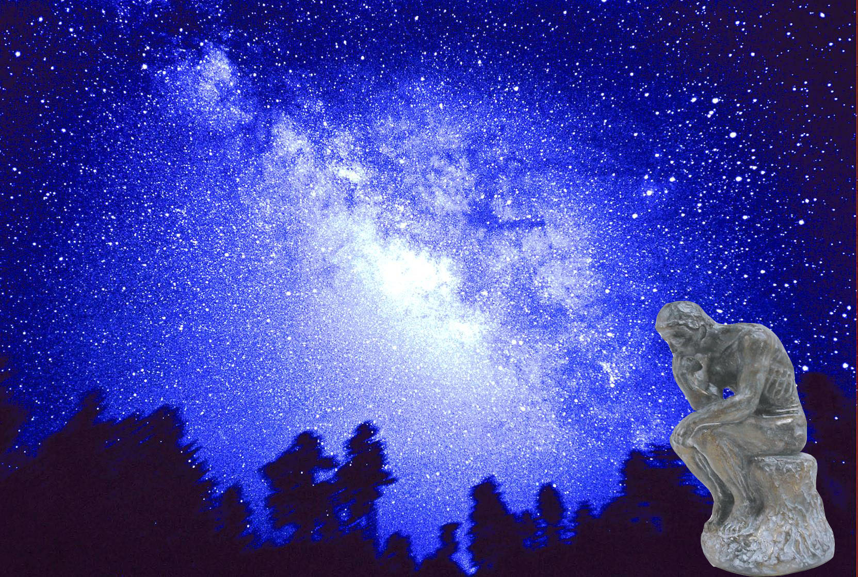

We always wonder…
What makes up the universe?
How does the universe work?
What holds the universe together?
How can we live in the universe well?
Where do we all come from?

Slide 5
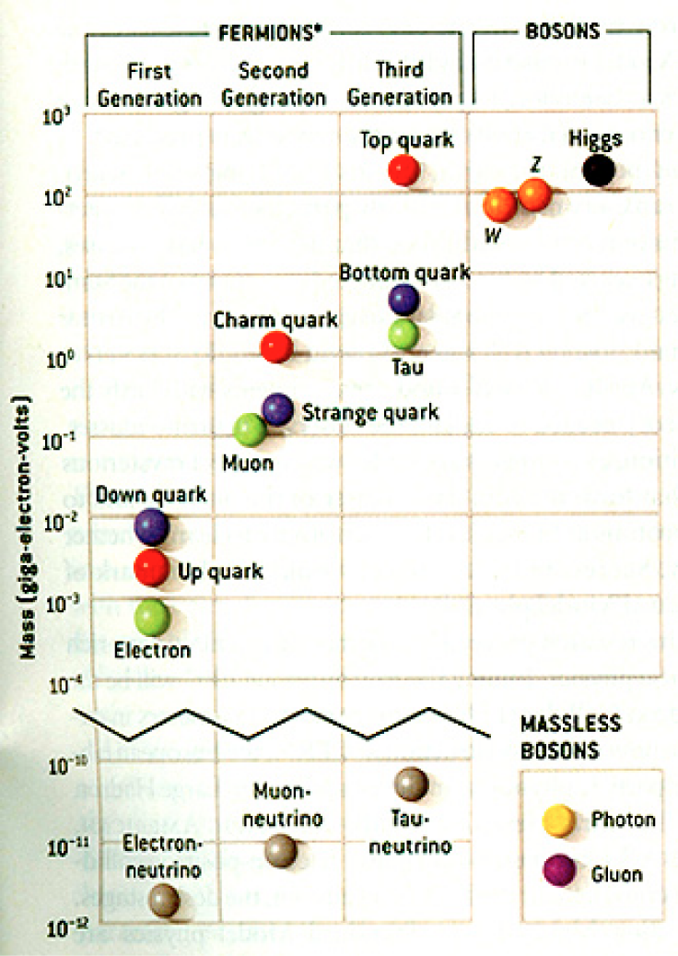
HEP and the Standard Model
HEP: A field of physics that studies the fundamental constituents of matter and basic principles of interactions between them.
Discovered in 1995, ~175m_{p}
Make up most ordinary matters ~0.1m_{p}
Total of 16 particles (12+4 force mediators) make up all the visible matter in the universe! ➔ Simple and elegant!!!
Tested to a precision of 1 part per million!

Slide 6
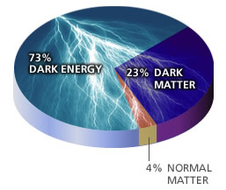
So what’s the problem?
Why is the mass range so large (0.1m_{p} – 175 m_{p})?
How do matters acquire mass?
  Higgs mechanism, did we find the Higgs particle?
Why is the matter in the universe made only of particles?
Neutrinos have mass!! What are the mixing parameters, CP violations and mass ordering?
Why are there only three apparent forces?
  Can the forces be unified?
Is the picture we present the real thing?
  What makes up the 96% of the universe?
  What is the dark matter and dark energy?
Are there any other theories that describe the universe better?
  Does the super-symmetry exist?
How is the universe created, the Big Bang?

Slide 7
Accelerators are Powerful Microscopes.
They make high energy particle beams
that allow us to see small things.
seen by
low energy beam
(poorer resolution)
seen by
high energy beam
(better resolution)

Slide 8
Accelerators are also Time Machines.
They make particles last seen
in the earliest moments of the universe.
Energy
particle beam
energy
anti-particle beam
energy
Particle and anti-particle annihilate.
E = mc²

Slide 9
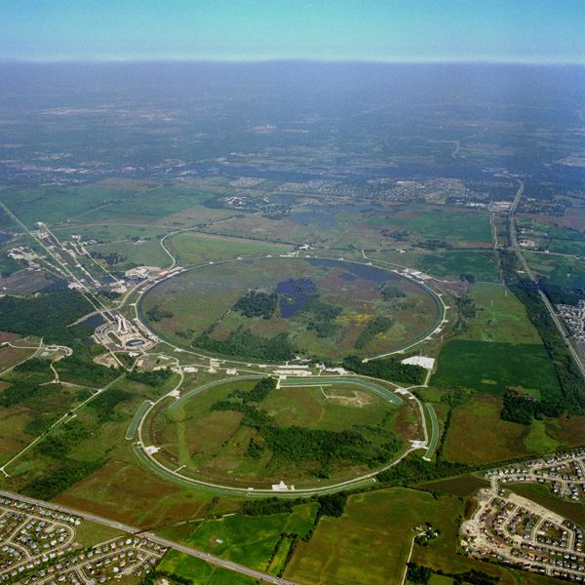
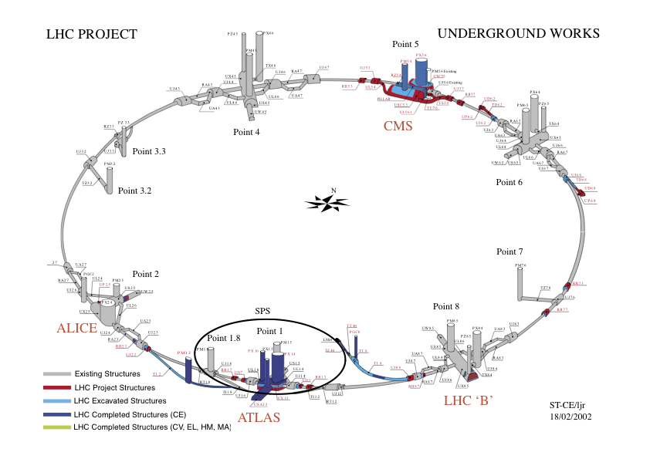
Fermilab Tevatron and LHC at CERN
World’s Highest Energy proton-anti-proton collider
  4km circumference
  E_{cm}=1.96 TeV (=6.3x10⁻⁷J/p➔ 13M Joules on the area smaller than 10⁻⁴m²)
  Equivalent to the kinetic energy of a 20t truck at the speed 81mi/hr➔ 130km/hr
    ~100,000 times the energy density at the ground 0 of the Hiroshima atom bomb
  Was shut down on Sept. 30, 2011
  Vibrant other programs running, including the search for dark matter!!
World’s Highest Energy p-p collider
  27km circumference, 100m underground
  Design E_{cm}=14 TeV (=44x10⁻⁷J/p➔ 362M Joules on the area smaller than 10⁻⁴m²)
  Equivalent to the kinetic energy of a B727 (80tons) at the speed 193mi/hr ➔ 312km/hr
    ~3M times the energy density at the ground 0 of the Hiroshima atom bomb
First 7TeV collisions 2010 ➔ The highest energy humans ever achieved!!
Large amount of data accumulated in 2011 – 2013
Shutdown in Feb. 2013 for 18mo for upgrade
Chicago
CDF
p
DØ
Tevatron
p

Slide 10
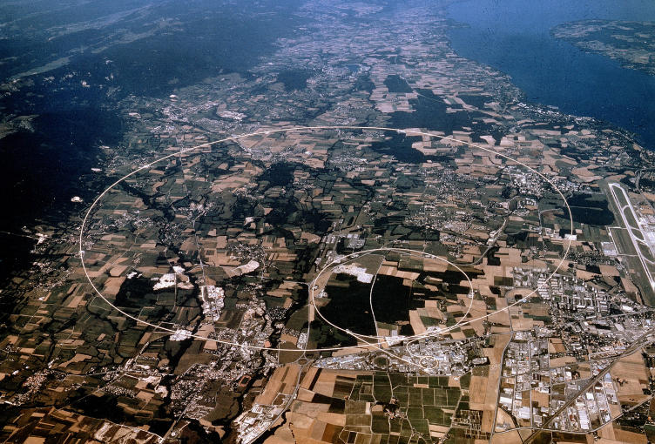
LHC @ CERN Aerial View
CMS
France
Geneva Airport
ATLAS
Swizerland

Slide 11
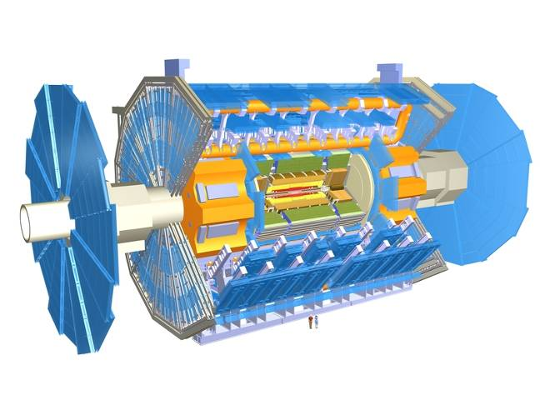
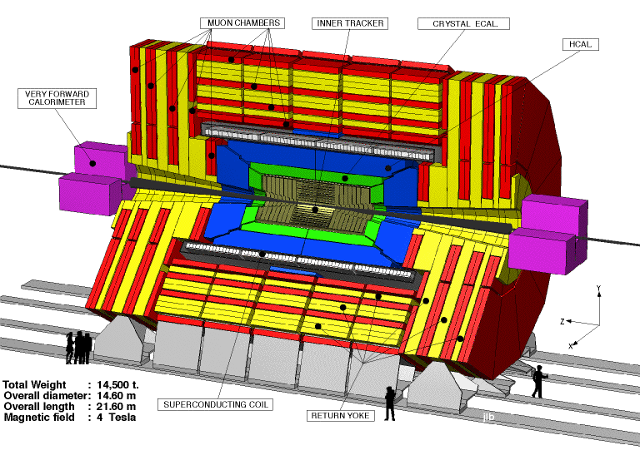
The ATLAS and CMS Detectors
Fully multi-purpose detectors with emphasis on lepton ID & precision E & P
Weighs 7000 tons and 10 story tall
Records 200 – 400 collisions/second
Records approximately 350 MB/second
Record ~2 PB per year ➔ 200*Printed material of the US Lib. of Congress

Slide 12
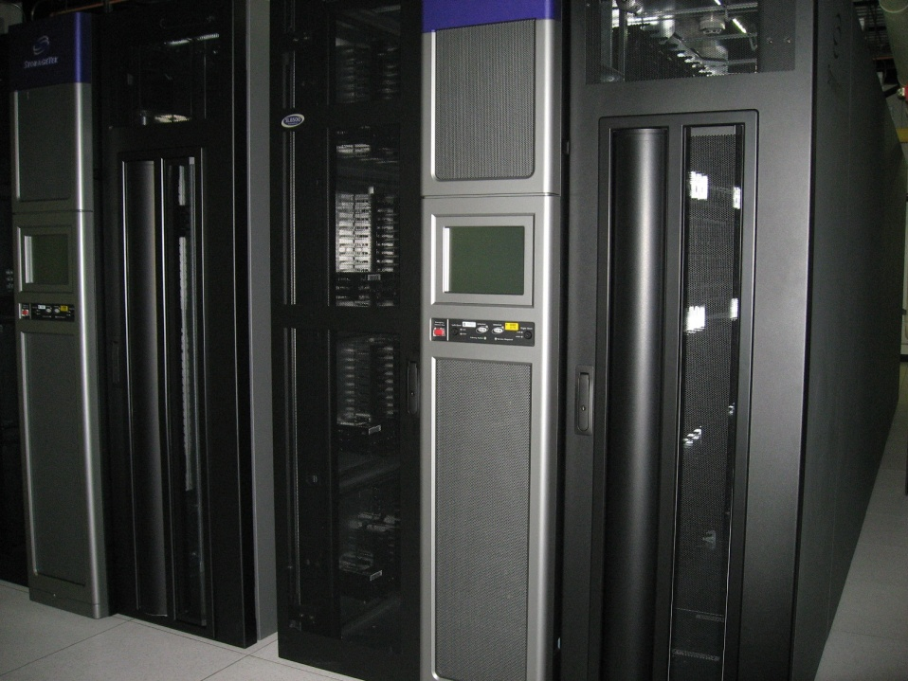
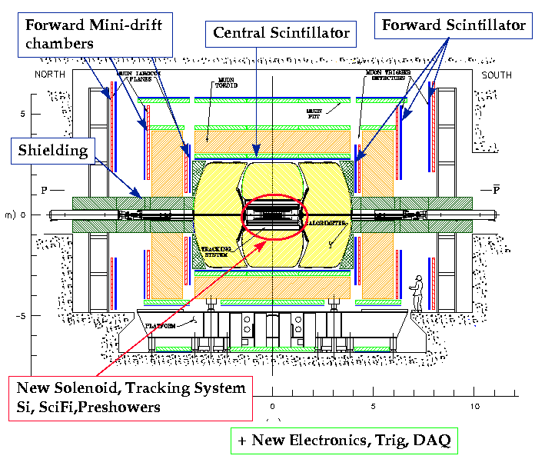
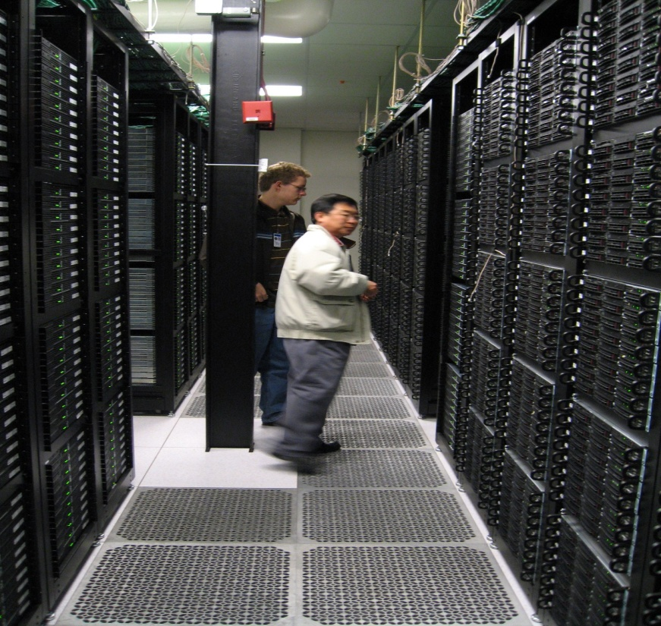
Computers put together a picture
Digital data
p
‾p
Data Reconstruction

Slide 13
What is the Higgs and What does it do?
When there is perfect symmetry, one cannot tell directions!
Only when symmetry is broken, can one tell directions
Higgs field works to break the perfect symmetry and gives mass to all fundamental particles
In this process, this field spontaneously generates a particle, the Higgs particle
So the Higgs particle is a piece of evidence of the existence of the Higgs field!

Slide 14

What? What’s the symmetry?
Where is the head of the table?
Without a broken symmetry, one cannot tell directional information!!

Slide 15



So how does Higgs Field work again?
Person in space ➔ no symmetry breaking
Person in air ➔ symmetry can be broken
Sometimes, you get
Just like a tornado is a piece of evidence of the existence of air, Higgs particle is a piece of evidence of Higgs mechanism

Slide 16
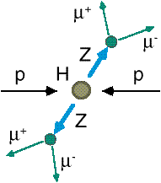
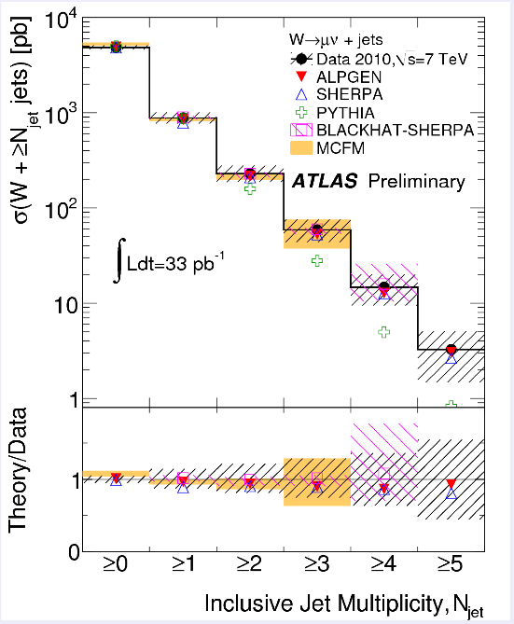
How do we look for the Higgs?
Identify Higgs candidate events
Understand fakes (backgrounds)
Look for a bump!!
  Large amount of data absolutely critical
e⁺ (μ⁺)
e⁻ (μ⁻)
e⁺
e⁻

Slide 17
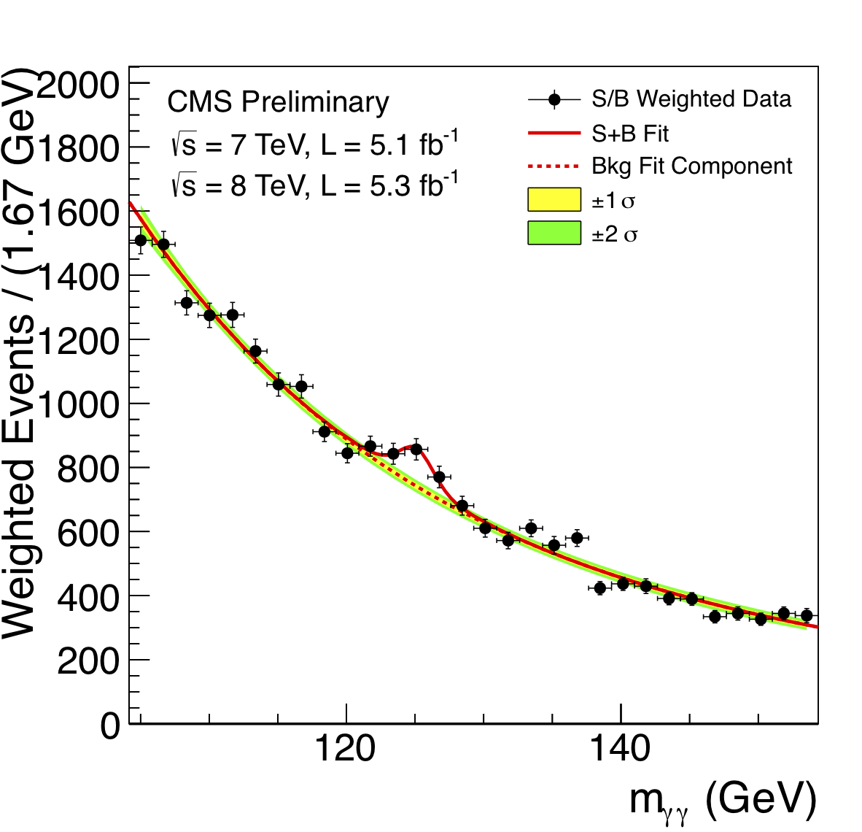
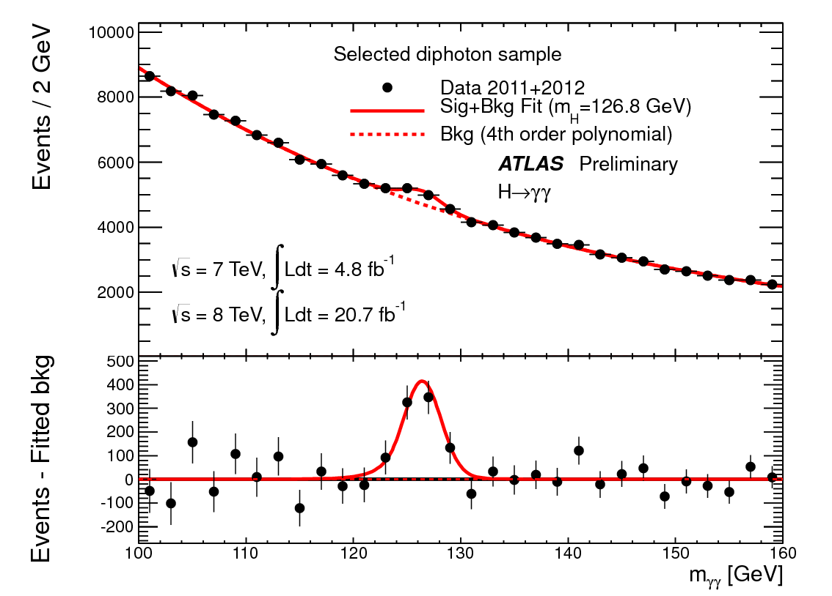
ATLAS and CMS Mass Bump Plots (H→γγ )
ATLAS
CMS
LOOK, Ma! Bumps!!

Slide 18

What did statistics do for Higgs?

Slide 19
So have we seen the Higgs particle?
The statistical significance of the finding is way over 7 standard deviations

Slide 20
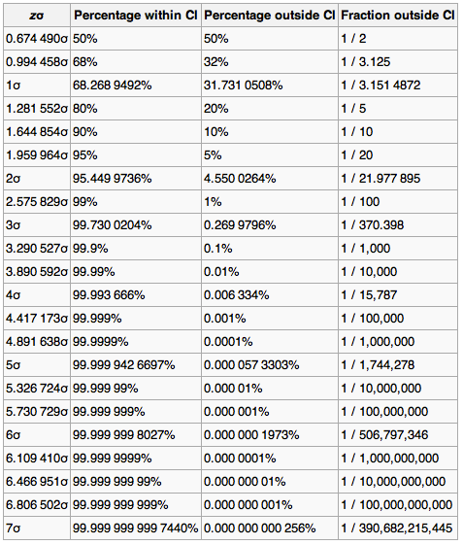
Statistical Significance Table

Slide 21
So have we seen the Higgs particle?
The statistical significance of the finding is over 7 standard deviations
  Level of significance: 99.999 999 999 7% (eleven 9s!!)
  We can be wrong once if we do the same experiment 391,000,000,000 times
So did we find the Higgs particle?
  We have discovered a new particle, the heaviest boson we’ve seen thus far
  It has many properties consistent with the Standard Model Higgs particle
  We, however, do not have enough data to precisely measure all the properties – mass, lifetime, the rate at which this particle decays to certain other particles, etc – to definitively determine
UTA had a lecture by Nobel Laureate, prof. Steven Weinberg, which was attended by 1200 people!!

Slide 22
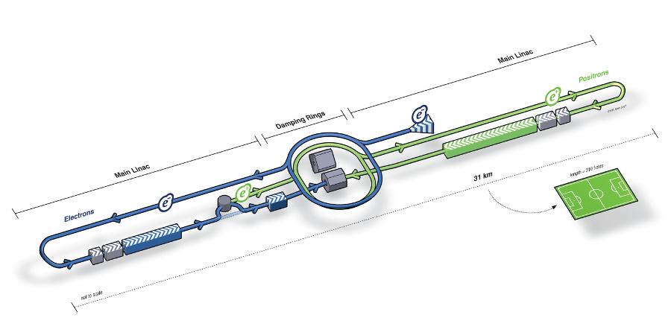
What next? Future Linear Collider
Now that we have found a new boson, precision measurement of the particle’s properties becomes important
An electron-positron collider on a straight line for precision measurements
10~15 years from now (In Dec. 2011, Japanese PM announced that they would bid for a LC in Japan and reaffirmed by the new PM in 2013
  Our Japanese colleagues have declared that they will bid for building a 250GeV machine in Japan!!
Takes 10 years to build a detector
L~31km
Circumference ~6.6km
~300 soccer fields

Slide 23
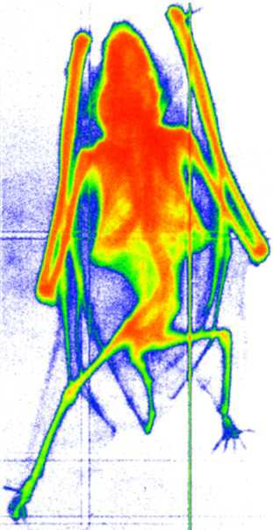
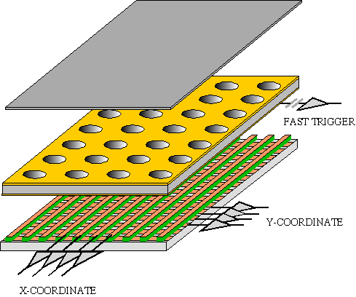
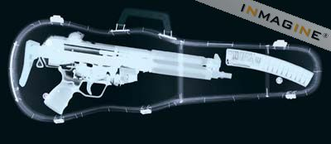
GEM Application Potential
FAST X-RAY IMAGING
Using the lower GEM signal, the readout can be self-triggered with energy discrimination:
9 keV absorption radiography of a small mammal (image size ~ 60 x 30 mm²)
A. Bressan et al,
Nucl. Instr. and Meth. A 425(1999)254
F. Sauli, Nucl. Instr. and Meth.A 461(2001)47

Slide 24
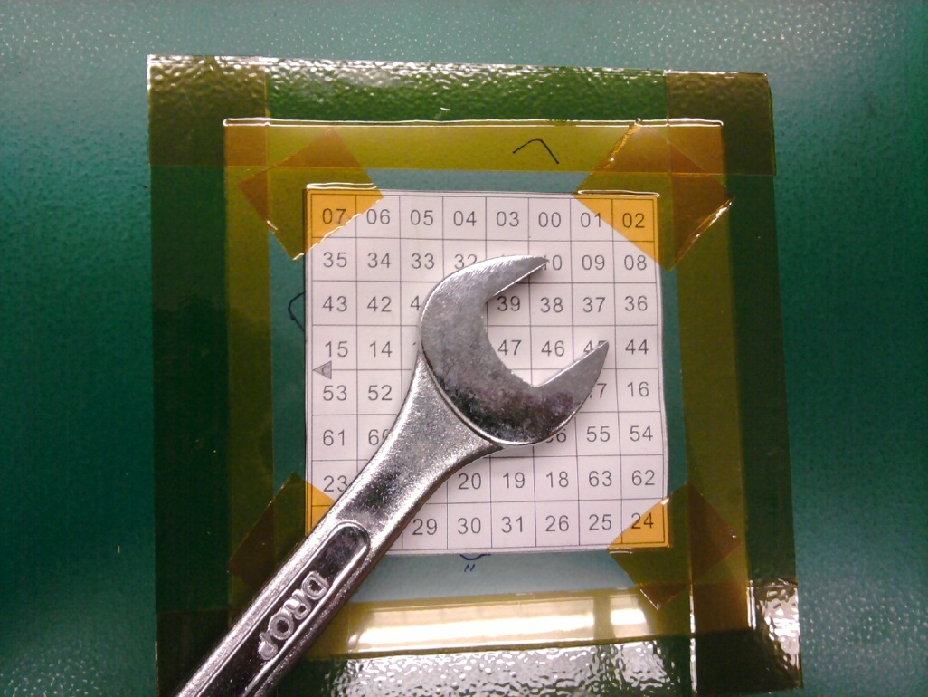
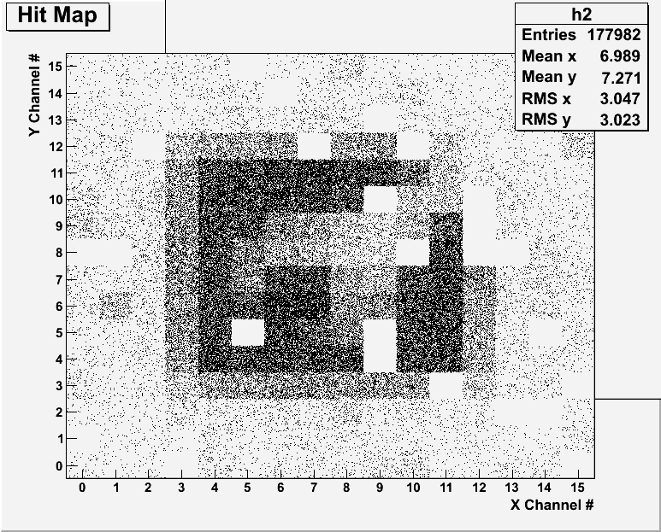
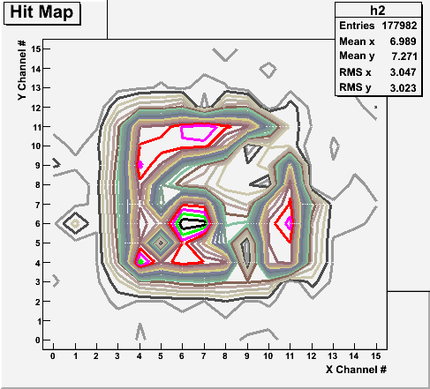
X-ray Image of an object with a prototype
Can you see what the object is?

Slide 25
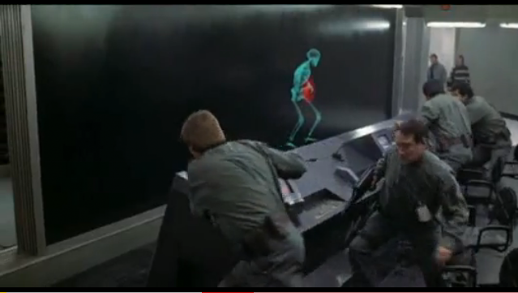
And in not too distant future, we could do …

Slide 26
Information & Communication Source
My web page: http://www-hep.uta.edu/~yu/
  Contact information & Class Schedule
  Syllabus
  Homework
  Holidays and Exam days
  Evaluation Policy
  Class Style & Communication
  Other information
Primary communication tool is e-mail: Make sure your e-mail address on your registration points to the most favorite one that you read at least once a day
Office Hours: 12:30 – 1:30pm, Monday - Thursday or by appointments

Slide 27
Evaluation Policy
Homework: 25%
Exams
  Final Comprehensive Exams (7/8): 23%
  Mid-term Comprehensive Exam (6/19): 20%
  One better of the two term Exams: 12%
    Total of two non-comprehensive term exams (6/11 and 6/27)
    One better of the two exams will be used for the final grade
  Missing an exam is not permissible unless pre-approved
    No makeup test
    You will get an F if you miss any of the exams without a prior approval no matter how well you’ve been doing in class!
Lab score: 10%
Pop-quizzes: 10%
Extra credits: 10% of the total
  Random attendances
  Strong participation in the class discussions
  Special projects (BIGGGGG!!!)
  Planetarium shows and Other many opportunities
Grading will be done on a sliding scale
100%

Slide 28
Homework
Solving homework problems is the only way to comprehend class material ➔ 2 homeworks per week
An electronic homework system has been setup for you
  Details are in the material distributed today and on the web
  https://quest.cns.utexas.edu/student/courses/list
  Choose the course 1442-Summer13, unique number 42013
  Download homeworks, solve the problems and submit them online
  Multiple unsuccessful tries will deduct points
  Roster will close at tpm Wednesday, June 4
  You need a UT e-ID: Go and apply at the URL https://idmanager.its.utexas.edu/eid_self_help/?createEID&qwicap-page-id=EA027EFF7E2DA39E if you don’t have one.
Each homework carries the same weight
Home work problems will be slightly ahead of the class
No homework will be dropped from the final grade!!
Home work will constitute 25% of the total ➔ A good way of keeping your grades high
Strongly encouraged to collaborate ➔ Does not mean you can copy

Slide 29
Attendances and Class Style
Attendances:
  Will be taken randomly
  Will be used for extra credits
Class style:
  Lectures will be on electronic media
    The lecture notes will be posted on the web AFTER each class
  Will be mixed with traditional methods
  Active participation through questions and discussions are STRONGLY encouraged ➔ Extra credit….
  Communication between you and me is extremely important
    If you have problems, please do not hesitate talking to me

Slide 30
Lab and Physics Clinic
Physics Labs:
  Intro-labs on Wednesday and Thursday, June 5 and 6 (official beginning June 10)
  Important to understand physical principles through experiments
  10% of the grade
  Prelab questions can be obtained at www.uta.edu/physics/labs
  Lab syllabus is available in your assigned lab rooms.
Physics Clinic:
  Free service
  They provide general help on physics, including help solving homework problems
    Do not expect solutions of the problem from them!
    Do not expect them to tell you whether your answers are correct!
    It is your responsibility to make sure that you have done everything correctly!
  11am – 6pm, Mon – Thu in SH 007
  This service begins today!
  Please take full advantage of this service!!

Slide 31
Extra credit
10% addition to the total
  Could boost a B to A, C to B or D to C
What constitute for extra credit?
  Special projects (biggest!!)
  Random attendances
  Strong participation in the class discussions
  Watch the valid planetarium shows
  Many other opportunities

Slide 32
Valid Planetarium Shows
Regular running shows
  We Are Astronomers - Wednesdays at 2:00 and Saturdays at 5:30
  Time Space – Fridays at 2:00 and Saturdays at 2:30
Shows that need special arrangements
  Astronaut; Bad Astronomy; Black Holes (can watch up to 2 times)
  Experience the Aurora IBEX; Ice Worlds; Magnificent Sun; Mayan Prophecies
  Nano Cam; Stars of the Pharaohs; Two Small Pieces of Glass
  Unseen Universe: The Vision of SOFIA; Violent Universe
How to submit for extra credit?
  Obtain the ticket stub that is signed and dated by the planetarium star lecturer of the day
  Collect the ticket stubs
  Tape one edge of all of the ticket stubs on a sheet of paper with your name and ID written on it
  Submit the sheet at the end of the semester at the final exam

Slide 33
What can you expect from this class?
All A’s?
  This would be really nice, wouldn’t it?
  But if it is too easy it is not fulfilling or meaningful….
This class is not going to be a stroll in the park!!
You will earn your grade in this class.
  You will need to put in sufficient time and sincere efforts
  Exams and quizzes will be tough!!
    Sometimes problems might not look exactly like what you learned in the class
    Just putting the right answer in free response problems does not work!
But you have a great control (up to 45%) of your grade in your hands
  Homework is 25% of the total grade!!
    Means you will have many homework problems
      Sometimes much more than any other classes
      Sometimes homework problems will be something that you have yet to learn in class
      Exam’s problems will be easier that homework problems but same principles!!
  Lab 10%
  Extra credit 10%
I will work with you so that your efforts are properly rewarded

Slide 34
What do we want to learn in this class?
Physics is everywhere around you.
Skills to understand the fundamental principles that surrounds you in everyday lives…
Skills to identify what laws of physics applies to what phenomena and use them appropriately
Understand the impact of physical laws and apply them
Learn skills to think, research and analyze observations.
Learn skills to express observations and measurements in mathematical language
Learn skills to express your research in systematic manner in writing
But most importantly the confidence in your physics ability and to take on any challenges laid in front of you!!
Most importantly, let us have a lot of FUN!!

Slide 35
In this course, you will learn…
Fundamentals of Electricity and Magnetism
Electric and Magnetic Forces and Fields
Electric charge and magnetic poles
Electric and magnetic potential, energy and power
Propagation of electric and magnetic fields
Relationship between electro-magnetic forces and light
Behaviors of light and optics
Special relativity and quantum theories

Slide 36
How to study for this course?
Keep up with the class for comprehensive understanding of materials
  Come to the class and participate in the discussions and problems solving sessions
  Follow through the lecture notes
  Work out example problems in the book yourself without looking at the solution
  Have many tons of fun in the class!!!!!
Keep up with the homework to put the last nail on the coffin
  One can always input the answers as you solve the problems. Do not wait till you are done with all the problems.
  Form a study group and discuss how to solve problems with your friends, then work the problems out yourselves!
Prepare for upcoming classes
  Read the textbook for the material to be covered in the next class
The extra mile
  Work out additional problems in the back of the book starting the easiest problems to harder ones

Slide 37
Extra Credit Special Project #1
Compare the Coulomb force to the Gravitational force in the following cases by expressing Coulomb force (F_{C}) in terms of the gravitational force (F_{G})
  Between two protons separated by 1m
  Between two protons separated by an arbitrary distance R
  Between two electrons separated by 1m
  Between two electrons separated by an arbitrary distance R
Five points each, totaling 20 points
BE SURE to show all the details of your work, including all formulae, and properly referring them
Please staple them before the submission
Due at the beginning of the class Monday, June 10

Slide 38
Brief History of Physics
AD 18th century:
  Newton’s Classical Mechanics: A theory of mechanics based on observations and measurements
AD 19th Century:
  Electricity, Magnetism, and Thermodynamics ➔ unification of forces
Late AD 19th and early 20th century (Modern Physics Era)
  Einstein’s theory of relativity: Generalized theory of space, time, and energy (mechanics)
  Quantum Mechanics: Theory of atomic phenomena
Physics has come very far, very fast, and is still progressing, yet we’ve got a long way to go
  What is matter made of?
  How do matters get mass? ➔ Better than before since Higgs was found
  How and why do matters interact with each other?
  How is universe created?
  What are Dark Matter and Dark Energy?

Slide 39
Needs for Standards and Units
Three basic quantities for physical measurements
  Length, Mass, and Time
Need a language that everyone can understand each other
  Consistency is crucial for physical measurements
  The same quantity measured by one must be comprehendible and reproducible by others
  Practical matters contribute
A system of unit called SI (System International) established in 1960
  Length in meters (m)
  Mass in kilo-grams (kg)
  Time in seconds (s)

Slide 40
SI Base Quantities and Units
Quantity | Unit | Unit Abbrevation
Length | Meter | m
Time | Second | s
Mass | Kilogram | kg
Electric current | Ampere | A
Temperature | Kelvin | k
Amount of substance | Mole | mol
Luminous Intensity | Candela | cd
There are prefixes that scales the units larger or smaller for convenience (see pg. 7)

Slide 41
Prefixes, expressions and their meanings
deca (da): 10¹
hecto (h): 10²
kilo (k): 10³
mega (M): 10⁶
giga (G): 10⁹
tera (T): 10¹²
peta (P): 10¹⁵
exa (E): 10¹⁸
deci (d): 10⁻¹
centi (c): 10⁻²
milli (m): 10⁻³
micro (μ): 10⁻⁶
nano (n): 10⁻⁹
pico (p): 10⁻¹²
femto (f): 10⁻¹⁵
atto (a): 10⁻¹⁸

Slide 42
How do we convert quantities from one unit to another?
Unit 1 =
Conversion factor X
Unit 2
1 inch | 2.54 | cm
1 inch | 0.0254 | m
1 inch | 2.54x10⁻⁵ | km
1 ft | 30.3 | cm
1 ft | 0.303 | M
1 ft | 3.03x10⁻⁴ | km
1 hr | 60 | minutes
1 hr | 3600 | seconds
And many | More | Here….

Slide 43
What does the Electric Force do?
Electric force froms the bases of modern technology
  Virtually everything we use every day uses the electric force
    Can you give a few examples?
But this force also affects many others
  Making up materials with atoms and molecules
  Biological metabolic processes
    Nerve signals, heart pumping, etc

Slide 44
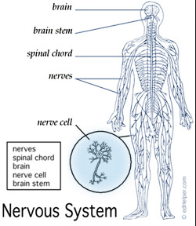
Human Nerve System Wiring
Nerve signals sent to the entire body via nerve wiring, just like any electronic gadgets we use

Slide 45
What does the Electric Force do?
Electric force froms the bases of modern technology
  Virtually everything we use every day uses the electric force
    Can you give a few examples?
But this force also affects many others
  Making up materials with atoms and molecules
  Biological metabolic processes
    Nerve signals, heart pumping, etc
Virtually all the forces we have learned in Physics I:
  Friction, normal force, elastic force and other contact forces are the results of electric forces acting at the atomic level

Slide 46
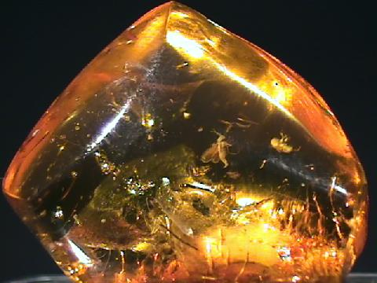
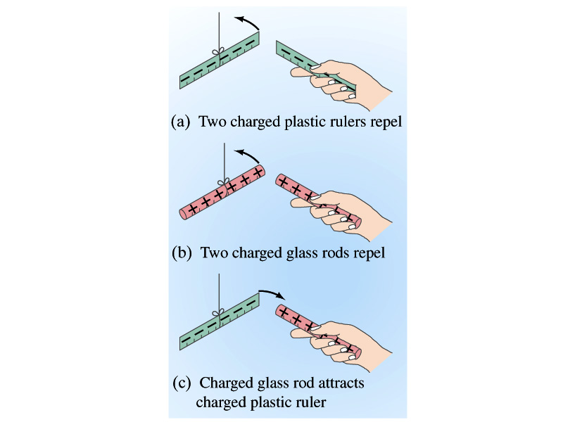
Static Electricity; Electric Charge and Its Conservation
Electricity is from Greek word elecktron=amber, a petrified tree resin that attracts matter when rubbed
Static Electricity: an amber effect
  An object becomes charged or “posses a net electric charge” due to rubbing
  Can you give some examples?
Two types of the electric charge
  Like charges repel while unlike charges attract
  Benjamin Franklin referred the charge on glass rod as the positive, arbitrarily. Thus the charge that attracts glass rod is negative. ➔ This convention is still used.

Slide 47
Static Electricity; Electric Charge and Its Conservation
Ben Franklin argued that when a certain amount of charge is produced on one body in a process, an equal amount of opposite type of charge is produced on another body.
  The positive and negative are treated algebraically so that at any time in the process the net change in the amount of produced charge is 0.
    When you comb your hair with a plastic comb, the comb acquires a negative charge and the hair an equal amount of positive charge.
This is the law of conservation of electric charge.
  The net amount of electric charge produced in any process is ZERO!!
  No net electric charge can be created or destroyed
    If one object or one region of the space acquires a positive charge, then an equal amount of negative charge will be found in neighboring areas or objects.
    No violations have ever been observed.
    This conservation law is as firmly established as that of energy or momentum.

Slide 48
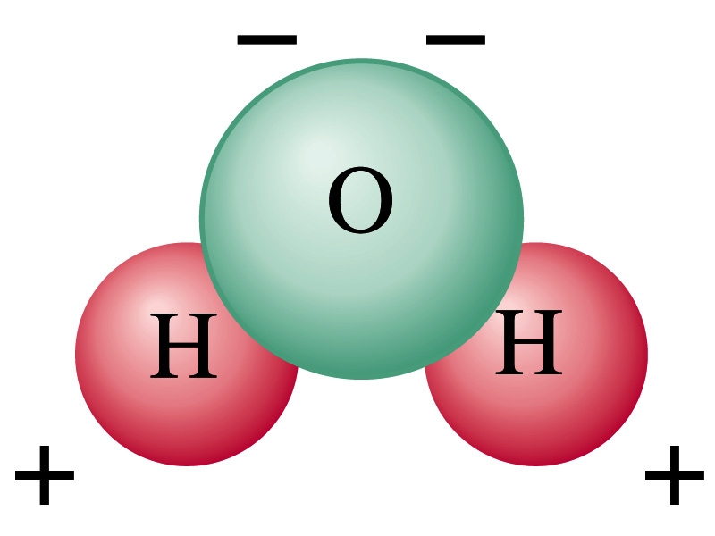
Electric Charge in the Atom
It has been understood through the past century that an atom consists of
  A positively charged heavy core ⬅ What is the name?
    This core is nucleus and consists of neutrons and protons.
  Many negatively charged light particles surround the core ⬅ What is the name of these light particles?
    These are called electrons
    How many of these?
So what is the net electrical charge of an atom?
  Zero!!! Electrically neutral!!!
Can you explain what happens when a comb is rubbed on a towel?
  Electrons from towel get transferred to the comb, making the comb negatively charged while leaving positive ions on the towel.
  These charges eventually get neutralized primarily by water molecules in the air.
As many as the number of protons!!

