Slide 1
PHYS 1442 – Section 001 Lecture #2
Tuesday, June 4, 2013
Dr. Jaehoon Yu
Chapter 16
Insulators and Conductors & Induced Charge
Coulomb’s Law
Vector Operations Recap
The Electric Field & Field Lines
Electric Fields and Conductors
Motion of a Charged Particle in an Electric Field
Gauss’ Law

Slide 2
Announcements
22 of you have registered in the homework system.
Fantastic job!!
You need my enrollment approval… So move quickly…
Remember, the deadline for the first homework is 11pm this Thursday.
Reading assignments: CH16 – 10, 16 – 11, 16 – 12
Quiz at the beginning of the class this Thursday, June 6
Appendix A1 – A8 and CH16

Slide 3
Extra Credit Special Project #1
Compare the Coulomb force to the Gravitational force in the following cases by expressing Coulomb force (F_{C}) in terms of the gravitational force (F_{G})
Between two protons separated by 1m
Between two protons separated by an arbitrary distance R
Between two electrons separated by 1m
Between two electrons separated by an arbitrary distance R
Five points each, totaling 20 points
BE SURE to show all the details of your work, including all formulae, and properly referring them
Please staple them before the submission
Due at the beginning of the class Monday, June 10

Slide 4
Special Project #2 – Angels & Demons
Compute the total possible energy released from an annihilation of x-grams of anti-matter and the same quantity of matter, where x is the last two digits of your SS#. (20 points)
Use the famous Einstein’s formula for mass-energy equivalence
Compute the power output of this annihilation when the energy is released in x ns, where x is again the last two digits of your SS#. (10 points)
Compute how many cups of gasoline (8MJ) this energy corresponds to. (5 points)
Compute how many months of world electricity usage (3.6GJ/mo) this energy corresponds to. (5 points)
Due by the beginning of the class Thursday, June 13.

Slide 5
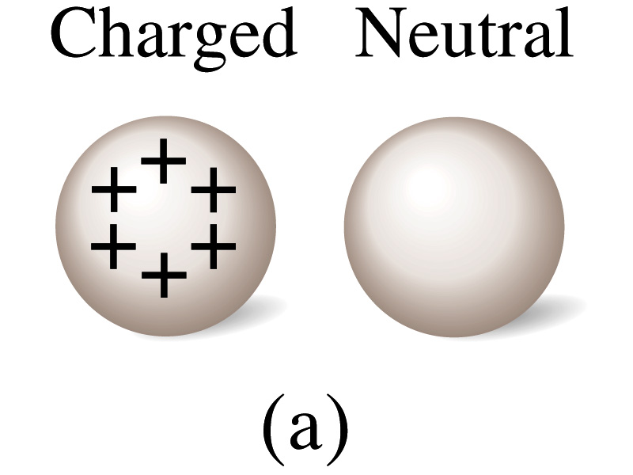
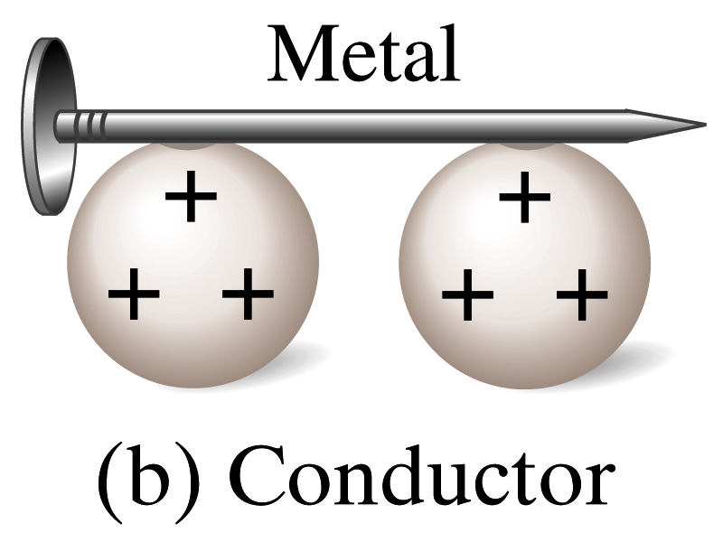
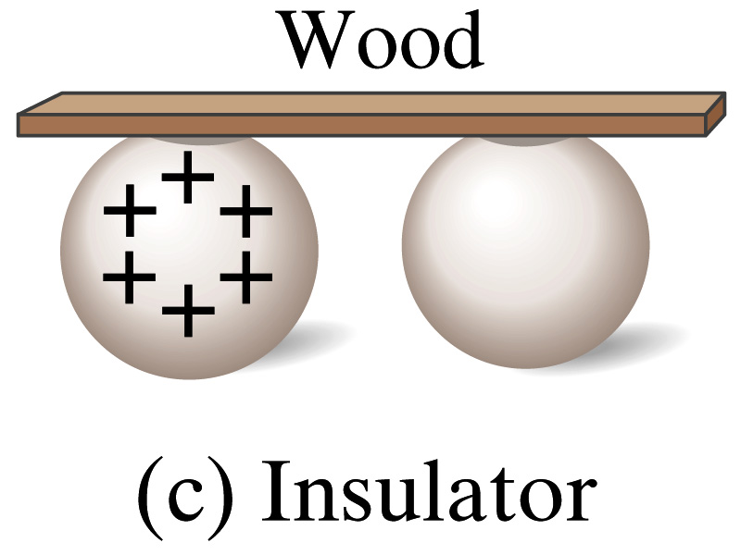
Insulators and Conductors
Let’s imagine two metal balls of which one is charged
What will happen if they are connected by
A metallic object?
Some charge is transferred.
These objects are called conductors of electricity.
A wooden object?
No charge is transferred
These objects are called nonconductors or insulators.
Metals are generally good conductors whereas most other materials are insulators.
There are third kind of materials called, semi-conductors, like silicon or germanium ➔ conduct only in certain conditions
Atomically, conductors have loosely bound electrons while insulators have them tightly bound!

Slide 6
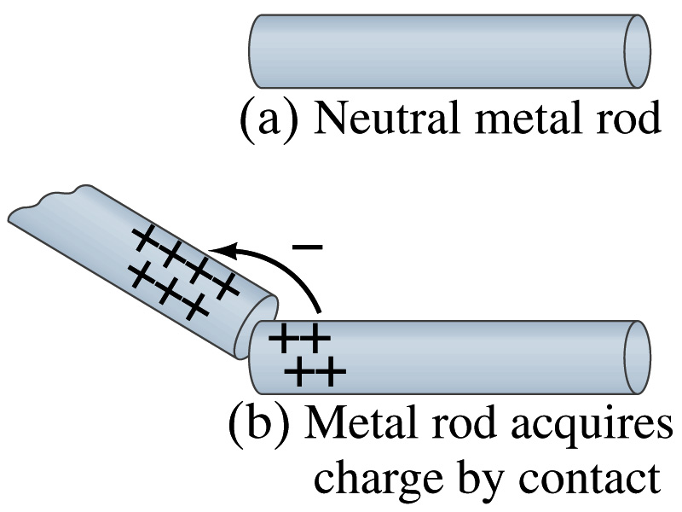
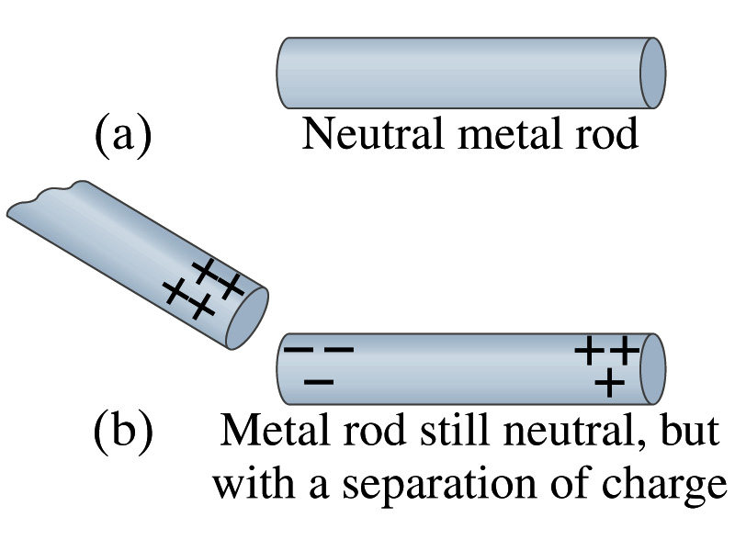
Induced Charge
When a positively charged metal object is brought close to an uncharged metal object
If two objects touch each other, the free electrons in the neutral ones are attracted to the positively charged object and some will pass over to it, leaving the neutral object positively charged. ➔ Charging by conduction
If the objects get close, the free electrons in the neutral ones still move within the metal toward the charged object leaving the opposite of the object positively charged.
The charges have been “induced” in the opposite ends of the object.

Slide 7
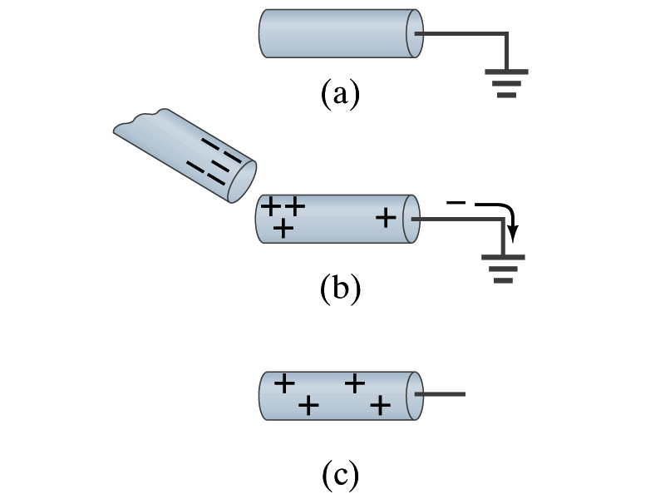
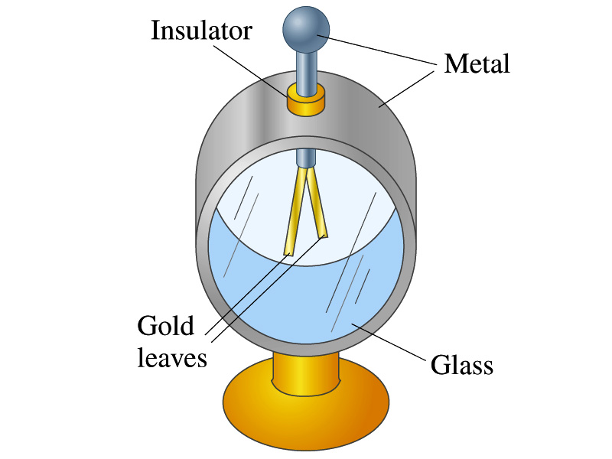
Induced Charge
ground
We can induce a net charge on a metal object by connecting a wire to the ground.
The object is “grounded” or “earthed”.
Since the Earth is so large and conducts, it can give or accept charge.
The Earth acts as a reservoir of the electric charge.
If the negative charge is brought close to a neutral metal
The positive charges will be induced toward the negatively charged metal.
The negative charges in the neutral metal will be gathered on the opposite side, transferring through the wire to the Earth.
If the wire is cut, the metal bar has net positive charge.
An electroscope is a device that can be used for detecting charge and signs.
Previously charged device can determine the sign of unknown charge

Slide 8
Coulomb’s Law
Electric charges exert force to each other. What factors affect the magnitude of this force?
Any guesses?
Charles Coulomb figured this out in 1780’s.
Coulomb found that the electrical force is
Proportional to the multiplication of the two charges
If one of the charges doubles, the force doubles.
If both the charges double, the force quadruples.
Inversely proportional to the square of the distances between them.
If the distance between the two charges double, the force reduces by a factor of 4!
Electric charge is a fundamental property of matter, just like mass.
How would you put the above into a formula?

Slide 9
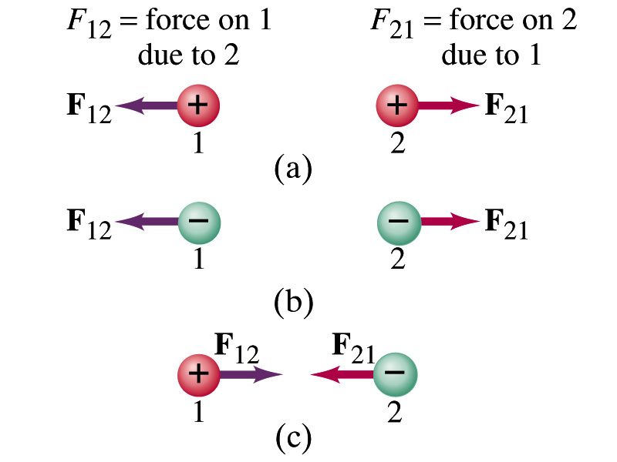
Coulomb’s Law – The Formula
Formula
Is Coulomb force a scalar quantity or a vector quantity? Unit?
A vector quantity. The unit is Newtons (N)!
The direction of electric (Coulomb) force is always along the line joining the two objects.
If the two charges are the same: forces are directed away from each other.
If the two charges are opposite: forces are directed toward each other.
Coulomb force is precise to 1 part in 10¹⁶.
Unit of charge is called Coulomb, C, in SI.
The value of the proportionality constant, k, in SI unit is
Thus, 1C is the charge that gives F~9x10⁹N of force when placed 1m apart from each other.

Slide 10
Electric Force
and Gravitational Force
Extremely
Similar
Does the electric force look similar to another force? What is it?
Gravitational Force
What are the sources of the forces?
Electric Force: Electric charges, fundamental properties of matter
Gravitational Force: Masses, fundamental properties of matter
What else is similar?
Inversely proportional to the square of the distance between the sources of the force ➔ What is this kind law called?
Inverse Square Law
What is the biggest difference?
Gravitational force is always attractive.
Electric force depends on the type of the two charges.

Slide 11
The Elementary Charge and Permittivity
Elementary charge, the smallest charge, is that of an electron:
Since an electron is a negatively charged particle, its charge is –e.
Object cannot gain or lose fraction of an electron.
Electric charge is quantized.
It changes always in integer multiples of e.
The proportionality constant k is often written in terms of another constant, ε₀, the permittivity* of free space. They are related and .
Thus the electric force can be written:
Note that this force is for “point” charges at rest.
*Mirriam-Webster, Permittivity: The ability of a material to store electric potential energy under the influence of an electric field

Slide 12
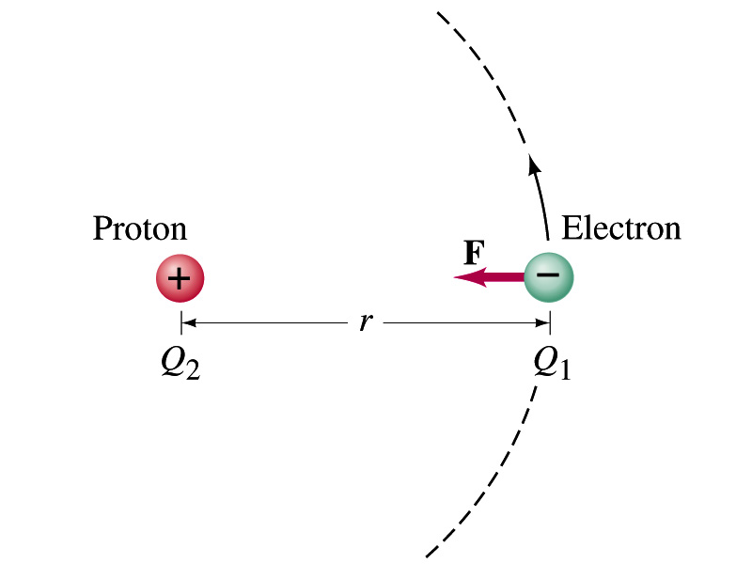
Example 16 – 1
Electric force on electron by proton. Determine the magnitude of the electric force on the electron of a hydrogen atom exerted by the single proton (Q₂=+e) that is its nucleus. Assume the electron “orbits” the proton at its average distance of r=0.53x10⁻¹⁰m.
Using Coulomb’s law
Each charge is
and
So the magnitude of the force is
Which direction?
Toward each other…

Slide 13
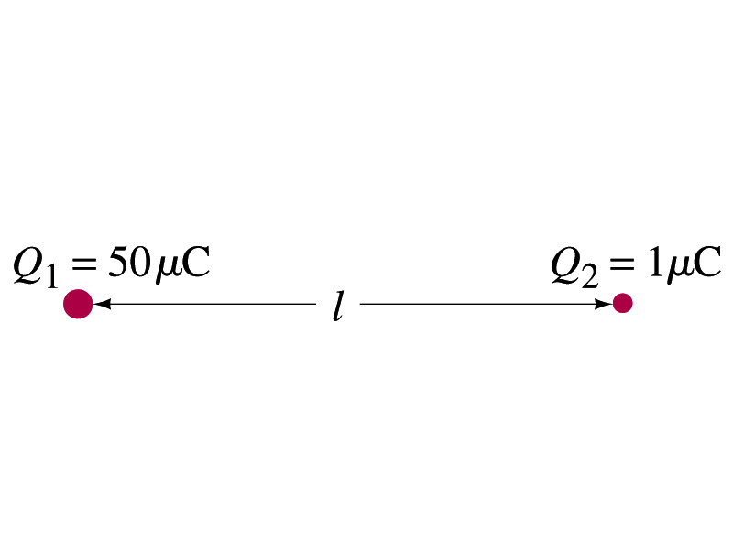
Example 16 – 2
Which charge exerts a greater force? Two positive point charges, Q₁=50μC and Q₂=1μC, are separated by a distance L. Which is larger in magnitude, the force that Q₁ exerts on Q₂ or the force that Q₂ exerts on Q₁?
What is the force that Q₁ exerts on Q₂?
What is the force that Q₂ exerts on Q₁?
Therefore the magnitudes of the two forces are identical!!
Well then what is different?
The direction.
Which direction?
Opposite to each other!
What is this law?
Newton’s third law, the law of action and reaction!!

Slide 14
Vector Additions and Subtractions
Addition:
Triangular Method: One can add vectors by connecting the head of one vector to the tail of the other (head-to-tail)
Parallelogram method: Connect the tails of the two vectors and extend
Addition is commutative: Changing order of operation does not affect the results A+B=B+A, A+B+C+D+E=E+C+A+B+D
A+B
A
A+B
B
=
OR
B
A+B
B
A
A
Subtraction:
The same as adding a negative vector:A - B = A + (-B)
A
-B
Since subtraction is the equivalent to adding a negative vector, subtraction is also commutative!!!
A-B
Multiplication by a scalar is increasing the magnitude A, B=2A
A
B=2A

Slide 15
Example for Vector Addition
A force of 20.0N applies to north while another force of 35.0N applies in the direction 60.0º west of north. Find the magnitude and direction of resultant force.
F₂sin60^{ο}
N
F₂
60^{ο}
F₂cos60^{ο}
20
F
θ
F₁
E
Find other ways to solve this problem…

Slide 16
Components and Unit Vectors
Coordinate systems are useful in expressing vectors in their components
y
(+,+)
F_{y}
(F_{x},F_{y})
}Components
F
(-,+)
θ
x
} Magnitude
(-,-)
(+,-)
F_{x}

Slide 17
Unit Vectors
Unit vectors are the ones that tells us the directions of the components
Dimensionless
Magnitudes are exactly 1
Unit vectors are usually expressed in i, j, k or
So the vector F can be re-written as

Slide 18
Examples of Vector Operations
Find the resultant force which is the sum of F1=(2.0i+2.0j)N and F2 =(2.0i-4.0j)N.
Find the resultant force of the sum of three forces: F₁=(15i+30j +12k)N, F₂=(23i+14j -5.0k)N, and F₃=(-13i+15j)N.
Magnitude

Slide 19
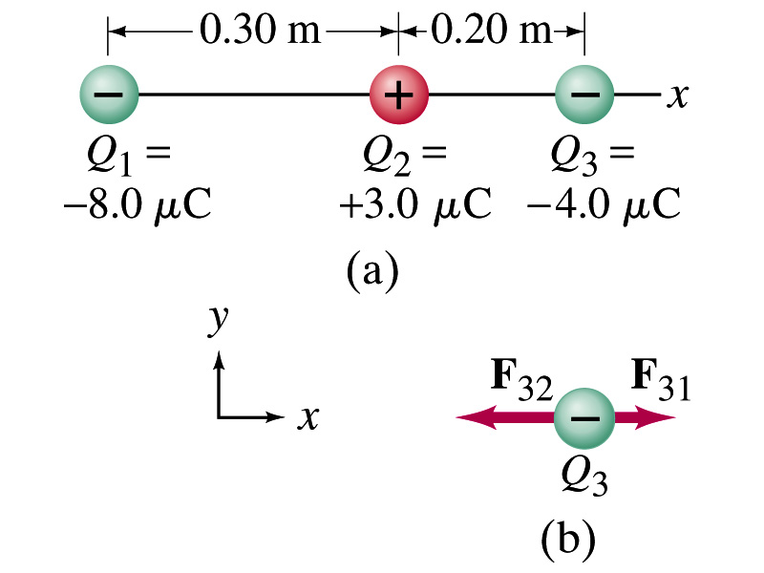
Example 16 – 3
Three charges in a line. Three charged particles are arranged in a line as shown in the figure. Calculate the net electrostatic force on particle 3 (the -4μC on the right) due to other two charges.
What is the force that Q₁ exerts on Q₃?
What is the force that Q₂ exerts on Q₃?
Using the vector sum of the two forces

