Slide 1
PHYS 1442 – Section 001 Lecture #4
Thursday, June 6, 2013
Dr. Jaehoon Yu
Chapter 16
Electric Flux
Chapter 17
Electric Potential Energy
Electric Potential
Electric Potential and Electric Field
Equi-potential Lines
The Electron Volt, a Unit of Energy
Today’s homework is homework #2, due 11pm, Monday, June 10!!

Slide 2
Announcements
First term exam coming Tuesday, June 11
Covers up to what we finish Monday, June 10, plus A1 – A8
Mixture of multiple choice and free response problems
Just putting an answer to free response problem will get you 0!

Slide 3
Extra Credit Special Project #1
Compare the Coulomb force to the Gravitational force in the following cases by expressing Coulomb force (F_{C}) in terms of the gravitational force (F_{G})
Between two protons separated by 1m
Between two protons separated by an arbitrary distance R
Between two electrons separated by 1m
Between two electrons separated by an arbitrary distance R
Five points each, totaling 20 points
BE SURE to show all the details of your work, including all formulae, and properly referring them
Please staple them before the submission
Due at the beginning of the class Monday, June 10

Slide 4
Special Project #2 – Angels & Demons
Compute the total possible energy released from an annihilation of x-grams of anti-matter and the same quantity of matter, where x is the last two digits of your SS#. (20 points)
Use the famous Einstein’s formula for mass-energy equivalence
Compute the power output of this annihilation when the energy is released in x ns, where x is again the last two digits of your SS#. (10 points)
Compute how many cups of gasoline (8MJ) this energy corresponds to. (5 points)
Compute how many months of world electricity usage (3.6GJ/mo) this energy corresponds to. (5 points)
Due by the beginning of the class Thursday, June 13.

Slide 5
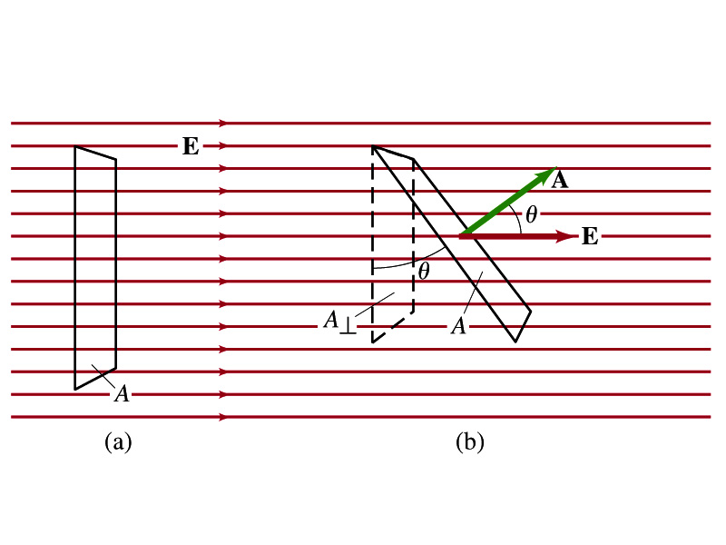
Electric Flux
Let’s imagine a surface of area A through which a uniform electric field E passes
The electric flux Φ_{E} is defined as
Φ_{E}=EA, if the field is perpendicular to the surface
Φ_{E}=EAcosθ, if the field makes an angle θ to the surface
So the electric flux is defined as .
How would you define the electric flux in words?
The total number of field lines passing through the unit area perpendicular to the field.

Slide 6
Example for Electric Flux
Electric flux. (a) Calculate the electric flux through the rectangle in the figure (a). The rectangle is 10cm by 20cm and the electric field is uniform with magnitude 200N/C. (b) What is the flux in figure if the angle is 30 degrees?
The electric flux is defined as
So when (a) θ=0, we obtain
And when (b) θ=30 degrees, we obtain

Slide 7
Electric Potential Energy
Concept of energy is very useful solving mechanical problems
Conservation of energy makes solving complex problems easier.
When can the potential energy be defined?
Only for a conservative force.
The work done by a conservative force is independent of the path. What does it only depend on??
The difference between the initial and final positions
Can you give me an example of a conservative force?
Gravitational force
Is the electrostatic force between two charges a conservative force?
Yes. Why?
The dependence of the force to the distance is identical to that of the gravitational force.
The only thing matters is the direct linear distance between the object not the path.

Slide 8
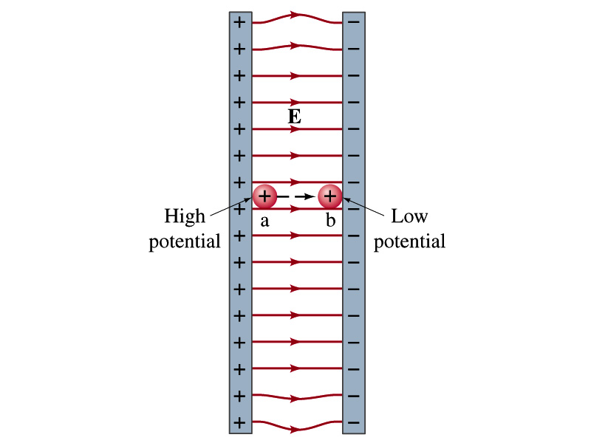
Electric Potential Energy
How would you define the change in electric potential energy U_{b} – U_{a}?
The potential gained by the charge as it moves from point a to point b.
The negative work done on the charge by the electric force to move it from a to b.
Let’s consider an electric field between two parallel plates w/ equal but opposite charges
The field between the plates is uniform since the gap is small and the plates are infinitely long…
What happens when we place a small charge, +q, on a point at the positive plate and let go?
The electric force will accelerate the charge toward negative plate.
What kind of energy does the charged particle gain?
Kinetic energy

Slide 9
Electric Potential Energy
What does this mean in terms of energies?
The electric force is a conservative force.
Thus, the mechanical energy (KE+PE) is conserved under this force.
A positively charged object has only the electric potential energy at the positive plate.
The electric potential energy decreases and turns into kinetic energy of the positively charged object as the electric force works on the object it gains speed.
Point of greatest potential energy for
Positively charged object
Negatively charged object
PE=
U
0
KE=
0
K
ME=
U
K
U+K

Slide 10
Electric Potential
How is the electric field defined?
Electric force per unit charge: F/q
We can define electric potential (potential) as
The electric potential energy per unit charge
This is like the voltage of a battery…
Electric potential is written with the symbol V
If a positive test charge q has potential energy U_{a} at a point a, the electric potential of the charge at that point is

Slide 11
Electric Potential
Since only the difference in potential energy is meaningful, only the potential difference between two points is measurable
What happens when the electric force does “positive work”?
The charge gains kinetic energy
Electric potential energy of the charge decreases
Thus the difference in potential energy is the same as the negative of the work, W_{ba}, done on the charge by the electric field to move the charge from point a to b.
The potential difference V_{ba} is (remember U_{b}>U_{a})
Electric potential is independent of the test charge!!

Slide 12
A Few Things about Electric Potential
What does the electric potential depend on?
Other charges that creates the field
What about the test charge?
No, the electric potential is independent of the test charge
Test charge gains potential energy by simply being within the potential created by other charges
Which plate is at a higher potential?
Positive plate. Why?
Since positive charge has the greatest potential energy on it.
What happens to the positive charge if it is let go?
It moves from higher potential to lower potential
How about a negative charge?
Its potential energy is higher on the negative plate. Thus, it moves from negative plate to positive. Potential difference is the same.
The unit of the electric potential is Volt (V).
From the definition, 1V = 1J/C.
Zero point of electric potential can be chosen arbitrarily.
Often the ground, a conductor connected to Earth, is zero.

Slide 13
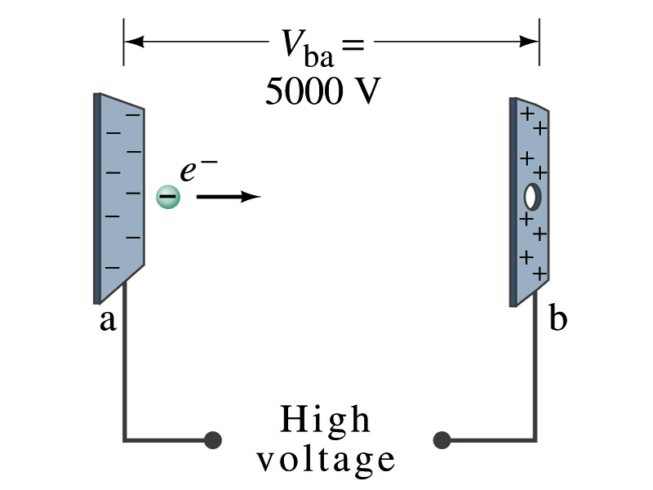
Example 17 – 1
A negative charge: Suppose a negatively charged particle, such as an electron, is placed at point a in the figure. If the electron is free to move, will its electric potential energy increase or decrease? How will the electric potential change?
An electron placed at point a will move toward the positive plate since it was released at its highest potential energy point.
It will gain kinetic energy as it moves toward left, decreasing its potential energy.
The electron, however, moves from the point a at a lower potential to point b at a higher potential. ΔV=V_{b}-V_{a}>0.
This is because the potential is generated by the charges on the plates not by the electron.

Slide 14
Electric Potential and Potential Energy
What is the definition of the electric potential, again?
The potential energy difference per unit charge
OK, then, how would you express the potential energy that a charge q would obtain when it is moved between point a and b with a potential difference V_{ba}?
In other words, if an object with charge q moves through a potential difference V_{ba}, its potential energy changes by qV_{ba}.
So based on this, how differently would you describe the electric potential in words?
A measure of how much energy an electric charge can acquire in a given situation
A measure of how much work a given charge can do

Slide 15
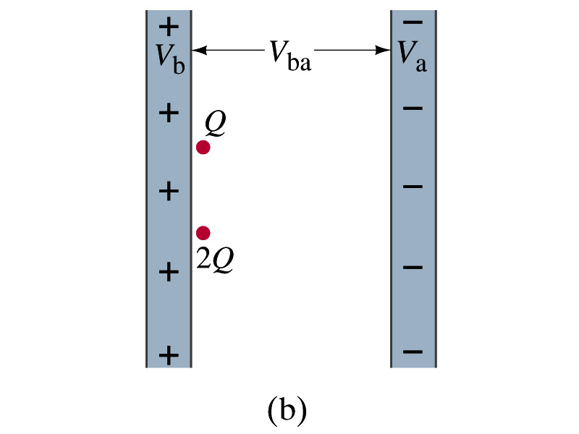
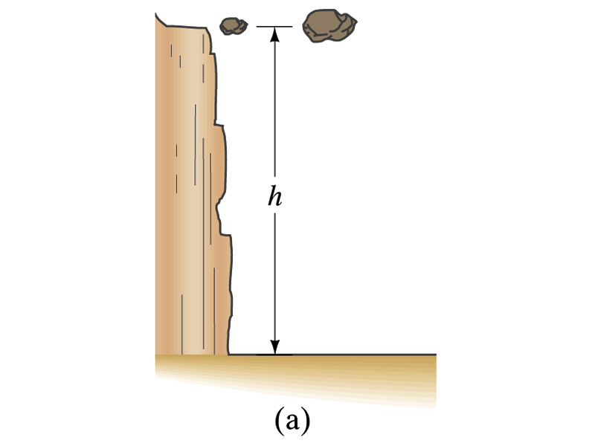
Comparisons of Potential Energies
Let’s compare gravitational and electric potential energies
m
2m
What are the potential energies of the rocks?
mgh and 2mgh
Which rock has a bigger potential energy?
The rock with a larger mass
Why?
It’s got a bigger mass.
What are the potential energies of the charges?
QV_{ba} and 2QV_{ba}
Which object has a bigger potential energy?
The object with a larger charge.
Why?
It’s got a bigger charge.
The potential is the same but the heavier rock or larger charge can do a greater work.

Slide 16
Electric Potential and Potential Energy
The electric potential difference gives potential energy or possibility to do work depending on the charge of the object.
So what is happening in batteries or generators?
They maintain a potential difference.
The actual amount of energy used or transformed depends on how much charge flows.
How much is the potential difference maintained by a car’s battery?
12Volts
If for a given period, 5C charge flows through the headlight lamp, what is the total energy transformed?
E_{tot}=5C*12V=60 Umm… What is the unit?
If it is left on twice as long? E_{tot}=10C*12V=120J.
Joules

Slide 17
Some Typical Voltages
Sources | Approximate Voltage
Thundercloud to ground | 10⁸ V
High-Voltage Power Lines | 10⁶ V
Power supply for TV tube | 10⁴ V
Automobile ignition | 10⁴ V
Household outlet | 10² V
Automobile battery | 12 V
Flashlight battery | 1.5 V
Resting potential across nerve membrane | 10⁻¹ V
Potential changes on skin (EKG and EEG) | 10⁻⁴ V

Slide 18
Example 17 – 2
Electrons in TV tube: Suppose an electron in the picture tube of a television set is accelerated from rest through a potential difference V_{ba}=+5000V. (a) What is the change in potential energy of the electron? (b) What is the speed of the electron (m=9.1x10⁻³¹kg) as a result of this acceleration? (c) Repeat for a proton (m=1.67x10⁻²⁷kg) that accelerates through a potential difference of V_{ba}=-5000V.
(a) What is the charge of an electron?
So what is the change of its potential energy?

Slide 19
Example 17 – 2
(b) Speed of the electron?
The entire potential energy of the electron turns to its kinetic energy. Thus the equation is
(C) Speed of a proton?

