Slide 1
PHYS 1442 – Section 001 Lecture #5
Monday, June 10, 2013
Dr. Jaehoon Yu
Chapter 17
Electric Potential and Electric Field
Equi-potential Lines
The Electron Volt, a Unit of Energy
Capacitor and Capacitance
Di-electrics
Storage of Electric Energy
Chapter 18
The Electric Battery
Ohm’s Law: Resisters
Resistivity
Today’s homework is homework #3, due 11pm, Thursday, June 13!!

Slide 2
Announcements
Quiz results
Class average: 21.2/41
Equivalent to 51.7/100
Top score: 40/41
Reading assignments
CH17 – 6, 17 – 10, and 17 – 11
First term exam tomorrow, Tuesday, June 11
Covers CH1 – Ch7 plus A1 – A8
Mixture of multiple choice and free response problems
Bring extra credit special project #1 during the break

Slide 3
Special Project #2 – Angels & Demons
Compute the total possible energy released from an annihilation of x-grams of anti-matter and the same quantity of matter, where x is the last two digits of your SS#. (20 points)
Use the famous Einstein’s formula for mass-energy equivalence
Compute the power output of this annihilation when the energy is released in x ns, where x is again the last two digits of your SS#. (10 points)
Compute how many cups of gasoline (8MJ) this energy corresponds to. (5 points)
Compute how many months of world electricity usage (3.6GJ/mo) this energy corresponds to. (5 points)
Due by the beginning of the class Thursday, June 13.

Slide 4
Electric Potential and Electric Field
The effect of a charge distribution can be described in terms of electric field or electric potential.
What kind of quantities are the electric field and the electric potential?
Electric Field:
Electric Potential:
Since electric potential is a scalar quantity, it is often easier to handle.
Well other than the above, what are the connections between these two quantities?
Vector
Scalar

Slide 5
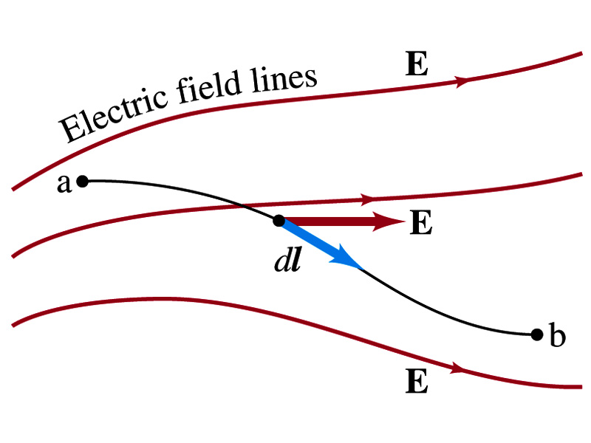
Electric Potential and Electric Field
Potential energy change is expressed in terms of a conservative force (point a at a higher potential)
For the electrical case, we are more interested in the potential difference:
This formula can be used to determine V_{ba} when the electric field is given.
When the field is uniform
so
What does “-”sign mean?
The direction of E is along that of decreasing potential.
Unit of the electric field in terms of potential?
V/m
Can you derive this from N/C?

Slide 6
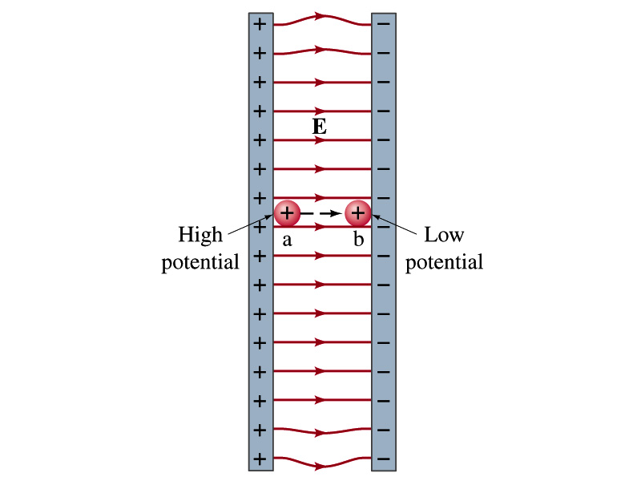
Example 17 – 3
Uniform electric field obtained from voltage: Two parallel plates are charged to a voltage of 50V. If the separation between the plates is 5.0cm, calculate the magnitude of the electric field between them, ignoring any fringe effect.
5cm
50V
What is the relationship between electric field and the potential for a uniform field?
Solving for E
Which direction is the field?
Direction of decreasing potential!

Slide 7
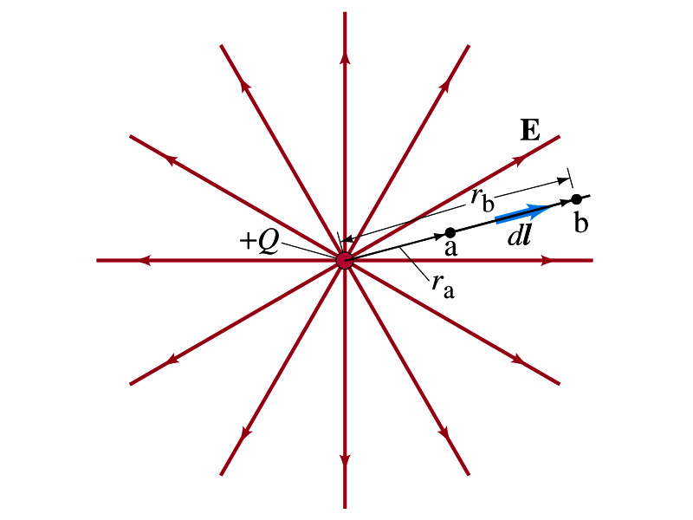
Electric Potential due to Point Charges
What is the electric field by a single point charge Q at a distance r?
Electric potential due to the field E for moving from point r_{a} to r_{b} in radial direction away from the charge Q is

Slide 8
Electric Potential due to Point Charges
Since only the differences in potential have physical meaning, we can choose at .
The electric potential V at a distance r from a single point charge is
So the absolute potential by a single point charge can be thought of as the potential difference by a single point charge between r and infinity

Slide 9
Properties of the Electric Potential
What are the differences between the electric potential and the electric field?
Electric potential
Electric potential energy per unit charge
Inversely proportional to the distance
Simply add the potential by each of the source charges to obtain the total potential from multiple charges, since potential is a scalar quantity
Electric field
Electric force per unit charge
Inversely proportional to the square of the distance
Need vector sums to obtain the total field from multiple source charges
Potential due to a positive charge is a large positive near the charge and decreases towards 0 at the large distance.
Potential due to a negative charge is a large negative near the charge and increases towards 0 at a large distance.

Slide 10
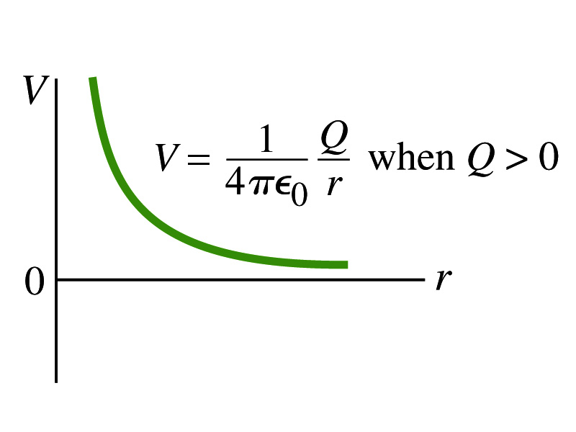
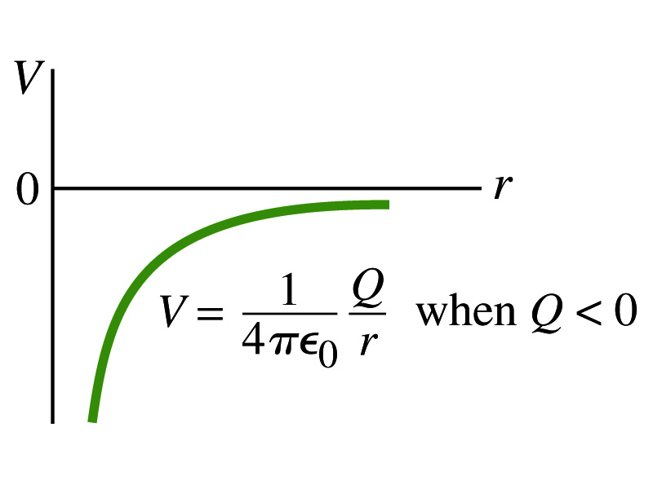
Shape of the Electric Potential
So, how does the electric potential look like as a function of distance from the source charge?
What is the formula for the potential by a single charge?
Positive Charge
Negative Charge
Uniformly charged sphere would have the potential the same shape as a single point charge.
What does this mean?
Uniformly charged sphere behaves like all the charge is on the single point in the center.

Slide 11
Example 17 – 4
Potential due to a positive or negative charge: Determine the potential at a point 0.50m (a) from a +20μC point charge and (b) from a -20μC point charge.
The formula for absolute potential at a point r away from the charge Q is
(a) For +20μC charge:
(b) For -20μC charge:
It is important to express electric potential with the proper sign!!

Slide 12
Example 17 – 5
Work to bring two positive charges close together: What minimum work is required by an external force to bring a point charge q=+3.00μC from a great distance away (r=infinity) to a point 0.500m from a charge Q=+20.0 μC?
What is the work done by the electric field in terms of potential energy and potential?
Since we obtain
Electric force does negative work. In other words, the external force must work +1.08J to bring the charge 3.00μC from infinity to 0.500m to the charge 20.0μC.

Slide 13
Electric Potential by Charge Distributions
Let’s consider that there are n individual point charges in a given space and V=0 at r=infinity.
Then the potential due to the charge Q_{i} at a point a, distance r_{ia} from Q_{i} is
Thus the total potential V_{a} by all n point charges is
For a continuous charge distribution, we obtain

Slide 14
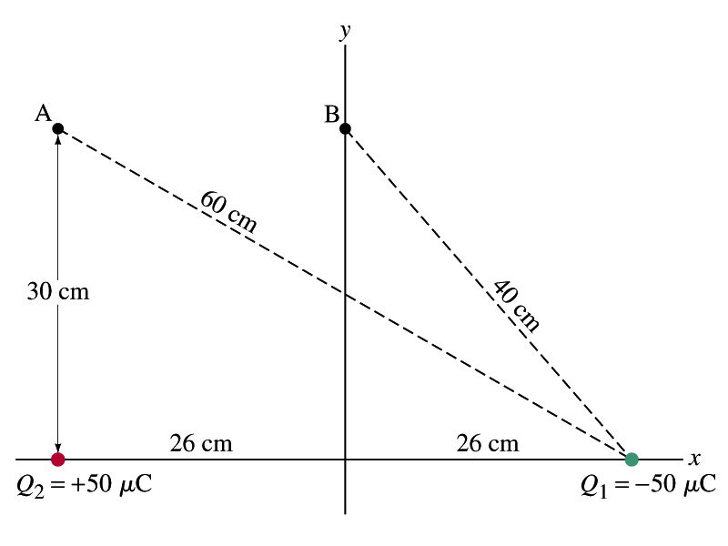
Example 17 – 6
Potential due to two charges: Calculate the electric potential (a) at point A in the figure due to the two charges shown, and (b) at point B.
Potential is a scalar quantity, so one adds the potential by each of the source charge, as if they are numbers.
(a) potential at A is
(b) How about potential at B?

Slide 15
Equi-potential Surfaces
Electric potential can be visualized using equipotential lines in 2-D or equipotential surfaces in 3-D
Any two points on an equipotential surface (line) are on the same potential
What does this mean in terms of the potential difference?
Thus, the potential difference between the two points on an equipotential surface is 0.
How about the potential energy difference?
Also 0.
What does this mean in terms of the work to move a charge along the surface between these two points?
No work is necessary to move a charge between these two points.

Slide 16
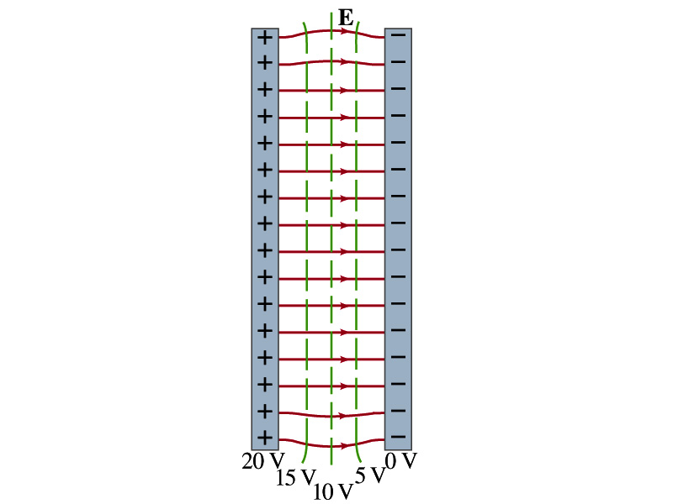
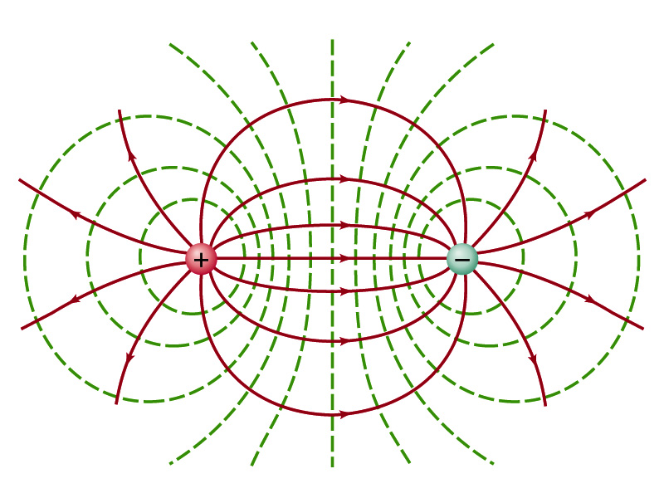
Equi-potential Surfaces
An equipotential surface (line) must be perpendicular to the electric field. Why?
If there are any parallel components to the electric field, it would require work to move a charge along the surface, and thus a potential difference exists.
Since the equipotential surface (line) is perpendicular to the electric field, we can draw these surfaces or lines easily.
There can be no electric field inside a conductor in static case, thus the entire volume of a conductor must be at the same potential.
So the electric field must be perpendicular to the conductor surface.
Parallel Plate
Point charges
Just like a topographical map

Slide 17
Electrostatic Potential Energy
Consider a point charge q is moved between points a and b where the electrostatic potentials due to other charges are V_{a} and V_{b}
The change in electrostatic potential energy of q in the field by other charges is
Now what is the electrostatic potential energy of a system of charges?
Let’s choose V=0 at r=infinity
If there are no other charges around, single point charge Q₁ in isolation has no potential energy and is exerted on with no electric force

Slide 18
Electrostatic Potential Energy; Two charges
If a second point charge Q₂ is brought close to Q₁ at the distance r₁₂, the potential due to Q₁ at the position of Q₂ is
The potential energy of the two charges relative to V=0 at r=infinity is
This is the work that needs to be done by an external force to bring Q₂ from infinity to a distance r₁₂ from Q₁.
It is also a negative of the work needed to separate them to infinity.

Slide 19
Electrostatic Potential Energy; Three Charges
So what do we do for three charges?
Work is needed to bring all three charges together
Work needed to bring Q₁ to a certain place without the presence of any charge is 0.
Work needed to bring Q₂ to a distance to Q₁ is
Work need to bring Q₃ to a distance to Q₁ and Q₂ is
So the total electrostatic potential of the three charge system is
What about a four charge system?

Slide 20
Electrostatic Potential Energy: electron Volt
What is the unit of electrostatic potential energy?
Joules
Joules is a very large unit in dealing with electrons, atoms or molecules in atomic scale problems
For convenience a new unit, electron volt (eV), is defined
1 eV is defined as the energy acquired by a particle carrying the charge equal to that of an electron (q=e) when it moves across a potential difference of 1V.
How many Joules is 1 eV then?
eV however is not a standard SI unit. You must convert the energy to Joules for computations.
What is the speed of an electron with kinetic energy 5000eV?

Slide 21
Capacitors (or Condensers)
What is a capacitor?
A device that can store electric charge
But does not let them flow through
What does it consist of?
Usually consists of two conducting objects (plates or sheets) placed near each other without touching
Why can’t they touch each other?
The charge will neutralize…
Can you give some examples?
Camera flash, UPS, Surge protectors, binary circuits, etc…
How is a capacitor different than a battery?
Battery provides potential difference by storing energy (usually chemical energy) while the capacitor stores charges but very little energy.

Slide 22
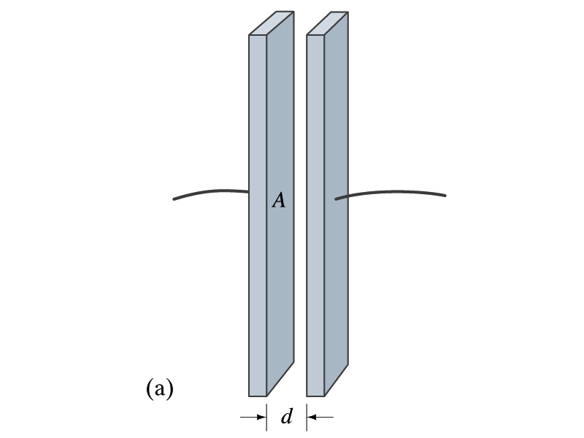
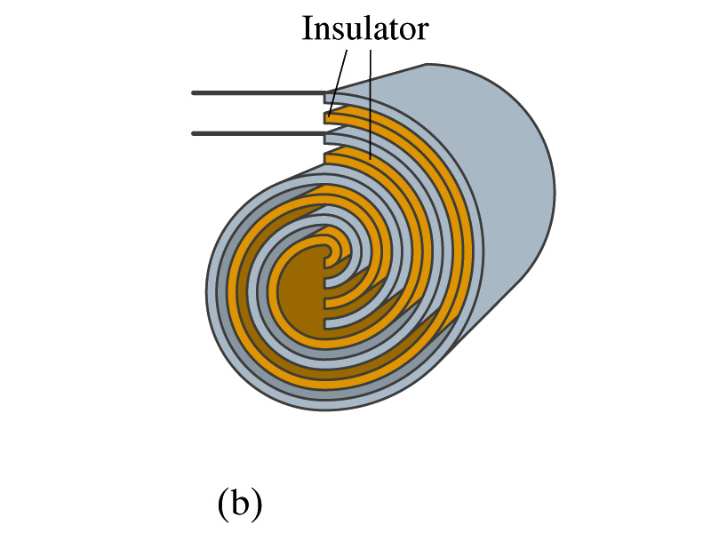
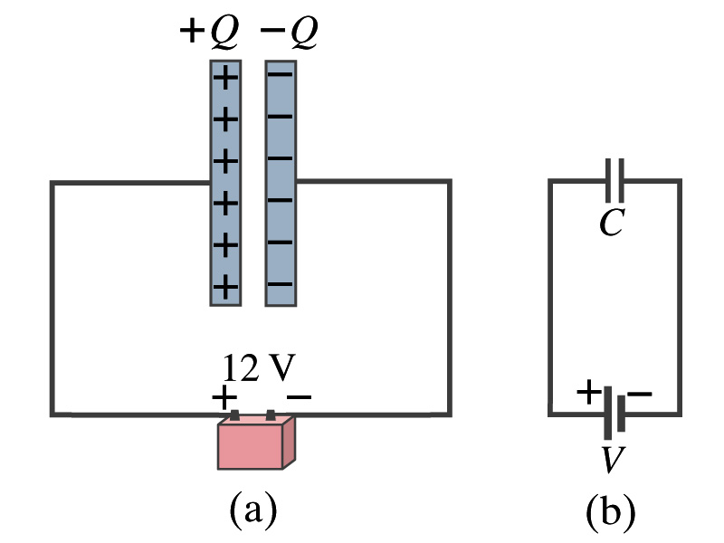
Capacitors
A simple capacitor consists of a pair of parallel plates of area A separated by a distance d.
A cylindrical capacitors are essentially parallel plates wrapped around as a cylinder.
How would you draw symbols for a capacitor and a battery?
Capacitor -||-
Battery (+) -|i- (-)
Circuit
Diagram

Slide 23
Capacitors
What do you think will happen if a battery is connected ( or a voltage is applied) to a capacitor?
The capacitor gets charged quickly, one plate positive and the other negative in equal amount.
Each battery terminal, the wires and the plates are conductors. What does this mean?
All conductors are at the same potential. And?
So the full battery voltage is applied across the capacitor plates.
So for a given capacitor, the amount of charge stored in the capacitor is proportional to the potential difference V_{ba} between the plates. How would you write this formula?
C is a proportionality constant, called capacitance of the device.
What is the unit?
C is a property of a capacitor so does not depend on Q or V.
C/V
or
Farad (F)
Normally use μF, nF or pF.

Slide 24
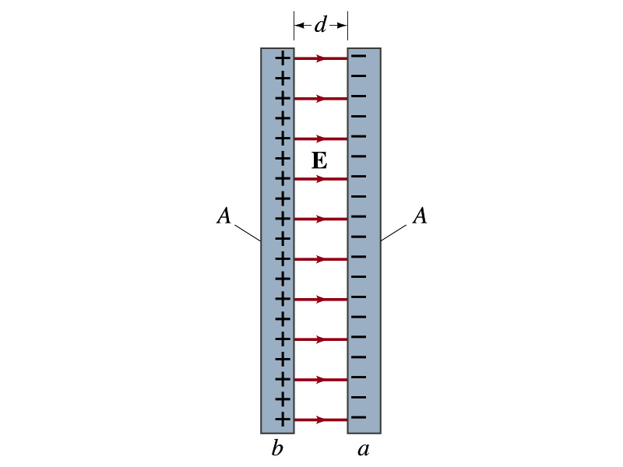
Determination of Capacitance
C can be determined analytically for capacitors w/ simple geometry and air in between.
Let’s consider a parallel plate capacitor.
Plates have area A each and separated by d.
d is smaller than the length, and so E is uniform.
E for parallel plates is E=σ/ε₀, σ=Q/A is the surface charge density.
E and V are related
Since Q=CV, we obtain:
C only depends on the area and the distance of the plates and the permittivity of the medium between them.

Slide 25
Example 17 – 8
Capacitor calculations: (a) Calculate the capacitance of a capacitor whose plates are 20cmx3.0cm and are separated by a 1.0mm air gap. (b) What is the charge on each plate if the capacitor is connected to a 12-V battery? (c) What is the electric field between the plates? (d) Estimate the area of the plates needed to achieve a capacitance of 1F, given the same air gap.
(a) Using the formula for a parallel plate capacitor, we obtain
(b) From Q=CV, the charge on each plate is

Slide 26
Example 17 – 8
(C) Using the formula for the electric field in two parallel plates
Or, since
we can obtain
(d) Solving the capacitance formula for A, we obtain
Solve for A
About 40% the area of Arlington (256km²).

