Slide 1
PHYS 1442 – Section 001 Lecture #6
Wednesday, June 12, 2013
Dr. Jaehoon Yu
Chapter 17
Di-electrics
Storage of Electric Energy
Chapter 18
The Electric Battery
Electric Current
Ohm’s Law: Resisters
Resistivity

Slide 2
Announcements
Reading assignments
CH18 – 8, 18 – 9, and 18 – 10
Second quiz, Monday, June 17
Covers CH7.9 through what we finish tomorrow

Slide 3
Special Project #2 – Angels & Demons
Compute the total possible energy released from an annihilation of x-grams of anti-matter and the same quantity of matter, where x is the last two digits of your SS#. (20 points)
Use the famous Einstein’s formula for mass-energy equivalence
Compute the power output of this annihilation when the energy is released in x ns, where x is again the last two digits of your SS#. (10 points)
Compute how many cups of gasoline (8MJ) this energy corresponds to. (5 points)
Compute how many months of world electricity usage (3.6GJ/mo) this energy corresponds to. (5 points)
Due by the beginning of the class tomorrow, Thursday, June 13.

Slide 4
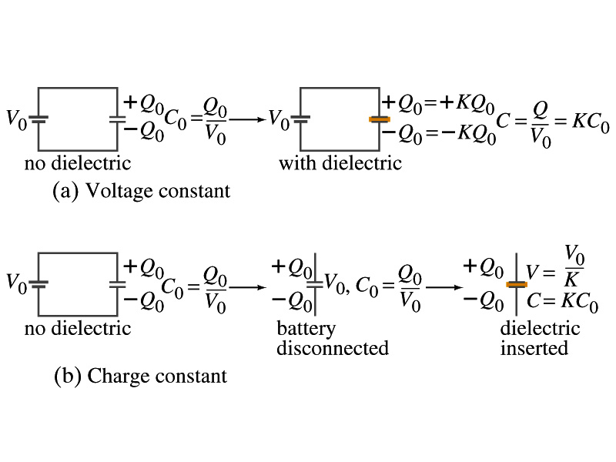
Effect of a Dielectric Material on Capacitance
Let’s consider the two cases below:
Case #1 : constant V
Case #2 : constant Q
Constant voltage: Experimentally observed that the total charge on the each plate of the capacitor increases by K as a dielectric material is inserted between the gap ➔ Q=KQ₀
The capacitance increased to C=Q/V₀=KQ₀/V₀=KC₀
Constant charge: Voltage found to drop by a factor K ➔ V=V₀/K
The capacitance increased to C=Q₀/V=KQ₀/V₀=KC₀

Slide 5
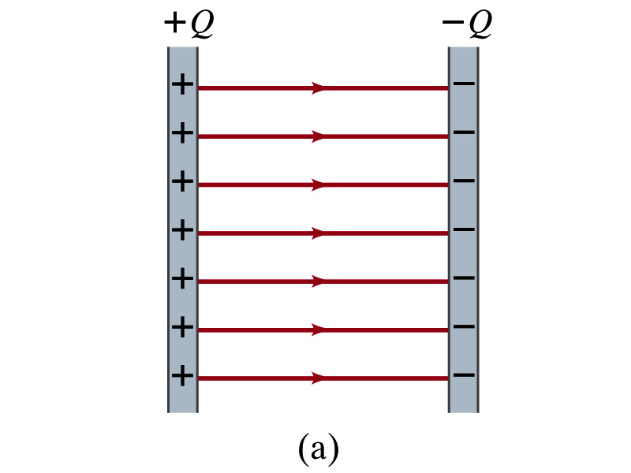
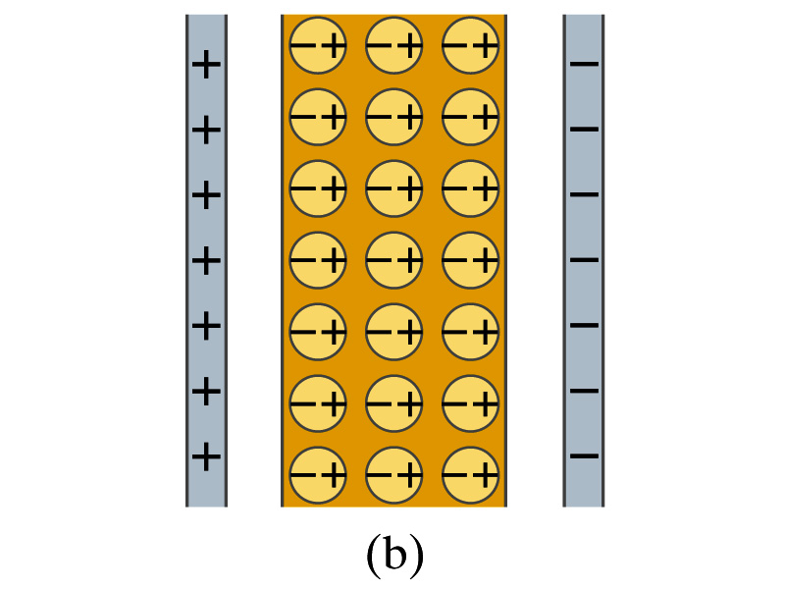
Molecular Description of Dielectric
So what in the world makes dielectrics behave the way they do?
We need to examine this in a microscopic scale.
Let’s consider a parallel plate capacitor that is charged up +Q(=C₀V₀) and –Q with air in between.
Let’s assume that there is no way any additional charge can flow in or out
Now insert a dielectric
Dielectrics can be polar ➔ could have permanent dipole moment. What will happen?
Due to the electric field molecules may be aligned.

Slide 6
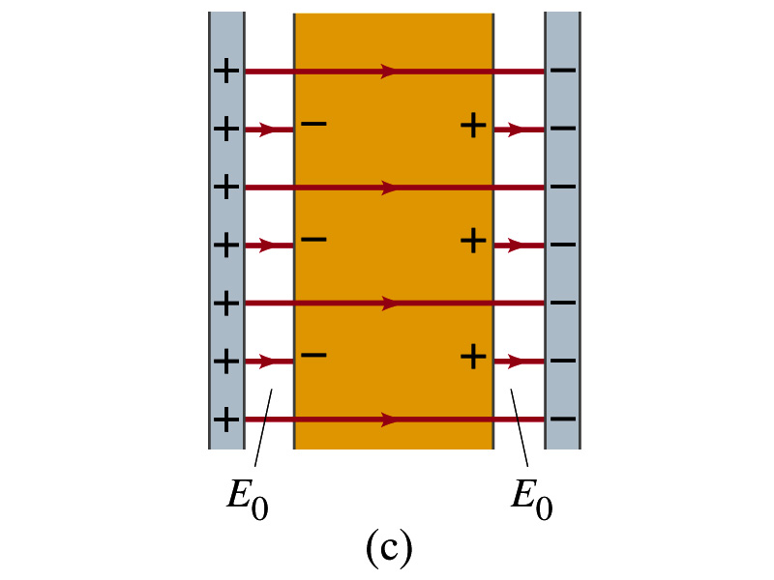
Molecular Description of Dielectric
OK. Then what happens?
Then effectively, there will be some negative charges close to the surface of the positive plate and positive charges close to the negative plate
Some electric field do not pass through the whole dielectric but stops at the negative charge
So the field inside dielectric is smaller than the air
Since electric field is smaller, the force is smaller
The work need to move a test charge inside the dielectric is smaller
Thus the potential difference across the dielectric is smaller than across the air

Slide 7
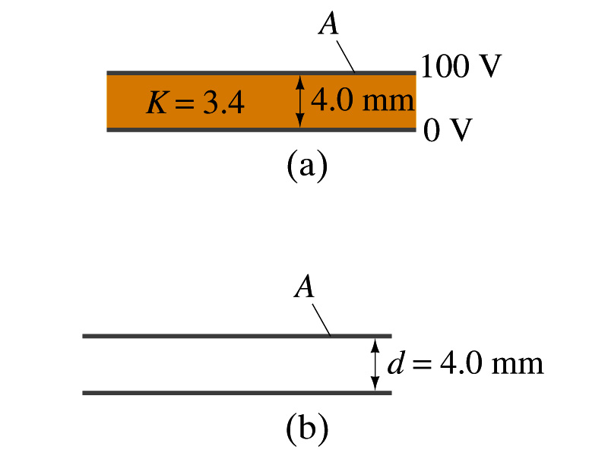
Example
Dielectric Removal: A parallel-plate capacitor, filled with a dielectric with K=3.4, is connected to a 100-V battery. After the capacitor is fully charged, the battery is disconnected. The plates have area A=4.0m², and are separated by d=4.0mm. (a) Find the capacitance, the charge on the capacitor, the electric field strength, and the energy stored in the capacitor. (b) The dielectric is carefully removed, without changing the plate separation nor does any charge leave the capacitor. Find the new value of capacitance, electric field strength, voltage between the plates and the energy stored in the capacitor.
(a)

Slide 8
Example cont’d
(b)
Since the dielectric has been removed, the effect of dielectric constant must be removed as well.
Since the charge is the same ( ) before and after the removal of the dielectric, we obtain
Wrong!
Where did the extra energy come from?.
The energy conservation law is violated in electricity???
Wrong!
Wrong!
External force has done the work of 3.6x10⁻⁴J on the system to remove dielectric!!

Slide 9
Electric Energy Storage
A charged capacitor stores energy.
The stored energy is the work done to charge it.
The net effect of charging a capacitor is removing one type of charge from a plate and put them onto the other.
Battery does this when it is connected to a capacitor.
Capacitors do not charge immediately.
Initially when the capacitor is uncharged, no work is necessary to move the first bit of charge. Why?
Since there is no charge, there is no field that the external work needs to overcome.
When some charge is on each plate, it requires work to add more charge due to electric repulsion.

Slide 10
Electric Energy Storage
The work needed to add a small amount of charge, Q, when a potential difference across the plate is V: W=Q<V>=QV_{f}/2
Since V=Q/C, the work needed to store total charge Q is
Thus, the energy stored in a capacitor when the capacitor carries charges +Q and –Q is
Since Q=CV, we can rewrite

Slide 11
Example 17 – 11
Energy store in a capacitor: A camera flash unit stores energy in a 150μF capacitor at 200V. How much electric energy can be stored?
Use the formula for stored energy.
Umm.. Which one?
What do we know from the problem?
C and V
So we use the one with C and V:
How do we get J from FV²?

Slide 12
Electric Energy Density
The energy stored in a capacitor can be considered as being stored in the electric field between the two plates
For a uniform field E between two plates, V=Ed and C=ε₀A/d
Thus the stored energy is
Since Ad is the gap volume V, we can obtain the energy density, stored energy per unit volume, as
Valid for any space that is vacuum
Electric energy stored per unit volume in any region of space is proportional to the square of E in that region.

Slide 13
Electric Current and Resistance
So far we have been studying static electricity
What is the static electricity?
The charges so far has not been moving but staying put at the location they are placed.
Now we will learn dynamics of electricity
What is the electric current?
A flow of electric charge
A few examples of the things that use electric current in everyday lives?
In an electrostatic situation, there is no electric field inside a conductor but when there is current, there is field inside a conductor. Why?
Electric field is needed to keep charges moving

Slide 14
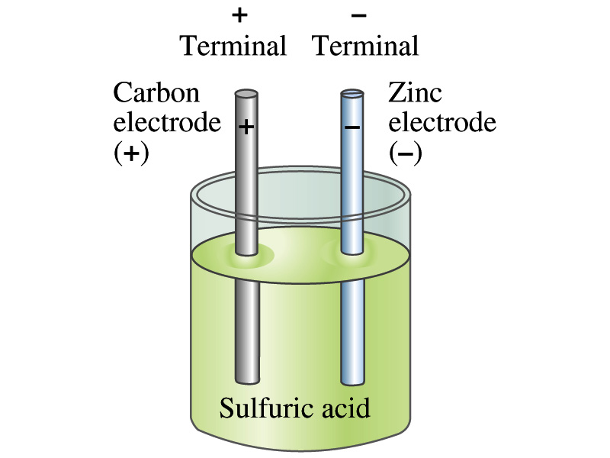
The Electric Battery
What is a battery?
A device that produces electrical energy from the stored chemical energy and produces electricity ➔ Maintains potential difference!
Electric battery was invented by Volta in 1790s in Italy
It was made of disks of zinc and silver based on his research that certain combinations of materials produce a greater electromotive force (emf), or potential, than others
Simplest batteries contain two plates made of dissimilar metals called electrodes
Electrodes are immersed in a solution, the electrolyte
This unit is called a cell and many of these form a battery
Zinc and Iron in the figure are called terminals

Slide 15
How does a battery work?
One of the electrodes in the figure is zinc and the other carbon
The acid electrolyte reacts with the zinc electrode and dissolves it.
Each zinc atom leaves two electrons in the electrode and enters into the solution as a positive ion ➔ zinc electrode acquires negative charge and the electrolyte becomes positively charged
The carbon electrode picks up the positive charge
Since the two terminals are oppositely charged, there is a potential difference between them

Slide 16
How does a battery work?
When the terminals are not connected, only the necessary amount of zinc is dissolved into the solution.
How is a particular potential maintained?
As too many of zinc ion gets produced, if the terminals are not connected,
zinc electrode gets increasingly charged up negative
zinc ions get recombined with the electrons in zinc electrode
Why does battery go dead?
When the terminals are connected, the negative charges will flow away from the zinc electrode
More zinc atoms dissolve into the electrolyte to produce more charge
One or more electrode get used up not producing any more charge.

Slide 17
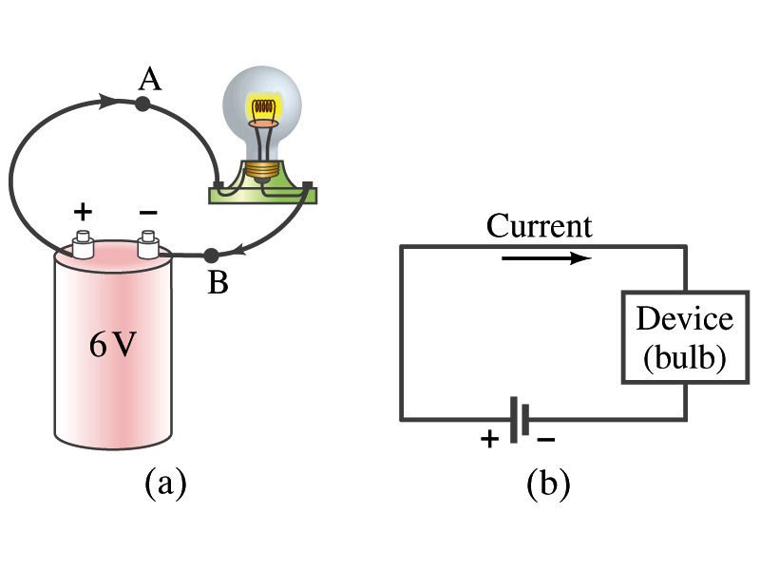
Electric Current
When a circuit is powered by a battery (or a source of emf) the charge can flow through the circuit.
Electric Current: Any flow of charge
Current can flow whenever there is a potential difference between the ends of a conductor (or when the two ends have opposite charges)
The current can flow even through the empty space under certain conditions
Electric current in a wire can be defined as the net amount of charge that passes through the wire’s full cross section at any point per unit time (just like the flow of water through a conduit.)
Average current is defined as:
The instantaneous current is:
What kind of a quantity is the current?
Unit of the current?
C/s
1A=1C/s
Scalar
In a single circuit, conservation of electric charge guarantees that the current at one point of the circuit is the same as any other points on the circuit.

Slide 18
Example 18 – 1
Current is the flow of charge: A steady current of 2.5A flows in a wire for 4.0min. (a) How much charge passed by any point in the circuit? (b) How many electrons would this be?
Current is total amount charge flow through a circuit in a given time. So from , we obtain
The total number of electrons passed through the circuit is

Slide 19
Direction of the Electric Current
What do conductors have in abundance?
Free electrons
What happens if a continuous loop of conducting wire is connected to the terminals of a battery?
Electrons start flowing through the wire continuously as soon as both the terminals are connected to the wire. How?
The potential difference between the battery terminals sets up an electric field inside the wire and in the direction parallel to it
Free electrons in the conducting wire get attracted to the positive terminal
The electrons leaving negative terminal flow through the wire and arrive at the positive terminal
Electrons flow from negative to positive terminal
Due to historical convention, the direction of the current is opposite to the direction of flow of electrons ➔ Conventional Current

Slide 20
Ohm’s Law: Resistance and Resistors
What do we need to produce electric current?
Potential difference
Georg S. Ohm experimentally established that the current is proportional to the potential difference ( )
If we connect a wire to a 12V battery, the current flowing through the wire is twice that of 6V, three times that of 4V and four times that of 3V battery.
What happens if we reverse the sign of the voltage?
It changes the direction of the current flow
Does not change the magnitude of the current
Just as in water flow case, if the height difference is large the flow rate is large ➔ If the potential difference is large, the current is large.

Slide 21
Ohm’s Law: Resistance
The exact amount of current flow in a wire depends on
The voltage
The resistance of the wire to the flow of electrons
Just like the gunk in water pipe slows down water flow
Electrons are slowed down due to interactions with the atoms of the wire
The higher the resistance the less the current for the given potential difference V
So how would you define resistance?
So that current is inversely proportional to the resistance
Often it is rewritten as
What does this mean?
The metal conductor’s resistance R is a constant independent of V.
This linear relationship is not valid for some materials like diodes, vacuum tubes, transistors etc. ➔ These are called non-ohmic
Unit?
Ohm’s Law
ohms

Slide 22
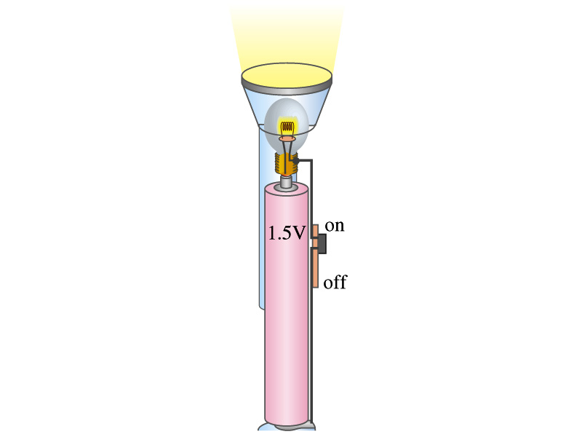
Example 18 – 3
Flashlight bulb resistance: A small flashlight bulb draws 300mA from its 1.5V battery. (a) What is the resistance of the bulb? (b) If the voltage drops to 1.2V, how would the current change?
From Ohm’s law, we obtain
Would the current increase or decrease, if the voltage reduces to 1.2V?
If the resistance did not change, the current is

Slide 23
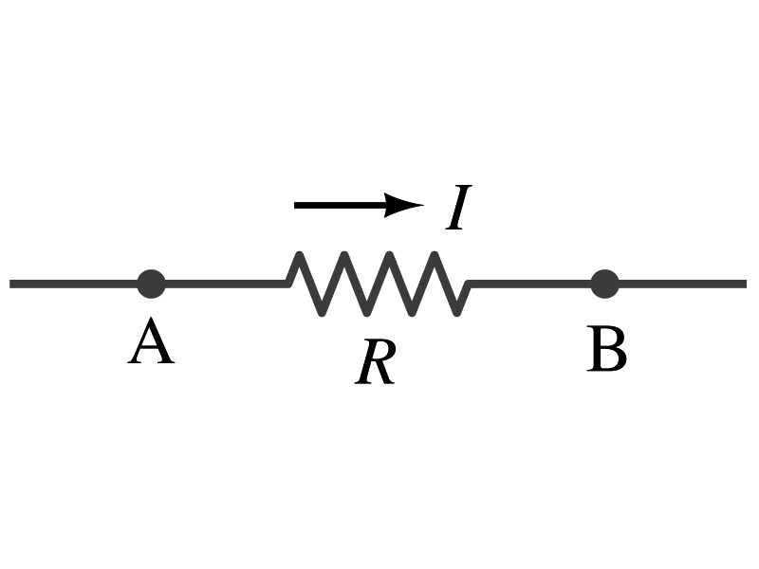
Ohm’s Law: Resistors
All electric devices offer resistance to the flow of current.
Filaments of light bulbs or heaters are wires with high resistance to cause electrons to lose their energy in the wire
In general connecting wires have low resistance compared to other devices on the circuit
In circuits, resistors are used to control the amount of current
Resistors offer resistance of less than one ohm to millions of ohms
Main types are
“wire-wound” resistors which consists of a coil of fine wire
“composition” resistors which are usually made of semiconductor carbon
thin metal films
When drawn in the circuit, the symbol for a resistor is:
Wires are drawn simply as straight lines

Slide 24
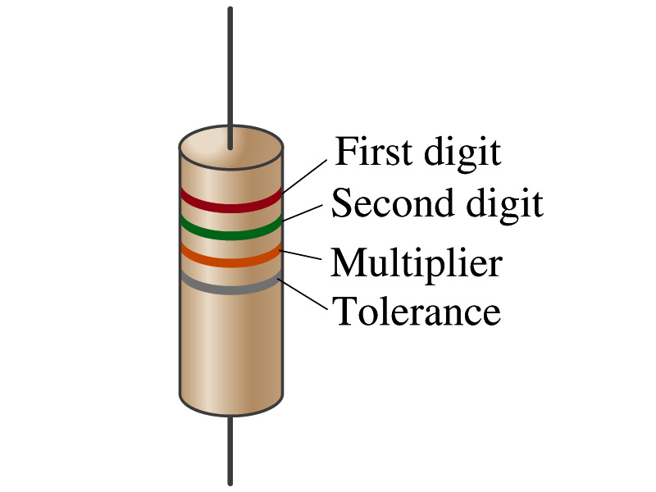
Ohm’s Law: Resistor Values
Resistors have its resistance color-coded on its body
The color-coding follows the convention below:
Color | Number | Multiplier | Tolerance
Black | 0 | 1=10⁰
Brown | 1 | 10¹
Red | 2 | 10²
Orange | 3 | 10³
Yellow | 4 | 10⁴
Green | 5 | 10⁵
Blue | 6 | 10⁶
Violet | 7 | 10⁷
Gray | 8 | 10⁸
White | 9 | 10⁹
Gold |  | 10-¹ | 5%
Silver |  | 10⁻² | 10%
None |  |  | 20%
What is the resistance of the resistor in this figure?

Slide 25
Resistivity
It is experimentally found that the resistance R of a metal wire is directly proportional to its length l and inversely proportional to its cross-sectional area A
How would you formularize this?
The proportionality constant ρ is called the resistivity and depends on the material used. What is the unit of this constant?
ohm-m or Ω−m
The values depends on purity, heat treatment, temperature, etc
How would you interpret the resistivity?
The higher the resistivity the higher the resistance
The lower the resistivity the lower the resistance and the higher the conductivity ➔ Silver has the lowest resistivity.
So the silver is the best conductor
The reciprocal of the resistivity is called the conductivity, σ,
A
l

Slide 26
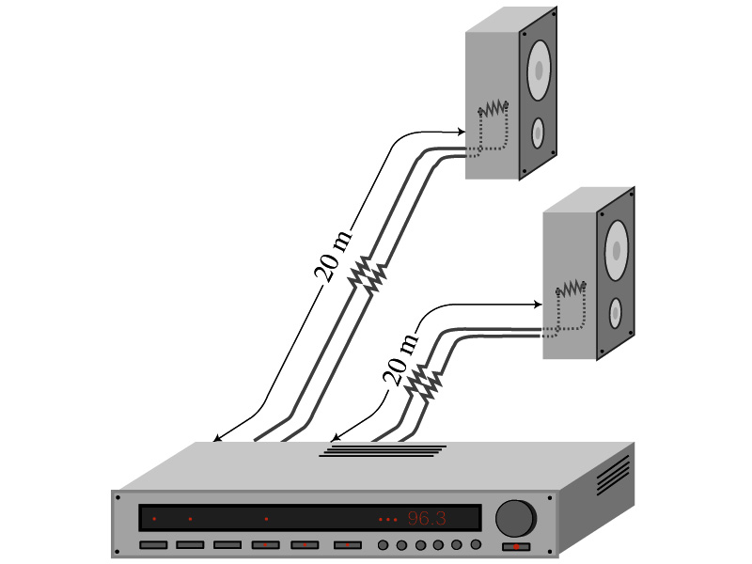
Example 18 – 5
Speaker wires: Suppose you want to connect your stereo to remote speakers. (a) If each wire must be 20m long, what diameter copper wire should you use to keep the resistance less than 0.1-Ω per wire? (b) If the current on each speaker is 4.0A, what is the voltage drop across each wire?
The resistivity of a copper is
Table 25.1
From the formula for resistance, we can obtain the formula for area
Solve for A
Solve for d
From Ohm’s law, V=IR, we obtain

Slide 27
Example 18 – 6
Stretching changes resistance: A wire of resistance R is stretched uniformly until it is twice its original length. What happens to its resistance?
What is the constant quantity in this problem?
The volume!
What is the volume of a cylinder of length L and radius r?
What happens to A if L increases factor two, L’=2L?
The cross-sectional area, A, halves. A’=A/2
The original resistance is
The new resistance is
The resistance of the wire increases by a factor of four if the length increases twice.

Slide 28
Temperature Dependence of Resistivity
Do you think the resistivity depends on temperature?
Yes
Would it increase or decrease with the temperature?
Increase
Why?
Since the atoms are vibrating more rapidly as temperature increases and are arranged in a less orderly fashion. So?
They might interfere more with the flow of electrons.
If the temperature change is not too large, the resistivity of metals usually increase nearly linearly w/ temperature
α is the temperature coefficient of resistivity
α of some semiconductors can be negative due to increased number of freed electrons.

