Slide 1
PHYS 1442 – Section 001 Lecture #7
Thursday, June 13, 2013
Dr. Jaehoon Yu
Chapter 18
Electric Power
Alternating Current
Power Delivered by AC
Microscopic View of Electric Current
Ohm’s Law in Microscopic View
Superconductivity
Chapter 19
EMF and Terminal Voltage
Resistors in Series and Parallel
Today’s homework is homework #4, due 11pm, Tuesday, June 18!!

Slide 2
Announcements
Term exam results
Class average: 48.5/92
Equivalent to 52.7/100
Top score: 76/92
Remember this exam is 12% and can be replaced by the next term exam!
Homework takes the largest portion of the grade at 25%!
Mid term (20%) and final exams (23%) will be comprehensive!
Second quiz, Monday, June 17
Covers CH17.9 through what we finish today (CH19.2?)
Mid-term exam
Wednesday, June 19
Comprehensive exam
Covers CH16.1 – what we finish Tuesday, June 18 plus Appendices A1 – A8
Quest payment of $25 each
Deadline is June 14.
If not paid, your homework access will be disabled.

Slide 3
Special Project #3
Make a list of the power consumption and the resistance of all electric and electronic devices at your home and compiled them in a table. (5 points total for the first 10 items and 0.25 points each additional item.)
Estimate the cost of electricity for each of the items on the table using your own electric cost per kWh (if you don’t find your own, use $0.12/kWh) and put them in the relevant column. (2 points total for the first 10 items and 0.1 points each additional items)
Estimate the the total amount of energy in Joules and the total electricity cost per day, per month and per year for your home. (6 points)
Due: Beginning of the class Thursday, June 20

Slide 4
How does an electric heater work?
Electrons flow through a circuit that includes the heater under a potential difference.
Flowing electrons collide with the vibrating atoms in the wire.
In each collision, part of electron’s kinetic energy is transferred to the atom it collides with.
The kinetic energy of wire’s atoms increases, and thus the temperature of the wire increases.
The increased thermal energy can be transferred as heat through conduction and convection to the air.
So then what happens to the electrons that lost their kinetic energy?
Since they are still under potential difference, they will still flow to the other side of the electrode, gaining kinetic energy!

Slide 5
Electric Power
Why is the electric energy useful?
It can transform into different forms of energy easily.
Motors, pumps, etc, transform electric energy to mechanical energy
Heaters, dryers, cook-tops, etc, transform electricity to thermal energy
Light bulb filament transforms electric energy to optical energy
Only about 10% of the energy turns to light and the 90% lost via heat
Typical household light bulb and heating elements have resistance of order few ohms to few hundred of ohms
How does the electric energy transforms to thermal energy (toaster)?
Flowing electrons collide with the vibrating atoms of the wire.
In each collision, part of electron’s kinetic energy is transferred to the atom it collides with.
The kinetic energy of wire’s atoms increases, and thus the temperature of the wire increases.
The increased thermal energy can be transferred as heat through conduction and convection to the air in a heater or to food on a pan, through radiation to bread in a toaster or radiated as light.

Slide 6
Electric Power
How do we find out the power transformed by an electric device?
What is definition of power?
The rate at which the work is done or the energy is transformed
What is the energy transformed when an infinitesimal charge Δq moves through a potential difference V?
ΔU=VΔq
If Δt is the time required for an amount of charge Δq to move through the potential difference V, the power P is
Thus, we obtain .
What is the unit?
What kind of quantity is the electrical power?
Scalar
P=IV can apply to any devices while the formula with resistance can only apply to resistors.
What is this?
In terms of resistance
Watts = J/s

Slide 7
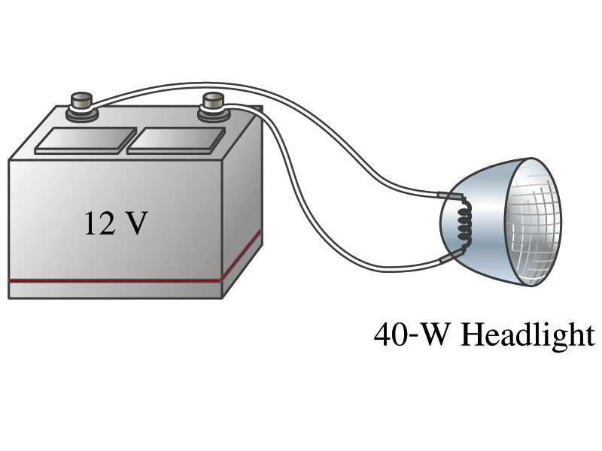
Example 18 – 8
Headlights: Calculate the resistance of a 40-W automobile headlight designed for 12V.
Since the power is 40W and the voltage is 12V, we use the formula with V and R.
Solve for R

Slide 8
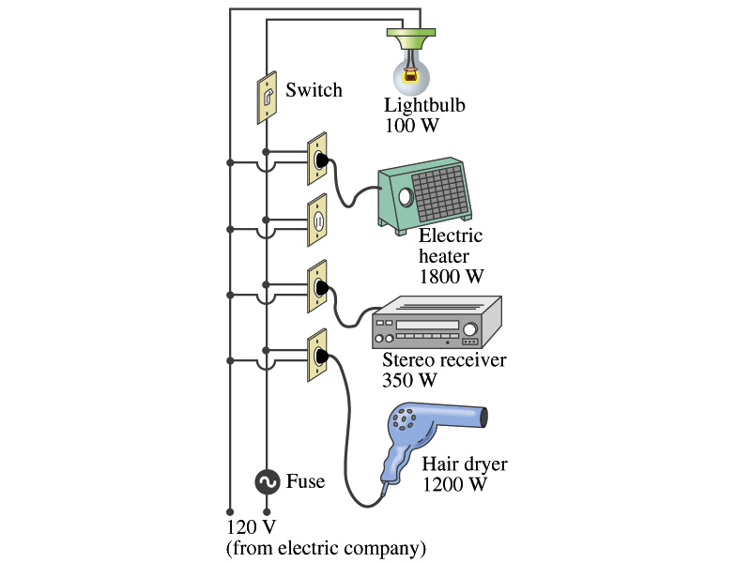
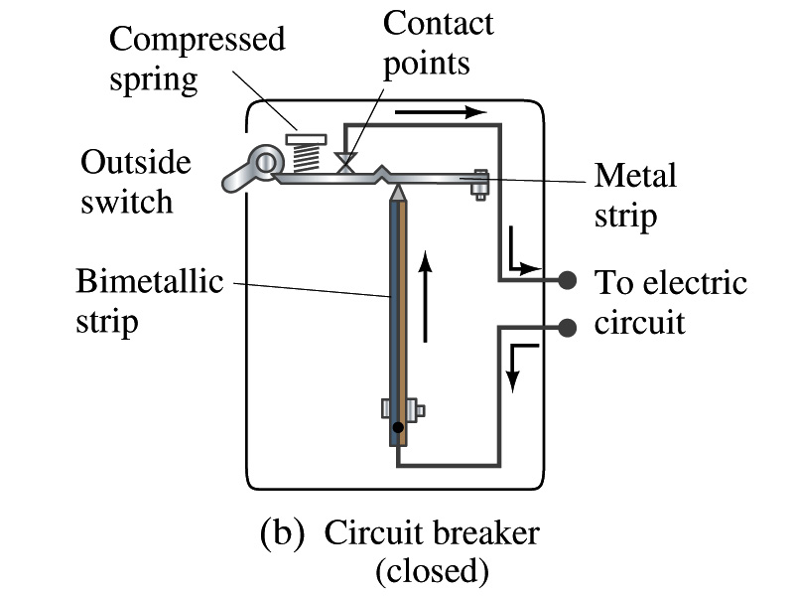
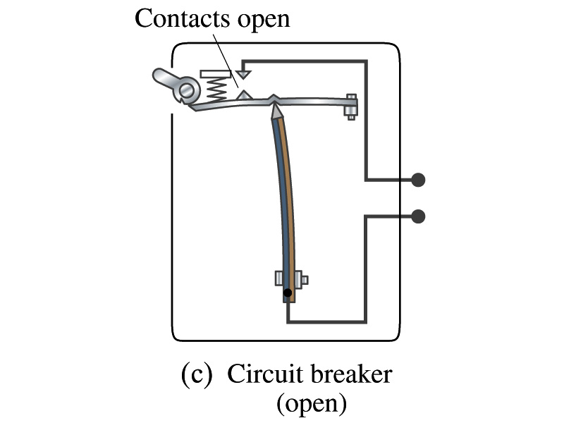
Power in Household Circuits
Household devices usually have small resistance
But since they draw current, if they become large enough, wires can heat up (overloaded)
Why is using thicker wires safer?
Thicker wires have less resistance, lower heat
Overloaded wire can set off a fire at home
How do we prevent this?
Put in a switch that would disconnect the circuit when overloaded
Fuse or circuit breakers
They open up the circuit when the current is over certain value
Overload

Slide 9
Example 18 – 11
Will the fuse blow?: Calculate Determine the total current drawn by all the devices in the circuit in the figure.
The total current is the sum of current drawn by individual device.
Solve for I
Bulb
Heater
Stereo
Dryer
Total current
What is the total power?

Slide 10
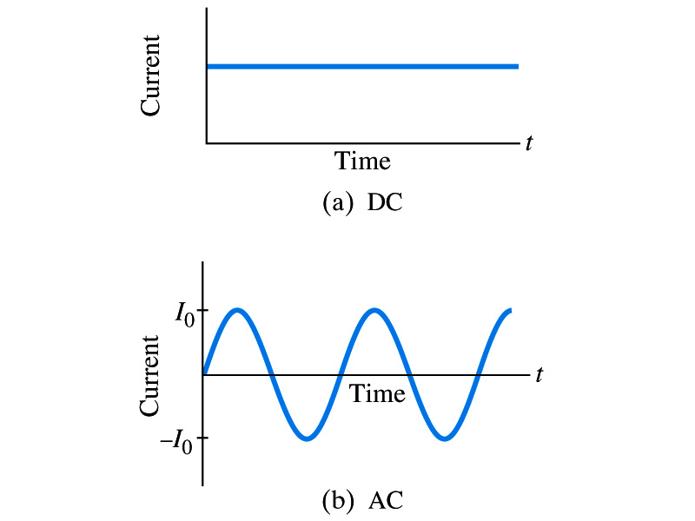
Alternating Current
Does the direction of the flow of current change when a battery is connected to a circuit?
No. Why?
Because its source of potential difference stays put.
This kind of current is called the Direct Current (DC), and it does not change its direction of flow.
How would DC look as a function of time?
A straight line
Electric generators at electric power plant produce alternating current (AC)
AC reverses direction many times a second
AC is sinusoidal as a function of time
Most the currents supplied to homes and business are AC.

Slide 11
Alternating Current
The voltage produced by an AC electric generator is sinusoidal
This is why the current is sinusoidal
Voltage produced can be written as
What are the maximum and minimum voltages?
V₀ and –V₀
The potential oscillates between +V₀ and –V₀, the peak voltages or the amplitude
What is f?
The frequency, the number of complete oscillations made per second. What is the unit of f? What is the normal size of f in the US?
f=60Hz (1/sec) in the US and Canada.
Many European countries have f=50Hz.
ω=2πf

Slide 12
Alternating Current
Since V=IR, if the voltage V exists across a resistance R, the current I is
What are the maximum and minimum currents?
I₀ and –I₀
The current oscillates between +I₀ and –I₀, the peak currents or amplitude. The current is positive when electron flows to one direction and negative when they flow opposite.
AC is as many times positive as negative. What’s the average current?
Zero. So there is no power and no heat is produced in a heater?
Yes there is! The electrons actually flow back and forth, so power is delivered.
What is this?

Slide 13
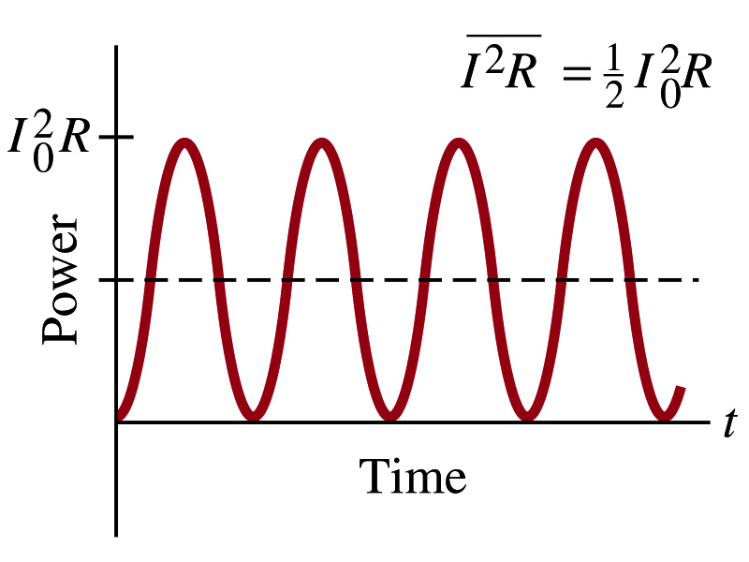
Power Delivered by Alternating Current
AC power delivered to a resistance is:
Since the current is squared, the power is always positive
The average power delivered is
Since the power is also P=V²/R, we can obtain
The average of the square of current and voltage are important in calculating power:
Average power

Slide 14
Power Delivered by Alternating Current
The square root of each of these are called root-mean-square, or rms:
rms values are sometimes called effective values
These are useful quantities since they can substitute current and voltage directly in power, as if they are in DC
In other words, an AC of peak voltage V₀ or peak current I₀ produces as much power as DC voltage V_{rms} or DC current I_{rms}.
So normally, rms values in AC are specified or measured.
US uses 115V rms voltage. What is the peak voltage?
Europe uses 240V

Slide 15
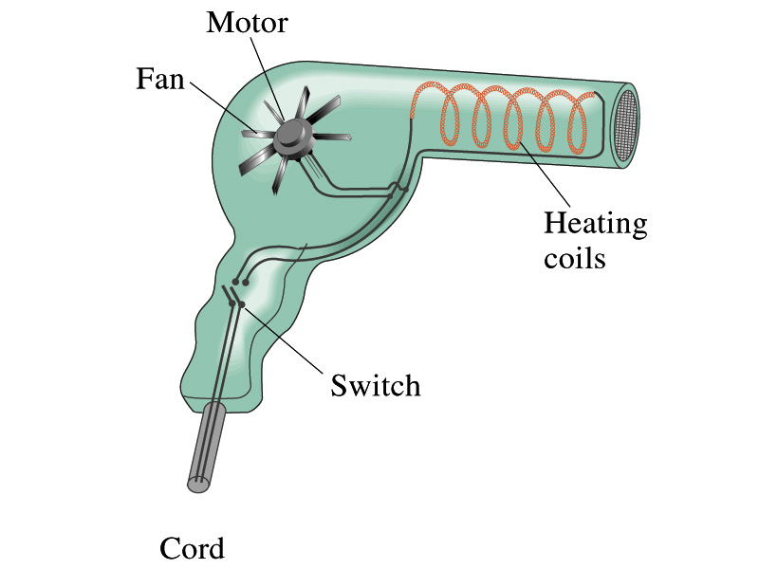
Example 18 – 12
Hair Dryer. (a) Calculate the resistance and the peak current in a 1000-W hair dryer connected to a 120-V AC line. (b) What happens if it is connected to a 240-V line in Britain?
The rms current is:
The peak current is:
Thus the resistance is:
(b) If connected to 240V in Britain …
The average power provide by the AC in UK is
So?
The heating coils in the dryer will melt!

Slide 16
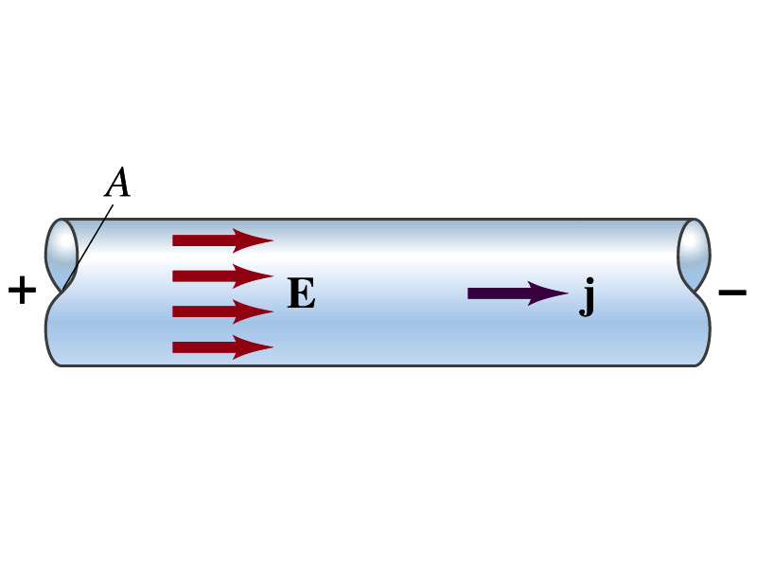
Microscopic View of Electric Current
When a potential difference is applied to the two ends of a wire w/ a uniform cross-section, the direction of the electric field is parallel to the walls of the wire, this is possible since the charges are moving
Let’s define a microscopic vector quantity, the current density j, the electric current per unit cross-sectional area
j=I/A or I = jA if the current density is uniform
If not uniform
The direction of j is the direction the positive charge would move when placed at that position, generally the same as that of E
The current density exists on any point in space while the current I refers to a conductor as a whole so it’s macroscopic

Slide 17
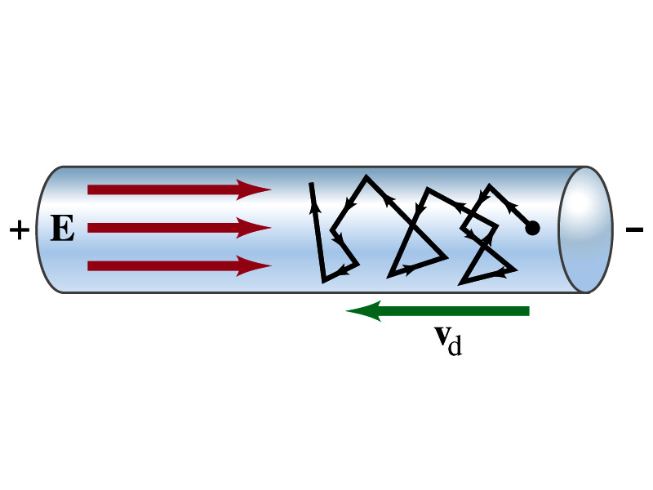
Microscopic View of Electric Current
The direction of j is the direction of a positive charge. So in a conductor, since negatively charged electrons move, the direction is –j.
Let’s think about the current in a microscopic view again:
When voltage is applied to the ends of a wire
Electric field is generated by the potential difference
Electrons feel force and get accelerated
Electrons soon reach to a steady average velocity due to collisions with atoms in the wire, called drift velocity, v_{d}
The drift velocity is normally much smaller than the electrons’ average random speed.

Slide 18
Microscopic View of Electric Current
The drift velocity of electrons in a wire is only about 0.05mm/s. How could we get light turned on immediately then?
While the electrons in a wire travels slow, the electric field travels essentially at the speed of light. Then what is all the talk about electrons flowing through?
It is just like water. When you turn on the facet, water flows right off the facet despite the fact that the water travels slow.
Electricity is the same. Electrons fill the conductor wire and when the switch is flipped on or a potential difference is applied, the electrons closed to the positive terminal flows into the bulb.
Interesting, isn’t it? Why is the field travel at the speed of light then?

Slide 19
Ohm’s Law in Microscopic View
Ohm’s law can be written in microscopic quantities.
Resistance in terms of resistivity is
We can rewrite V and I as: I=jA, V=El.
If electric field is uniform, from V=IR, we obtain
So
In a metal conductor, ρ or σ does not depend on V, thus, the current density j is proportional to the electric field E ➔ Microscopic statement of Ohm’s Law
In vector form, the density can be written as

