Slide 1
PHYS 1442 – Section 001
Lecture #8
Monday, June 17, 2013
Dr. Jaehoon Yu
Chapter 18
  Superconductivity
  Electric Hazards
Chapter 19
  EMF and Terminal Voltage
  Resistors in Series and Parallel
  Energy losses in Resistors
  Kirchhoff’s Rules
  EMFs in Series and Parallel
  Capacitors in Series and Parallel
  RC Circuit

Slide 2
Announcements
Mid-term exam
  This Wednesday, June 19
  Comprehensive exam
    Covers CH16.1 – what we finish tomorrow, Tuesday, June 18 plus Appendices A1 – A8
Quest payment of $25 each
  Deadline is June 28.
  If not paid, your homework access will be disabled.
Will have a mid-term grade discussion
  Between 2 – 3:30 pm this Friday, June 21
  In Dr. Yu’s office (CPB342)

Slide 3
Special Project #3
Make a list of the power consumption and the resistance of all electric and electronic devices at your home and compiled them in a table. (5 points total for the first 10 items and 0.25 points each additional item.)
Estimate the cost of electricity for each of the items on the table using your own electric cost per kWh (if you don’t find your own, use $0.12/kWh) and put them in the relevant column. (2 points total for the first 10 items and 0.1 points each additional items)
Estimate the the total amount of energy in Joules and the total electricity cost per day, per month and per year for your home. (6 points)
Due: Beginning of the class Thursday, June 20

Slide 4
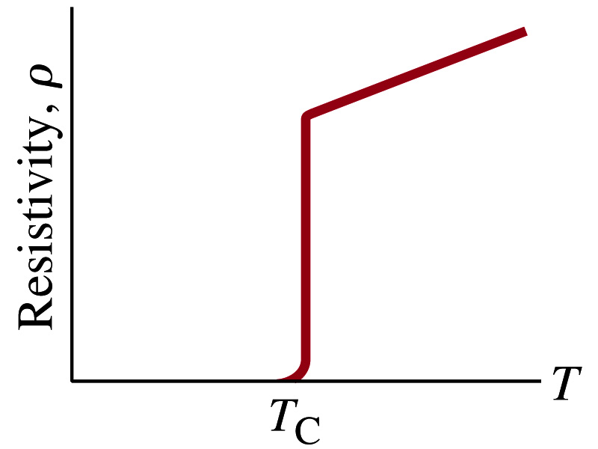
Superconductivity
At the temperature near absolute 0K, resistivity of certain material becomes 0Ω.
  This state is called the “superconducting” state.
  Observed in 1911 by H. K. Onnes when he cooled mercury to 4.2K (-269ºC).
    Resistance of mercury suddenly dropped to 0Ω.
  In general superconducting materials become superconducting below at the transition temperature or critical temperature.
  The highest temperature superconductivity seen is 160K
    First observation above the boiling temperature of liquid nitrogen is in 1987 at 90k observed from a compound of yttrium, barium, copper and oxygen.
Since much smaller amount of material can carry just as much current more efficiently, superconductivity can make electric cars more practical, computers faster, and capacitors store higher energy

Slide 5
Electric Hazards: Leakage Currents
How does one feel shock by electricity?
  Electric current stimulates nerves and muscles, and we feel a shock
  The severity of the shock depends on the amount of current, how long it acts and through what part of the body it passes
  Electric current heats tissues and can cause burns
Currents above 70mA on a torso for a second or more is fatal, causing the heart to function irregularly, “ventricular fibrillation”
A dry human body between two points on opposite side of the body is about 10⁴ to 10⁶ Ω.
When wet, it could be 10³Ω.
A person in good contact with the ground who touches 120V DC line with wet hands can get the current:
  Could be lethal

Slide 6
EMF and Terminal Voltage
What do we need to have current in an electric circuit?
  A device that provides a potential difference, such as a battery or a generator
    They normally convert some types of energy into electric energy
    These devices are called source of the electromotive force (emf)
      emf does NOT refer to a real “force”.
Potential difference between terminals of an emf source, when no current flows to an external circuit, is called the emf (ε) of the source. What is the unit of the emf?
Battery itself has some internal resistance (r) due to the flow of charges in the electrolyte
  Why does the headlight dim when you start the car?
    The starter needs a large amount of current but the battery cannot provide charge fast enough to supply current to both the starter and the headlight
V

Slide 7
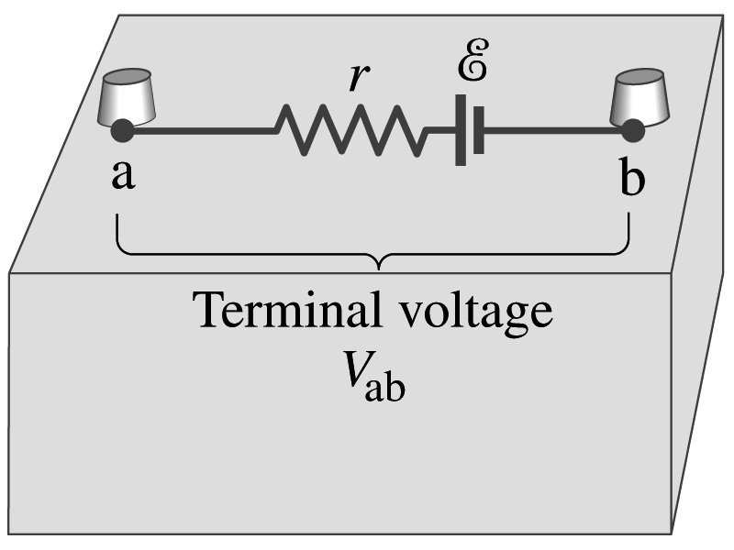
EMF and Terminal Voltage
Since the internal resistance is inside the battery, we can never separate them out.
So the terminal voltage difference is V_{ab}=V_{a}-V_{b}.
When no current is drawn from the battery, the terminal voltage equals the emf which is determined by the chemical reaction; V_{ab}= ε.
However when the current I flows naturally from the battery, there is an internal drop in voltage which is equal to Ir. Thus the actual delivered terminal voltage of a battery in a circuit is .

Slide 8
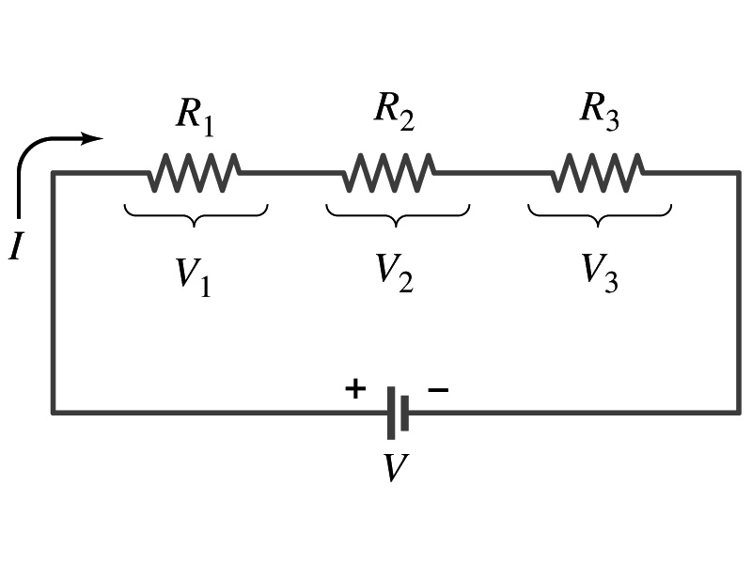
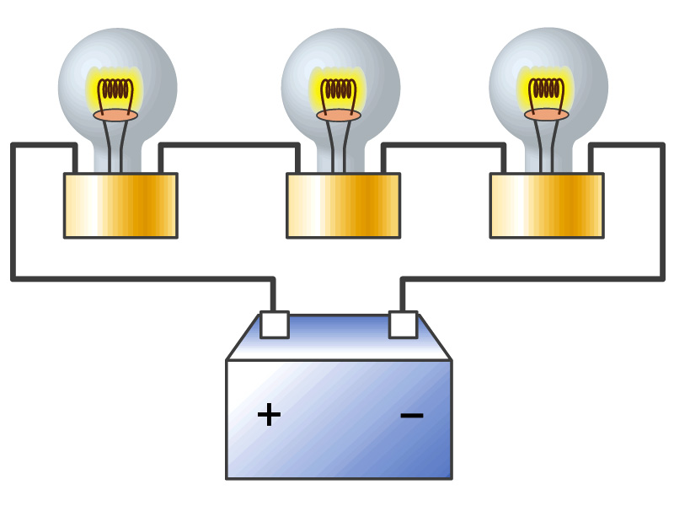
Resisters in Series
Resisters are in series when two or more resisters are connected end to end
  These resisters represent simple resisters in circuit or electrical devices, such as light bulbs, heaters, dryers, etc
What quantity is the same for resisters in a circuit connected in series?
  Current is the same through all the elements in series
Potential difference across every element in the circuit is
  V₁=IR₁, V₂=IR₂ and V₃=IR₃
Since the total potential difference is V, we obtain
  V=IR_{eq}=V₁+V₂+V₃=I(R₁+R₂+R₃)
  Thus, R_{eq}=R₁+R₂+R₃
Resisters in series
When resisters are connected in series, the total resistance increases and the current decreases.

Slide 9
Energy Losses in Resisters
Why is it true that V=V₁+V₂+V₃?
What is the potential energy loss when charge q passes through the resister R₁, R₂ and R₃?
  ΔU₁=qV₁, ΔU₂=qV₂, ΔU₃=qV₃
Since the total energy loss should be the same as the energy provided to the system, we obtain
  ΔU=qV=ΔU₁+ΔU₂+ΔU₃=q(V₁+V₂+V₃)
  Thus, V=V₁+V₂+V₃

Slide 10
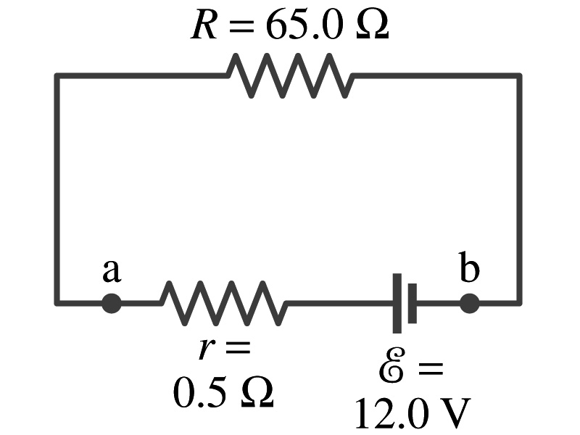
Example 19 – 1
Battery with internal resistance. A 65.0-Ω resistor is connected to the terminals of a battery whose emf is 12.0V and whose internal resistance is 0.5-Ω. Calculate (a) the current in the circuit, (b) the terminal voltage of the battery, V_{ab}, and (c) the power dissipated in the resistor R and in the battery’s internal resistor.
(a) Since
We obtain
What is this?
Solve for I
A battery or a source of emf.
(b) The terminal voltage V_{ab} is
(c) The power dissipated in R and r are

Slide 11
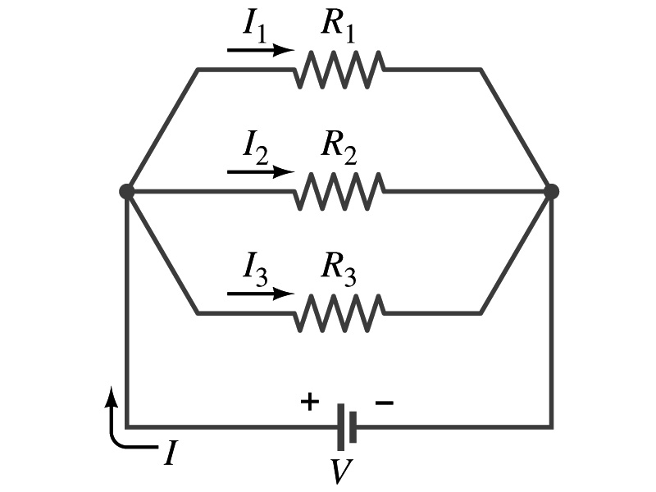
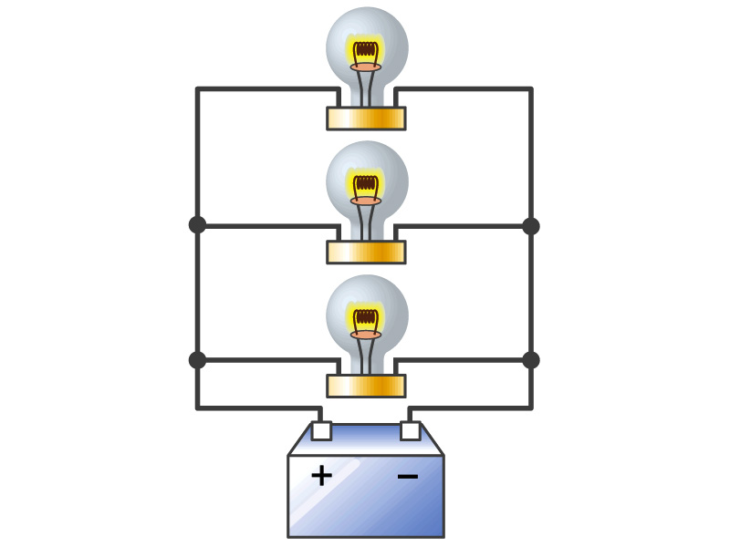
Resisters in Parallel
Resisters are in parallel when two or more resisters are connected in separate branches
  Most the house and building wirings are arranged this way.
What quantity is the same for the resisters in a circuit connected in parallel?
  The voltage is the same across all the resisters.
  The total current that leaves the battery, is however, split through the branches.
The current that passes through every element is
  I₁=V/R₁, I₂=V/R₂, I₃=V/R₃
Since the total current is I, we obtain
  I=V/R_{eq}=I₁+I₂+I₃=V(1/R₁+1/R₂+1/R₃)
  Thus, 1/R_{eq}=1/R₁+1/R₂+1/R₃
Resisters in parallel
When resisters are connected in parallel, the total resistance decreases and the current increases.

Slide 12
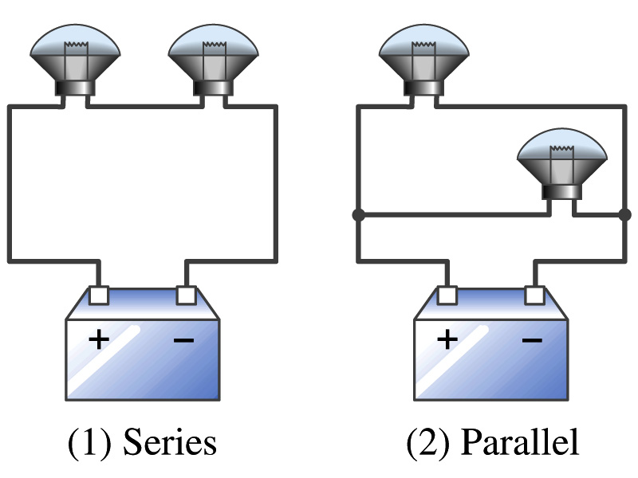
Example 19 – 2
Series or parallel? (a) The light bulbs in the figure are identical and have identical resistance R. Which configuration produces more light? (b) Which way do you think the headlights of a car are wired?
(a) What are the equivalent resistances for the two cases?
Series
Parallel
So
The bulbs get brighter when the total power transformed is larger.
series
parallel
So parallel circuit provides brighter lighting.
(b) Car’s headlights are in parallel to provide brighter lighting and also to prevent both lights going out at the same time when one burns out.
So what is bad about parallel circuits?
Uses more energy in a given time.

Slide 13
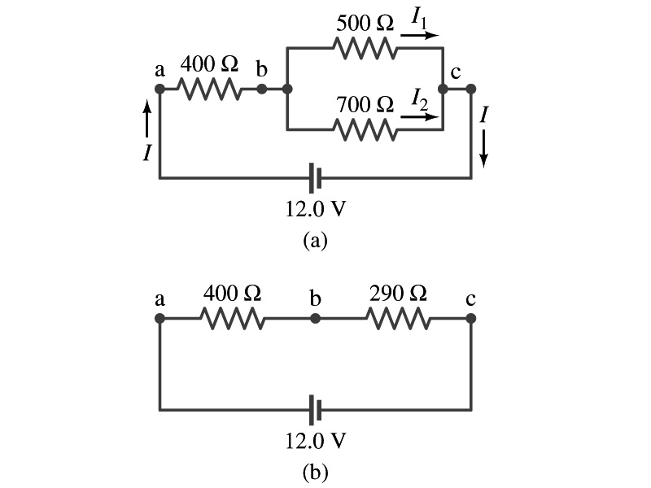
Example 19 – 5
Current in one branch. What is the current flowing through the 500-Ω resister in the figure?
We need to find the total current.
What do we need to find first?
To do that we need to compute the equivalent resistance.
R_{eq} of the small parallel branch is:
R_{eq} of the circuit is:
Thus the total current in the circuit is
The voltage drop across the parallel branch is
The current flowing across 500-Ω resister is therefore
What is the current flowing thru 700-Ω resister?

Slide 14
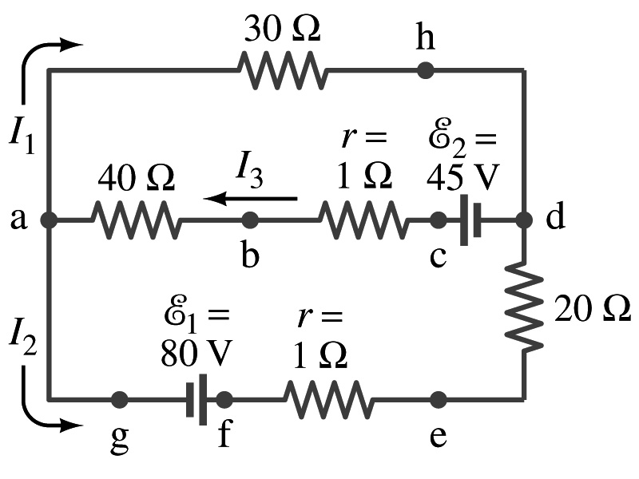
Kirchhoff’s Rules – 1st Rule
Some circuits are very complicated to analyze using the simple combinations of resisters
  G. R. Kirchhoff devised two rules to deal with complicated circuits.
Kirchhoff’s rules are based on conservation of charge and energy
  Kirchhoff’s 1st rule: Junction rule, charge conservation.
    At any junction point, the sum of all currents entering the junction must equal to the sum of all currents leaving the junction.
    In other words, what goes in must come out.
    At junction a in the figure, I₃ comes into the junction while I₁ and I₂ leaves: I₃ = I₁+ I₂

Slide 15
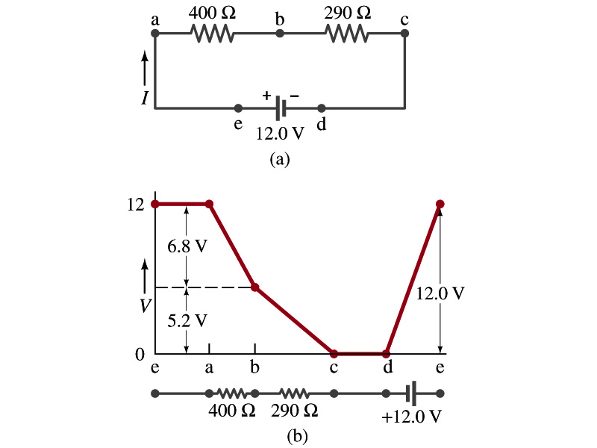
Kirchhoff’s Rules – 2nd Rule
Kirchoff’s 2nd rule: Loop rule, uses conservation of energy.
  The sum of the changes in potential around any closed path of a circuit must be zero.
The current in the circuit in the figure is I=12/690=0.017A.
  Point e is the highest potential point while point d is the lowest potential.
  When the test charge starts at e and returns to e, the total potential change is 0.
  Between point e and a, no potential change since there is no source of potential or any resistance to drop potential.
  Between a and b, there is a 400Ω resistance, causing IR=0.017*400 =6.8V drop.
  Between b and c, there is a 290Ω resistance, causing IR=0.017*290 =5.2V drop.
  Since these are voltage drops, we use negative sign for these, -6.8V and -5.2V.
  No change between c and d while from d to e there is +12V change.
  Thus the total change of the voltage through the loop is: -6.8V-5.2V+12V=0V.

Slide 16
Using Kirchhoff’s Rules
Determine the flow of currents at the junctions.
  It does not matter which direction of the current you choose.
  If the value of the current after completing the calculations are negative, you just flip the direction of the current flow.
Write down the current equation based on Kirchhoff’s 1st rule at various junctions.
  Be sure to see if any of them are the same.
Choose independent closed loops in the circuit
Write down the potential in each interval of the junctions, keeping the signs properly.
Write down the potential equations for each loop.
Solve the equations for unknowns.

