Slide 1
PHYS 1442 – Section 001 Lecture #9
Tuesday, June 18, 2013
Dr. Jaehoon Yu
Chapter 19
Kirchhoff’s Rules
EMFs in Series and Parallel
Capacitors in Series and Parallel
RC Circuit
Chapter 20
Magnets and Magnetic Field
Electric Current and Magnetism
Magnetic Forces on Electric Current
Today’s homework is homework #5, due 11pm, Monday, June 24!!

Slide 2
Announcements
Quiz results
Class average: 58.1/95
Equivalent to 61.2/100
Previous result 51.7/100
Top score: 87/95
Mid-term exam
Tomorrow, Wednesday, June 19
Comprehensive exam
Covers CH16.1 – what we finish today (CH20.1?) plus Appendices A1 – A8
Mid-term grade discussion
Between 2 – 3:30 pm this Friday, June 21
In Dr. Yu’s office (CPB342)

Slide 3
Special Project #3
Make a list of the power consumption and the resistance of all electric and electronic devices at your home and compiled them in a table. (5 points total for the first 10 items and 0.25 points each additional item.)
Estimate the cost of electricity for each of the items on the table using your own electric cost per kWh (if you don’t find your own, use $0.12/kWh) and put them in the relevant column. (2 points total for the first 10 items and 0.1 points each additional items)
Estimate the the total amount of energy in Joules and the total electricity cost per day, per month and per year for your home. (6 points)
Due: Beginning of the class Thursday, June 20
Print the entire width of the table to be contained in one page!!

Slide 4
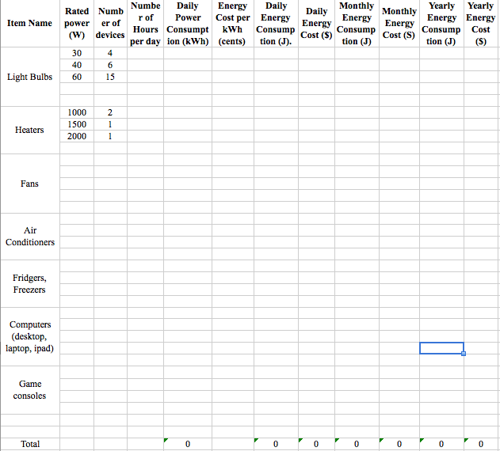
Spread Sheet

Slide 5
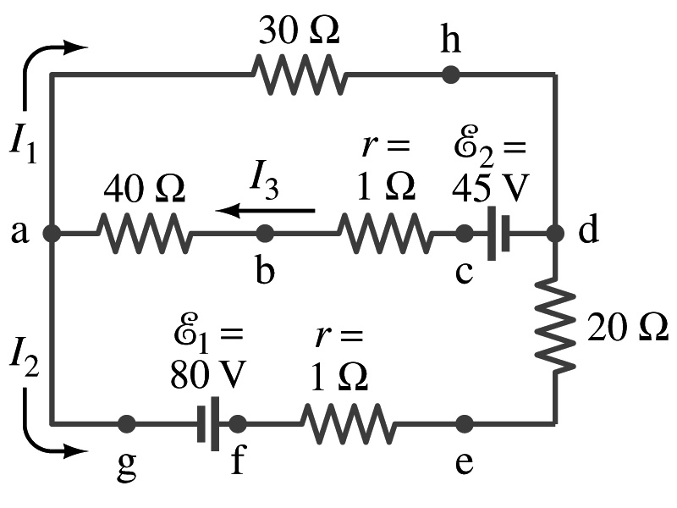
Kirchhoff’s Rules – 1st Rule
Some circuits are very complicated to analyze using the simple combinations of resisters
G. R. Kirchhoff devised two rules to deal with complicated circuits.
Kirchhoff’s rules are based on conservation of charge and energy
Kirchhoff’s 1st rule: Junction rule, charge conservation.
At any junction point, the sum of all currents entering the junction must equal to the sum of all currents leaving the junction.
In other words, what goes in must come out.
At junction a in the figure, I₃ comes into the junction while I₁ and I₂ leaves: I₃ = I₁+ I₂

Slide 6
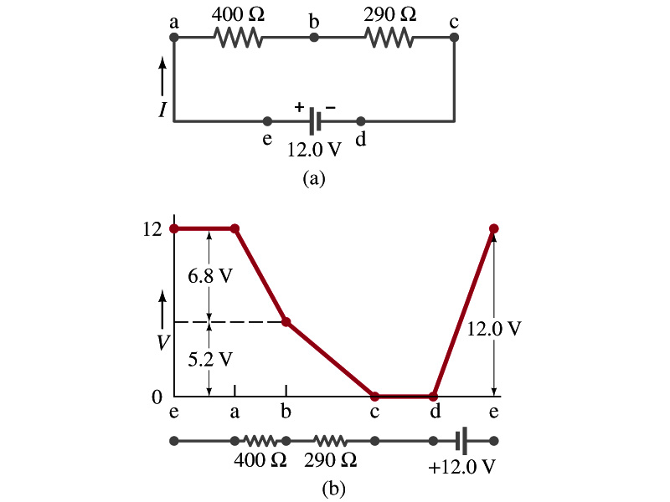
Kirchhoff’s Rules – 2nd Rule
Kirchoff’s 2nd rule: Loop rule, uses conservation of energy.
The sum of the changes in potential around any closed path of a circuit must be zero.
The current in the circuit in the figure is I=12/690=0.017A.
Point e is the highest potential point while point d is the lowest potential.
When the test charge starts at e and returns to e, the total potential change is 0.
Between point e and a, no potential change since there is no source of potential or any resistance to drop potential.
Between a and b, there is a 400Ω resistance, causing IR=0.017*400 =6.8V drop.
Between b and c, there is a 290Ω resistance, causing IR=0.017*290 =5.2V drop.
Since these are voltage drops, we use negative sign for these, -6.8V and -5.2V.
No change between c and d while from d to e there is +12V change.
Thus the total change of the voltage through the loop is: -6.8V-5.2V+12V=0V.

Slide 7
Using Kirchhoff’s Rules
Determine the flow of currents at the junctions.
It does not matter which direction of the current you choose.
If the value of the current after completing the calculations are negative, you just flip the direction of the current flow.
Write down the current equation based on Kirchhoff’s 1st rule at various junctions.
Be sure to see if any of them are the same.
Choose independent closed loops in the circuit
Write down the potential in each interval of the junctions, keeping the signs properly.
Write down the potential equations for each loop.
Solve the equations for unknowns.

Slide 8
Example 19 – 8
Using Kirchhoff’s rules. Calculate the currents I₁, I₂ and I₃ in each of the branches of the circuit in the figure.
The directions of the current through the circuit is not known a priori but since the current tends to move away from the positive terminal of a battery, we arbitrarily choose the direction of the currents as shown.
We have three unknowns so we need three equations.
Using Kirchhoff’s junction rule at point a, we obtain
This is the same for junction d as well, so no additional information.
Now the second rule on the loop ahdcba.
The total voltage change in loop ahdcba is.

Slide 9
Example 19 – 8, cnt’d
Now the second rule on the other loop agfedcba.
The total voltage change in loop agfedcba is.
So the three equations become
We can obtain the three current by solving these equations for I₁, I₂ and I₃.

Slide 10
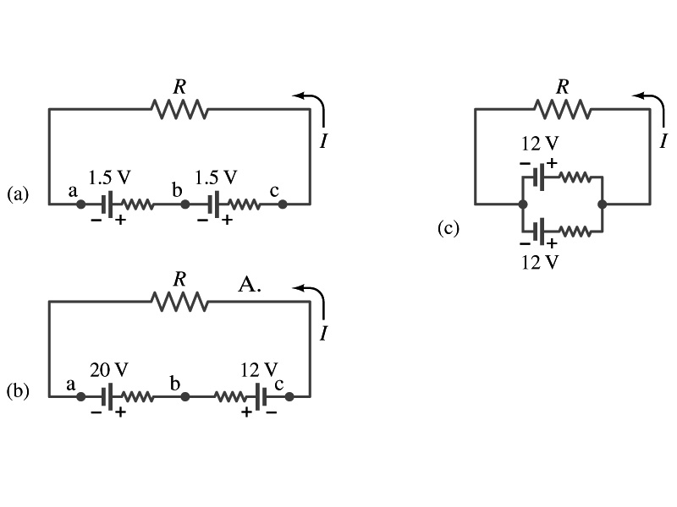
EMF’s in Series and Parallel: Charging a Battery
When two or more sources of emf’s, such as batteries, are connected in series
The total voltage is the algebraic sum of their voltages, if their direction is the same
V_{ac}=1.5 + 1.5=3.0V in figure (a).
If the batteries are arranged in an opposite direction, the total voltage is the difference between them
Parallel arrangements (c) are used only to increase currents.
V_{ac}=20 – 12=8.0V in figure (b)
Connecting batteries in opposite direction is wasteful.
This, however, is the way a battery charger works.
Since the 20V battery is at a higher voltage, it forces charges into 12V battery
Some battery are rechargeable since their chemical reactions are reversible but most the batteries can not reverse their chemical reactions
This is the way we jump start a car

Slide 11
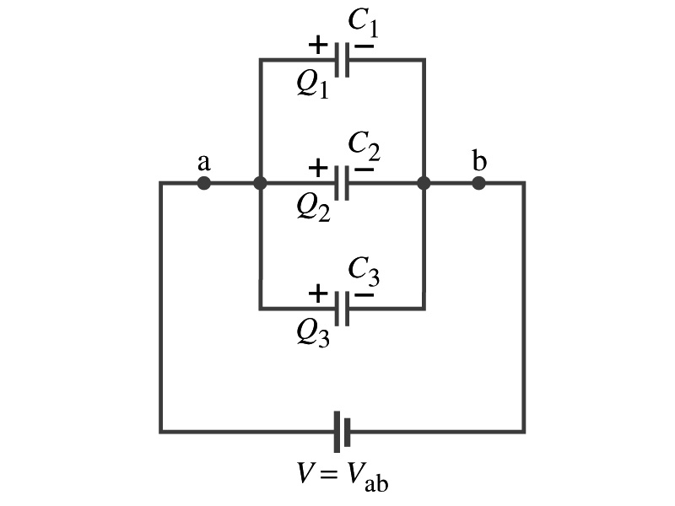
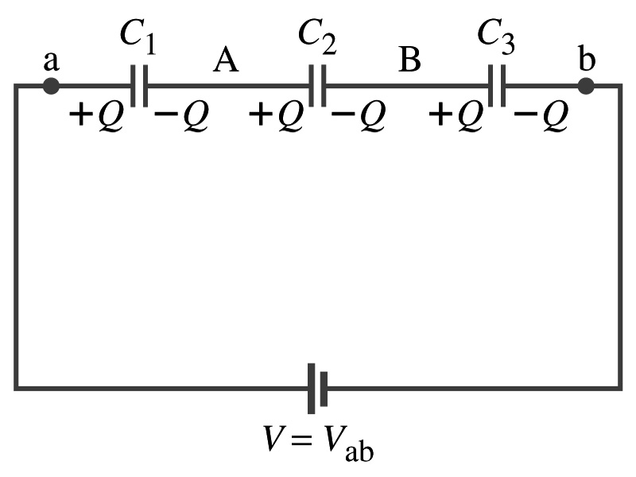
Capacitors in Series or Parallel
Capacitors are also used in many electric circuits.
So what is an electric circuit again?
A closed path of conductors, usually wires, connecting capacitors, resisters and other electrical devices, in which
charges can flow
And includes a source of potential such as a battery
Capacitors can be connected in various ways.
In parallel and in Series or in combination

Slide 12
Capacitors in Parallel
Parallel arrangement provides the same voltage across all the capacitors.
Left hand plates are at V_{a} and right hand plates are at V_{b}
So each capacitor plate acquires charges given by the formula
Q₁=C₁V, Q₂=C₂V, and Q₃=C₃V
The total charge Q that must leave the battery is then
Q=Q₁+Q₂+Q₃=V(C₁+C₂+C₃)
Consider that the three capacitors behave like an equivalent one
Q=C_{eq}V= V(C₁+C₂+C₃)
Thus the equivalent capacitance in parallel is
What is the net effect?
The capacitance increases!!!

Slide 13
Capacitors in Series
Series arrangement is more interesting
When a battery is connected, +Q flows to the left plate of C₁ and –Q flows to the right plate of C₃ inducing opposite sign charges on the other plates.
Since the capacitor in the middle was originally neutral, charges get induced to neutralize the induced charges
So the charge on each capacitor is the same value, Q. (Same charge)
Consider that the three capacitors behave like an equivalent one
Q=C_{eq}V ➔ V=Q/C_{eq}
The total voltage V across the three capacitors in series must be equal to the sum of the voltages across each capacitor.
V=V₁+V₂+V₃=(Q/C₁+Q/C₂+Q/C₃)
Putting all these together, we obtain:
V=Q/C_{eq}=Q(1/C₁+1/C₂+1/C₃)
Thus the equivalent capacitance is
What is the net effect?
The capacitance smaller than the smallest C!!!

Slide 14
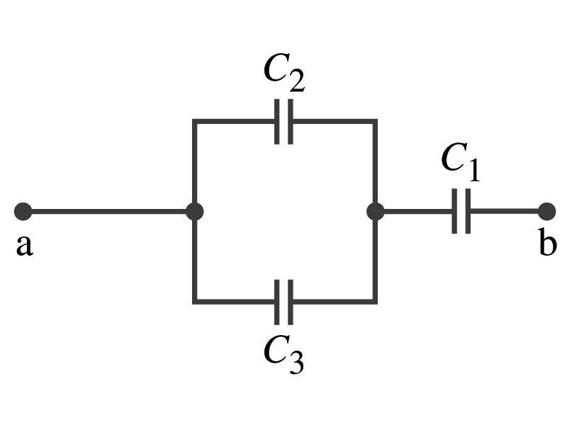
Example 19 – 10
Equivalent Capacitor: Determine the capacitance of a single capacitor that will have the same effect as the combination shown in the figure. Assume C₁=C₂=C₃=C.
We should do these first!!
How?
These are in parallel so the equivalent capacitance is:
Now the equivalent capacitor is in series with C₁.
Solve for C_{eq}

Slide 15
Resister and Capacitor Arrangements
Parallel Capacitor arrangements
Parallel Resister arrangements
Series Capacitor arrangements
Series Resister arrangements

Slide 16
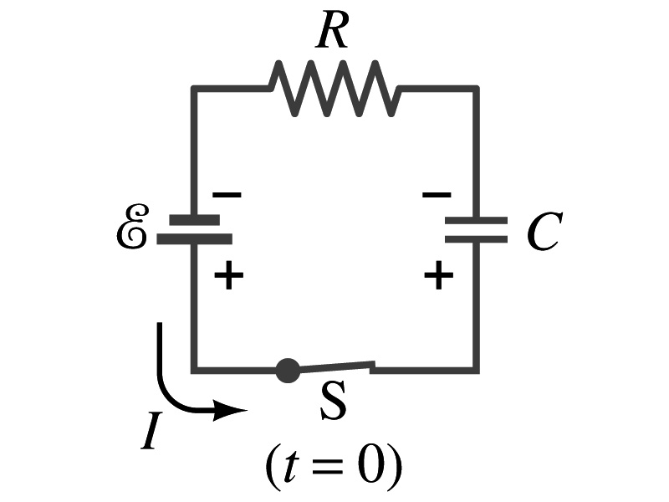
RC Circuits
Circuits containing both resisters and capacitors
RC circuits are used commonly in everyday life
Control windshield wiper
Timing of traffic light color change
Camera flashes and heart pacemakers
How does an RC circuit look?
There should be a source of emf, capacitors and resisters
What happens when the switch S is closed?
Current immediately starts flowing through the circuit.
Electrons flows out of negative terminal of the emf source, through the resister R and accumulates on the upper plate of the capacitor
The electrons from the bottom plate of the capacitor flow into the positive terminal of the battery, leaving only positive charge on the bottom plate
As the charge accumulates on the capacitor, the potential difference across it increases
The current reduces gradually to 0 until the voltage across the capacitor is the same as emf.
The charge on the capacitor increases unil it reaches to its maximum, Cε.
What happens when the battery in the circuit is replaced with a wire?
Capacitor discharges

Slide 17
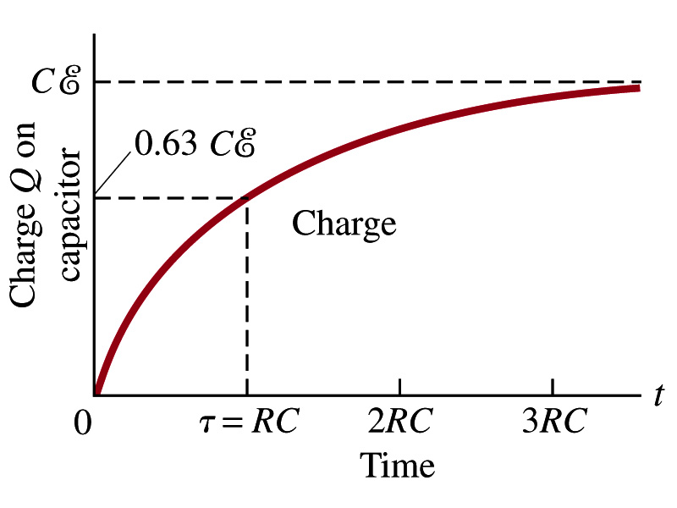
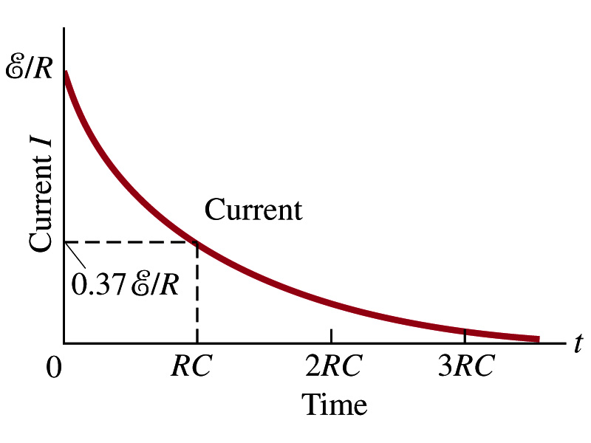
RC Circuits
How does all this look like in graphs?
Charge and the current on the capacitor as a function of time
From energy conservation (Kirchhoff’s 2nd rule), the emf ε must be equal to the voltage drop across the capacitor and the resister
ε=IR+Q/C
R includes all resistance in the circuit, including the internal resistance of the battery, I is the current in the circuit at any instant, and Q is the charge of the capacitor at that same instance.

Slide 18
Analysis of RC Circuits
Charge and voltage
What can we see from the above equations?
Q and V_{C} increase from 0 at t=0 to maximum value Q_{max}=Cε and V_{C}= ε.
In how much time?
The quantity RC is called the time constant, τ, of the circuit
τ=RC, What is the unit?
What is the physical meaning?
The time required for the capacitor to reach (1-e⁻¹)=0.63 or 63% of its full charge
The current is
Sec.

Slide 19
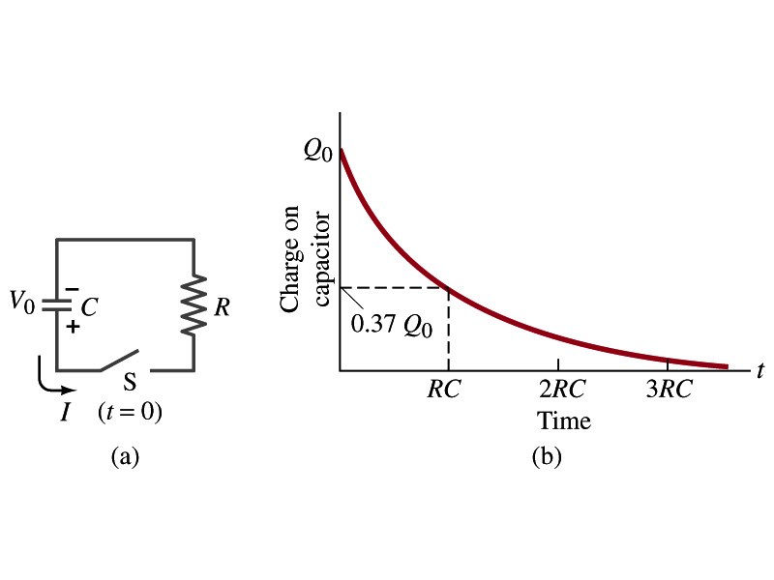
Discharging RC Circuits
When a capacitor is already charged, it is allowed to discharge through a resistance R.
When the switch S is closed, the voltage across the resistor at any instant equals that across the capacitor. Thus IR=Q/C.
The rate at which the charge leaves the capacitor equals the negative of the current flows through the resistor
I= - ΔQ/Δt. Why negative?
Since the current is leaving the capacitor
Thus the voltage equation becomes a differential equation
Rearrange terms

Slide 20
Discharging RC Circuits
What happens when an RC circuit discharges from its original charge of Q₀?
Charge at any given time t is
What does this tell you about the charge on the capacitor?
It decreases exponentially with time at a time constant RC
Just like the case of charging
The current is:
The voltage is:

Slide 21
Ex. 19 – 12
Discharging RC circuit. If a charged capacitor C=35μF is connected to a resistance R=120Ω as in the figure, how much time will elapse until the voltage falls to 10% of its original (maximum) value?
What is the RC time of this circuit?
The RC time
Since we are looking for the time it takes for V_{c}=10% of V₀, we obtain
For 0.1V₀
Rearrange terms
Solve for t

Slide 22
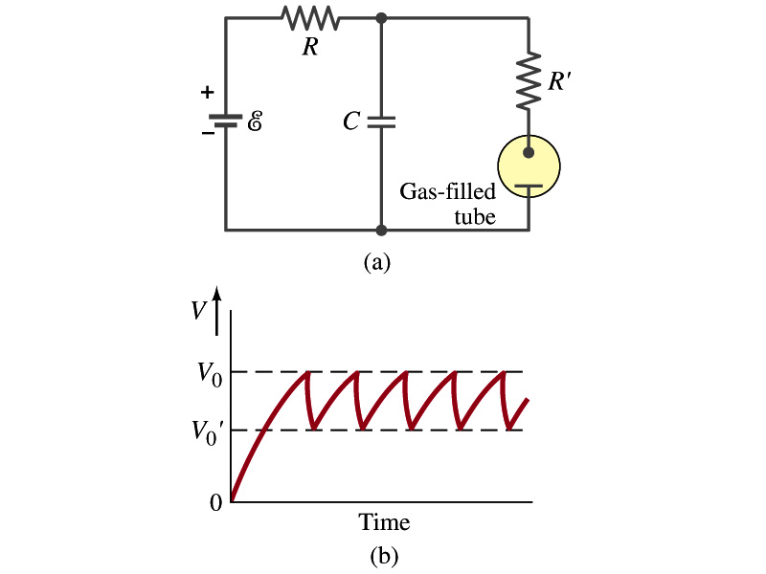
Application of RC Circuits
What do you think the charging and discharging characteristics of RC circuits can be used for?
To produce voltage pulses at a regular frequency
How?
The capacitor charges up to a particular voltage and discharges
A simple way of doing this is to use breakdown of voltage in a gas filled tube
The discharge occurs when the voltage breaks down at V₀
After the completion of discharge, the tube no longer conducts
Then the voltage is at V₀’ and it starts charging up
How do you think the voltage as a function of time look?
A sawtooth shape
Pace maker, intermittent windshield wiper, etc

Slide 23
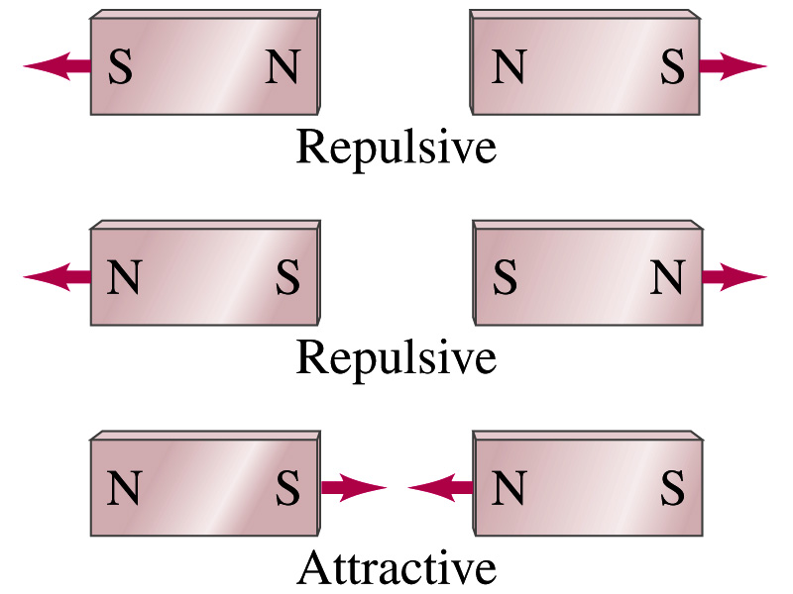
Magnetism
What are magnets?
Objects with two poles, north and south poles
The pole that points to geographical north is the north pole and the other is the south pole
Principle of compass
These are called magnets due to the name of the region, Magnesia, where rocks that attract each other were found
What happens when two magnets are brought to each other?
They exert force onto each other
What kind?
Both repulsive and attractive forces depending on the configurations
Like poles repel each other while the unlike poles attract

Slide 24
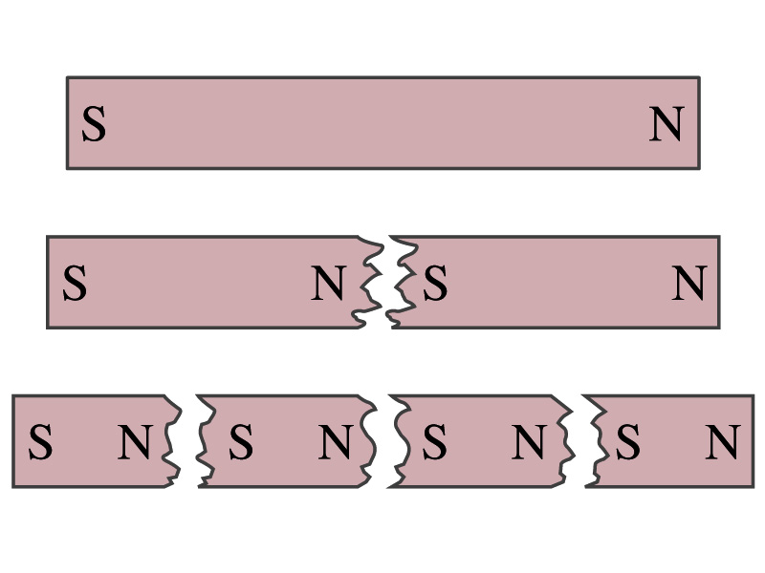
Magnetism
So the magnet poles are the same as the electric charge?
No. Why not?
While the electric charges (positive and negative) can be isolated the magnet poles cannot be isolated.
So what happens when a magnet is cut?
If a magnet is cut, two magnets are made.
The more they get cut, the more magnets are made
Single pole magnets are called the monopole but it has not been seen yet
Ferromagnetic materials: Materials that show strong magnetic effects
Iron, cobalt, nickel, gadolinium and certain alloys
Other materials show very weak magnetic effects

Slide 25
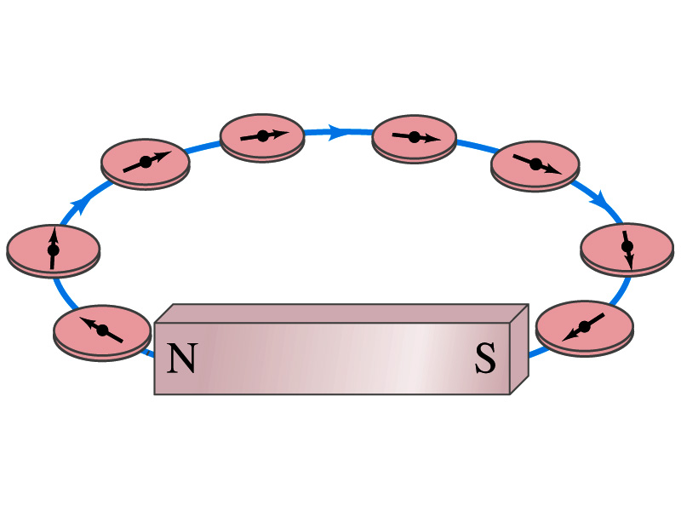
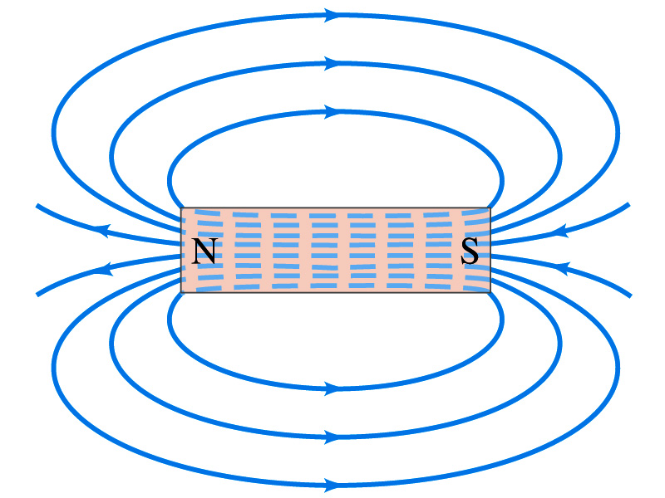
Magnetic Field
Just like the electric field that surrounds electric charge, a magnetic field surrounds a magnet
What does this mean?
Magnetic force is also a field force
The force one magnet exerts onto another can be viewed as the interaction between the magnet and the magnetic field produced by the other magnet
What kind of quantity is the magnetic field? Vector or Scalar?
So one can draw magnetic field lines, too.
Vector
The direction of the magnetic field is tangent to a line at any point
The direction of the field is the direction the north pole of a compass would point to
The number of lines per unit area is proportional to the strength of the magnetic field
Magnetic field lines continue inside the magnet
Since magnets always have both the poles, magnetic field lines form closed loops unlike electric field lines

