Slide 1
PHYS 1442 – Section 001 Lecture #10
Monday, June 24, 2013
Dr. Jaehoon Yu
Chapter 20
Electric Current and Magnetism
Magnetic Forces on Electric Current
Magnetic Forces on a Moving Charge
Charged Particle Path in a Magnetic Field
Today’s homework is #6, due 11pm, Monday, July 1!!

Slide 2
Announcements
Exam results
Class average: 77.1/110
Equivalent to 70.1/100
Previous result 51.7/100
Top score: 109/110
2nd term exam
In class this Thursday, June 27
Non-comprehensive exam
Covers CH20.1 – what we finish this Wednesday
Reading assignments
CH20.8 – 20.11
Will give you a chance to submit your special project #3
Deadline by the beginning of the class tomorrow, Tuesday, June 25
You will get 75% of the original maximum

Slide 3
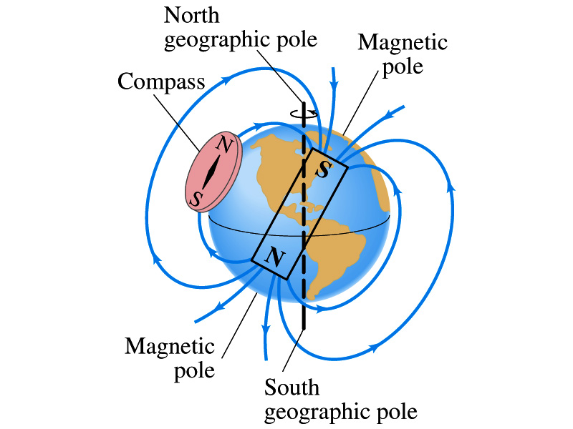
Earth’s Magnetic Field
What magnetic pole does the geographic north pole has to have?
W. Gilbert realized in 1600s that the Earth is a giant magnet
Magnetic south pole. What? How do you know that?
Since the magnetic north pole points to the geographic north, the geographic north must have magnetic south pole
The pole in the north is still called geomagnetic north pole just because it is in the north
Similarly, south pole has magnetic north pole
The Earth’s magnetic poles do not coincide with the geographic poles ➔ magnetic declination (0 – 20º in the US)
Geomagnetic north pole is in northern Canada, some 1300km off the true north pole
Earth’s magnetic field line is not tangent to the Earth’s surface at all points
The angle the Earth’s field makes to the horizontal line is called the angle dip

Slide 4
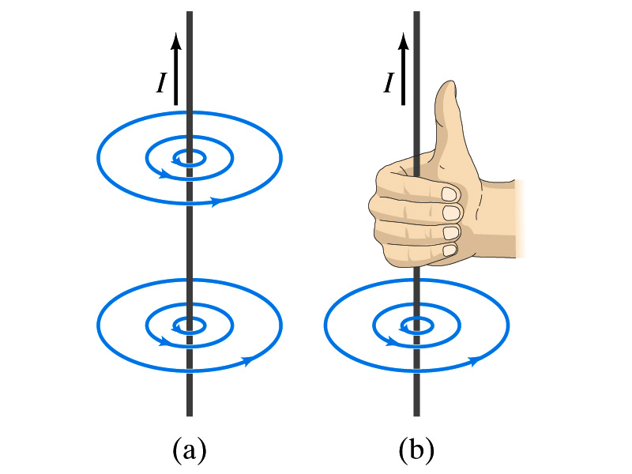
Electric Current and Magnetism
In 1820, Oersted found that when a compass needle is placed near an electric wire, the needle deflects as soon as the wire is connected to a battery and the current flows
Electric current produces a magnetic field
The first indication that electricity and magnetism are the same thing
What about a stationary electric charge and magnet?
They don’t affect each other.
The magnetic field lines produced by a current in a straight wire is in the form of circles following the “right-hand” rule
The field lines follow right-hand’s fingers wrapped around the wire when the thumb points to the direction of the electric current
The arrow head points from North to South

Slide 5
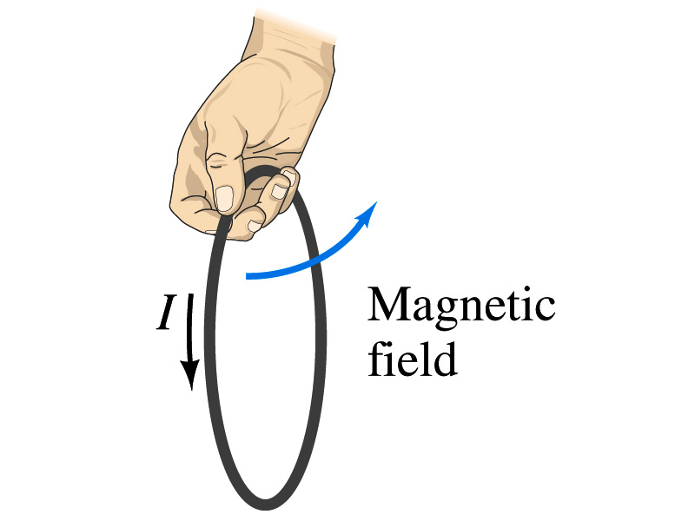
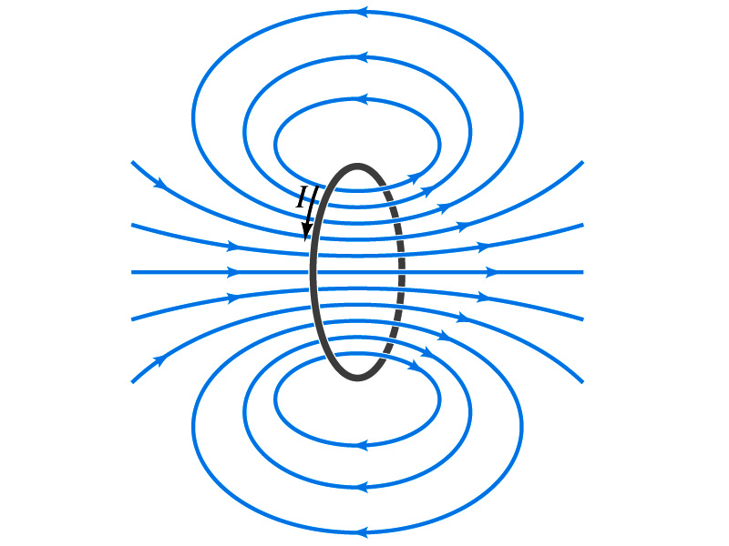
Directions in a Circular Wire?
OK, then what are the directions of the magnetic fields generated by the current flowing through circular loops?

Slide 6
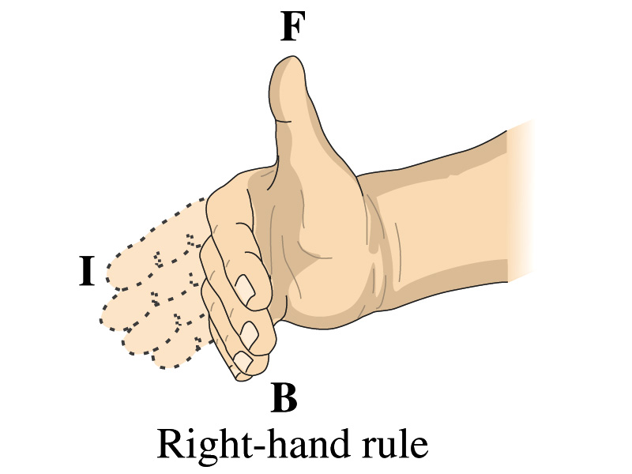
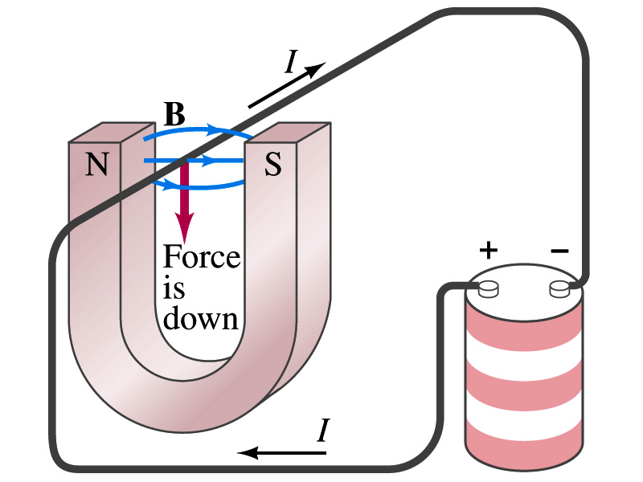
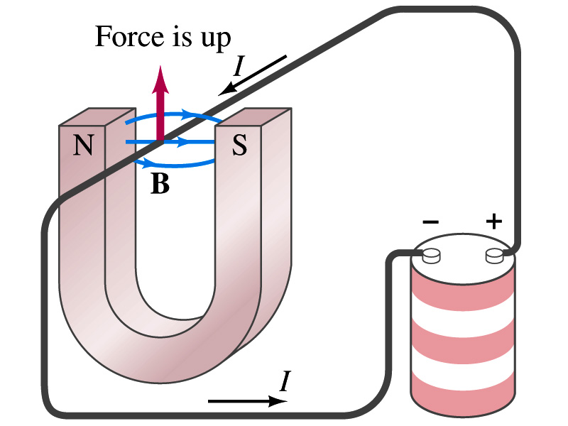
Magnetic Forces on Electric Current
Since the electric current exerts force on a magnet, the magnet should also exert force on the electric current
Which law justifies this?
Newton’s 3rd law
This was also discovered by Oersted
Direction of the force is always
perpendicular to the direction of the current
And also perpendicular to the direction of the magnetic field, B
Experimentally the direction of the force is given by another right-hand rule ➔ When the fingers of the right-hand points to the direction of the current and the finger tips bent to the direction of magnetic field B, the direction of thumb points to the direction of the force

Slide 7
Magnetic Forces on Electric Current
OK, we are set for the direction but what about the magnitude?
It is found that the magnitude of the force is directly proportional to
The current flowing in the wire
The length of the wire in the magnetic field (if the field is uniform)
The strength of the magnetic field
The force also depends on the angle θ between the directions of the current and the magnetic field
When the wire is perpendicular to the field, the force is the strongest
When the wire is parallel to the field, there is no force at all
Thus the force on current I in the wire with the length l in a uniform field B is

Slide 8
Magnetic Forces on Electric Current
Magnetic field strength B can be defined using the previous proportionality relationship w/ the constant 1:
If θ=90º, and if θ=0º
So the magnitude of the magnetic field B can be defined as
where F_{max} is the magnitude of the force on a straight length l of wire carrying a current I when the wire is perpendicular to B
The relationship between F, B and I can be written in a vector formula:
l is the vector whose magnitude is the length of the wire and its direction is along the wire in the direction of the conventional current
This formula works if B is uniform.
If B is not uniform or l does not form the same angle with B everywhere, the infinitesimal force acting on a differential length dl is

Slide 9
About the Magnetic Field, B
The magnetic field is a vector quantity
The SI unit for B is tesla (T)
What is the definition of 1 Tesla in terms of other known units?
1T=1N/Am
In older names, tesla is the same as weber per meter-squared
1Wb/m²=1T
The cgs unit for B is gauss (G)
How many T is one G?
1G=10⁻⁴ T
For computation, one MUST convert G to T at all times
Magnetic field on the Earth’s surface is about 0.5G=0.5x10⁻⁴T
On a diagram, for field coming out and for going in.

Slide 10
Properties of Vector Product
Vector Product is Non-commutative
What does this mean?
If the order of operation changes the result changes
Following the right-hand rule, the direction changes
Vector Product of two parallel vectors is 0.
Thus,
If two vectors are perpendicular to each other
Vector product follows distribution law
The derivative of a Vector product with respect to a scalar variable is

Slide 11
More Properties of Vector Product
The relationship between unit vectors,
Vector product of two vectors can be expressed in the following determinant form

Slide 12
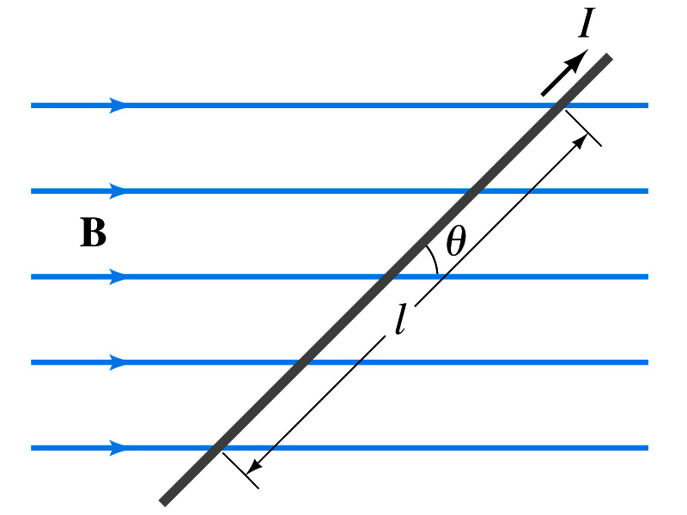
Example 20 – 1
Magnetic force on a current carrying wire. A wire carrying a 30 A current I, has a length l = 12cm between the pole faces of a magnet at an angle θ=60º as in the figure. The magnetic field is approximately uniform at 0.9T. We ignore the field beyond the pole pieces. What is the magnitude of the force on the wire?
Which formula should we use for this problem?
The magnitude of the magnitude of the magnetic force is

Slide 13
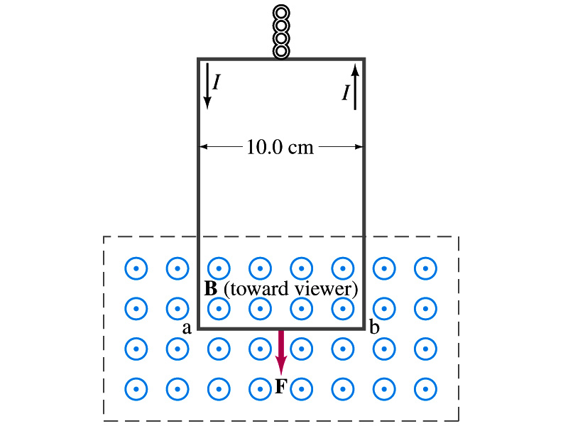
Example 20 – 2
Measuring a magnetic field. A rectangular loop of wire hangs vertically as shown in the figure. A magnetic field B is directed horizontally perpendicular to the wire, and points out of the page. The magnetic field B is very nearly uniform along the horizontal portion of wire ab (length l=10.0cm) which is near the center of a large magnet producing the field. The top portion of the wire loop is free of the field. The loop hangs from a balance which measures a downward force ( in addition to the gravitational force) of F=3.48x10⁻²N when the wire carries a current I=0.245A. What is the magnitude of the magnetic field B at the center of the magnet?
Magnetic force exerted on the wire due to the uniform field is
Since
Magnitude of the force is
Solving for B
Something is not right! What happened to the forces on the loop on the side?
The two forces cancel out since they are in opposite direction with the same magnitude.

Slide 14
Magnetic Forces on a Moving Charge
Will moving charge in a magnetic field experience force?
Yes
Why?
Since the wire carrying a current (moving charge) experience force in a magnetic field, a free moving charge must feel the same kind of force…☺
OK, then how much force would it experience?
Let’s consider N moving particles with charge q each, and they pass by the given point in a time interval t.
What is the current?
Let t be the time for a charge q to travel a distance l in a magnetic field B
Then, the displacement vector l becomes
Where v is the velocity of the incident particle with charge q
Thus the force on N particles by the field is
The force on one particle with charge q,

Slide 15
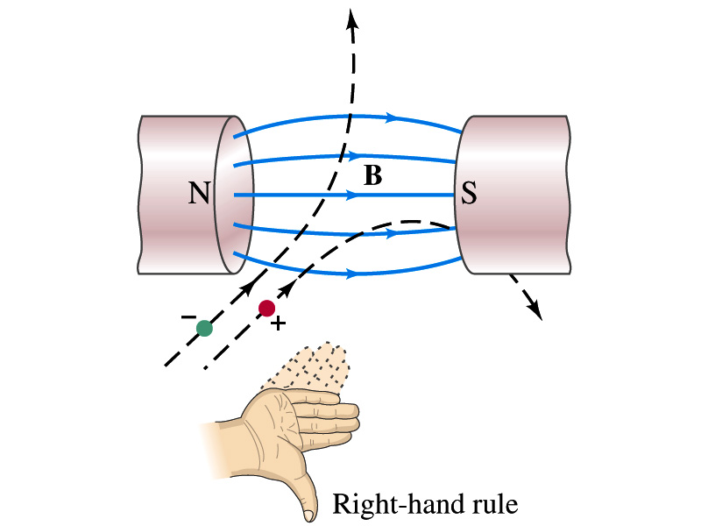
Magnetic Forces on a Moving Charge
This can be an alternative way of defining the magnetic field.
How?
The magnitude of the force on a particle with charge q moving with a velocity v in the field B is
What is θ?
The angle between the magnetic field and the direction of particle’s movement
When is the force maximum?
When the angle between the field and the velocity vector is perpendicular.
➔
The direction of the force follows the right-hand-rule and is perpendicular to the direction of the magnetic field

Slide 16
Example 20 – 4
Magnetic force on a proton. A proton having a speed of 5x10⁶m/s in a magnetic field feels a force of F=8.0x10⁻¹⁴N toward the west when it moves vertically upward. When moving horizontally in a northerly direction, it feels zero force. What is the magnitude and direction of the magnetic field in this region?
What is the charge of a proton?
What does the fact that the proton does not feel any force in a northerly direction tell you about the magnetic field?
The field is along the north-south direction.
Why?
Because the particle does not feel any magnetic force when it is moving along the direction of the field.
Since the particle feels force toward the west, the field should be pointing to ….
North
Using the formula for the magnitude of the field B, we obtain
We can use magnetic field to measure the momentum of a particle. How?

Slide 17
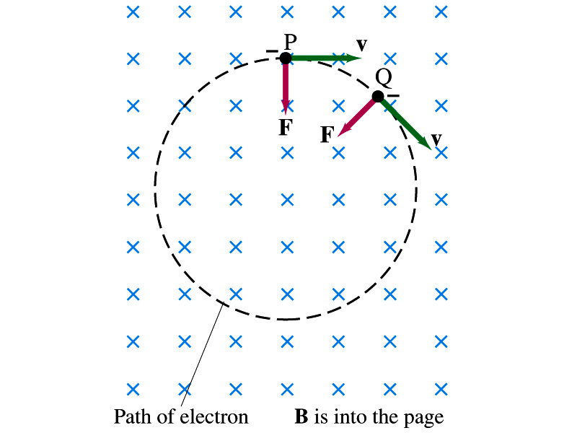
Charged Particle’s Path in Magnetic Field
What shape do you think is the path of a charged particle on a plane perpendicular to a uniform magnetic field?
Circle!! Why?
An electron moving to right at the point P in the figure will be pulled downward
At a later time, the force is still perpendicular to the velocity
Since the force is always perpendicular to the velocity, the magnitude of the velocity is constant
The direction of the force follows the right-hand-rule and is perpendicular to the direction of the magnetic field
Thus, the electron moves on a circular path with a centripetal force F.

Slide 18
Example 20 – 5
Electron’s path in a uniform magnetic field. An electron travels at a speed of 2.0x10⁷m/s in a plane perpendicular to a 0.010-T magnetic field. Describe its path.
What is formula for the centripetal force?
Since the magnetic field is perpendicular to the motion of the electron, the magnitude of the magnetic force is
Since the magnetic force provides the centripetal force, we can establish an equation with the two forces
Solving for r

Slide 19
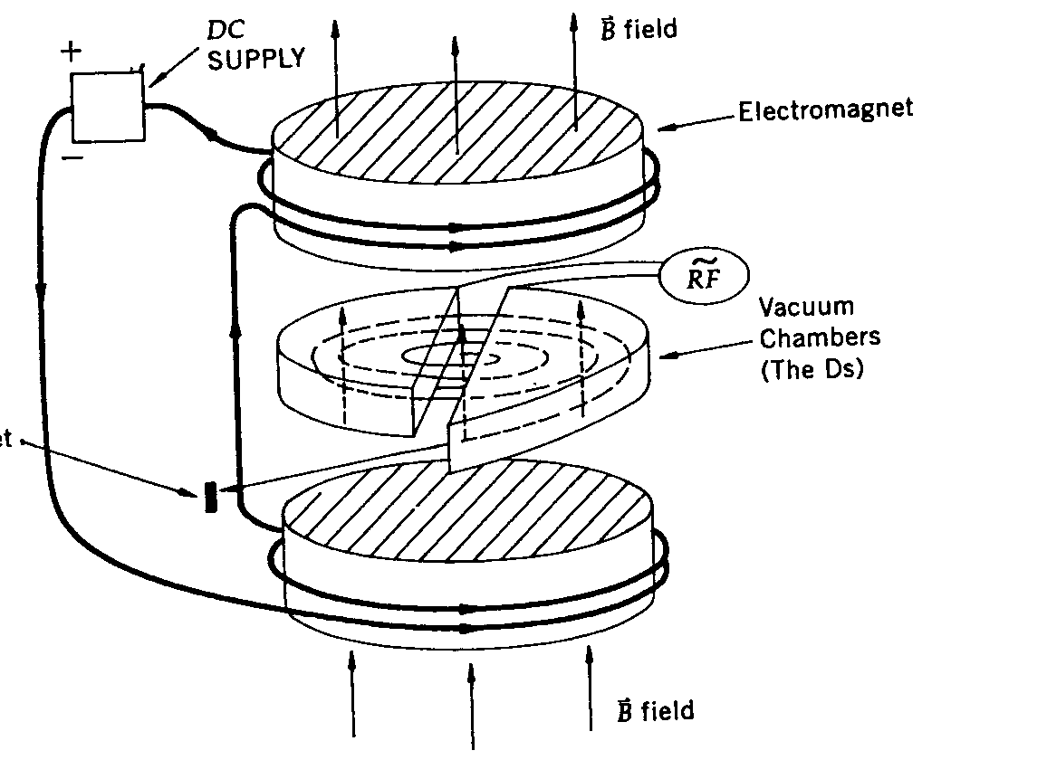
Cyclotron Frequency
The time required for a particle of charge q moving w/ constant speed v to make one circular revolution in a uniform magnetic field, , is
Since T is the period of rotation, the frequency of the rotation is
This is the cyclotron frequency, the frequency of a particle with charge q in a cyclotron accelerator
While r depends on v, the frequency is independent of v and r.

