Slide 1
PHYS 1442 – Section 001 Lecture #11
Tuesday, June 25, 2013
Dr. Jaehoon Yu
Chapter 20
Sources of Magnetic Field
Magnetic Field Due to Straight Wire
Forces Between Two Parallel Wires
Ampére’s Law and Its Verification
Solenoid and Toroidal Magnetic Field
Chapter 21
Induced EMF and Electromagnetic Induction
Faraday’s Law of Induction

Slide 2
Announcements
2nd term exam
In class this Thursday, June 27
Non-comprehensive exam
Covers CH20.1 – what we finish tomorrow, Wednesday (CH21.x?)
BYOF (Bring your own formula sheet)
This exam can replace your first term exam if better
If you miss the exam you will get an F no matter how well you have been doing in the class!
Homework #5 deadline moved to 11pm tonight!
Reading assignments
CH20.8 – 20.11

Slide 3
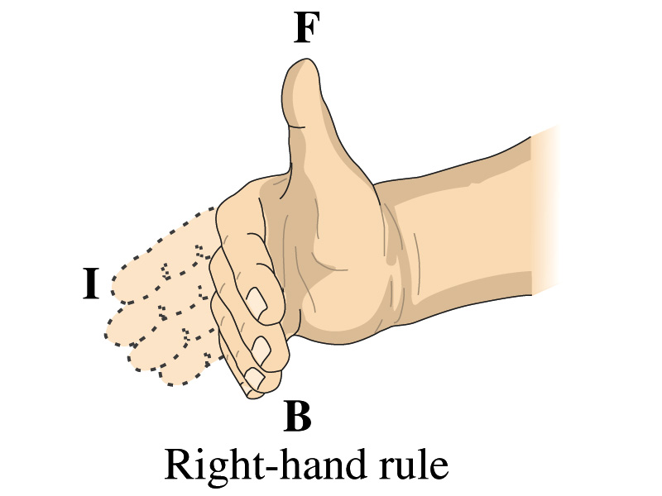
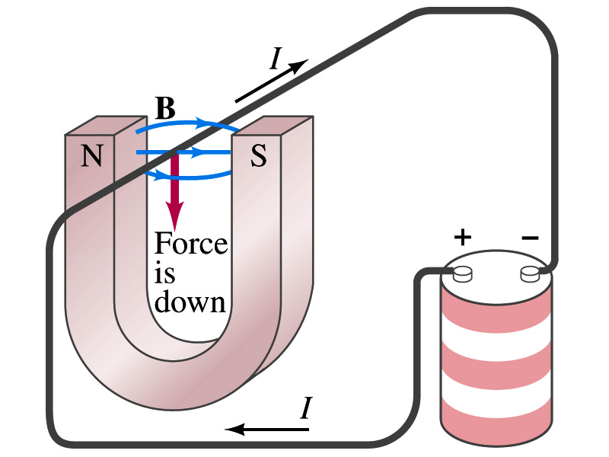
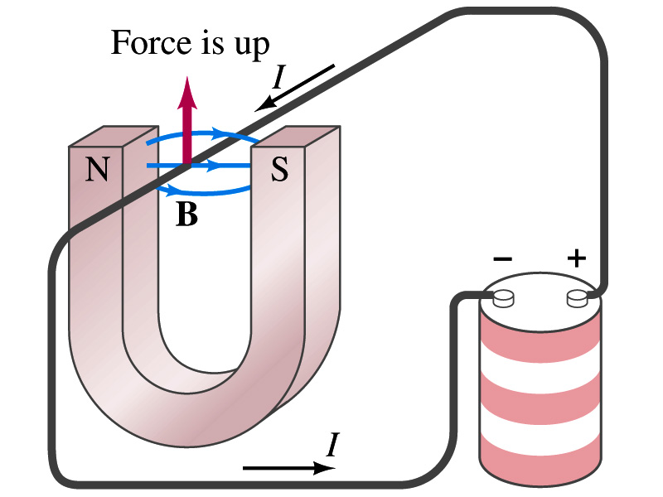
Refresher: Magnetic Forces on Electric Current
Since the electric current exerts force on a magnet, the magnet should also exert force on the electric current
Which law justifies this?
Newton’s 3rd law
This was also discovered by Oersted
Direction of the force is always
Perpendicular to the direction of the current
And also perpendicular to the direction of the magnetic field, B
Experimentally the direction of the force is given by another right-hand rule ➔ When the fingers of the right-hand points to the direction of the current and the finger tips bent to the direction of magnetic field B, the direction of thumb points to the direction of the force

Slide 4
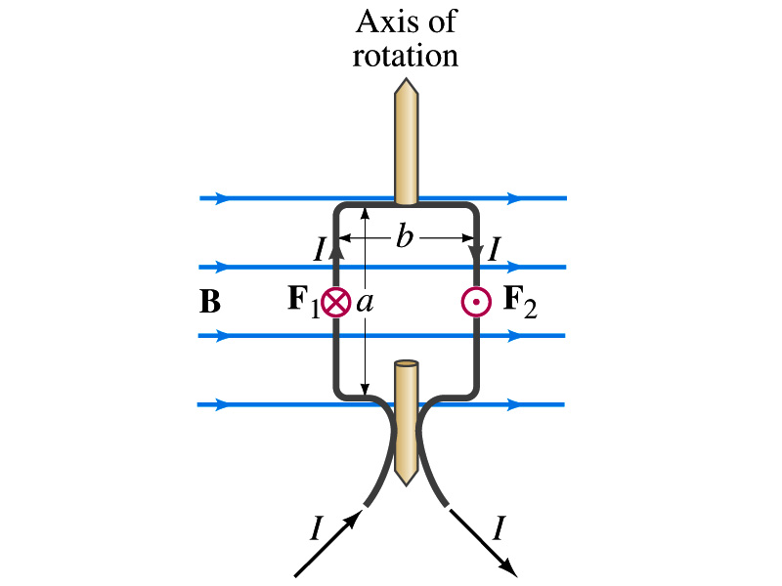
Torque on a Current Loop
What do you think will happen to a closed rectangular loop of wire with electric current as shown in the figure?
It will rotate! Why?
The magnetic field exerts a force on both vertical sections of wire.
Where is this principle used in?
Ammeters, motors, volt-meters, speedometers, etc
The two forces on the different sections of the wire exerts net torque to the same direction about the rotational axis along the symmetry axis of the wire.
What happens when the wire turns 90 degrees?
It will not turn unless the direction of the current changes

Slide 5
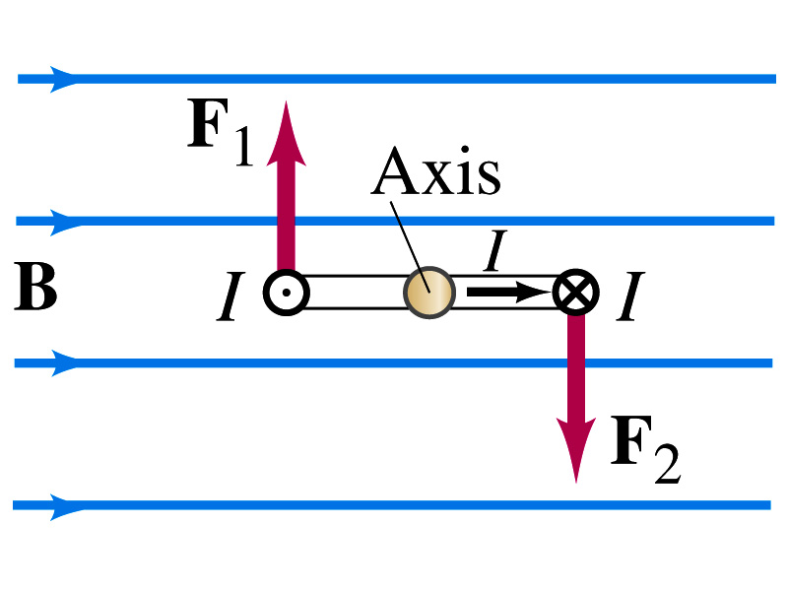
Torque on a Current Loop
So what would be the magnitude of this torque?
What is the magnitude of the force on the section of the wire with length a?
F_{a}=IaB
The moment arm of the coil is b/2
So the total torque is the sum of the torques by each of the forces
Where A=ab is the area of the coil
What is the total net torque if the coil consists of N loops of wire?
If the coil makes an angle θ w/ the field

Slide 6
Sources of Magnetic Field
We have learned so far about the effects of magnetic field on electric currents and moving charge
We will now learn about the dynamics of magnetism
How do we determine magnetic field strengths in certain situations?
How do two wires with electric current interact?
What is the general approach to finding the connection between current and magnetic field?

Slide 7
Magnetic Field due to a Straight Wire
The magnetic field (B) due to the current flowing through a straight wire forms a circular pattern around the wire
What do you imagine the strength of the field is as a function of the distance from the wire?
It must be weaker as the distance increases
How about as a function of the current?
Directly proportional to the current
Indeed, the above are experimentally verified
This is valid as long as r << the length of the wire
The proportionality constant is μ₀/2π, and thus the field strength becomes
μ₀ is the permeability of free space
Permeability: the degree in which magnetizable material modifies the magnetic flux in the region occupied by it in a magnetic field

Slide 8
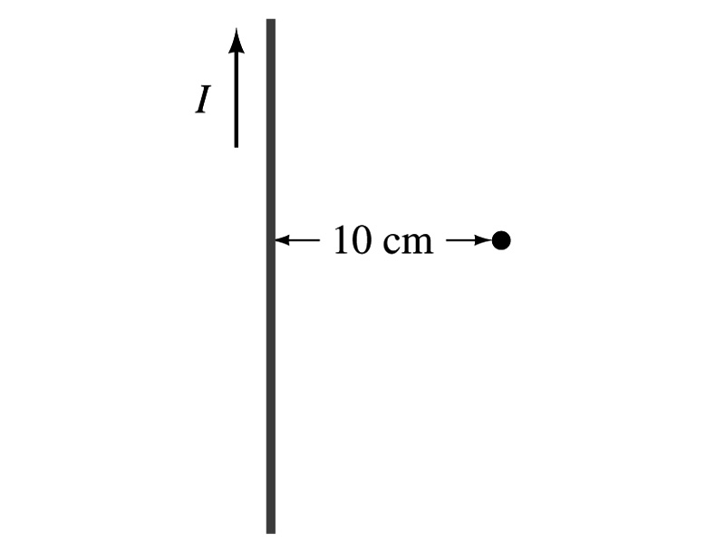
Example 20 – 7
Calculation of B near a wire. A vertical electric wire in the wall of a building carries a DC current of 25A upward. What is the magnetic field at a point 10cm due north of this wire?
Using the formula for the magnetic field near a straight wire
So we can obtain the magnetic field at 10cm away as

Slide 9
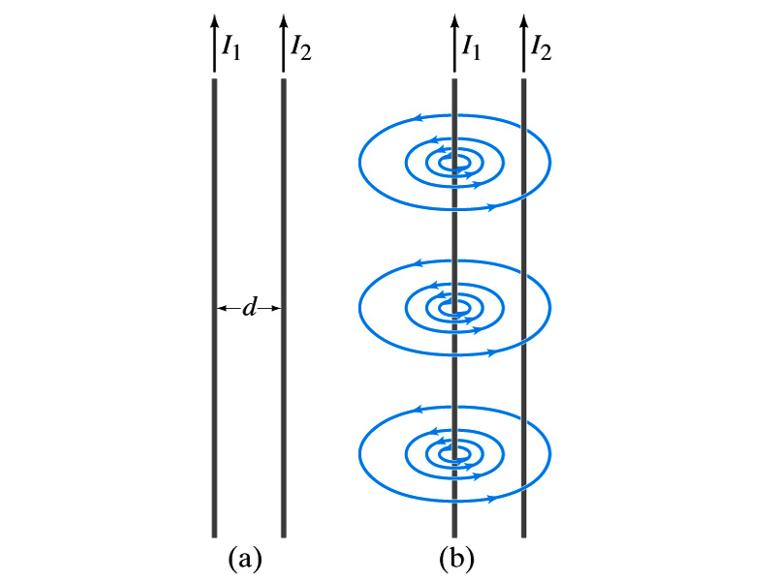
Force Between Two Parallel Wires
We have learned that a wire carrying the current produces magnetic field
Now what do you think will happen if we place two current carrying wires next to each other?
They will exert force onto each other. Repel or attract?
Depending on the direction of the currents
This was first pointed out by Ampére.
Let’s consider two long parallel conductors separated by a distance d, carrying currents I₁ and I₂.
At the location of the second conductor, the magnitude of the magnetic field produced by I₁ is

Slide 10
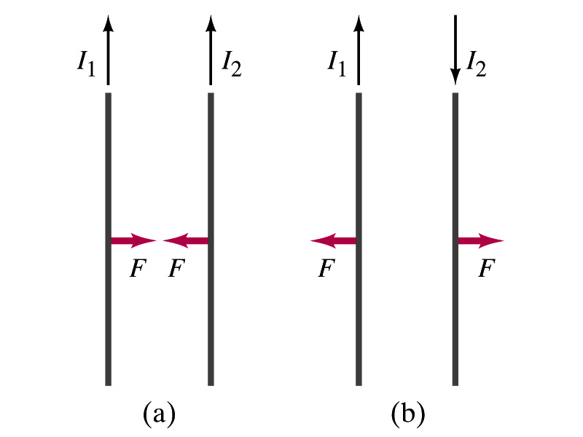
Force Between Two Parallel Wires
The force F by a magnetic field B₁ on a wire of length l, carrying the current I₂ when the field and the current are perpendicular to each other is:
So the force per unit length is
This force is only due to the magnetic field generated by the wire carrying the current I₁
There is the force exerted on the wire carrying the current I₁ by the wire carrying current I₂ of the same magnitude but in the opposite direction
So the force per unit length is
How about the direction of the force?
If the currents are in the same direction, the attractive force. If opposite, repulsive.

Slide 11
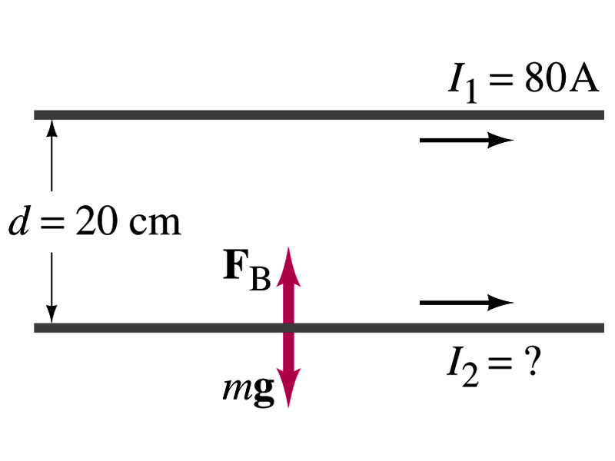
Example 20 – 11
Suspending a wire with current. A horizontal wire carries a current I₁=80A DC. A second parallel wire 20cm below it must carry how much current I₂ so that it doesn’t fall due to the gravity? The lower has a mass of 0.12g per meter of length.
Which direction is the gravitational force?
Down to the center of the Earth
This force must be balanced by the magnetic force exerted on the wire by the first wire.
Solving for I₂

Slide 12
Operational Definition of Ampere and Coulomb
The permeability of free space is defined to be exactly
The unit of current, ampere, is defined using the force between two wires each carrying 1A of current and separated by 1m
So 1A is defined as: the current flowing each of two long parallel conductors 1m apart, which results in a force of exactly 2x10⁻⁷N/m.
Coulomb is then defined as exactly 1C=1A.s.
We do it this way since current is measured more accurately and controlled more easily than charge.

Slide 13
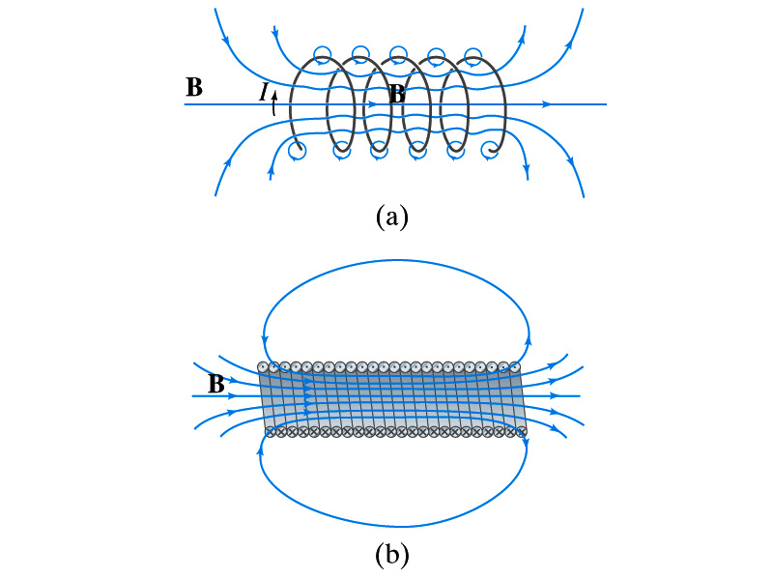
Solenoid and Its Magnetic Field
What is a solenoid?
A long coil of wire consisting of many loops
If the space between loops are wide
The field near the wires are nearly circular
Between any two wires, the fields due to each loop cancel
Toward the center of the solenoid, the fields add up to give a field that can be fairly large and uniform
For a long, densely packed loops
The field is nearly uniform and parallel to the solenoid axes within the entire cross section
The field outside the solenoid is very small compared to the field inside, except the ends
The same number of field lines spread out to an open space
Solenoid Axis

Slide 14
Solenoid Magnetic Field
If the current I flows in the wire of the solenoid, the total current enclosed is NI
Where N is the number of loops (or turns of the coil) enclosed
The magnetic field due to a solenoid of N turns is
If we let n=N/l be the number of loops per unit length, the magnitude of the magnetic field within the solenoid becomes
B depends on the number of loops per unit length, n, and the current I
Does not depend on the position within the solenoid but uniform inside it, like a bar magnet

Slide 15
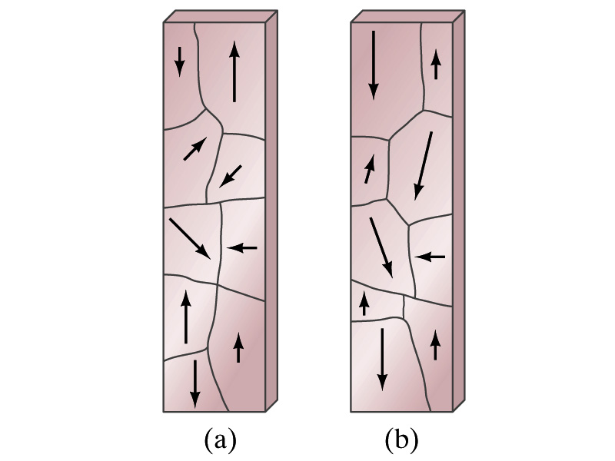
Magnetic Materials - Ferromagnetism
Iron is a material that can turn into a strong magnet
This kind of material is called ferromagnetic material
In a microscopic sense, ferromagnetic materials consists of many tiny regions called domains
Domains are like little magnets usually smaller than 1mm in length or width
What do you think the alignment of domains are like when they are not magnetized?
Randomly arranged
What if they are magnetized?
The size of the domains aligned with the external magnetic field direction grows while those of the domains not aligned reduce
This gives magnetization to the material
How do we demagnetize a bar magnet?
Hit the magnet hard or heat it over the Curie temperature

Slide 16
B in Magnetic Materials
What is the magnetic field inside a solenoid?
Magnetic field in a long solenoid is directly proportional to the current.
This is valid only if air is inside the coil
What do you think will happen to B if we have something other than the air inside the solenoid?
It will be increased dramatically, when the current flows
Especially if a ferromagnetic material such as an iron is put inside, the field could increase by several orders of magnitude
Why?
Since the domains in the iron aligns permanently by the external field.
The resulting magnetic field is the sum of that due to current and due to the iron

Slide 17
B in Magnetic Materials
It is sometimes convenient to write the total field as the sum of two terms
B₀ is the field due only to the current in the wire, namely the external field
The field that would be present without a ferromagnetic material
B_{M} is the additional field due to the ferromagnetic material itself; often B_{M}>>B₀
The total field in this case can be written by replacing μ₀ with another proportionality constant μ, the magnetic permeability of the material
μ is a property of a magnetic material
μ is not a constant but varies with the external field

Slide 18
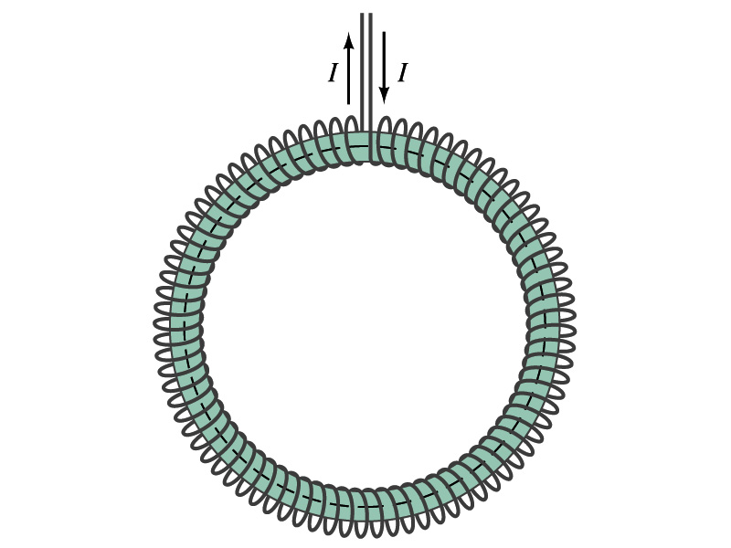
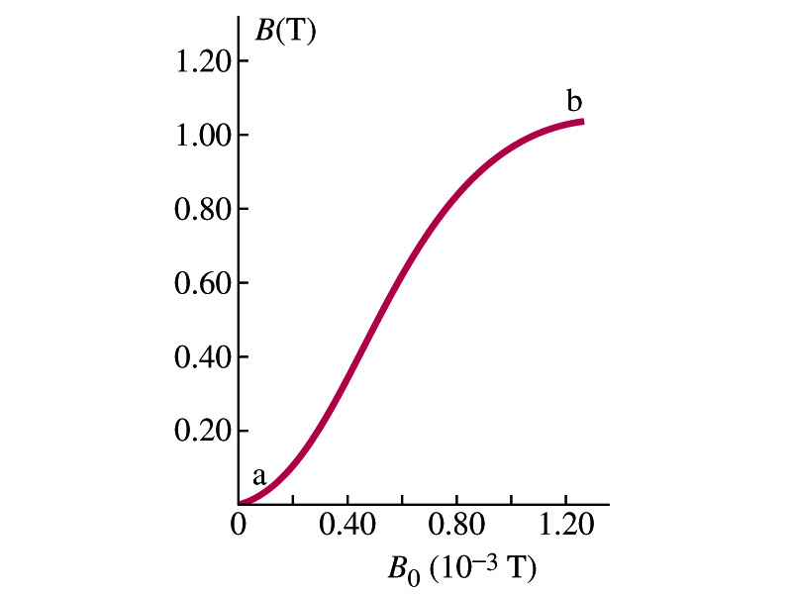
Hysteresis
Iron Core Toroid
What is a toroid?
A solenoid bent into a shape
Toroid is used for magnetic field measurement
Why?
Since it does not leak magnetic field outside of itself, it fully contains all the magnetic field created within it.
Consider an un-magnetized iron core toroid, without any current flowing in the wire
What do you think will happen if the current slowly increases?
B₀ increases linearly with the current.
And B increases also but follows the curved line shown in the graph
As B₀ increases, the domains become more aligned until nearly all are aligned (point b on the graph)
The iron is said to be approaching saturation
Point b is typically at 70% of the max

Slide 19
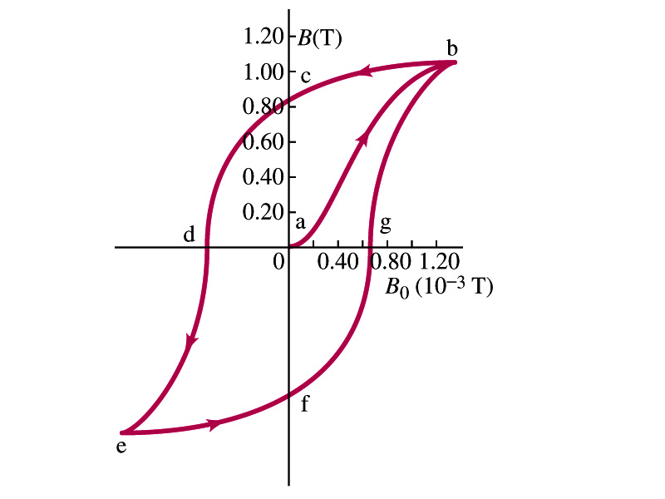
Hysteresis
What do you think will happen to B if the external field B₀ is reduced to 0 by decreasing the current in the coil?
Of course it goes to 0!!
Wrong! Wrong! Wrong! They do not go to 0. Why not?
The domains do not completely return to random alignment state
Now if the current direction is reversed, the external magnetic field direction is reversed, causing the total field B pass 0, and the direction reverses to the opposite side
If the current is reversed again, the total field B will increase but never goes through the origin
This kind of curve whose path does not retrace themselves and does not go through the origin is called the Hysteresis.

Slide 20
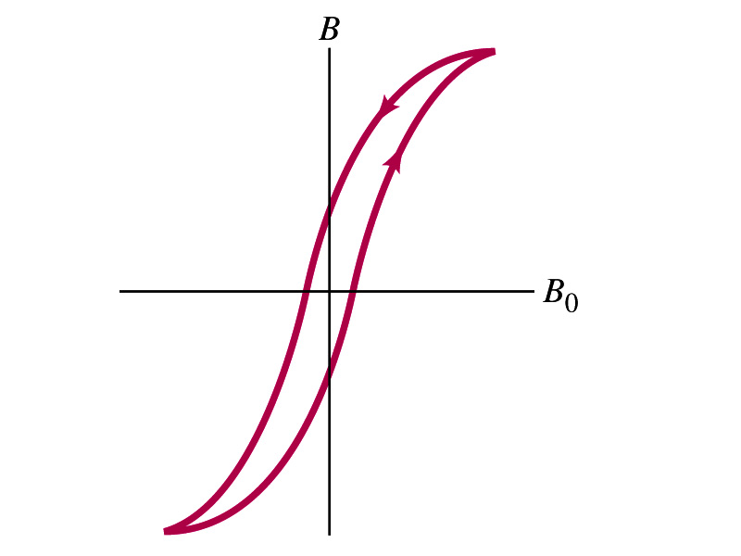
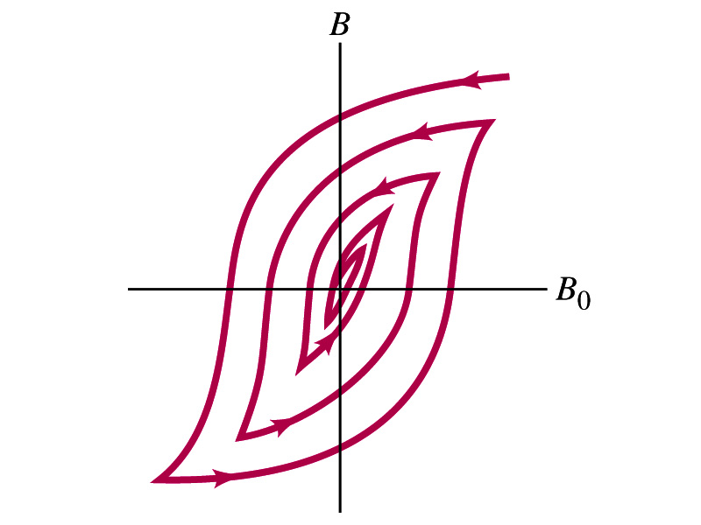
Magnetically Soft Material
In a hysteresis cycle, much energy is transformed to thermal energy. Why?
Due to the microscopic friction between domains as they change directions to align with the external field
The energy dissipated in the hysteresis cycle is proportional to the area of the hysteresis loop
Ferromagnetic material with large hysteresis area is called magnetically hard while the small ones are called soft
Which ones do you think are preferred in electromagnets or transformers?
Soft. Why?
Since the energy loss is small and much easier to switch off the field
Then how do we demagnetize a ferromagnetic material?
Keep repeating the Hysteresis loop, reducing the range of B₀.

Slide 21
Summary on Solenoid and Toroid
The magnitude of the solenoid magnetic field without any material inside of the loop
n is the number of loops per unit length
I is the current flowing through the loop
If the loop has some material inside of it:
The magnitude of the Toroid magnetic field with radius r:

Slide 22
Induced EMF
It has been discovered by Oersted and company in early 19th century that
Magnetic field can be produced by the electric current
Magnetic field can exert force on electric charge
So if you were scientists at that time, what would you wonder?
Yes, you are absolutely right. You would wonder if the magnetic field can create the electric current.
An American scientist Joseph Henry and an English scientist Michael Faraday independently found that it was possible
Though, Faraday was given the credit since he published his work before Henry did
He also did a lot of detailed studies on magnetic induction

Slide 23
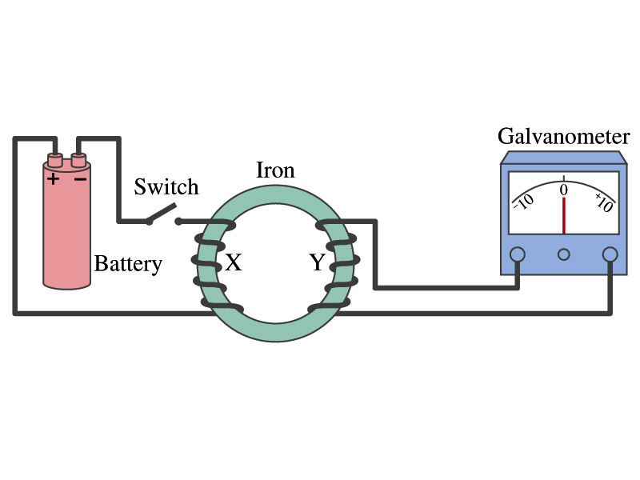
Electromagnetic Induction
Faraday used an apparatus below to show that magnetic field can induce current
Despite his hope he did not see steady current induced on the other side when the switch is thrown
But he did see that the needle on the Galvanometer turns strongly when the switch is initially thrown and is opened
When the magnetic field through coil Y changes, a current flows as if there were a source of emf
Thus he concluded that an induced emf is produced by a changing magnetic field ➔ Electromagnetic Induction

Slide 24
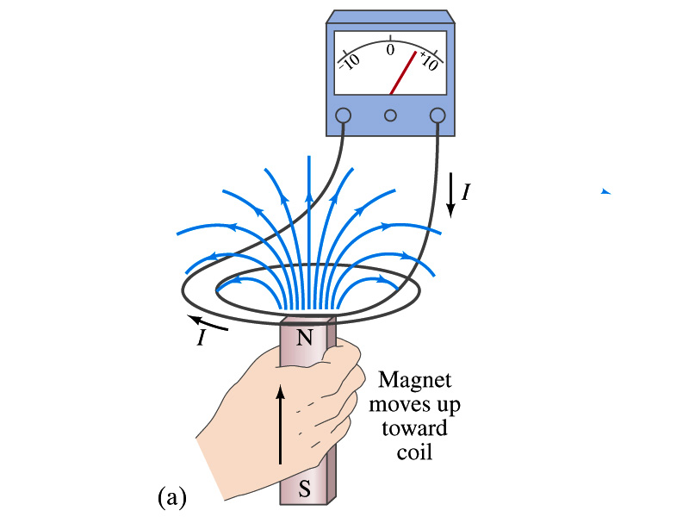
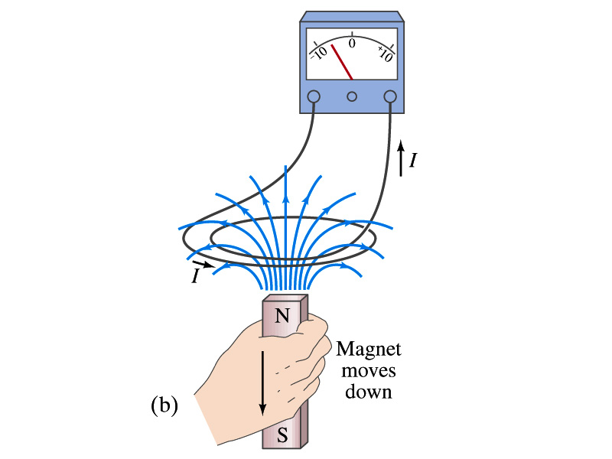
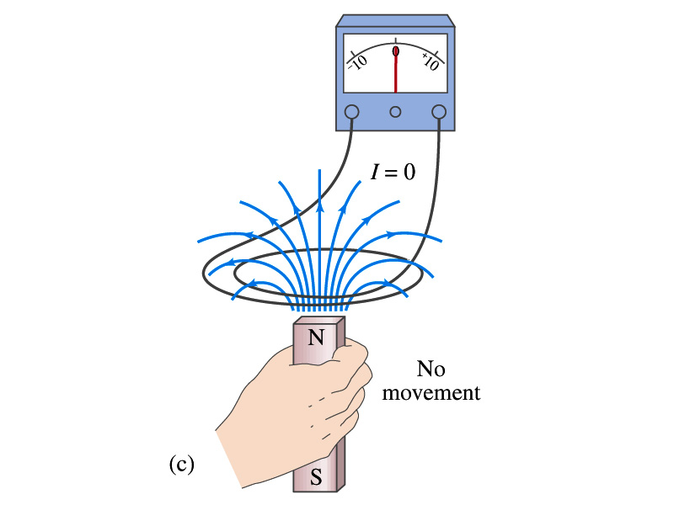
Electromagnetic Induction
Further studies on electromagnetic induction taught
If magnet is moved quickly into a coil of wire, a current is induced in the wire.
If the magnet is removed from the coil, a current is induced in the wire in the opposite direction
By the same token, current can also be induced if the magnet stays put but the coil moves toward or away from the magnet
Current is also induced if the coil rotates.
In other words, it does not matter whether the magnet or the coil moves. It is the relative motion that counts.

Slide 25
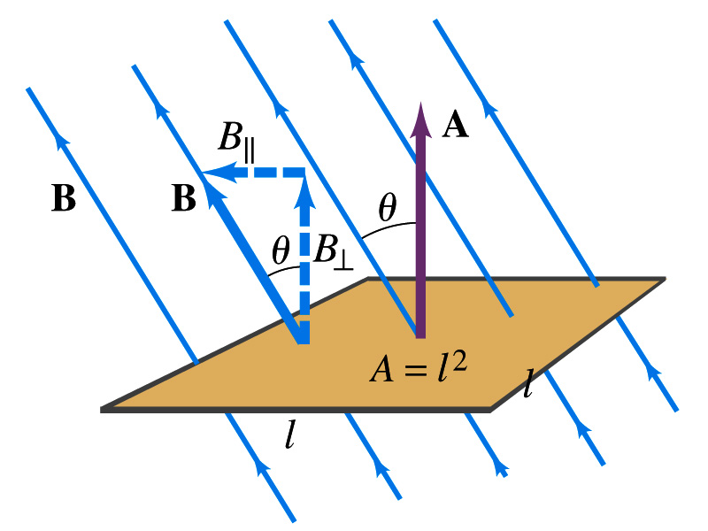
Magnetic Flux
So what do you think is the induced emf proportional to?
The rate of changes of the magnetic field?
the higher the changes the higher the induction
Not really, it rather depends on the rate of change of the magnetic flux, Φ_{B}.
Magnetic flux is defined as (just like the electric flux)
θ is the angle between B and the area vector A whose direction is perpendicular to the face of the loop based on the right-hand rule
What kind of quantity is the magnetic flux?
Scalar. Unit?
or weber
If the area of the loop is not simple or B is not uniform, the magnetic flux can be written as

Slide 26
Faraday’s Law of Induction
In terms of magnetic flux, we can formulate Faraday’s findings
The emf induced in a circuit is equal to the rate of change of magnetic flux through the circuit
If the circuit contains N closely wrapped loops, the total induced emf is the sum of emf induced in each loop
Why negative?
Has got a lot to do with the direction of induced emf…
Faraday’s Law of Induction

