Slide 1
PHYS 1442 – Section 001 Lecture #12
Wednesday, June 26, 2013
Dr. Jaehoon Yu
Chapter 21
Lenz’s Law
EMF Induction in Moving Conductor
Generation of Electricity
Transformer
Mutual and Self Inductance
Energy Stored in Magnetic Field
Alternating Current and AC Circuits

Slide 2
Announcements
2nd term exam
In class tomorrow, June 27
Non-comprehensive exam
Covers CH20.1 – what we finish today (CH 21 – 8)
BYOF (Bring your own formula sheet)
This exam can replace your first term exam if better
If you miss the exam you will get an F no matter how well you have been doing in the class!
Your planetarium extra credit
Please bring your planetarium extra credit sheet by the beginning of the exam Monday, July 8
Be sure to tape one edge of the ticket stub with the title of the show on top and your name on the sheet

Slide 3
Special Projects
Derive the unit of speed from the product of the permitivity and permeability, starting from their original units. (5 points)
Derive and compute the speed of light in free space from the four Maxwell’s equations. (20 points for derivation and 3 points for computation.)
Compute the speed of the EM waves in copper, water and one other material which is different from other students. ( 3 points each)
Due of these projects are the start of the class Wednesday, July 3!

Slide 4
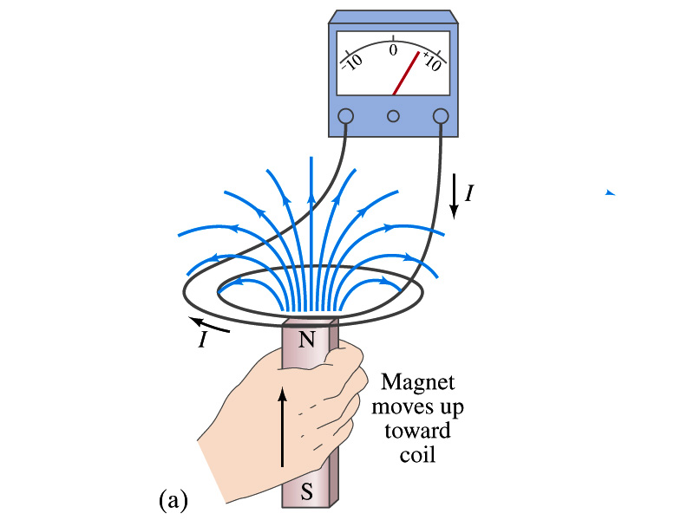
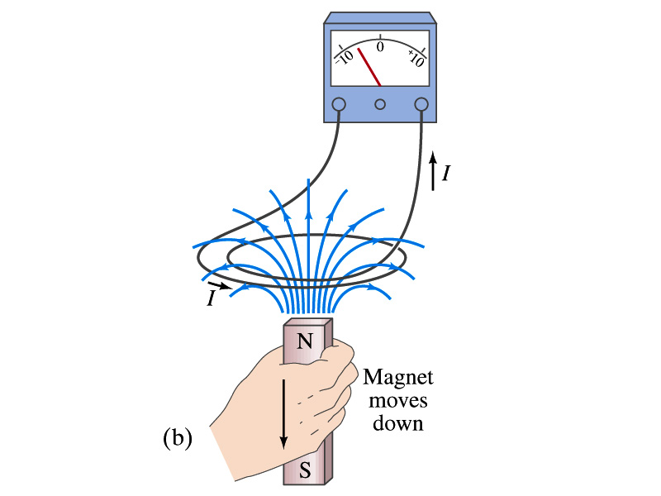
Lenz’s Law
It is experimentally found that
An induced emf gives rise to a current whose magnetic field opposes the original change in flux ➔ This is known as Lenz’s Law
In other words, an induced emf is always in the direction that opposes the original change in flux that caused it.
We can use Lenz’s law to explain the following cases in the figures
When the magnet is moving into the coil
Since the external flux increases, the field inside the coil takes the opposite direction to minimize the change and causes the current to flow clockwise
When the magnet is moving out
Since the external flux decreases, the field inside the coil takes the opposite direction to compensate the loss, causing the current to flow counter-clockwise
Which law is Lenz’s law result of?
Energy conservation. Why?

Slide 5
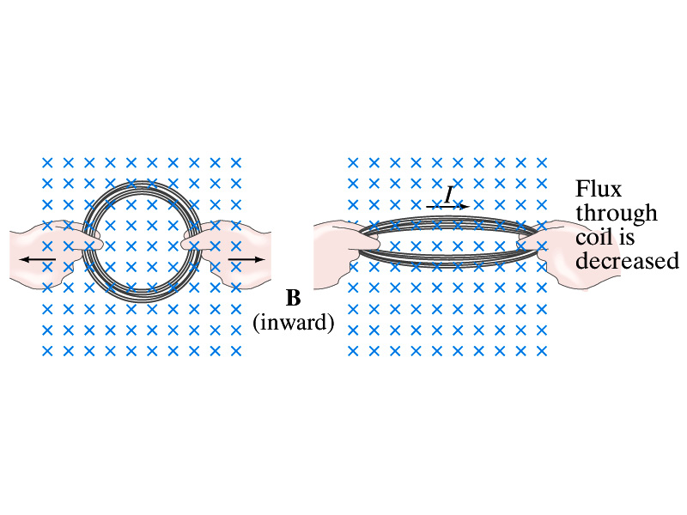
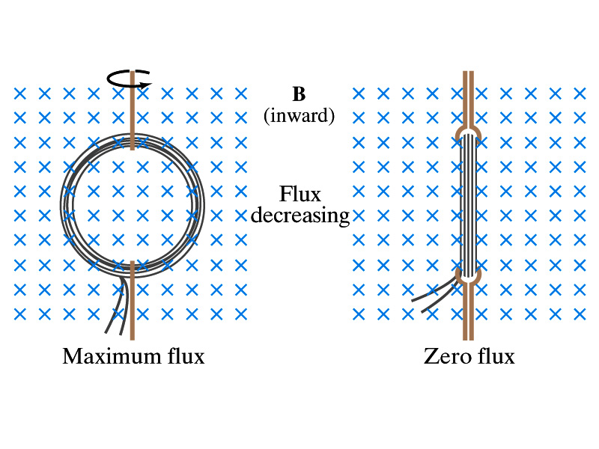
Induction of EMF
How can we induce emf?
Let’s look at the formula for magnetic flux
What do you see? What are the things that can change with time to result in change of magnetic flux?
Magnetic field
The area of the loop
The angle θ between the field and the area vector

Slide 6
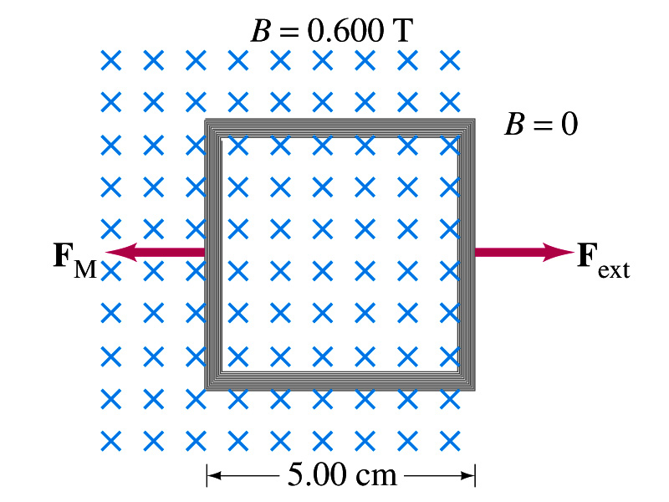
Example 21 – 5
Pulling a coil from a magnetic field. A square coil of wire with side 5.00cm contains 100 loops and is positioned perpendicular to a uniform 0.600-T magnetic field. It is quickly and uniformly pulled from the field (moving perpendicular to B) to the region where B drops abruptly to zero. At t=0, the right edge of the coil is at the edge of the field. It takes 0.100s for the whole coil to reach the field-free
region. Find (a) the rate of change in flux through the coil, (b) the emf and current induced, and (c) how much energy is dissipated in the coil if its resistance is 100Ω. (d) what was the average force required?
What is the procedure to solve this problem?
1. Compute the magnetic flux change.
2. Compute the emf generated by the change of flux using
3. Compute the current using Ohm’s law
Faraday’s law
4. Compute the energy loss using
5. Compute the magnetic force using

Slide 7
Example 21 – 5
Pulling a coil from a magnetic field. A square coil of wire with side 5.00cm contains 100 loops and is positioned perpendicular to a uniform 0.600-T magnetic field. It is quickly and uniformly pulled from the field (moving perpendicular to B) to the region where B drops abruptly to zero. At t=0, the right edge of the coil is at the edge of the field. It takes 0.100s for the whole coil to reach the field-free
region. Find (a) the rate of change in flux through the coil, (b) the emf and current induced, and (c) how much energy is dissipated in the coil if its resistance is 100Ω. (d) what was the average force required?
What should be computed first?
The initial flux at t=0.
The flux at t=0 is
The change of flux is
Thus the rate of change of the flux is

Slide 8
Example 21 – 5, cnt’d
Thus the total emf induced in this period is
The induced current in this period is
Which direction would the induced current flow?
Clockwise! Why?
The total energy dissipated is
To counter against the flux reduction!!
Force for each coil is
Force for N coil is
This is due to the fact that forces on two of the sides cancel, while one side stays out side the area covered by the B field, leaving only one side to apply the force.

Slide 9
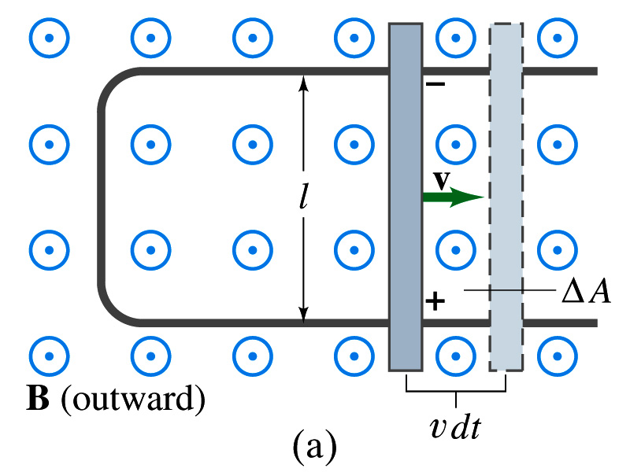
EMF Induced on a Moving Conductor
Another way of inducing emf is using a U shaped conductor with a movable rod resting on it.
As the rod moves at a speed v, it travels vΔt in time Δt, changing the area of the loop by ΔA=lvΔt.
Using Faraday’s law, the induced emf for this loop is
This equation is valid as long as B, l and v are perpendicular to each other. What do we do if they are not?
Use the scalar product of vector quantities
An emf induced on a conductor moving in a magnetic field is called a motional emf

Slide 10
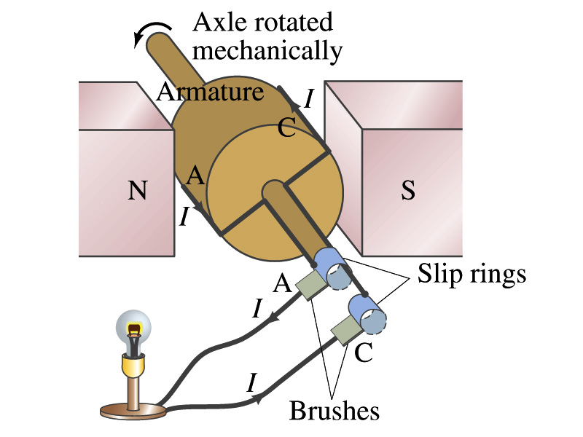
Electric Generators
What does a generator do?
Transforms mechanical energy into the electrical energy
What does this look like?
An inverse of an electric motor which transforms electrical energy to mechanical energy
An electric generator is also called a dynamo
Whose law does the generator based on?
Faraday’s law of induction

Slide 11
How does an Electric Generator work?
An electric generator consists of
Many coils of wires wound on an armature that can rotate by mechanical means in a magnetic field
An emf is induced in the rotating coil
Electric current is the output of a generator
Which direction does the output current flow when the armature rotates counterclockwise?
The conventional current flows outward on wire A toward the brush
After half the revolution the wire A will be where the wire C is and the current flow on A is reversed
Thus the current produced is alternating its direction

Slide 12
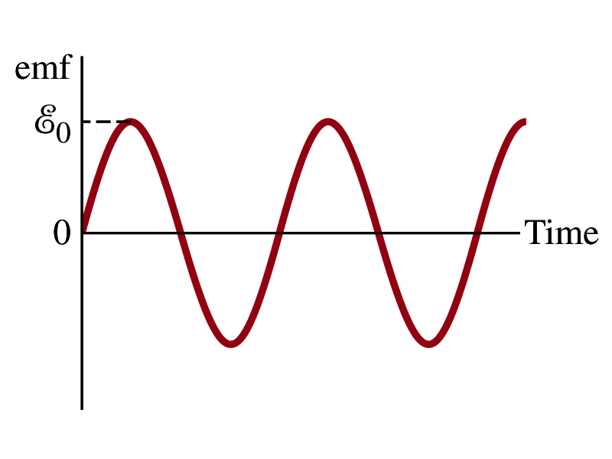
How does an Electric Generator work?
Let’s assume the loop is rotating in a uniform B field w/ constant angular velocity ω. The induced emf is
What is the variable that changes above?
The angle θ. What is Δθ/Δt?
The angular speed ω.
So θ=θ₀+ωt
If we choose θ₀=0, we obtain
If the coil contains N loops:
What is the shape of the output?
Sinusoidal w/ amplitude E₀=NBAω
US AC frequency is 60Hz. Europe is at 50Hz
Most the U.S. power is generated at steam plants

Slide 13
Example
An AC generator. The armature of a 60-Hz AC generator rotates in a 0.15-T magnetic field. If the area of the coil is 2.0x10⁻²m², how many loops must the coil contain if the peak output is to be E₀=170V?
The maximum emf of a generator is
Solving for N
Since
We obtain

Slide 14
US Electricity Sources

Slide 15
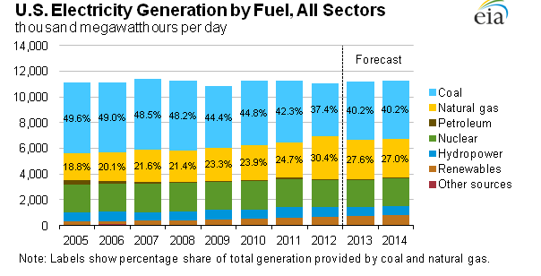
US Electricity Consumption by Source
US Energy Information Administration http://www.eia.gov/electricity/

Slide 16
The World Energy Consumption
In 2008, total worldwide energy consumption was 474 EJ (474×10¹⁸ J=132 PWh).
Equivalent to an average energy consumption rate of 15 terawatts (1.504×10¹³ W)
US uses 26.6 PWh (as of 2008)
The potential for renewable energy
solar energy 1600 EJ (444,000 TWh)
wind power 600 EJ (167,000 TWh)
geothermal energy 500 EJ (139,000 TWh),
biomass 250 EJ (70,000 TWh)
hydropower 50 EJ (14,000 TWh) an
ocean energy 1 EJ (280 TWh)

Slide 17
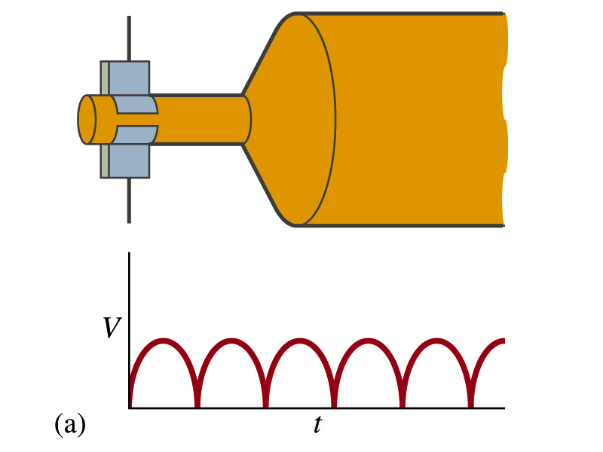
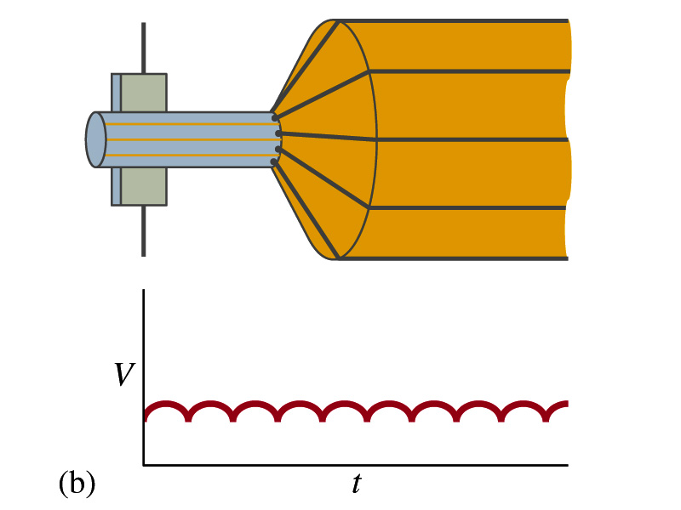
A DC Generator
A DC generator is almost the same as an AC generator except the slip rings are replaced by split-ring commutators
Output can be smoothed out by placing a capacitor on the output
More commonly done using many armature windings
Smooth output using many windings

Slide 18
Eddy Currents (read more in CH. 21 – 6)
Induced currents are not always confined to well-defined path
In some cases where a conductor is moving in and out of the magnetic field, the Lenz’s law causes flow of electrons that opposes the change in magnetic flux
This change is in the direction that impedes the production of emf
And thus causes energy losses
These currents are called eddy currents
Just like the eddy currents in the water that pulls the boat in the opposite direction of the movement

Slide 19
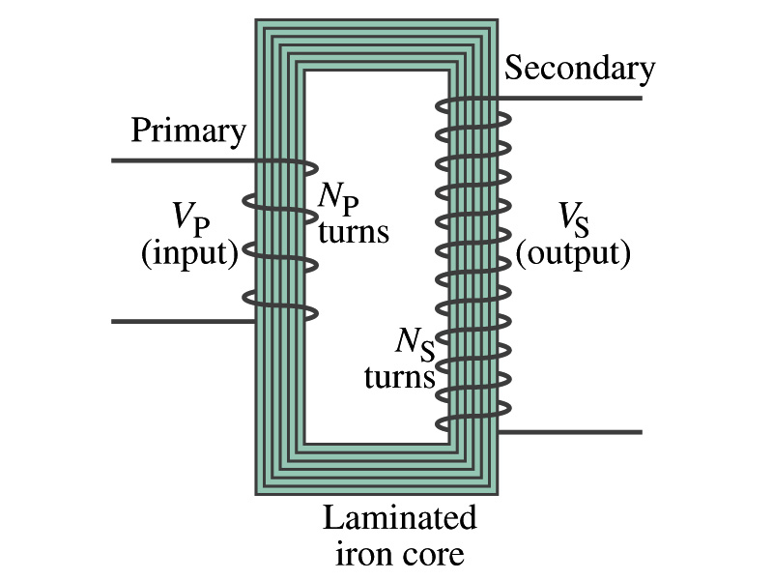
Transformer
What is a transformer?
A device for increasing or decreasing an AC voltage
A few examples?
TV sets to provide High Voltage to picture tubes, portable electronic device converters, transformers on the pole, etc
A transformer consists of two coils of wires known as the primary and the secondary
The two coils can be interwoven or linked by a laminated soft iron core to reduce losses due to Eddy current
Transformers are designed so that all magnetic flux produced by the primary coil pass through the secondary

Slide 20
How does a transformer work?
When an AC voltage is applied to the primary, the changing B it produces will induce voltage of the same frequency in the secondary wire
So how would we make the voltage different?
By varying the number of loops in each coil
From Faraday’s law, the induced emf in the secondary is
The input primary voltage is
Since ΔΦ_{B}/Δt is the same, we obtain
Transformer Equation

Slide 21
Transformer Equation
The transformer equation does not work for DC current
Since there is no change of magnetic flux!!
If N_{S}>N_{P}, the output voltage is greater than the input so it is called a step-up transformer while N_{S}<N_{P} is called step-down transformer
Now, it looks like energy conservation is violated since we can get more emf from smaller ones, right?
Wrong! Wrong! Wrong! Energy is always conserved!
A well designed transformer can be more than 99% efficient
The power output is the same as the input:
The output current for step-up transformer will be lower than the input, while it is larger for step-down x-former than the input.

Slide 22
Ex. 21 – 11 Portable Radio Transformer
Portable radio transformer. A transformer for home use of a portable radio reduces 120-V AC to 9.0V AC. The secondary contains 30 turns, and the radio draws 400mA. Calculate (a) the number of turns in the primary (b) the current in the primary and (c) the power transformed.
(a) What kind of a transformer is this?
A step-down x-former
Since
We obtain
We obtain
(b) Also from the transformer equation
(c) Thus the power transformed is
How about the input power?
The same assuming 100% efficiency.

Slide 23
Example 21 – 12: Power Transmission
Transmission lines. An average of 120kW of electric power is sent to a small town from a power plant 10km away. The transmission lines have a total resistance of 0.4Ω. Calculate the power loss if the power is transmitted at (a) 240V and (b) 24,000V.
We cannot use P=V²/R since we do not know the voltage along the transmission line. We, however, can use P=I²R.
(a) If 120kW is sent at 240V, the total current is
Thus the power loss due to transmission line is
(b) If 120kW is sent at 24,000V, the total current is
Thus the power loss due to transmission line is
The higher the transmission voltage, the smaller the current, causing less loss of energy. This is why power is transmitted w/ HV, as high as 170kV.

