Slide 1
PHYS 1442 – Section 001 Lecture #13
Monday, July 1, 2013
Dr. Jaehoon Yu
Chapter 21
Mutual and Self Inductance
Energy Stored in Magnetic Field
Alternating Current and AC Circuits
Chapter 22
Gauss’ Law of Magnetism
Today’s homework is #7, due 11pm, Saturday, July 6!!

Slide 2
Announcements
Quiz Wednesday, July 3
At the beginning of the class
Will cover what we’ve learned today and tomorrow
Final exam
Comprehensive exam
Covers CH16.1 – what we finish this Wednesday plus Appendices A1 – A8
Monday, July 8
Please do not miss this exam!
You will get an F if you miss it!
BYOF with the same rules as before
Your planetarium extra credit
Please bring your planetarium extra credit sheet by the beginning of the exam Monday, July 8
Be sure to tape one edge of the ticket stub with the title of the show on top and your name on the sheet

Slide 3
Reminder: Special Project #4
Derive the unit of speed from the product of the permitivity and permeability, starting from their original units. (5 points)
Derive and compute the speed of light in free space from the four Maxwell’s equations. (20 points for derivation and 3 points for computation.)
Compute the speed of the EM waves in copper, water and one other material which is different from other students. ( 3 points each)
Due of these projects are the start of the class this Wednesday, July 3!

Slide 4
Inductance
Changing magnetic flux through a circuit induce an emf in that circuit
An electric current produces a magnetic field
From these, we can deduce
A changing current in one circuit must induce an emf in a nearby circuit ➔ Mutual inductance
Or induce an emf in itself ➔ Self inductance

Slide 5
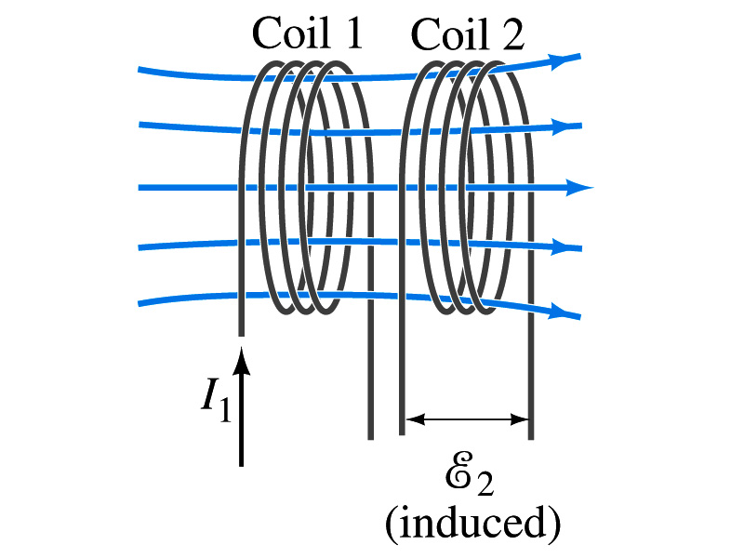
Mutual Inductance
If two coils of wire are placed near each other, a changing current in one will induce an emf in the other.
What is the induced emf, ε₂, in coil2 proportional to?
Rate of the change of the magnetic flux passing through it
This flux is due to current I₁ in coil 1
If Φ₂₁ is the magnetic flux in each loop of coil2 created by coil1 and N₂ is the number of closely packed loops in coil2, then N₂Φ₂₁ is the total flux passing through coil2.
If the two coils are fixed in space, N₂Φ₂₁ is proportional to the current I₁ in coil 1, .
The proportionality constant for this is called the Mutual Inductance and defined as .
The emf induced in coil2 due to the changing current in coil1 is

Slide 6
Mutual Inductance
The mutual induction of coil2 with respect to coil1, M₂₁,
is a constant and does not depend on I₁.
depends only on “geometric” factors such as the size, shape, number of turns and relative position of the two coils, and whether a ferromagnetic material is present
The farther apart the two coils are the less flux can pass through coil #2, so M₂₁ will be less.
In most cases the mutual inductance is determined experimentally
Conversely, the changing current in coil2 will induce an emf in coil1
M₁₂ is the mutual inductance of coil1 with respect to coil2 and M₁₂ = M₂₁
We can put M=M₁₂=M₂₁ and obtain
SI unit for mutual inductance is Henry (H)
What? Does this make sense?

Slide 7
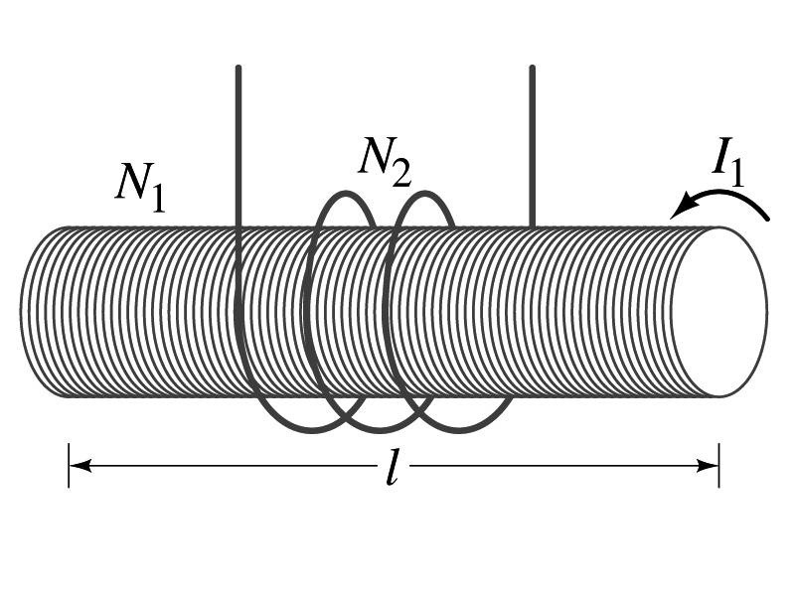
Example 21 – 14
Solenoid and coil. A long thin solenoid of length l and cross-sectional area A contains N₁ closely packed turns of wire. Wrapped around it is an insulated coil of N₂ turns. Assuming all the flux from coil 1 (the solenoid) passes through coil 2, calculate the mutual inductance.
First we need to determine the flux produced by the solenoid.
What is the magnetic field inside the solenoid?
Since the solenoid is closely packed, we can assume that the field lines are perpendicular to the surface area of the coils. Thus the flux through coil 2 is
Thus the mutual inductance of coil 2 is
Note that M₂₁ only depends on geometric factors!

Slide 8
Self Inductance
The concept of inductance applies to a single isolated coil of N turns. How does this happen?
When a changing current passes through a coil
A changing magnetic flux is produced inside the coil
The changing magnetic flux in turn induces an emf in the same coil
This emf opposes the change in flux. Whose law is this?
Lenz’s law
What happens
When the current through the coil is increasing?
The increasing magnetic flux induces an emf that opposes the original current
This tends to impedes its increase, trying to maintain the original current
When the current through the coil is decreasing?
The decreasing flux induces an emf in the same direction as the current
This tends to increase the flux, trying to maintain the original current

Slide 9
Self Inductance
Since the magnetic flux Φ_{B} passing through N turn coil is proportional to current I in the coil,
We define self-inductance, L:
The induced emf in a coil of self-inductance L is
What is the unit for self-inductance?
What does magnitude of L depend on?
Geometry and the presence of a ferromagnetic material
Self inductance can be defined for any circuit or part of a circuit
Self Inductance

Slide 10
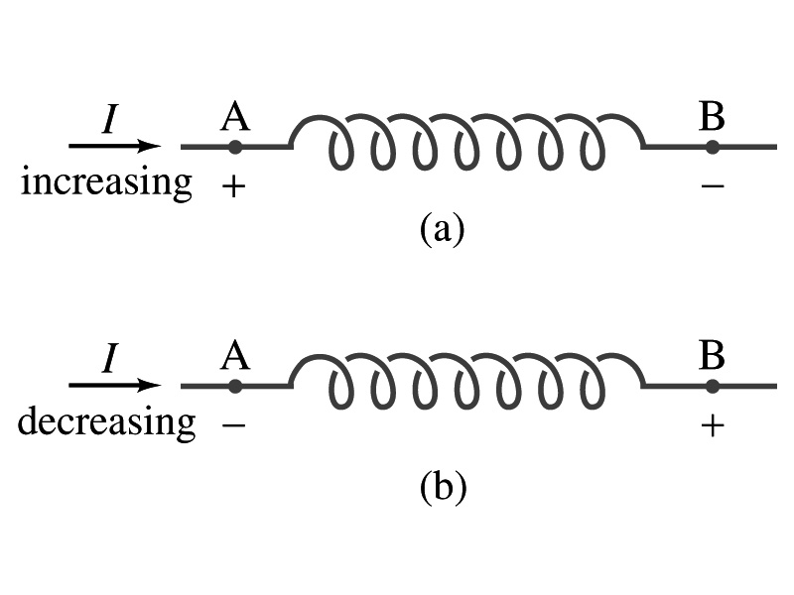
Inductor
An electrical circuit always contains some inductance but is normally negligibly small
If a circuit contains a coil of many turns, it could have large inductance
A coil that has significant inductance, L, is called an inductor and is express with the symbol
Precision resisters are normally wire wound
Would have both resistance and inductance
The inductance can be minimized by winding the wire back on itself in opposite direction to cancel magnetic flux
This is called a “non-inductive winding”
If an inductor has negligible resistance, inductance controls the changing current
For an AC current, the greater the inductance the less the AC current
An inductor thus acts like a resistor to impede the flow of alternating current (not to DC, though. Why?)
The quality of an inductor is indicated by the term reactance or impedance

Slide 11
Example 21 – 14
Solenoid inductance. (a) Determine the formula for the self inductance L of a tightly wrapped solenoid ( a long coil) containing N turns of wire in its length l and whose cross-sectional area is A. (b) Calculate the value of L if N=100, l=5.0cm, A=0.30cm² and the solenoid is air filled. (c) calculate L if the solenoid has an iron core with μ=4000μ₀.
What is the magnetic field inside a solenoid?
The flux is, therefore,
Using the formula for self inductance:
(b) Using the formula above
(c) The magnetic field with an iron core solenoid is

Slide 12
So what in the world is the Inductance?
It is an impediment onto the electrical current due to the existence of changing flux
So what?
In other words, it behaves like a resistance to the varying current, such as AC, that causes a constant change of flux
But it also provides means to store energy, just like the capacitance

Slide 13
Energy Stored in a Magnetic Field
When an inductor of inductance L is carrying current I which is changing at a rate ΔI/Δt, energy is supplied to the inductor at a rate
What is the work needed to increase the current in an inductor from 0 to I?
The work, ΔW, done in time Δt is
Thus the total work needed to bring the current from 0 to I in an inductor is

Slide 14
Energy Stored in the Magnetic Field
The work done to the system is the same as the energy stored in the inductor when it is carrying current I
This is compared to the energy stored in a capacitor, C, when the potential difference across it is V,
Just like the energy stored in a capacitor is considered to reside in the electric field between its plates
The energy in an inductor can be considered as that stored in its magnetic field
Energy Stored in a magnetic field inside an inductor

Slide 15
Stored Energy in terms of B
So how is the stored energy written in terms of magnetic field B?
Inductance of an ideal solenoid without a fringe effect
The magnetic field in a solenoid is
Thus the energy stored in an inductor is
Thus the energy density is
This formula is valid in any regions of space
If a ferromagnetic material is present, μ₀ becomes μ.
E
What is this?
E density
Volume V
What volume does Al represent?
The volume inside a solenoid!!

Slide 16
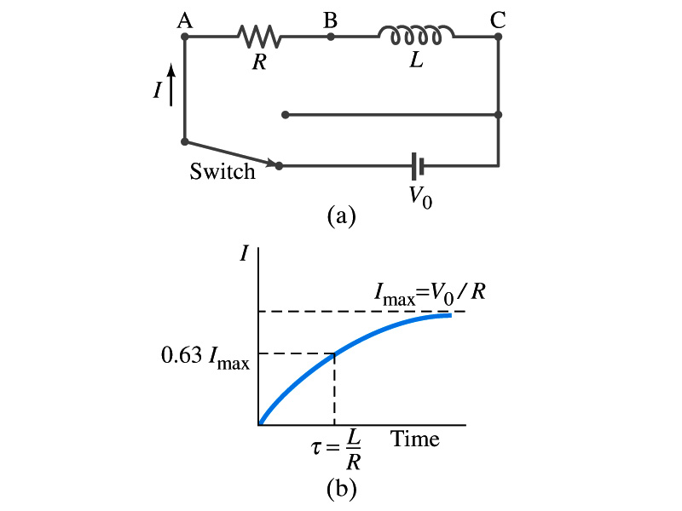
LR Circuits
What happens when an emf is applied to an inductor?
An inductor has some resistance, however negligible
So an inductor can be drawn as a circuit of separate resistance and coil. What is the name this kind of circuit?
What happens at the instance when the switch is thrown to apply emf to the circuit?
The current starts to flow, gradually increasing from 0
This change is opposed by the induced emf in the inductor ➔ the emf at point B is higher than point C
However there is a voltage drop at the resistance which reduces the voltage across inductance
Thus the current increases less rapidly
The overall behavior of the current is gradual increase, reaching to the maximum current I_{max}=V₀/R.
LR Circuit

Slide 17
Why do we care about circuits on AC?
The circuits we’ve learned so far contain resistors, capacitors and inductors and have been connected to a DC source or a fully charged capacitor
What? This does not make sense.
The inductor does not work as an impedance unless the current is changing. So an inductor in a circuit with DC source does not make sense.
Well, actually it does. When does it impede?
Immediately after the circuit is connected to the source so the current is still changing. So?
It causes the change of magnetic flux.
Now does it make sense?
Anyhow, learning the responses of resistors, capacitors and inductors in a circuit connected to an AC emf source is important. Why is this?
Since most the generators produce sinusoidal current
Any voltage that varies over time can be expressed as a superposition of sine and cosine functions

Slide 18
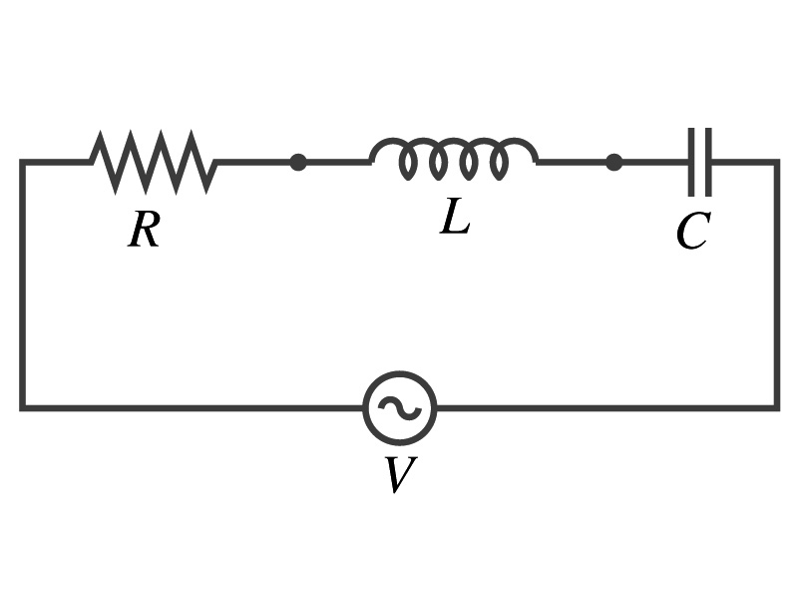
AC Circuits – the preamble
Do you remember how the rms and peak values for current and voltage in AC are related?
The symbol for an AC power source is
We assume that the voltage gives rise to current
where

Slide 19
Electric Field due to Magnetic Flux Change
When the electric current flows through a wire, there is an electric field in the wire that moves electrons
We saw, however, that changing magnetic flux induces a current in the wire. What does this mean?
There must be an electric field induced by a changing magnetic flux.
In other words, a changing magnetic flux produces an electric field
This results apply not just to wires but to any conductor or any regions in space

Slide 20
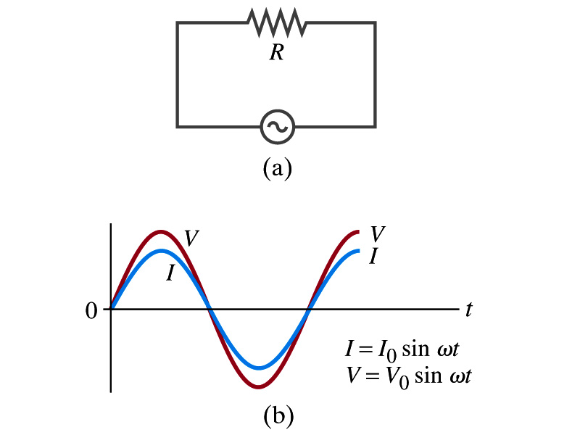
AC Circuit w/ Resistance only
What do you think will happen when an AC source is connected to a resistor?
From Kirchhoff’s loop rule, we obtain
Thus
where
What does this mean?
Current is 0 when voltage is 0 and current is in its peak when voltage is in its peak.
Current and voltage are “in phase”
Energy is lost via the transformation into heat at an average rate

Slide 21
Reminder: Faraday’s Law of Induction
In terms of magnetic flux, we can formulate Faraday’s findings
The emf induced in a circuit is equal to the rate of change of magnetic flux through the circuit
If the circuit contains N closely wrapped loops, the total induced emf is the sum of emf induced in each loop
Why negative?
Has got a lot to do with the direction of induced emf…
Faraday’s Law of Induction

Slide 22
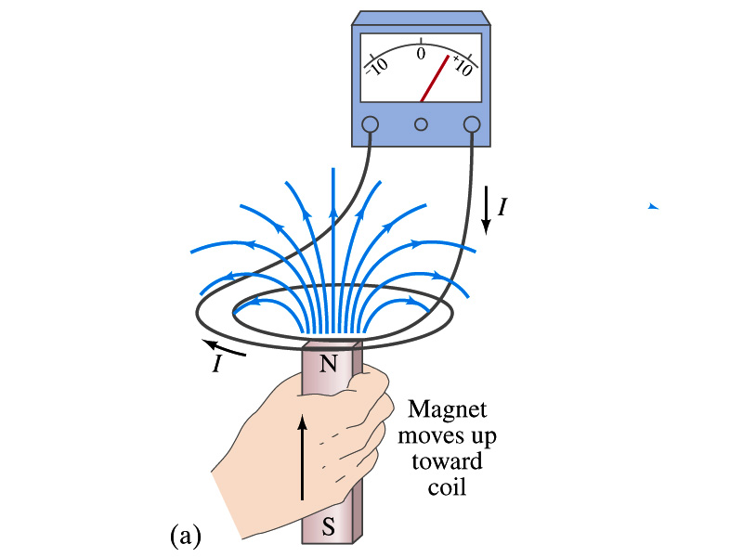
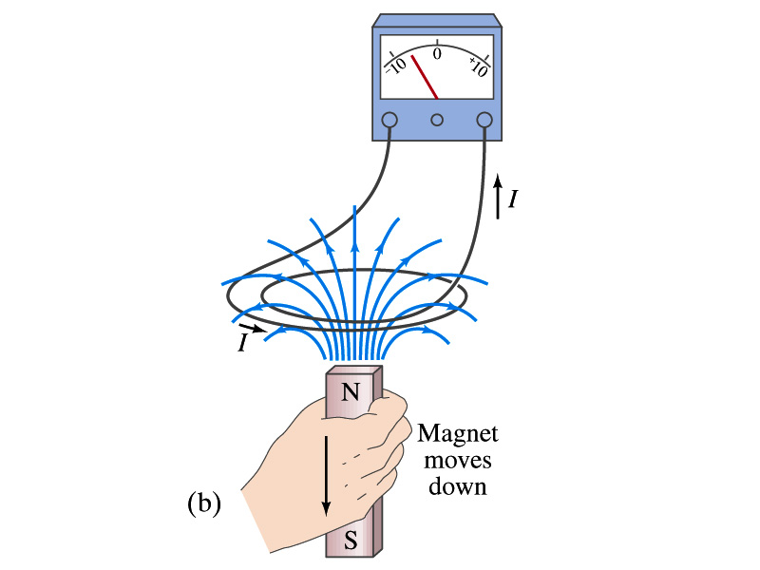
Reminder: Lenz’s Law
It is experimentally found that
An induced emf gives rise to a current whose magnetic field opposes the original change in flux ➔ This is known as Lenz’s Law
In other words, an induced emf is always in the direction that opposes the original change in flux that caused it.
We can use Lenz’s law to explain the following cases in the figures
When the magnet is moving into the coil
Since the external flux increases, the field inside the coil takes the opposite direction to minimize the change and causes the current to flow clockwise
When the magnet is moving out
Since the external flux decreases, the field inside the coil takes the opposite direction to compensate the loss, causing the current to flow counter-clockwise
Which law is Lenz’s law result of?
Energy conservation. Why?

Slide 23
Displacement Current
Maxwell predicted the second term in the generalized Ampere’s law and interpreted it as equivalent to an electric current
If a change of magnetic field induces an electric current, a change of electric field must do the same to magnetic field…
He called this term as the displacement current, Ι_{D}
While the original term is called the conduction current, Ι
Ampere’s law then can be written as
Where
While it is in effect equivalent to an electric current, a flow of electric charge, this actually does not have anything to do with the flow of electric charge itself

Slide 24
Gauss’ Law for Magnetism
What was the Gauss’ law in the electric case?
The electric flux through a closed surface is equal to the total net charge Q enclosed by the surface divided by ε₀.
Similarly, we can write Gauss’ law for magnetism as
Why is result of the integral zero?
There is no isolated magnetic poles, the magnetic equivalent of single electric charges
Gauss’ Law for electricity
Gauss’ Law for magnetism

Slide 25
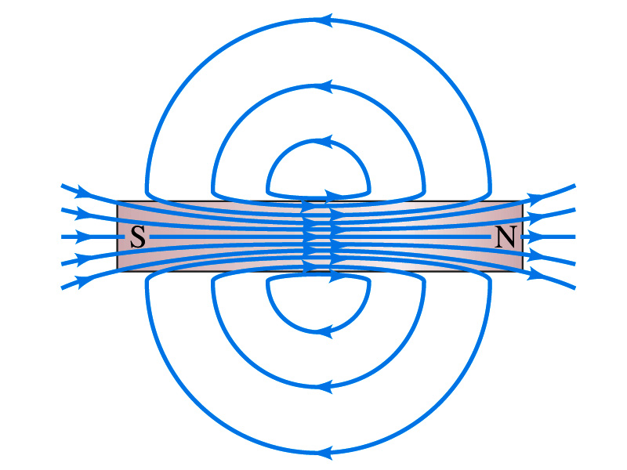
Gauss’ Law for Magnetism
What does the Gauss’ law in magnetism mean physically?
There are as many magnetic flux lines that enter the enclosed volume as leave it
If magnetic monopole does not exist, there is no starting or stopping point of the flux lines
Electricity do have the source and the sink
Magnetic field lines must be continuous
Even for bar magnets, the field lines exist both insides and outside of the magnet

