Slide 1
PHYS 1442 – Section 001 Lecture #14
Tuesday, July 2, 2013
Dr. Jaehoon Yu
Chapter 22
Maxwell’s Equations
Production of Electromagnetic Waves
EM Waves from Maxwell’s Equations
Speed of EM Waves
Light as an EM Wave
EM Spectrum
EM Waves in Transmission lines

Slide 2
Announcements
Term exam results:
Class average: 60.4/100
Previous exams: 52.8/100 and 73.1/100
Top score: 87
Quiz tomorrow, Wednesday, July 3
At the beginning of the class
Will cover what we’ve learned today and tomorrow
Final exam
Comprehensive exam
Covers CH16.1 – what we finish this Wednesday plus Appendices A1 – A8
Monday, July 8
Please do not miss this exam!
You will get an F if you miss it!
BYOF with the same rules as before
Your planetarium extra credit
Please bring your planetarium extra credit sheet by the beginning of the exam Monday, July 8
Be sure to tape one edge of the ticket stub with the title of the show on top and your name on the sheet

Slide 3
Reminder: Special Project #4
Derive the unit of speed from the product of the permitivity and permeability, starting from their original units. (5 points)
Derive and compute the speed of light in free space from the four Maxwell’s equations. (20 points for derivation and 3 points for computation.)
Compute the speed of the EM waves in copper, water and one other material which is different from other students. ( 3 points each)
Due of these projects are the start of the class tomorrow, Wednesday, July 3!

Slide 4
The Electromagnetic Theory
The ramification of the EM theory in late 19th century is the prediction and the experimental verification of the fact that
Waves of electromagnetic fields can travel through space!!
Opened up a new means of communications
Wireless telegraphs, radio, TV, cell phones, cell phones, wireless charging device, etc
A spectacular prediction of light being an EM wave
This theory of EM forces was the work of a Scottish physicist, James Clerk Maxwell (1831 – 1879)

Slide 5
Maxwell’s Equations
In the absence of dielectric or magnetic materials, the four equations developed by Maxwell are:
Gauss’ Law for electricity
A generalized form of Coulomb’s law relating electric field to its sources, the electric charge
Gauss’ Law for magnetism
A magnetic equivalent of Coulomb’s law, relating magnetic field to its sources. This says there are no magnetic monopoles.
Faraday’s Law
An electric field is produced by a changing magnetic field
Ampére’s Law
A magnetic field is produced by an electric current or by a changing electric field

Slide 6
Maxwell’s Amazing Leap of Faith
According to Maxwell, a magnetic field will be produced even in an empty space if there is a changing electric field
He then took this concept one step further and concluded that
If a changing magnetic field produces an electric field, the electric field is also changing in time.
This changing electric field in turn produces the magnetic field that also changes
This changing magnetic field then in turn produces the electric field that changes
This process continues
With the manipulation of his equations, Maxwell found that the net result of this interacting changing fields is a wave of electric and magnetic fields that can actually propagate (travel) through the space

Slide 7
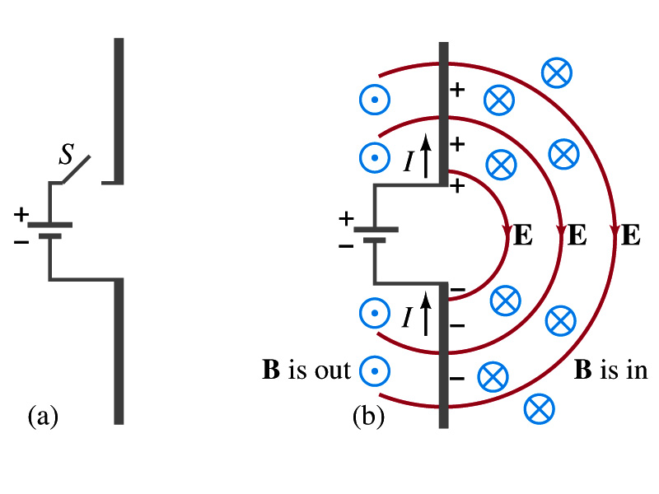
Production of EM Waves
Consider two conducting rods that will serve as an antenna are connected to a DC power source
What do you think will happen when the switch is closed?
The rod connected to the positive terminal is charged positive and the other negative
Then an electric field will be generated between the two rods
Since there is current that flows through the rods, a magnetic field around them will be generated
How far would the electric and magnetic fields extend?
In static cases, the field extends indefinitely
When the switch is closed, the fields are formed near the rods quickly but
The stored energy in the fields won’t propagate w/ infinite speed

Slide 8
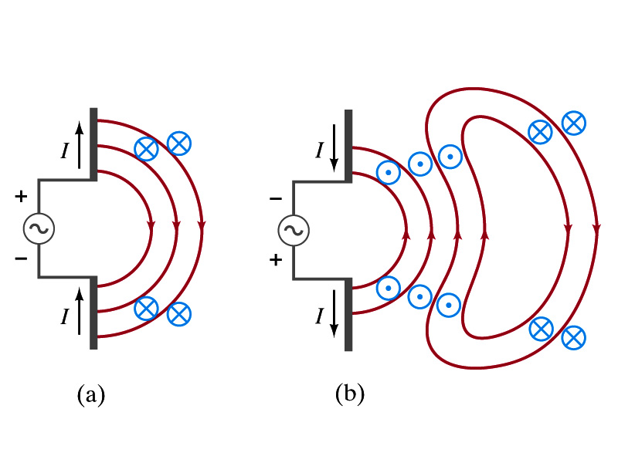
Production of EM Waves, cnt’d
What happens if the antenna is connected to an AC power source?
When the connection was initially made, the rods are charging up quickly w/ the current flowing in one direction as shown in the figure
The field lines form as in the DC case
The field lines propagate away from the antenna
Then the direction of the voltage reverses

Slide 9
Production of EM Waves, cnt’d
New field lines in the opposite direction forms
While the original field lines still propagates away from the rod reaching out far
Since the original field propagates through an empty space, the field lines must form a closed loop (no charge exist)
Since changing electric and magnetic fields produce changing magnetic and electric fields, the fields moving outward is self supporting and do not need antenna with flowing charge
The fields far from the antenna is called the radiation field
Both electric and magnetic fields form closed loops perpendicular to each other

Slide 10
Properties of Radiation Fields
The fields travel on the other side of the antenna as well
The field strength are the greatest in the direction perpendicular to the oscillating charge while along the parallel direction is 0
The magnitude of E and B in the radiation field decrease with distance from the source as 1/r
The energy carried by the EM wave is proportional to the square of the amplitude, E² or B²
So the intensity of wave decreases from the source as 1/r²

Slide 11
Properties of Radiation Fields, cnt’d
The electric and magnetic fields at any point are perpendicular to each other and to the direction of motion
The fields alternate in directions
The field strengths vary from maximum to 0 in one direction to 0 to maximum in the opposite direction
out of phase
The electric and magnetic fields are in phase
Very far from the antenna, the field lines are pretty flat over a reasonably large area
Called plane waves

Slide 12
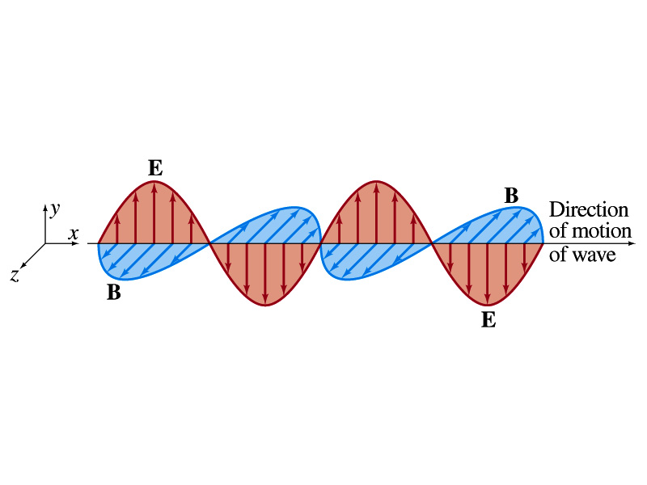
EM Waves
If the voltage of the source varies sinusoidally, the field strengths of the radiation field vary sinusoidally
We call these waves EM waves
They are transverse waves
EM waves are always waves of fields
Since these are fields, they can propagate through an empty space
In general accelerating electric charges give rise to electromagnetic waves
This prediction from Maxwell’s equations was experimentally proven by Heinrich Hertz through the discovery of radio waves

Slide 13
EM Waves and Their Speeds
Let’s consider a region of free space. What’s a free space?
An area of space where there is no charges or conduction currents
In other words, far from emf sources so that the wave fronts are essentially flat or not distorted over a reasonable area
What are these flat waves called?
Plane waves
At any instance E and B are uniform over a large plane perpendicular to the direction of propagation
So we can also assume that the wave is traveling in the x-direction w/ velocity, v=vi, and that E is parallel to y axis and B is parallel to z axis

Slide 14
Maxwell’s Equations w/ Q=Ι=0
In free space where Q=0 and Ι=0, the four Maxwell’s equations become
Q_{encl}=0
No Changes
No Changes
I_{encl}=0
One can observe the symmetry between electricity and magnetism.
The last equation is the most important one for EM waves and their propagation!!

Slide 15
EM Waves from Maxwell’s Equations
If the wave is sinusoidal w/ wavelength λ and frequency f, such traveling wave can be written as
Where
What is v?
The speed of the traveling wave
What are E₀ and B₀?
The amplitudes of the EM wave. Maximum values of E and B field strengths.
Thus

Slide 16
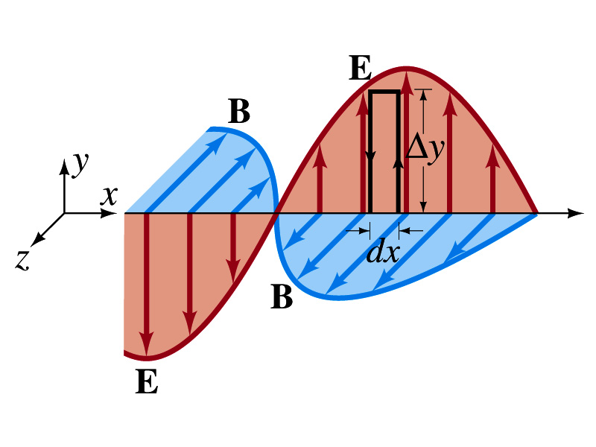
From Faraday’s Law
Let’s apply Faraday’s law
to the rectangular loop of height Δy and width dx
along the top and bottom of the loop is 0. Why?
Since E is perpendicular to Δl.
So the result of the sum through the loop counterclockwise becomes
For the right-hand side of Faraday’s law, the magnetic flux through the loop changes as
Thus

Slide 17
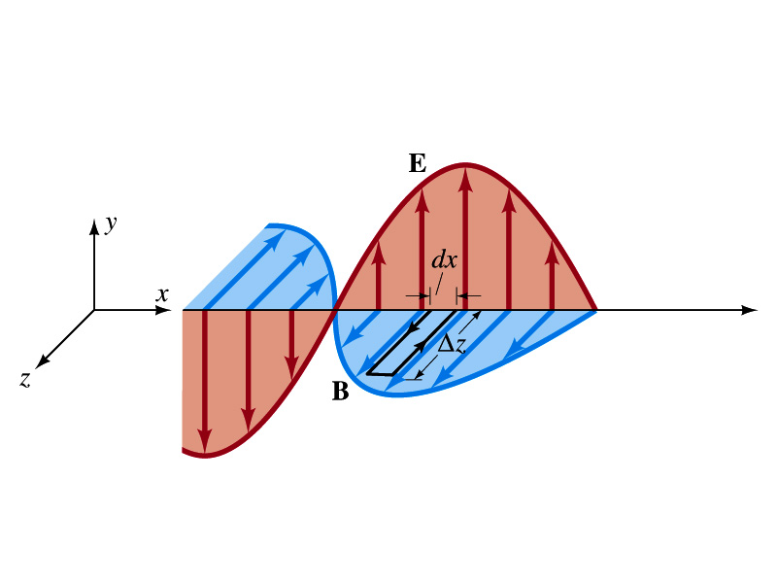
From Modified Ampére’s Law
Let’s apply Maxwell’s 4th equation
to the rectangular loop of length Δz and width Δx
along the x-axis of the loop is 0
Since B is perpendicular to dl.
So the result of the sum through the loop counterclockwise becomes
For the right-hand side of the equation is
Thus

Slide 18
Relationship between E, B and v
Let’s now use the relationship from Faraday’s law
Taking the derivatives of E and B as given their traveling wave form, we obtain
Since E and B are in phase, we can write
This is valid at any point and time in space. What is v?
The speed of the wave
We obtain
Since
Thus

Slide 19
Speed of EM Waves
Let’s now use the relationship from Ampere’s law
Taking the derivatives of E and B as given their traveling wave form, we obtain
However, from the previous page we obtain
Thus
Since
We obtain
Thus
The speed of EM waves is the same as the speed of light. EM waves behaves like the light.

