Slide 1
PHYS 1442 – Section 001 Lecture #15
Wednesday, July 3, 2013
Dr. Jaehoon Yu
Chapter 22
Light as an EM Wave
EM Spectrum
EM Waves in Transmission lines
Chapter 23
Index of Refraction
Snell’s Law of Refraction
Total Internal Reflection

Slide 2
Announcements
Final exam
Comprehensive exam
Covers CH16.1 – what we finish today plus Appendices A1 – A8
10:30am – 12:30pm, Monday, July 8
Please do not miss this exam!
You will get an F if you miss it!
BYOF with the same rules as before
Your planetarium extra credit
Please bring your planetarium extra credit sheet by the beginning of the exam Monday, July 8
Be sure to tape one edge of the ticket stub with the title of the show on top and your name on the sheet

Slide 3
Light as EM Wave
People knew some 60 years before Maxwell that light behaves like a wave, but …
They did not know what kind of wave it is.
Most importantly what is it that oscillates in light?
Heinrich Hertz first generated and detected EM waves experimentally in 1887 using a spark gap apparatus
Charge was rushed back and forth in a short period of time, generating waves with frequency about 10⁹Hz (these are called radio waves)
He detected using a loop of wire in which an emf was produced when a changing magnetic field passed through
These waves were later shown to travel at the speed of light

Slide 4
Light as EM Wave, cnt’d
The wavelengths of visible light were measured in the first decade of the 19th century
The visible light wavelengths were found to be between 4.0x10⁻⁷m (400nm) and 7.5x10⁻⁷m (750nm)
The frequency of visible light is from fλ=c
Where f and λ are the frequency and the wavelength of the wave
What is the range of visible light frequency?
4.0x10¹⁴Hz to 7.5x10¹⁴Hz
c is 3x10⁸m/s, the speed of light
EM Waves, or EM radiation, are categorized using EM spectrum

Slide 5
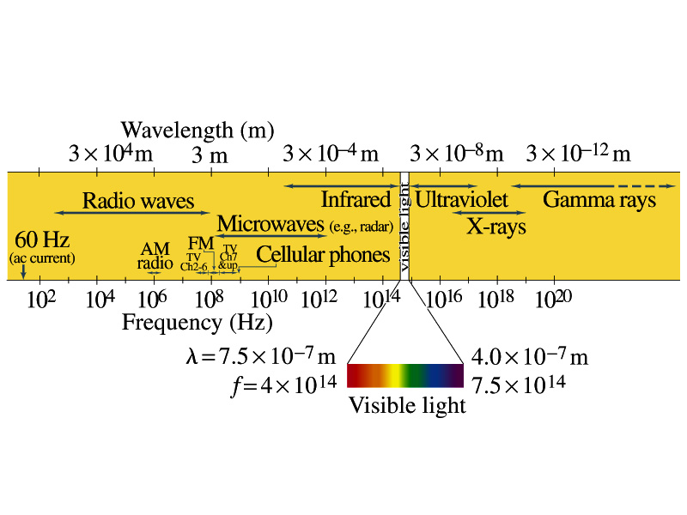
Electromagnetic Spectrum
Low frequency waves, such as radio waves or microwaves can be easily produced using electronic devices
Higher frequency waves are produced through natural processes, such as emission from atoms, molecules or nuclei
Or they can be produced from acceleration of charged particles
Infrared radiation (IR) is mainly responsible for the heating effect of the Sun
The Sun emits visible lights, IR and UV
The molecules of our skin resonate at infrared frequencies so IR is preferentially absorbed and thus warms up our body

Slide 6
Example 22 – 1
Wavelength of EM waves. Calculate the wavelength (a) of a 60-Hz EM wave, (b) of a 93.3-MHz FM radio wave and (c) of a beam of visible red light from a laser at frequency 4.74x10¹⁴Hz.
What is the relationship between speed of light, frequency and the wavelength?
Thus, we obtain
For f=60Hz
For f=93.3MHz
For f=4.74x10¹⁴Hz

Slide 7
EM Wave in the Transmission Lines
Can EM waves travel through a wire?
Can it not just travel through the empty space?
Yes, it sure can travel through a wire.
When a source of emf is connected to a transmission line, the electric field within the wire does not get set up immediately at all points along the line
When two wires are separated via air, the EM wave travel through the air at the speed of light, c.
However, through medium w/ permittivity ε and permeability μ, the speed of the EM wave is given
Is this faster than c?
Nope! It is slower.

Slide 8
Energy in EM Waves
Since B=E/c and , we can rewrite the energy density
Note that the energy density associate with B field is the same as that associate with E field
So each field contributes half to the total energy of the EM wave
By rewriting using B field only, we obtain
We can also rewrite to contain both E and B

Slide 9
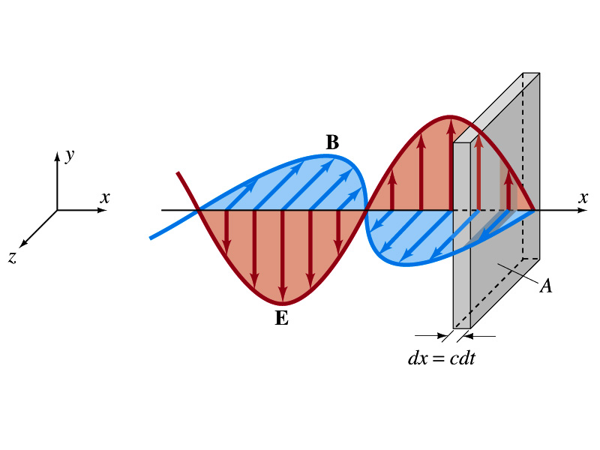
Energy Transport
What is the energy the wave transport per unit time per unit area?
This is given by the vector S, the Poynting vector
The unit of S is W/m².
The direction of S is the direction in which the energy is transported. Which direction is this?
The direction the wave is moving
Let’s consider a wave passing through an area A perpendicular to the x-axis, the axis of propagation
How much does the wave move in time Δt?
Δξ=χΔτ
The energy that passes through A in time Δt is the energy that occupies the volume ΔV,
Since the energy density is u=ε₀E², the total energy, ΔU, contained in the volume ΔV is

Slide 10
Energy Transport
Thus, the energy crossing the area A per time Δt is
Since E=cB and , we can also rewrite
Since the direction of S is along v, perpendicular to E and B, the Poynting vector S can be written
This gives the energy transported per unit area per unit time at any instant

Slide 11
Average Energy Transport
The average energy transport in an extended period of time since the frequency is so high we do not detect the rapid variation with respect to time.
If E and B are sinusoidal,
Thus we can write the magnitude of the average Poynting vector as
This time averaged value of S is the intensity, defined as the average power transferred across unit area. E₀ and B₀ are maximum values.
We can also write
Where E_{rms} and B_{rms} are the rms values ( )

Slide 12
Example 22 – 4
E and B from the Sun. Radiation from the Sun reaches the Earth (above the atmosphere) at a rate of about 1350W/m². Assume that this is a single EM wave and calculate the maximum values of E and B.
What is given in the problem?
The average S!!
For E₀,
For B₀

Slide 13
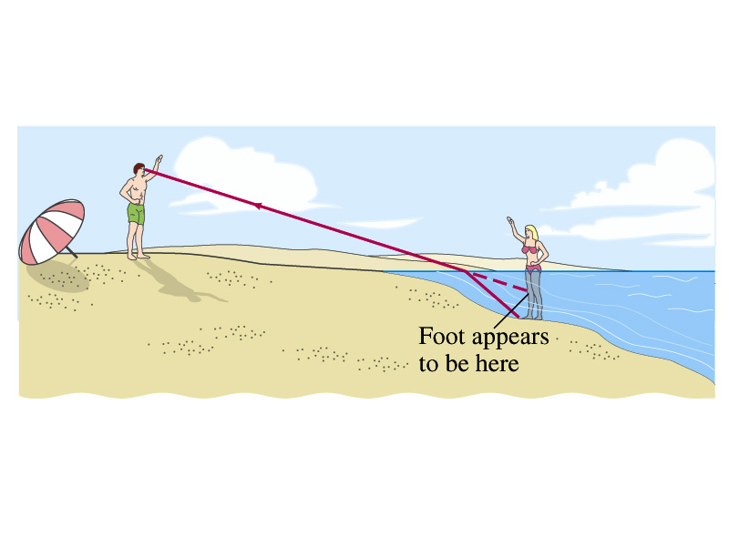
Index of Refraction
Index of refraction of a material is defined as:
The inverse of the relative of speed light in a material
Index of refraction of vacuum is 1.0000, and that of air is 1.0003
So mathematically, one would define it as
What is the refraction?
The phenomena that the direction of light changes when it passes through the boundary of two transparent materials whose indices of refraction are different
How is this different than reflection?

Slide 14
Example 23 – 5
Speed of Light in Diamond. Calculate the speed of light in diamond.
What is the relationship between speed of light and the index of refraction?
Index of refraction of diamond is, from table 23 -1
So the speed of light in diamond is

Slide 15
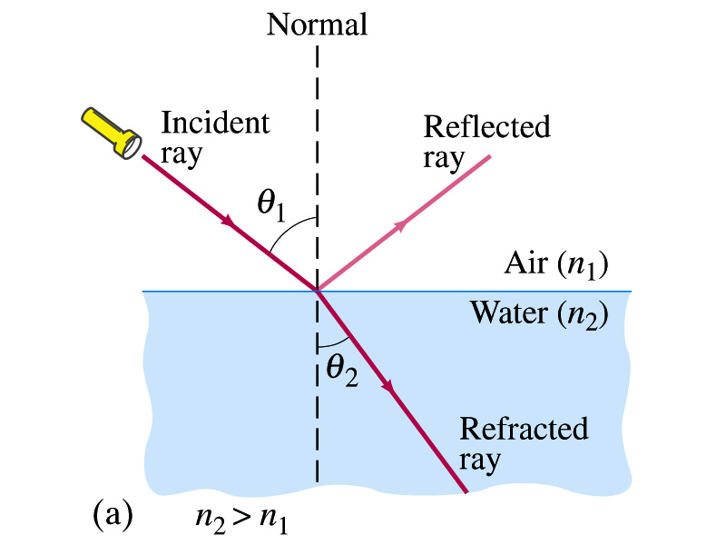
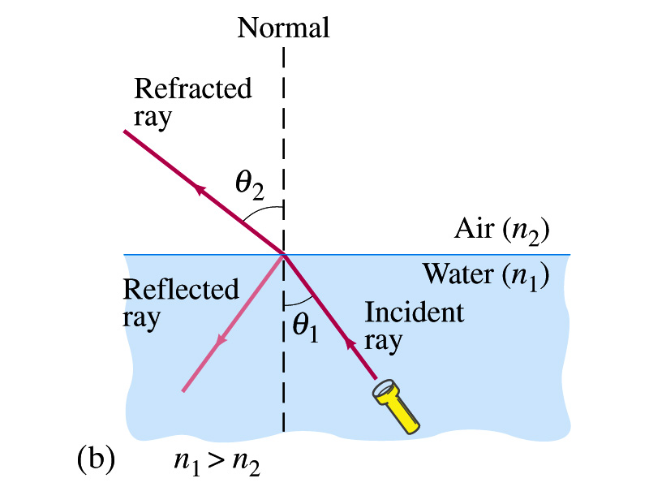
Refraction cont’d
When refraction occurs, it normally comes with a partial reflection of the light
The refracted light bends towards the normal incident plane when the index of refraction changes from small to large
The refracted light bends away from the normal incident plane if the index of refraction changes from large to small
θ_{1:} Angle of Incidence
θ_{2:} Angle of refraction

Slide 16
Snell’s Law of Refraction
The angle of refraction depends on the speed of light in the two media and the incident angle.
Willebrord Snell analytically derived the relationship between the angle of incidence and refraction in 1621
This is the basic Law of Refraction
Does this law explain the bend angles we discussed in the previous page?

Slide 17
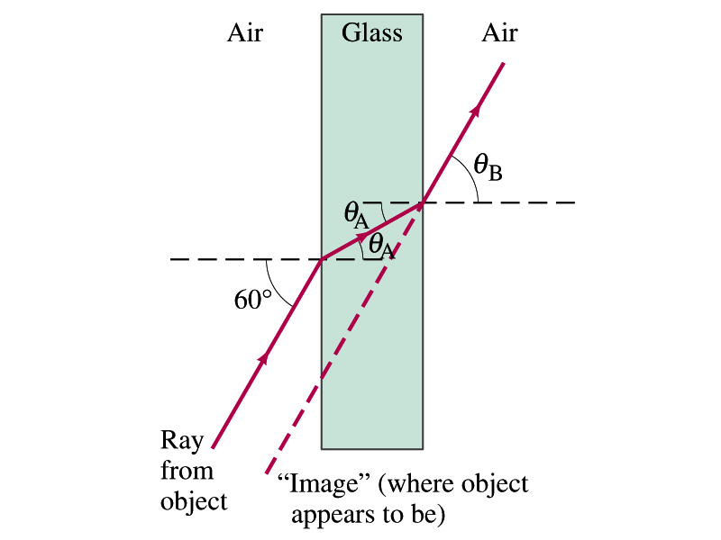
Example 23 – 6
Refraction through flat glass. Light travels through a uniformly thick glass at an incident angle of 60º as shown in the figure. If the index of refraction of the glass is 1.5, (a) what is the angle of refraction θ_{A} in the glass and (b) what is the light’s emerging angle θ_{B}?
(a) From Snell’s law, we obtain
(b) Again from Snell’s law, we obtain
The lights comes out at the same angle as it went in. The image will look shifted slightly.

Slide 18
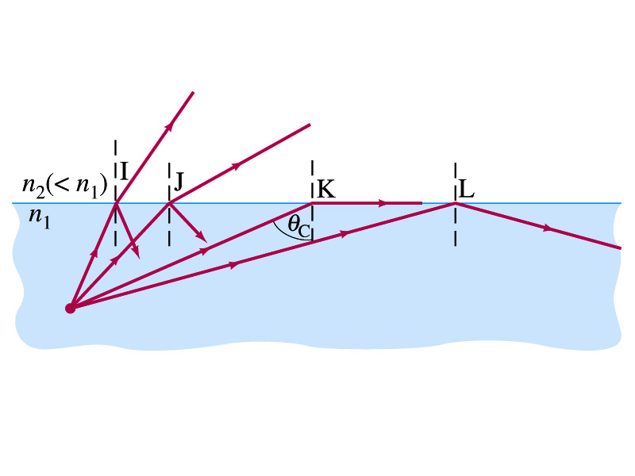
Total Internal Reflection
What happens when the light passes through the boundary of two media from larger index of refraction to smaller one?
Right… It bends away from the normal incident plane
And has some partial reflections
But when the incident angle is above certain value, the entire light reflects back into the first medium
This phenomena is called the total internal reflection
Can total internal reflection happen in all cases?
Nope. Then when can it?
When the light enters from larger to smaller index of refraction material.

Slide 19
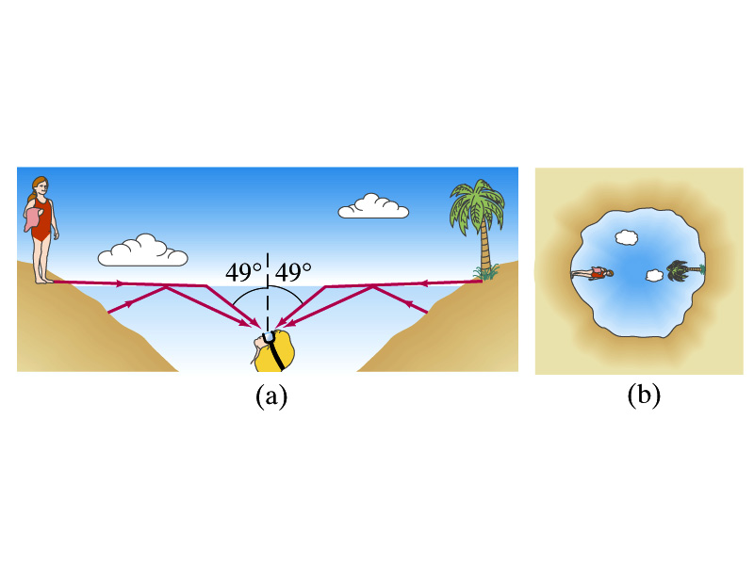
Conceptual Problem Total Internal Refl.
View up from under water: What do you think a person would see if she looks up from beneath the undisturbed perfectly smooth surface of water?
What is the critical angle for air-water interface?
The person will see the world compressed in a circle that forms a 49º angle relative to the eyes. Beyond that angle, she will see the bottom of the pool.

Slide 20
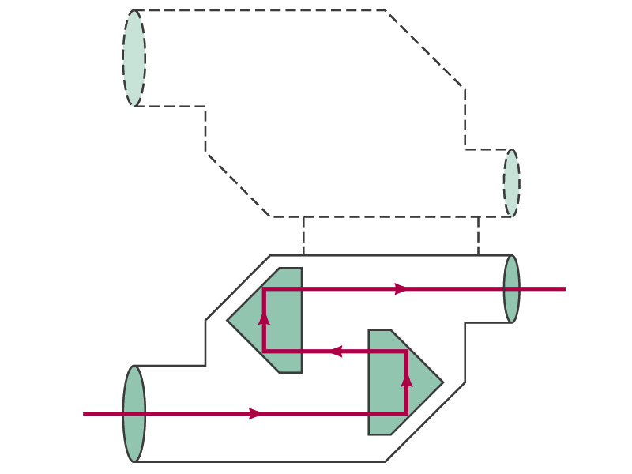
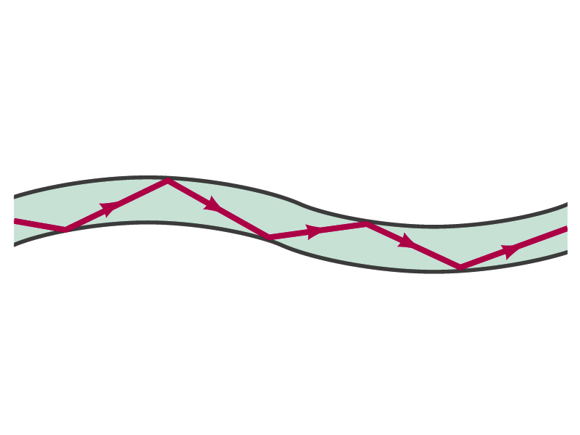
Total Internal Reflection Devices
Glass Prisms: What should the angle of the prisms be for total internal reflection?
41.8º
Fiber optic cables: glass or plastic fibers with a few μm diameter. How do you think it works?
Light signal gets carried through the fiber with virtually no loss since the incident angle is larger than the critical angle!
Some cables can carry up to 1 Tera bit/sec information!!

Slide 21
Congratulations!!!!
You have survived me!!
You all have have been fantastic!!!
I am truly proud of you!
Good luck with your exam!!!
Have a great and safe summer!!

