Slide 1
PHYS 1441 – Section 001 Lecture #2
Tuesday, June 3, 2014
Dr. Jaehoon Yu
Chapter 1
Standards and units
Dimensional Analysis
Chapter 2:
One Dimensional Motion
Instantaneous Velocity and Speed
Acceleration
Motion under constant acceleration

Slide 2
Announcements
Homework registration
47/66 have registered as of early this morning
Only 20 have submitted answers!!
You must complete the process all the way to the submission to obtain the free full credit for homework #1!!
You need to get approval for enrollment from me so please take an action quickly!
Temporary issue with online submission has been resolved➔ Go ahead and submit online
Reading assignment #1: Read and follow through all sections in appendix A by tomorrow, Wednesday, June 4
There will be a quiz tomorrow Wednesday, June 4, on this reading assignment and what we have learned up to today!
Beginning of the class ➔ Do not be late
Bring your calculator but DO NOT input formula into it!
You can prepare a one 8.5x11.5 sheet (front and back) of handwritten formulae and values of constants for the exam ➔ no solutions or derivations!
No additional formulae or values of constants will be provided!

Slide 3
Special Project #1 for Extra Credit
Find the solutions for yx²-zx+v=0 ➔ 5 points
You cannot just plug into the quadratic equations!
You must show a complete algebraic process of obtaining the solutions!
Derive the kinematic equation from first principles and the known kinematic equations ➔ 10 points
You must show your OWN work in detail to obtain the full credit
Must be in much more detail than in this lecture note!!!
Please do not copy from the lecture note or from your friends. You will all get 0!
Due Thursday, June 5

Slide 4
Significant Figures
Operational rules:
Addition or subtraction: Keep the smallest number of decimal place in the result, independent of the number of significant digits: 12.001+ 3.1=
Multiplication or Division: Keep the smallest number of significant digits in the result: 12.001 x 3.1 = , because the smallest significant figures is ?.
15.1
37
What does this mean?
The worst precision determines the precision the overall operation!!
In English?
Can’t get any better than the worst measurement!
4

Slide 5
Needs for Standards and Units
Seven fundamental quantities for physical measurements
Length, Mass, Time, Electric Current, Temperature, the Amount of substance and the Luminous intensity
Need a language that everyone can understand each other
Consistency is crucial for physical measurements
The same quantity measured by one must be comprehendible and reproducible by others
Practical matters contribute
A system of unit called SI (System Internationale) was established in 1960
Length in meters (m)
Mass in kilo-grams (kg)
Time in seconds (s)
5

Slide 6
Definition of Three Relevant Base Units
SI Units
Definitions
1 m (Length) = 100 cm
One meter is the length of the path traveled by light in vacuum during the time interval of 1/299,792,458 of a second.
1 kg (Mass) =
1000 g
It is equal to the mass of the international prototype of the kilogram, made of platinum-iridium in International Bureau of Weights and Measure in France.
1 s (Time)
One second is the duration of 9,192,631,770 periods of the radiation corresponding to the transition between the two hyperfine levels of the ground state of the Cesium 133 (C¹³³) atom.
There are total of seven base quantities (see table 1-5 on page 10)
There are prefixes that scales the units larger or smaller for convenience (see T.1-4 pg. 10)
Units for other quantities, such as Newtons for force and Joule for energy, for ease of use
6

Slide 7
Prefixes, expressions and their meanings
Larger
Smaller
deca (da): 10¹
hecto (h): 10²
kilo (k): 10³
mega (M): 10⁶
giga (G): 10⁹
tera (T): 10¹²
peta (P): 10¹⁵
exa (E): 10¹⁸
zetta (Z): 10²¹
yotta (Y): 10²⁴
deci (d): 10⁻¹
centi (c): 10⁻²
milli (m): 10⁻³
micro (μ): 10⁻⁶
nano (n): 10⁻⁹
pico (p): 10⁻¹²
femto (f): 10⁻¹⁵
atto (a): 10⁻¹⁸
zepto (z): 10⁻²¹
yocto (y): 10⁻²⁴
7

Slide 8
International Standard Institutes
International Bureau of Weights and Measure http://www.bipm.fr/
Base unit definitions: http://www.bipm.fr/enus/3_SI/base_units.html
Unit Conversions: http://www.bipm.fr/enus/3_SI/
US National Institute of Standards and Technology (NIST) http://www.nist.gov/
8

Slide 9
How do we convert quantities from one unit to another?
Unit 1 =
Conversion factor X
Unit 2
1 inch | 2.54 | cm
1 inch | 0.0254 | m
1 inch | 2.54x10⁻⁵ | km
1 ft | 30.3 | cm
1 ft | 0.303 | m
1 ft | 3.03x10⁻⁴ | km
1 hr | 60 | minutes
1 hr | 3600 | seconds
And many | More | Here….
9

Slide 10
Examples 1.4 and 1.5 for Unit Conversions
Ex 1.4: An apartment has a floor area of 880 square feet (ft²). Express this in square meters (m²).
What do we need to know?
Ex 1.5: Where the posted speed limit is 55 miles per hour (mi/h or mph), what is this speed (a) in meters per second (m/s) and (b) kilometers per hour (km/h)?
(a)
(b)
10

Slide 11
Estimates & Order-of-Magnitude Calculations
Estimate = Approximation
Useful for rough calculations to determine the necessity of higher precision
Usually done under certain assumptions
Might require modification of assumptions, if higher precision is necessary
Order of magnitude estimate: Estimates done to the precision of 10s or exponents of 10s;
Three orders of magnitude: 10³=1,000
Round up for Order of magnitude estimate; 8x10⁷ ~ 10⁸
Similar terms: “Ball-park-figures”, “guesstimates”, etc
11

Slide 12
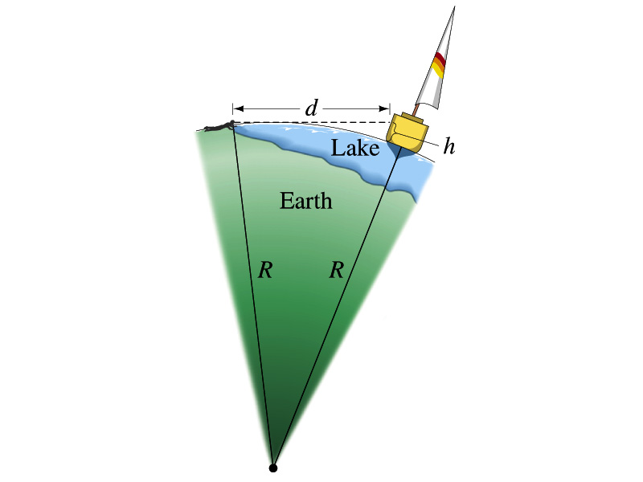
Problem # 34
Estimate the radius of the Earth using triangulation as shown in the picture when d=4.4km and h=1.5m.
Pythagorian theorem
D=4.4km
Solving for R
R
R+h
12
Real R=6380km

Slide 13
Dimension and Dimensional Analysis
An extremely useful concept in solving physical problems
Good to write physical laws in mathematical expressions
No matter what units are used the base quantities are the same
Length (distance) is length whether meter or inch is used to express the size: Usually denoted as [L]
The same is true for Mass ([M])and Time ([T])
One can say “Dimension of Length, Mass or Time”
Dimensions are treated as algebraic quantities: Can perform two algebraic operations; multiplication or division
13

Slide 14
Dimension and Dimensional Analysis cnt’d
One can use dimensions only to check the validity of one’s expression: Dimensional analysis
Eg: Speed [v] = [L]/[T]=[L][T⁻¹]
Distance (L) traveled by a car running at the speed V in time T
L = V*T = [L/T]*[T]=[L]
More general expression of dimensional analysis is using exponents: eg. [v]=[L^{n}T^{m}] =[L][T⁻¹] where n = 1 and m = -1
14

Slide 15
Examples
Show that the expression [v] = [at] is dimensionally correct
Speed: [v] =[L]/[T]
Acceleration: [a] =[L]/[T]²
Thus, [at] = (L/T²)xT=LT⁽⁻²⁺¹⁾ =LT⁻¹ =[L]/[T]= [v]
Suppose the acceleration a of a circularly moving particle with speed v and radius r is proportional to r^{n} and v^{m}. What are n andm?
a
r
v
Dimensionless
constant
Length
Speed
15

