Slide 1
PHYS 1441 – Section 001 Lecture #3
Wednesday, June 4, 2014
Dr. Jaehoon Yu
Chapter 2:
One Dimensional Motion
Instantaneous Velocity and Speed
Acceleration
Motion under constant acceleration
One dimensional Kinematic Equations
How do we solve kinematic problems?
Falling motions

Slide 2
Announcements
Homework registration
65/66 have registered as of early this morning
62 have submitted answers!!
You must complete the process all the way to the submission to obtain the free full credit for homework #1!!
First term exam
In the class coming Monday, June 9
Covers CH1.1 through what we learn tomorrow, Thursday, + Appendix A
Bring your calculator but DO NOT input formula into it!
You can prepare a one 8.5x11.5 sheet (front and back) of handwritten formulae and values of constants for the exam ➔ no solutions or derivations!
No additional formulae or values of constants will be provided!

Slide 3
Reminder: Special Project #1 for Extra Credit
Find the solutions for x from yx²-zx+v=0 ➔ 5 points
You cannot just plug into the quadratic equations!
You must show a complete algebraic process of obtaining the solutions!
Derive the kinematic equation from first principles and the known kinematic equations ➔ 10 points
You must show your OWN work in detail to obtain the full credit
Must be in much more detail than in this lecture note!!!
Please do not copy from the lecture note or from your friends. You will all get 0!
Due Thursday, June 5

Slide 4
Some Fundamentals
Kinematics: Description of Motion without understanding the cause of the motion
Dynamics: Description of motion accompanied with understanding the cause of the motion
Vector and Scalar quantities:
Scalar: Physical quantities that require magnitude but no direction
Speed, length, mass, height, volume, area, magnitude of a vector quantity, etc
Vector: Physical quantities that require both magnitude and direction
Velocity, Acceleration, Force, Momentum
It does not make sense to say “I ran with velocity of 10miles/hour.”
Objects can be treated as point-like if their sizes are smaller than the scale in the problem
Earth can be treated as a point like object (or a particle)in celestial problems
Simplification of the problem (The first step in setting up to solve a problem…)
Any other examples?
4

Slide 5
Some More Fundamentals
Motions: Can be described as long as the position is known at any given time (or position is expressed as a function of time)
Translation: Linear motion along a line
Rotation: Circular or elliptical motion
Vibration: Oscillation
Dimensions
0 dimension: A point
1 dimension: Linear drag of a point, resulting in a line ➔ Motion in one-dimension is a motion on a line
2 dimension: Linear drag of a line resulting in a surface
3 dimension: Perpendicular Linear drag of a surface, resulting in a stereo object
5

Slide 6
Displacement, Velocity and Speed
One dimensional displacement is defined as:
A vector quantity
Displacement is the difference between initial and final potions of the motion and is a vector quantity. How is this different than distance?
Unit?
m
The average velocity is defined as:
Unit?
m/s
A vector quantity
Displacement per unit time in the period throughout the motion
The average speed is defined as:
Unit?
m/s
A scalar quantity

Slide 7
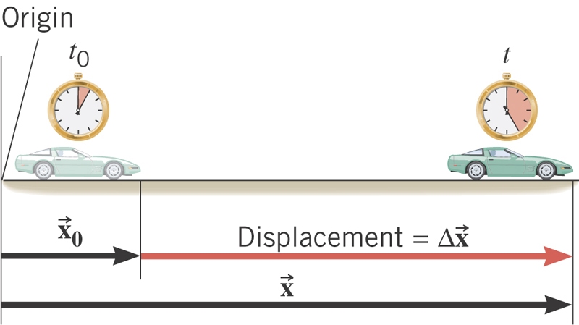
What is the displacement?
How much is the elapsed time?

Slide 8
Displacement, Velocity and Speed
One dimensional displacement is defined as:
Displacement is the difference between initial and final potions of the motion and is a vector quantity. How is this different than distance?
Unit?
m
The average velocity is defined as:
Unit?
m/s
Displacement per unit time in the period throughout the motion
The average speed is defined as:
Unit?
m/s
Can someone tell me what the difference between speed and velocity is?

Slide 9
Difference between Speed and Velocity
Let’s take a simple one dimensional translation that has many steps:
Let’s call this line as X-axis
Let’s have a couple of motions in a total time interval of 20 sec.
+10m
+15m
+5m
-5m
-10m
-15m
Total Displacement:
Average Velocity:
Total Distance Traveled:
Average Speed:
9

Slide 10
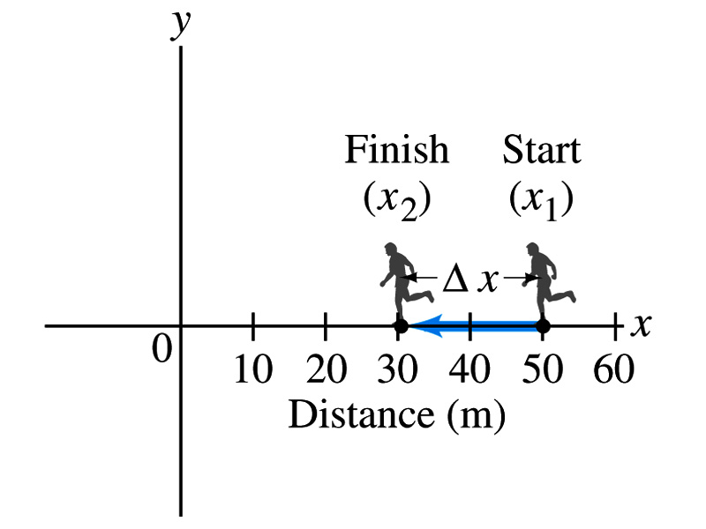
Example 2.1: Runner’s Average Velocity
The position of a runner as a function of time is plotted as moving along the x axis of a coordinate system. During a 3.00-s time interval, the runner’s position changes from x₁=50.0m to x₂=30.5 m, as shown in the figure. What was the runner’s average velocity? What was the average speed?
Displacement:
Average Velocity:
Average Speed:
10

Slide 11
Example Distance Run by a Jogger
How far does a jogger run in 1.5 hours if his average speed is 2.22 m/s?

Slide 12
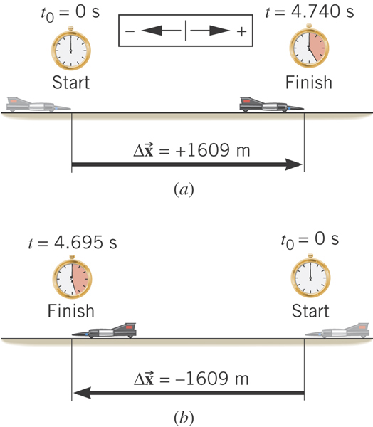
Example: The World’s Fastest Jet-Engine Car
Andy Green in the car ThrustSSC set a world record of 341.1 m/s in 1997. To establish such a record, the driver makes two runs through the course, one in each direction to nullify wind effects. From the data, determine the average speed for each run.
What is the speed?
Segment of a motion!!
What is the speed?
Segment of a motion!!

Slide 13
Instantaneous Velocity and Speed
Can average quantities tell you the detailed story of the whole motion?
NO!!
Instantaneous velocity is defined as:
What does this mean?
Displacement in an infinitesimal time interval
Average velocity over a very, very short amount of time
Instantaneous speed is the size (magnitude) of the velocity vector:
*Magnitude of Vectors are Expressed in absolute values

Slide 14
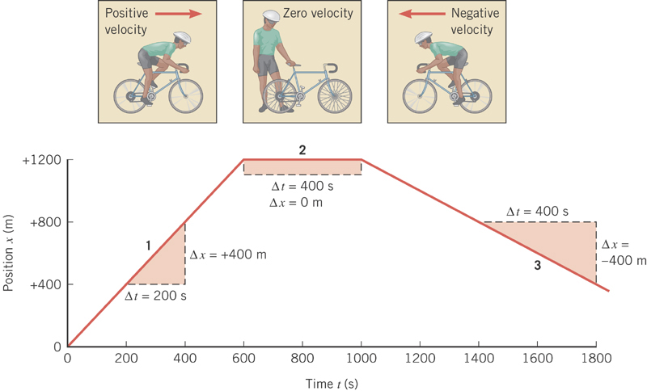
Position vs Time Plot
It is helpful to understand motions to draw them on position vs time plots.
Running at a constant velocity at a rate of +400m in 200s.
Velocity is 0 since stayed in the same location in 400s.
Running at a constant velocity but in the reverse direction as 1 at a rate of -400m in 400s.

Slide 15
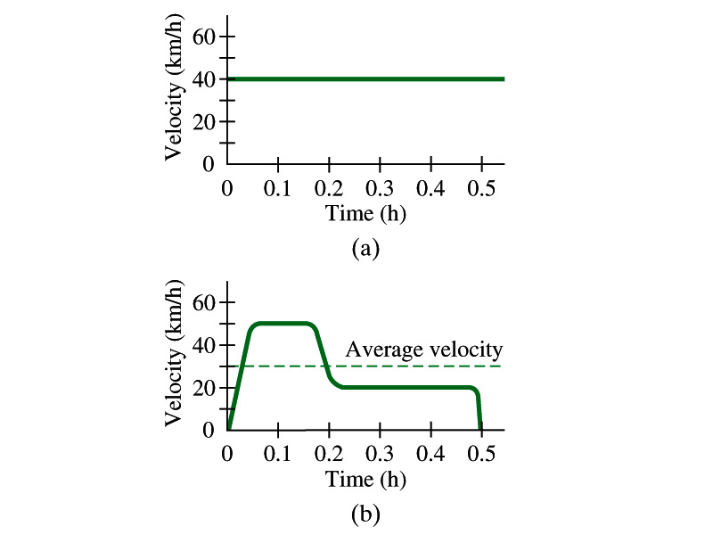
Velocity vs Time Plot

Slide 16
Displacement, Velocity and Speed
Displacement
Average velocity
Average speed
Instantaneous velocity
Instantaneous speed
16
16

