Slide 1
PHYS 1441 – Section 001 Lecture #4
Thursday, June 5, 2014
Dr. Jaehoon Yu
Chapter 2:
One Dimensional Motion
Acceleration
Motion under constant acceleration
One dimensional Kinematic Equations
How do we solve kinematic problems?
Falling motions
Today’s homework is homework #2, due 11pm, Tuesday, June 10!!

Slide 2
Announcements
Reading Assignment
CH2.8
First term exam
In the class coming Monday, June 9
Covers CH1.1 through what we learn today (CH2.8?) + Appendix A
Bring your calculator but DO NOT input formula into it!
You can prepare a one 8.5x11.5 sheet (front and back) of handwritten formulae and values of constants for the exam ➔ no solutions, derivations or definitions!
No additional formulae or values of constants will be provided!
Quiz Results
Class average: 50/72
Equivalent to 69/100
Top score: 72/72

Slide 3
Displacement, Velocity and Speed
Displacement
Average velocity
Average speed
Instantaneous velocity
Instantaneous speed
3
3

Slide 4
Acceleration
Change of velocity in time (what kind of quantity is this?)
Vector!
Definition of Average acceleration:
analogs to
Dimension?
[LT⁻²]
Unit?
m/s²
Definition of Instantaneous acceleration: Average acceleration over a very short amount of time.
analogs to

Slide 5
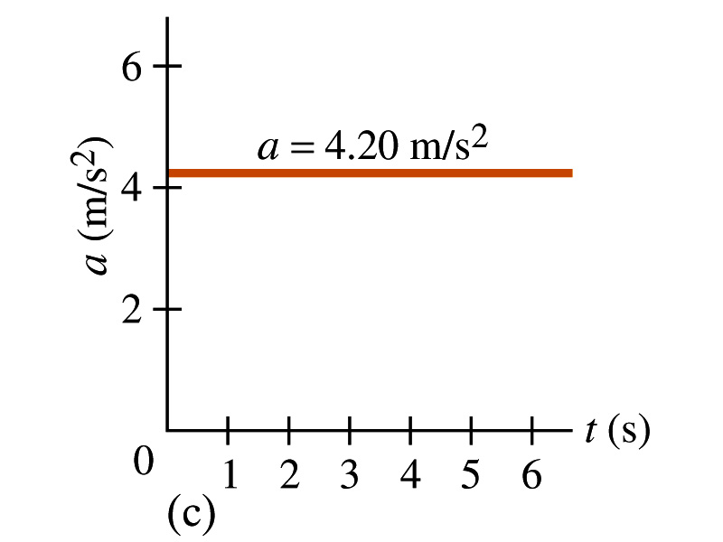
Acceleration vs Time Plot
What does this plot tell you?
Yes, you are right!!
The acceleration of this motion is a constant!!

Slide 6
Example 2.4
A car accelerates along a straight road from rest to 75km/h in 5.0s.
What is the magnitude of its average acceleration?

Slide 7
Few Confusing Things on Acceleration
When an object is moving in a constant velocity (v=v₀), there is no acceleration (a=0)
Is there any acceleration when an object is not moving?
When an object is moving faster as time goes on, (v=v(t) ), acceleration is positive (a>0).
Incorrect, since the object might be moving in negative direction initially
When an object is moving slower as time goes on, (v=v(t) ), acceleration is negative (a<0)
Incorrect, since the object might be moving in negative direction initially
In all cases, velocity is positive, unless the direction of the movement changes.
Incorrect, since the object might be moving in negative direction initially
Is there acceleration if an object moves in a constant speed but changes direction?
The answer is YES!!

Slide 8
The Direction (sign) of the Acceleration
If the velocity INCREASES, the acceleration must be in the SAME direction as the velocity!!
If the positive velocity increases, what sign is the acceleration?
Positive!!
If the negative velocity increases, what sign is the acceleration?
Negative
If the velocity DECREASES, the acceleration must be in the OPPOSITE direction to the velocity!!
If the positive velocity decreases, what sign is the acceleration?
Negative
If the negative velocity decreases, what sign is the acceleration?
Positive

Slide 9
One Dimensional Motion
Let’s focus on the simplest case: acceleration is a constant (a=a₀)
Using the definitions of average acceleration and velocity, we can derive equations of motion (description of motion, velocity and position as a function of time)
(If t_{f}=t and t_{i}=0)
For constant acceleration, average velocity is a simple numeric average
(If t_{f}=t and t_{i}=0)
Resulting Equation of Motion becomes

Slide 10
One Dimensional Motion cont’d
Average velocity
Solving for t
Since
Substituting t in the above equation,
Resulting in

Slide 11
Kinematic Equations of Motion on a Straight Line Under Constant Acceleration
Velocity as a function of time
Displacement as a function of velocities and time
Displacement as a function of time, velocity, and acceleration
Velocity as a function of Displacement and acceleration
You may use different forms of Kinetic equations, depending on the information given to you for specific physical problems!!

Slide 12
How do we solve a problem using the kinematic formula for constant acceleration?
Identify what information is given in the problem.
Initial and final velocity?
Acceleration?
Distance?
Time?
Identify what the problem wants you to figure out.
Identify which kinematic formula is most appropriate and easiest to solve for what the problem wants.
Often multiple formulae can give you the answer for the quantity you are looking for. ➔ Do not just use any formula but use the one that makes the problem easiest to solve.
Solve the equation for the quantity wanted!

Slide 13
Example
Suppose you want to design an air-bag system that can protect the driver in a head-on collision at a speed 100km/hr (~60miles/hr). Estimate how fast the air-bag must inflate to effectively protect the driver. Assume the car crumples upon impact over a distance of about 1m. How does the use of a seat belt help the driver?
How long does it take for the car to come to a full stop?
As long as it takes for it to crumple.
The initial speed of the car is
We also know that
and
Using the kinematic formula
The acceleration is
Thus the time for air-bag to deploy is

Slide 14
Falling Motion
Falling motion is a motion under the influence of the gravitational pull (gravity) only; Which direction is a freely falling object moving?
A motion under constant acceleration
All kinematic formula we learned can be used to solve for falling motions.
Gravitational acceleration is inversely proportional to the square of the distance between the object and the center of the earth
The magnitude of the gravitational acceleration is g=9.80m/s² on the surface of the earth.
The direction of gravitational acceleration is ALWAYS toward the center of the earth, which we normally call (-y); where up and down direction are indicated as the variable “y”
Thus the correct denotation of gravitational acceleration on the surface of the earth is g=-9.80m/s² when +y points upward
The difference is that the object initially moving upward will turn around and come down!
Yes, down to the center of the earth!!

Slide 15
Example for Using 1D Kinematic Equations on a Falling object
A stone was thrown straight upward at t=0 with +20.0m/s initial velocity on the roof of a 50.0m high building,
What is the acceleration in this motion?
a=g=-9.80m/s²
(a) Find the time the stone reaches at the maximum height.
What happens at the maximum height?
The stone stops; V=0
Solve for t
(b) Find the maximum height.

Slide 16
Example of a Falling Object cnt’d
(c) Find the time the stone reaches back to its original height.
(d) Find the velocity of the stone when it reaches its original height.
(e) Find the velocity and position of the stone at t=5.00s.
Velocity
Position

