Slide 1
PHYS 1441 – Section 001 Lecture #5
Tuesday, June 10, 2014
Dr. Jaehoon Yu
Trigonometry Refresher
Properties and operations of vectors
Components of the 2D Vector
Understanding the 2 Dimensional Motion
2D Kinematic Equations of Motion
Projectile Motion
Today’s homework is homework #3, due 11pm, Friday, June 13!!

Slide 2
Announcements
Reading Assignment
CH3.7
Quiz #2
Beginning of the class this Thursday, June, 12
Covers CH3.1 to what we finish tomorrow, Wednesday, June 11
Bring your calculator but DO NOT input formula into it!
You can prepare a one 8.5x11.5 sheet (front and back) of handwritten formulae and values of constants for the exam ➔ no solutions, derivations or definitions!
No additional formulae or values of constants will be provided!

Slide 3
Special Project #2 for Extra Credit
Show that the trajectory of a projectile motion is a parabola!!
20 points
Due: Monday, June 16
You MUST show full details of your OWN computations to obtain any credit
Beyond what was covered in this lecture note and in the book!

Slide 4
Trigonometry Refresher
Definitions of sinθ, cosθ and tanθ
h_{o}=length of the side opposite to the angle θ
h=length of the hypotenuse of a right triangle
θ
90º
h_{a}=length of the side adjacent to the angle θ
Solve for θ
Solve for θ
Pythagorian theorem: For right angle triangles

Slide 5
Vector and Scalar
Vector quantities have both magnitudes (sizes) and directions
Velocity, acceleration, force, momentum, etc
Normally denoted in BOLD letters, F, or a letter with arrow on top
Their sizes or magnitudes are denoted with normal letters, F, or absolute values:
Scalar quantities have magnitudes only
Can be completely specified with a value and its unit
Speed, energy, heat, mass, time, etc
Normally denoted in normal letters, E
Both have units!!!

Slide 6
Properties of Vectors
sizes
directions
Two vectors are the same if their and the are the same, no matter where they are on a coordinate system!! ➔ You can move them around as you wish as long as their directions and sizes are kept the same.
y
Which ones are the same vectors?
D
F
A=B=E=D
A
Why aren’t the others?
B
x
C: The same magnitude but opposite direction: C=-A:A negative vector
E
C
F: The same direction but different magnitude

Slide 7
Vector Operations
Addition:
Triangular Method: One can add vectors by connecting the head of one vector to the tail of the other (head-to-tail)
Parallelogram method: Connect the tails of the two vectors and extend
Addition is commutative: Changing order of operation does not affect the results A+B=B+A, A+B+C+D+E=E+C+A+B+D
A+B
A
A+B
B
=
OR
B
A+B
B
A
A
Subtraction:
The same as adding a negative vector:A - B = A + (-B)
A
-B
Since subtraction is the equivalent to adding a negative vector, subtraction is also commutative!!!
A-B
Multiplication by a scalar is increasing the magnitude A, B=2A
A
B=2A

Slide 8
Example for Vector Addition
A car travels 20.0km due north followed by 35.0km in a direction 60.0º West of North. Find the magnitude and direction of resultant displacement.
Bsin60º
N
B
60^{ο}
Bcos60^{ο}
20
r
θ
A
E
Do this using components!!

Slide 9
Components and Unit Vectors
Coordinate systems are useful in expressing vectors in their components
y
(+,+)
A_{y}
(A_{x},A_{y})
}Components
A
(-,+)
θ
x
} Magnitude
(-,-)
(+,-)
A_{x}

Slide 10
Unit Vectors
Unit vectors are the ones that tells us the directions of the components
Very powerful and makes vector notation and operations much easier!
Dimensionless
Magnitudes these vectors are exactly 1
Unit vectors are usually expressed in i, j, k or
So a vector A can be expressed as

Slide 11
Examples of Vector Operations
Find the resultant vector which is the sum of A=(2.0i+2.0j) and B =(2.0i-4.0j)
Find the resultant displacement of three consecutive displacements: d₁=(15i+30j +12k)cm, d₂=(23i+14j -5.0k)cm, and d₃=(-13i+15j)cm
Magnitude

Slide 12
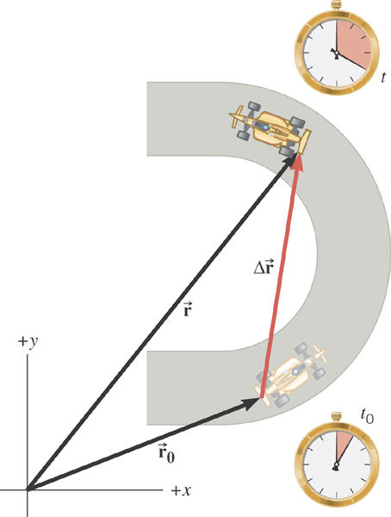
2D Displacement

Slide 13
2D Average Velocity
Average velocity is the
displacement divided by
the elapsed time.

Slide 14
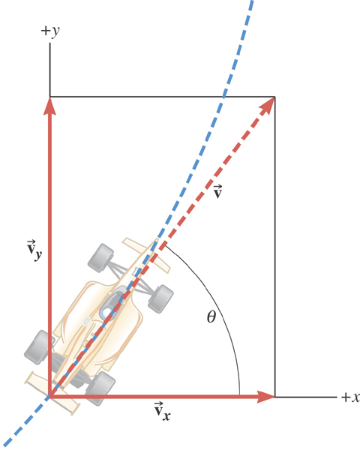
2D Instantaneous Velocity
The instantaneous velocity indicates how fast the car moves and the direction of motion at each instant of time.

Slide 15
2D Average Acceleration

Slide 16
Displacement, Velocity, and Acceleration in 2-dim
Displacement:
Average Velocity:
How is each of these quantities defined in 1-D?
Instantaneous Velocity:
Average Acceleration
Instantaneous Acceleration:

Slide 17
Kinematic Quantities in 1D and 2D
Quantities | 1 Dimension | 2 Dimension
Displacement
Average Velocity
Inst. Velocity
Average Acc.
Inst. Acc.
What is the difference between 1D and 2D quantities?

