Slide 1
PHYS 1441 – Section 001 Lecture #6
Wednesday, June 11, 2014
Dr. Jaehoon Yu
Understanding the 2 Dimensional Motion
2D Kinematic Equations of Motion
Projectile Motion

Slide 2
Announcements
Reading Assignment
CH3.7
Quiz #2
Beginning of the class tomorrow, Thursday, June, 12
Covers CH3.1 to what we finish today, Wednesday, June 11
Bring your calculator but DO NOT input formula into it!
Your phones or portable computers are NOT allowed as a replacement!
You can prepare a one 8.5x11.5 sheet (front and back) of handwritten formulae and values of constants for the exam ➔ no solutions, derivations or definitions!
No additional formulae or values of constants will be provided!
1st Term exam results
Class average: 61.2/99
Equivalent to 61.8/100
Top score: 99/99

Slide 3
Reminder: Special Project #2
Show that the trajectory of a projectile motion is a parabola!!
20 points
Due: Monday, June 16
You MUST show full details of your OWN computations to obtain any credit
Beyond what was covered in this lecture note and in the book!

Slide 4
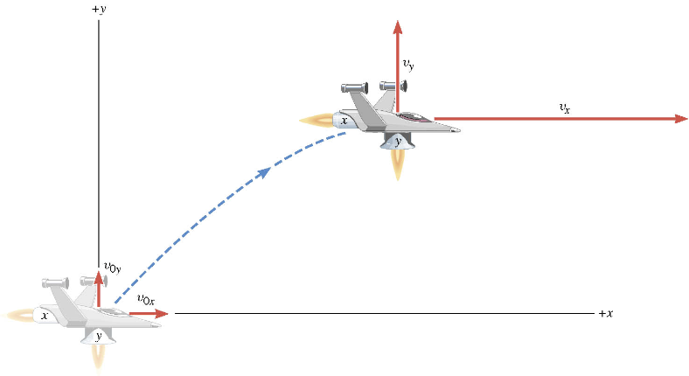
A Motion in 2 Dimension
This is a motion that could be viewed as two motions combined into one. (superposition…)

Slide 5
Motion in horizontal direction (x)

Slide 6
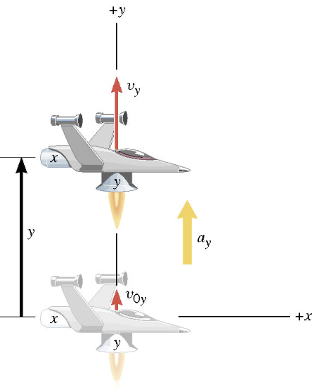
Motion in vertical direction (y)

Slide 7
A Motion in 2 Dimension
Imagine you add the two 1 dimensional motions on the left. It would make up a one 2 dimensional motion on the right.

Slide 8
Kinematic Equations in 2-Dim
x-component
y-component

Slide 9
Ex. A Moving Spacecraft
In the x direction, the spacecraft in zero-gravity zone has an initial velocity component of +22 m/s and an acceleration of +24 m/s². In the y direction, the analogous quantities are +14 m/s and an acceleration of +12 m/s². Find (a) x and v_{x}, (b) y and v_{y}, and (c) the final velocity of the spacecraft at time 7.0 s.

Slide 10
How do we solve this problem?
Visualize the problem ➔ Draw a picture!
Decide which directions are to be called positive (+) and negative (-). Normal convention is the right-hand rule.
Write down the values that are given for any of the five kinematic variables associated with each direction.
Verify that the information contains values for at least three of the kinematic variables. Do this for x and y separately. Select the appropriate equation.
When the motion is divided into segments, remember that the final velocity of one segment is the initial velocity for the next.
Keep in mind that there may be two possible answers to a kinematics problem.

Slide 11
Ex. continued
In the x direction, the spacecraft in a zero gravity zone has an initial velocity component of +22 m/s and an acceleration of +24 m/s². In the y direction, the analogous quantities are +14 m/s and an acceleration of +12 m/s². Find (a) x and v_{x}, (b) y and v_{y}, and (c) the final velocity of the spacecraft at time 7.0 s.
x | a_{x} | v_{x} | v_{ox} | t
? |  | ?
+24.0 m/s²
+22.0 m/s
7.0 s
y | a_{y} | v_{y} | v_{oy} | t
? |  | ?
+12.0 m/s²
+14.0 m/s
7.0 s

Slide 12
First, the motion in x-direciton…
x | a_{x} | v_{x} | v_{ox} | t
? | +24.0 m/s² | ? | +22 m/s | 7.0 s

Slide 13
Now, the motion in y-direction…
y | a_{y} | v_{y} | v_{oy} | t
? | +12.0 m/s² | ? | +14 m/s | 7.0 s

Slide 14
The final velocity…
A vector can be fully described when the magnitude and the direction are given. Any other way to describe it?
Yes, you are right! Using components and unit vectors!!

Slide 15
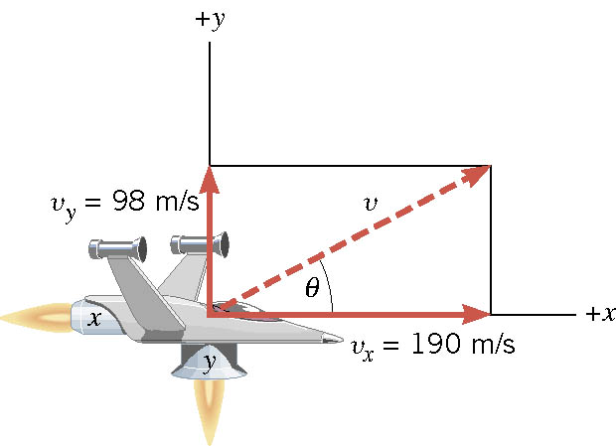
If we visualize the motion…

Slide 16
What is the Projectile Motion?
A 2-dim motion of an object under the gravitational acceleration with the following assumptions
Free fall acceleration, g, is constant over the range of the motion
and
Air resistance and other effects are negligible
A motion under constant acceleration!!!! ➔ Superposition of two motions
Horizontal motion with constant velocity ( no acceleration )
Vertical motion under constant acceleration ( g )

Slide 17
Projectile Motion
But the object is still moving!!
Why?
Because it still has constant velocity in horizontal direction!!
Why?
Because there is no acceleration in horizontal direction!!
Maximum height
The only acceleration in this motion. It is a constant!!

Slide 18
Kinematic Equations for a projectile motion
x-component
y-component

Slide 19
Show that a projectile motion is a parabola!!!
x-component
y-component
In a projectile motion, the only acceleration is gravitational one whose direction is always toward the center of the earth (downward).
a_{x}=0
Plug t into
the above
What kind of parabola is this?

Slide 20
Example for a Projectile Motion
A ball is thrown with an initial velocity v=(20i+40j)m/s. Estimate the time of flight and the distance from the original position when the ball lands.
Which component determines the flight time and the distance?
Flight time is determined by the y component, because the ball stops moving when it is on the ground after the flight.
So the possible solutions are…
Distance is determined by the x component in 2-dim, because the ball is at y=0 position when it completed it’s flight.
Why isn’t 0 the solution?

Slide 21
Ex.3.5 The Height of a Kickoff
A placekicker kicks a football at an angle of 40.0 degrees and
the initial speed of the ball is 22 m/s. Ignoring air resistance,
determine the maximum height that the ball attains.

Slide 22
First, the initial velocity components

Slide 23
Motion in y-direction is of the interest..
y | a_{y} | v_{y} | v_{0y} | t
?
-9.8 m/s²
0 m/s
+14 m/s

Slide 24
Now the nitty, gritty calculations…
y | a_{y} | v_{y} | v_{0y} | t
? | -9.80 m/s² | 0 | 14 m/s
What happens at the maximum height?
The ball’s velocity in y-direction becomes 0!!
And the ball’s velocity in x-direction?
Stays the same!! Why?
Because there is no acceleration in x-direction!!
Which kinematic formula would you like to use?
Solve for y

Slide 25
Ex.3.9 extended: The Time of Flight of a Kickoff
What is the time of flight between kickoff and landing?

Slide 26
What is y when it reached the max range?
y | a_{y} | v_{y} | v_{oy} | t
 |  |  |  | ?
0 m
-9.80 m/s²
14 m/s

Slide 27
Now solve the kinematic equations in y direction!!
y | a_{y} | v_{y} | v_{oy} | t
0 | -9.80 m/s² |  | 14 m/s | ?
Since y=0
Two soultions
or
Solve for t

Slide 28
Ex.3.9 The Range of a Kickoff
Calculate the range R of the projectile.

